Slide 1
Men and Women in the Church
1 Timothy 2:8-15

Slide 2
Purpose of Paul’s letter
1 Tim 3:14-15 I hope to come to you shortly; ¹⁵ but if I am delayed, I write so that you may know how you ought to conduct yourself in the house of God, which is the church of the living God, the pillar and ground of the truth.
Context
Ch 1 The true gospel (opposed to false teaching)
Ch 2 Praying for all men (to live quiet, godly honorable lives so the gospel may be spread)

Slide 3
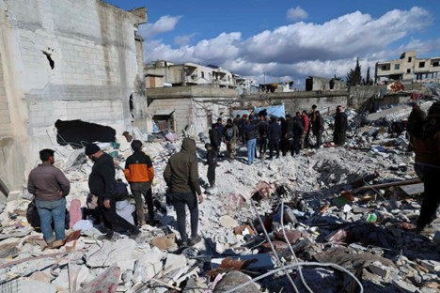

Slide 4
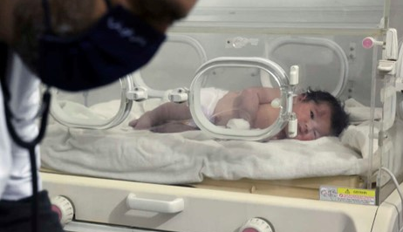

Slide 5
Outline of vs 8-15
God’s desire for men in the church vs 8
(Lead in prayer/godly life character)
God’s desire for women in the church vs 9-12
(Quiet demeanor/serving by good works)
The reasons for God’s established order vs 13-15
(Principles based in the creation account)

Slide 6
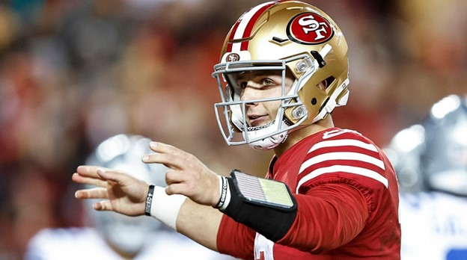
“Mr Irrelevant” (Brock Purdy)

Slide 7
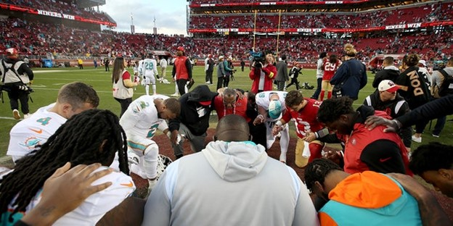

Slide 8
God’s Desire for Men 2:8
2:8 I desire therefore that the men pray everywhere, lifting up holy hands, without wrath and doubting
Lifting holy hands Exod 9:29 1 Kings 8:22 Isa 1:15
Without anger and disputing 1 Tim 3:8 Matt 6:15
(lack of holiness)

Slide 9
God’s Desire for Women 2:9-12
2:9-10 in like manner also, that the women adorn themselves in modest apparel, with propriety and moderation, not with braided hair or gold or pearls or costly clothing, ¹⁰ but, which is proper for women professing godliness, with good works.
Dress in appropriate attire in propriety, moderation (not for outward show, display wealth)
Inward character (godliness, good works) 1 Tim 5:10

Slide 10
God’s Desire for Women 2:9-12
2:11-12 Let a woman learn in silence with all submission. ¹² And I do not permit a woman to teach or to have authority over a man, but to be in silence.
Manner of learning (women were present)
Quiet, submissive demeanor 1 Peter 3:3-4
Not permitted (teach, authority) over man Titus 2:3-5

Slide 11
Reasons for God’s order 2:13-15
2:15 Nevertheless she will be saved in childbearing if they continue in faith, love, and holiness, with self-control.
Unlikely interpretation (by childbirth, of Messiah) Gen 3:15
God has provided women honor of bearing children 1 Tim 5:14
Respect woman’s role in keeping with godliness
Don’t lose sight what women can do Titus 2:3-5 2 Tim 1:5

Slide 12
Final Thoughts
In today’s world these are seen as hateful, unfair
The word of God must be standard of Christian behavior
These principles are grounded in the order of creation
Feminism has done great harm in society, invaded church
The evangelical church is in danger of relativizing the word of God

Slide 13
Men and Women in the Church
1 Timothy 2:8-15

