Slide 1
Fight the Good Fight
1 Timothy 6:11-21

Slide 2
Live for God 11
Flee these things (run)
Ungodliness, worldliness
Pride, false thinking, greed
Follow righteousness (chase)
Godliness, faith, love
Patience, gentleness

Slide 3
Fight the Good Fight 12
Fight the good fight (faith)
Fight for eternal value
Lay hold on eternal life
Remember the good confession
Jesus Christ is God’s Son
Died for our Sins, Raised to secure Life

Slide 4
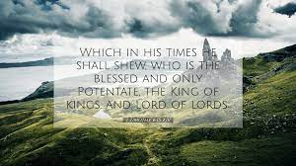
Be Bold for the King 13-16
In the presence of God
God gives life to all things
Jesus before Pontius Pilate
Keep commandment spotless
Blameless until Christ’s appearing
Only sovereign, King of kings

Slide 5
Store up True Riches 17-19
Those rich in this present age
Don’t be conceited, uncertain riches
Trust in the Living God who gives richly
What they should do
Be rich in good works, generous
Store up stockpile of true treasures

Slide 6
Guard the Truth 20-21
Committed to your trust
God’s truth entrusted to Timothy
Same treasure entrusted to us
The weapons of false teachers
Empty worldly babblings
Opposing arguments, false knowledge

Slide 8
Fight the Good Fight
1 Timothy 6:11-21

