Slide 1
Godly Ministry in Troubling Times
1 Timothy 4:1-16

Slide 2
Troublesome times coming
The Spirit says some will depart from the faith
Deceiving spirits and doctrines of demons
Speaking lies in hypocrisy, dead consciences
Forbidding to marry, abstain from foods God created

Slide 3
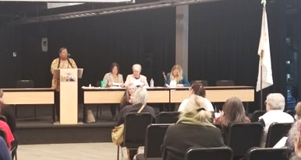
Wolves in sheep’s clothing

Slide 4
Troublesome times coming
The Spirit says some will depart from the faith
Deceiving spirits and doctrines of demons
Speaking lies in hypocrisy, dead consciences
Forbidding to marry, abstain from foods God created
Semblance of truth but wrong conclusions
Things God created to be received with thanksgiving
Every creature of God is good, if received/thanks

Slide 6
Encouragement to Timothy
If you instruct the brethren, you will be a good minister
Pattern of effective ministry
Faithfully teaching those in his care
Timothy would be nourished in faith/doctrine
Healthy personal life: exercise in godliness

Slide 7
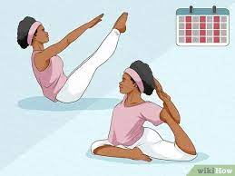
Keeping physically fit

Slide 8
Encouragement to Timothy
If you instruct the brethren, you will be a good minister
Pattern of effective ministry
Faithfully teaching those in his care
Timothy would be nourished in faith/doctrine
Healthy personal life: exercise in godliness
Godliness is the best of both worlds (now & eternity)
To this end we labor and suffer reproach
Because we trust in the living God (savior of all men)

Slide 9
Dedicated effective ministry
Don’t be intimidated by your youth
Let your character speak (be an example)
What you teach (words)
The way you live (conduct)
Inner qualities (love, spirit, faith, purity)
Thorough preparation (reading, encouraging, teaching)
Remember your God given gifts
Your faithfulness will help benefit you and hearers (salvation)

Slide 10
Godly Ministry in Troubling Times
1 Timothy 4:1-16

