Slide 1
Fearless
2 Timothy 1:1-7

Slide 2
Fearless
2nd Timothy
2 Timothy 1:1-7

Slide 3
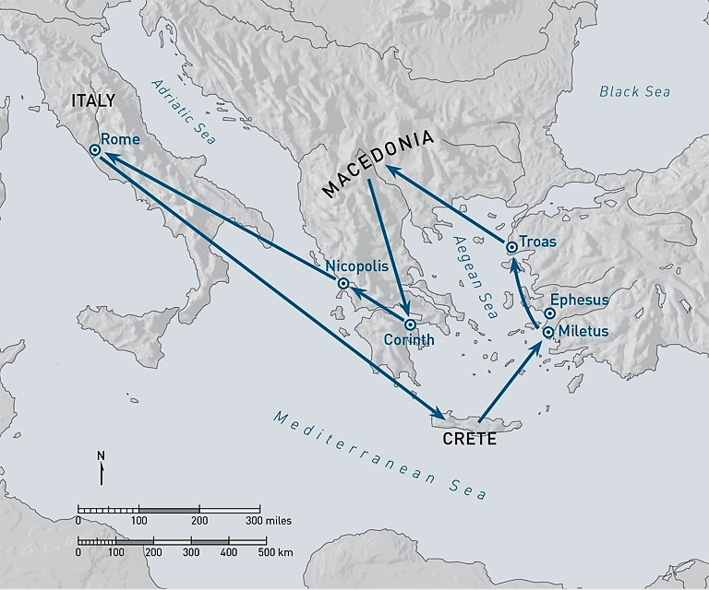
Fearless
2nd Timothy
2 Timothy 1:1-7

Slide 4
2 Timothy outline
Ch 1-2 Remain strong in the Lord
Ch 3 Living in perilous times
Ch 4 Come to Rome quickly

Slide 5
Are we captive to fears?
Economic uncertainty
Political unrest
Collapsing morals
Personal insecurity

Slide 6
The Promises of God 1-2
1 Paul, an apostle of Jesus Christ by the will of God, according to the promise of life which is in Christ Jesus, ² To Timothy, a beloved son: Grace, mercy, and peace from God the Father and Christ Jesus our Lord.

Slide 7
The Power of Prayer 3-4
3 I thank God, whom I serve with a pure conscience, as my forefathers did, as without ceasing I remember you in my prayers night and day, ⁴ greatly desiring to see you, being mindful of your tears, that I may be filled with joy

Slide 8
Remember past blessings 5-6
5 when I call to remembrance the genuine faith that is in you, which dwelt first in your grandmother Lois and your mother Eunice, and I am persuaded is in you also. ⁶ Therefore I remind you to stir up the gift of God which is in you through the laying on of my hands.

Slide 9
Rely on God’s power 7
7 For God has not given us a spirit of fear, but of power and of love and of a sound mind.
12 For this reason I also suffer these things; nevertheless I am not ashamed, for I know whom I have believed and am persuaded that He is able to keep what I have committed to Him until that Day.

Slide 10
Fearless
2 Timothy 1:1-7

Slide 11
Fearless
2nd Timothy
2 Timothy 1:1-7

