Slide 1
2 Timothy 1:8-18

Slide 2
Unashamed
2nd Timothy
2 Timothy 1:8-18

Slide 3
Take Courage 1:8
1:8 Therefore do not be ashamed of the testimony of our Lord, nor of me His prisoner, but share with me in the sufferings for the gospel according to the power of God

Slide 4
For the Gospel 9-12
8-9 who has saved us and called us with a holy calling, not according to our works, but according to His own purpose and grace which was given to us in Christ Jesus before time began
10 but has now been revealed by the appearing of our Savior Jesus Christ, who has abolished death and brought life and immortality to light through the gospel

Slide 5
For the Gospel 9-12
11-12 to which I was appointed a preacher, an apostle, and a teacher of the Gentiles. ¹² For this reason I also suffer these things; nevertheless I am not ashamed, for I know whom I have believed and am persuaded that He is able to keep what I have committed to Him until that Day.

Slide 6
Guard the Truth 13-14
13 Hold fast the pattern of sound words which you have heard from me, in faith and love which are in Christ Jesus. ¹⁴ That good thing which was committed to you, keep by the Holy Spirit who dwells in us.

Slide 7
A Clear Choice 15-18
Unfaithful (deserters in Asia)
15 This you know, that all those in Asia have turned away from me, among whom are Phygellus and Hermogenes.
Faithful (one man)
16 The Lord grant mercy to the household of Onesiphorus, for he often refreshed me, and was not ashamed of my chain; ¹⁷ but when he arrived in Rome, he sought me out very zealously and found me. ¹⁸ The Lord grant to him that he may find mercy from the Lord in that Day—and you know very well how many ways he ministered to me at Ephesus.

Slide 8
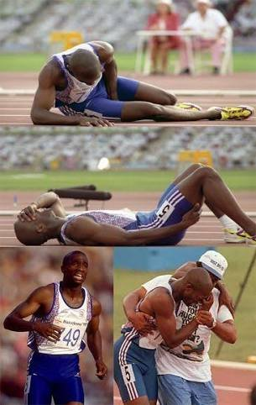
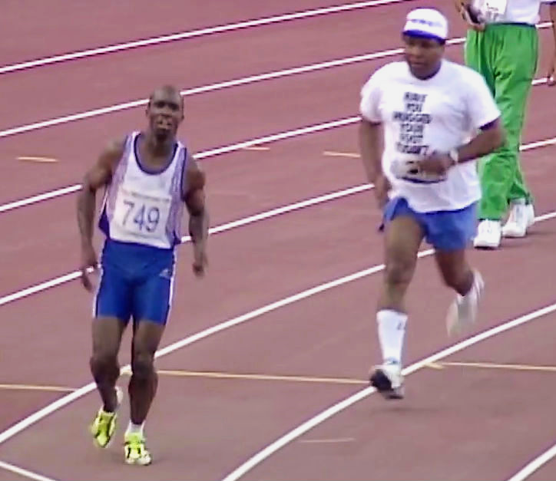

Slide 9
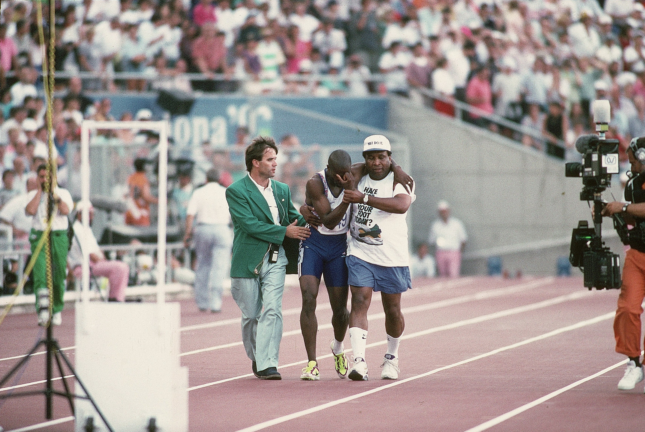

Slide 10
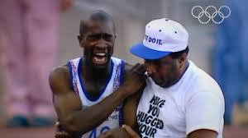

Slide 11
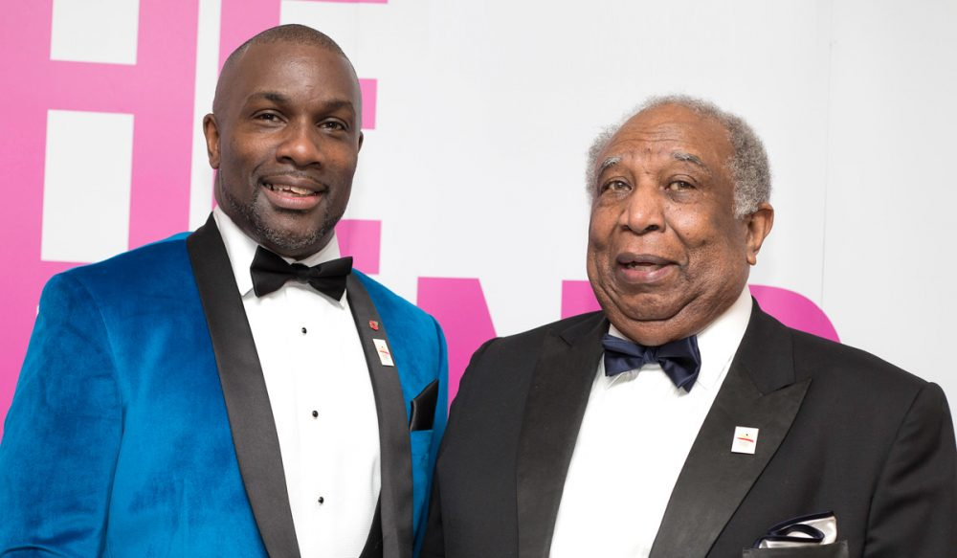

Slide 12
2 Timothy 1:8-18

Slide 13
Unashamed
2nd Timothy
2 Timothy 1:8-18

