Slide 1
Stand Firm in the Truth
Titus 1:1-16

Slide 2
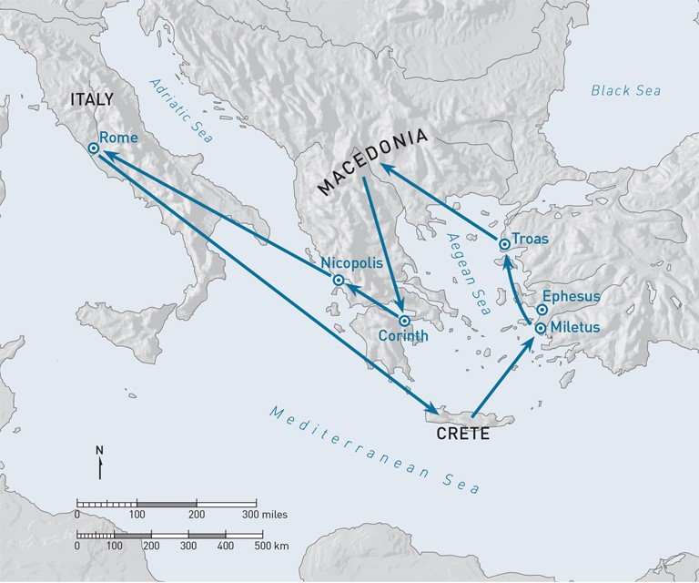
1st Imprisonment
A.D. 62-63
Paul
Timothy
Titus

Slide 3
Proclaim the Truth 1-4
Titus 1:1-4 Paul, a bondservant of God and an apostle of Jesus Christ, according to the faith of God’s elect and the acknowledgment of the truth which accords with godliness, ² in hope of eternal life which God, who cannot lie, promised before time began

Slide 4
Proclaim the Truth 1-4
3 but has in due time manifested His word through preaching, which was committed to me according to the commandment of God our Savior.
4 To Titus, a true son in our common faith: Grace, mercy, and peace from God the Father and the Lord Jesus Christ our Savior.

Slide 5
Appoint the Right Leaders 5-9
1:5-9 For this reason I left you in Crete, that you should set in order the things that are lacking, and appoint elders in every city as I commanded you—

Slide 6
Appoint the Right Leaders 5-9
6-7 if a man is blameless, the husband of one wife, having faithful children not accused of dissipation or insubordination. ⁷ For a bishop must be blameless, as a steward of God, not self-willed, not quick-tempered, not given to wine, not violent, not greedy for money,

Slide 7
Appoint the Right Leaders 5-9
8-9 but hospitable, a lover of what is good, sober-minded, just, holy, self-controlled, ⁹ holding fast the faithful word as he has been taught, that he may be able, by sound doctrine, both to exhort and convict those who contradict.

Slide 8
Protect the Church 10-16
10-12 For there are many insubordinate, both idle talkers and deceivers, especially those of the circum-cision, ¹¹ whose mouths must be stopped, who subvert whole households, teaching things which they ought not, for the sake of dishonest gain. ¹² One of them, a prophet of their own, said, “Cretans are always liars, evil beasts, lazy gluttons.”

Slide 9
Protect the Church 10-16
13-16 not giving heed to Jewish fables and command-ments of men who turn from the truth. ¹⁵ To the pure all things are pure, but to those who are defiled and unbelieving nothing is pure; but even their mind and conscience are defiled. ¹⁶ They profess to know God, but in works they deny Him, being abominable, disobedient, and disqualified for every good work.

Slide 11
Stand Firm in the Truth
Titus 1:1-16

