Slide 1
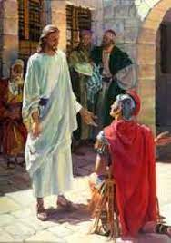
Great Faith Little Faith
Matthew 8:5-13

Slide 2
The Centurion
Matthew 8:5-10
Now when Jesus had entered Capernaum, a centurion came to Him, pleading with Him, ⁶ saying, “Lord, my servant is lying at home paralyzed, dreadfully tormented.” ⁷ And Jesus said to him, “I will come and heal him.”

Slide 3
The Centurion
Matthew 8:8-10
“Lord, I am not worthy that You should come under my roof.
But only speak a word, and my servant will be healed.
For I also am a man under authority, having soldiers under me. And I say to this one, ‘Go,’ and he goes; and to another, ‘Come,’ and he comes; and to my servant, ‘Do this,’ and he does it.”

Slide 4
The Centurion
Matthew 8:8-10
When Jesus heard it, He marveled, and said to those who followed, “Assuredly, I say to you, I have not found such great faith, not even in Israel!

Slide 5
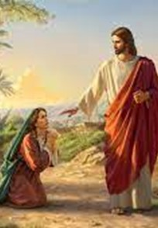
The Canaanite Woman
Matthew 15:21-28
Then Jesus went out from there and departed to the region of Tyre and Sidon. ²² And behold, a woman of Canaan came from that region and cried out to Him, saying, “Have mercy on me, O Lord, Son of David! My daughter is severely demon-possessed.”²³ But He answered her not a word. And His disciples came and urged Him, saying, “Send her away, for she cries out after us.”

Slide 6
The Canaanite Woman
Matthew 15:21-28
But He answered and said, “I was not sent except to the lost sheep of the house of Israel.” ⁵ Then she came and worshiped Him, saying, “Lord, help me!”
²⁶ But He answered and said, “It is not good to take the children’s bread and throw it to the little dogs.” ²⁷ And she said, “Yes, Lord, yet even the little dogs eat the crumbs which fall from their masters’ table.”
²⁸ Then Jesus answered and said to her, “O woman, great is your faith! Let it be to you as you desire.” And her daughter was healed from that very hour.

Slide 7
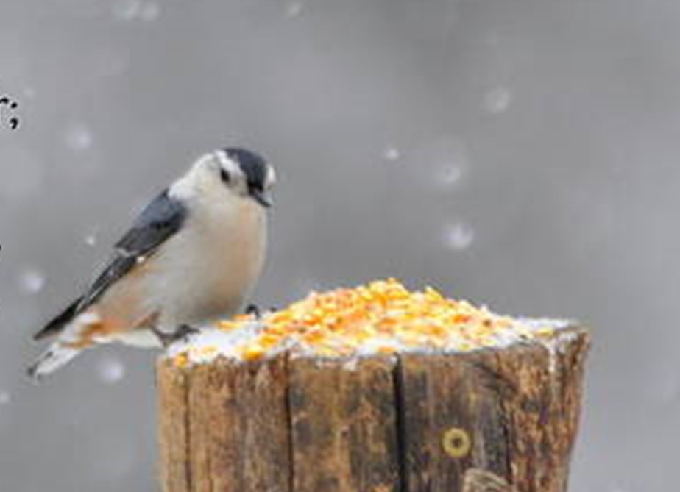
Worries about this life
Matthew 6:25-32
“Therefore I say to you,do not worry about your life, what you will eat or what you will drink; nor about your body, what you will put on. Is not life more than food and the body more than clothing?
²⁶ Look at the birds of the air, for they neither sow nor reap nor gather into barns; yet your heavenly Father feeds them. Are you not of more value than they? ²⁷ Which of you by worrying can add one cubit to his stature?

Slide 8
Worries about this life
Matthew 6:25-32
²⁸ “So why do you worry about clothing? Consider the lilies of the field, how they grow: they neither toil nor spin; ²⁹ and yet I say to you that even Solomon in all his glory was not ^{[c]}arrayed like one of these. ³⁰ Now if God so clothes the grass of the field, which today is, and tomorrow is thrown into the oven, will He not much more clothe you, O you of little faith?

Slide 9
Fear of death
Matthew 8:23-27
Now when He got into a boat, His disciples followed Him. ²⁴ And suddenly a great tempest arose on the sea, so that the boat was covered with the waves. But He was asleep. ²⁵ Then His disciples came to Him and awoke Him, saying, “Lord, save us! We are perishing!”
²⁶ But He said to them, “Why are you fearful, O you of little faith?” Then He arose and rebuked the winds and the sea, and there was a great calm. ²⁷ So the men marveled, saying, “Who can this be, that even the winds and the sea obey Him?”

Slide 10
Losing our Focus
Matthew 14:25-31
²⁵ Now in the fourth watch of the night Jesus went to them, walking on the sea. ²⁶ And when the disciples saw Him walking on the sea, they were troubled, saying, “It is a ghost!” And they cried out for fear.
²⁷ But immediately Jesus spoke to them, saying, “Be of good cheer! ^{[b]}It is I; do not be afraid.”²⁸ And Peter answered Him and said, “Lord, if it is You, command me to come to You on the water.”

Slide 11
Losing our Focus
Matthew 14:25-31
So He said, “Come.” And when Peter had come down out of the boat, he walked on the water to go to Jesus. ³⁰ But when he saw ^{[c]}that the wind was boisterous, he was afraid; and beginning to sink he cried out, saying, “Lord, save me!”
³¹ And immediately Jesus stretched out His hand and caught him, and said to him, “O you of little faith, why did you doubt?”

Slide 12
Great Faith Little Faith
Matthew 8:5-13

