Slide 1
The Assembly of the Saints
Psalm 89:1-7

Slide 2
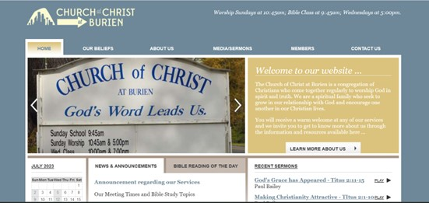
www.burienchurchofchrist.com

Slide 3
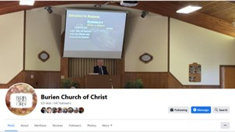
www.facebook.com/burienchurch

Slide 4
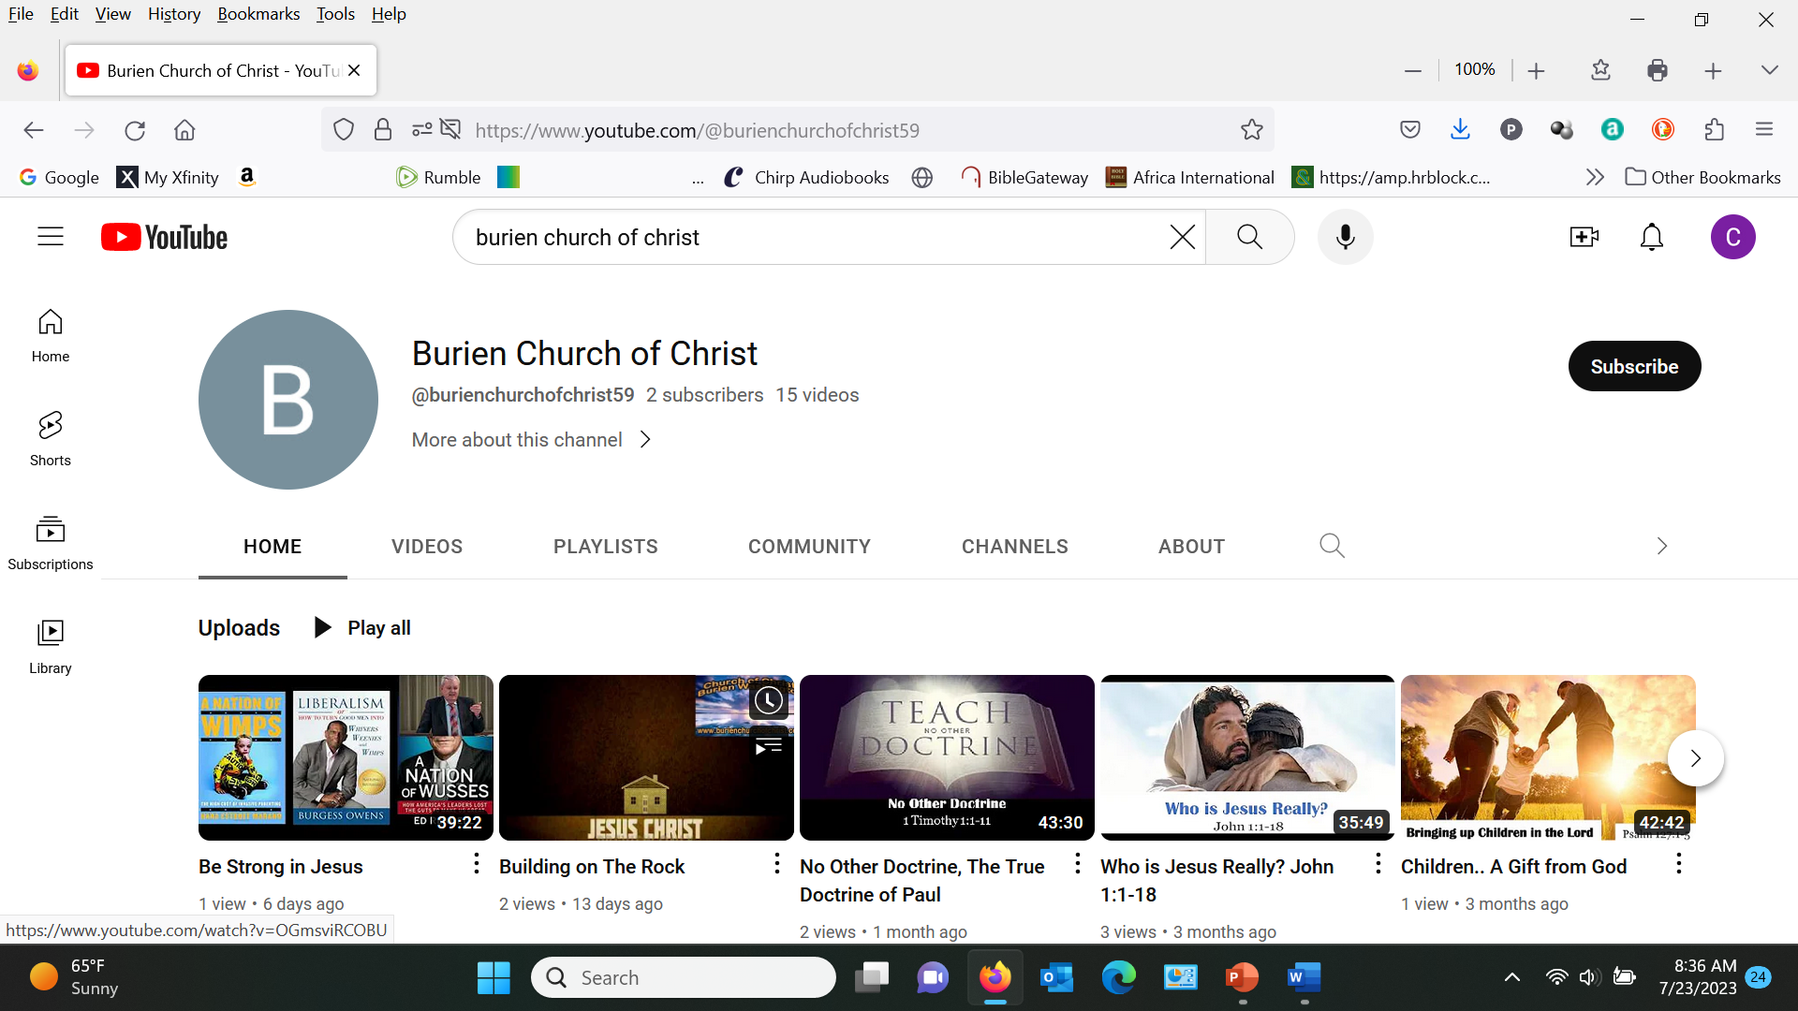
www.youtube.com/@burienchurchofchrist59

Slide 6
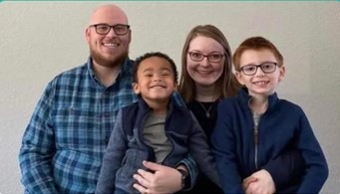

Slide 7
The Assembly of the Saints
Psalm 89:1-7

Slide 8
Psalm 89
1-4 I will sing of the mercies of the Lord forever; With my mouth will I make known Your faithfulness to all generations. ² For I have said, “Mercy shall be built up forever; Your faithfulness You shall establish in the very heavens.”
³ “I have made a covenant with My chosen, I have sworn to My servant David: ⁴ ‘Your seed I will establish forever, And build up your throne to all generations.’ ” Selah

Slide 9
A Sacred Assembly
5-7 And the heavens will praise Your wonders, O Lord; Your faithfulness also in the assembly of the saints.
⁶ For who in the heavens can be compared to the Lord? Who among the sons of the mighty can be likened to the Lord?
⁷ God is greatly to be feared in the assembly of the saints, And to be held in reverence by all those around Him.

Slide 10
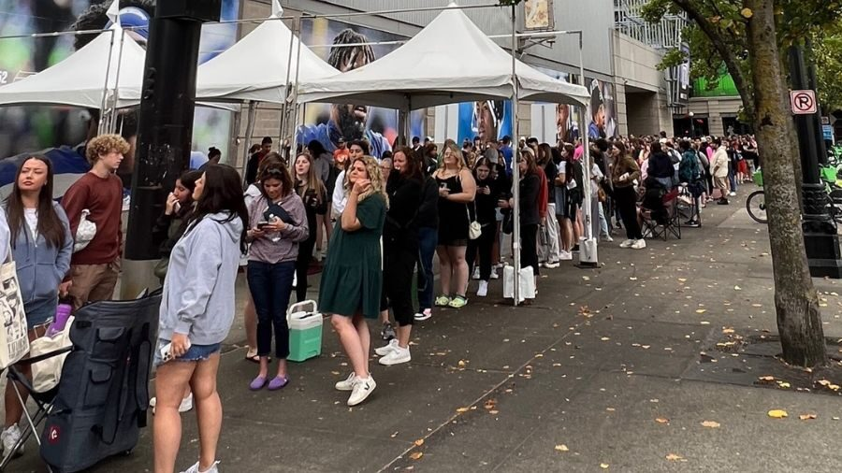
Seattle’s biggest entertainment weekend

Slide 11
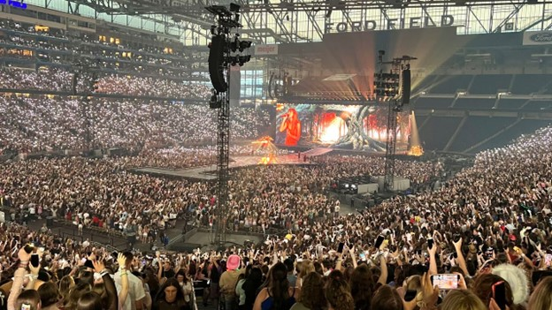
Taylor Swift Detroit concert

Slide 12
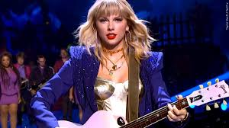
Ezekiel describes our nation
Ezekiel 5:6 She has rebelled against My judgments by doing wickedness more than the nations, and against My statutes more than the countries that are all around her; for they have refused My judgments, and they have not walked in My statutes.’

Slide 13
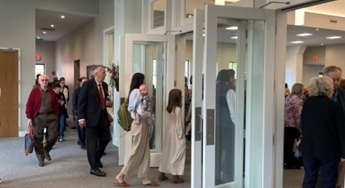
Assembly of the saints

Slide 14
Meeting together with Christians

Slide 15
1 Assembly of saints in NT
Acts 2:42 And they continued steadfastly in the apostles’ doctrine and fellowship, in the breaking of bread, and in prayers.
46-47 So continuing daily with one accord in the temple, and breaking bread from house to house, they ate their food with gladness and simplicity of heart, ⁴⁷ praising God and having favor with all the people. And the Lord added to the church daily those who were being saved.

Slide 16
Assembly strengthens us
Hebrews 10:24-25 And let us consider one another in order to stir up love and good works,
²⁵ not forsaking the assembling of ourselves together, as is the manner of some, but exhorting one another, and so much the more as you see the Day approaching.

Slide 17
Neglect results in weakness
1 Corinthians 11:20-30 when you come together in one place, it is not to eat the Lord’s Supper. ²¹ For in eating, each one takes his own supper ahead of others; and one is hungry and another is drunk. ²²Do you not have houses to eat and drink in? Or do you despise the church of God and shame those who have nothing? Shall I praise you in this? I do not praise you… 30 For this reason many are weak and sick among you, and many sleep.

Slide 18
2 A Command with a Purpose
Hebrews 10:24-25 And let us consider one another in order to stir up love and good works,
²⁵ not forsaking the assembling of ourselves together, as is the manner of some, but exhorting one another, and so much the more as you see the Day approaching.

Slide 19
A Command (and a privilege)
God commands us..
Assemble
Encourage one another
To love people
To do good works
Is this to our advantage or an inconvenience?

Slide 20
Are God’s commands w/o purpose?
Hebrews 10:32-33 But recall the former days in which, after you were illuminated, you endured a great struggle with sufferings: ³³ partly while you were made a spectacle both by reproaches and tribulations, and partly while you became companions of those who were so treated;
36 For you have need of endurance, so that after you have done the will of God, you may receive the promise:Now the just shall live by faith; But if anyone draws back, My soul has no pleasure in him.” ³⁹ But we are not of those who draw back to perdition, but of those who believe to the saving of the soul.

Slide 21
3 Coming together for Edification
“Edification” (oikodome)
“the act of building” (to build a house)
To build up, promote spiritual growth
To build up and strengthen the body of Christ

Slide 22
Our words are tools in building up
Colossians 3:16 Let the word of Christ dwell in you richly in all wisdom, teaching and admonishing one another in psalms and hymns and spiritual songs, singing with grace in your hearts to the Lord.
Sometimes we speak words to each other
Sometimes we sing words to each other

Slide 23
1 Corinthians 14
1 Cor 14:3-5 But he who prophesies speaks edification and exhortation and comfort to men. ⁴ He who speaks in a tongue edifies himself, but he who prophesies edifies the church. ⁵ I wish you all spoke with tongues, but even more that you prophesied; for he who prophesies is greater than he who speaks with tongues, unless indeed he interprets, that the church may receive edification.

Slide 24
1 Corinthians 14
12 Even so you, since you are zealous for spiritual gifts, let it be for the edification of the church that you seek to excel.
17Otherwise, if you bless with the spirit, how will he who occupies the place of the uninformed say “Amen” at your giving of thanks, since he does not understand what you say? ¹⁷ For you indeed give thanks well, but the other is not edified.
26How is it then, brethren? Whenever you come together, each of you has a psalm, has a teaching, has a tongue, has a revelation, has an interpretation. Let all things be done for edification.

Slide 25
The Assembly of the Saints
Psalm 89:1-7

