Slide 1
The Christian Path
Proverbs 3:5-8

Slide 2
Trust God’s direction
Prov 3:5-8 Trust in the Lord with all your heart, and lean not on your own understanding; ⁶ In all your ways acknowledge Him, and He shall direct your paths.. ⁸ It will be health to your flesh, and strength to your bones.

Slide 3
Trust that God is leading me in the right path..

Slide 4
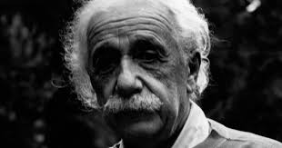
Will science replace religion..

Slide 5
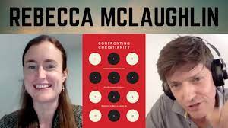
Benefits of church attendance

Slide 6
Relationships built on much bigger things
Acts 2:42-45 And they continued steadfastly in the apostles’ doctrine and fellowship, in the breaking of bread, and in prayers.. ⁴⁴ Now all who believed were together, and had all things in common, ⁴⁵ and sold their possessions and goods, and divided them among all, as anyone had need

Slide 7
Healthier attitude toward possessions
Acts 20:35 I have shown you in every way, by laboring like this, that you must support the weak. And remember the words of the Lord Jesus, that He said, ‘It is more blessed to give than to receive.’ ”
1 Timothy 6:7-9 For we brought nothing into this world, and it is certain we can carry nothing out. ⁸ And having food and clothing, with these we shall be content. ⁹ But those who desire to be rich fall into temptation and a snare, and into many foolish and harmful lusts which drown men in destruction and perdition.

Slide 8
Help in facing difficulties
2 Corinthians 1:3-4 Blessed be the God and Father of our Lord Jesus Christ, the Father of mercies and God of all comfort, ⁴ who comforts us in all our tribulation, that we may be able to comfort those who are in any trouble, with the comfort with which we ourselves are comforted by God.

Slide 9
Help in facing difficulties
Philippians 4:6-7 Be anxious for nothing, but in everything by prayer and supplication, with thanksgiving, let your requests be made known to God; ⁷ and the peace of God, which surpasses all understanding, will guard your hearts and minds through Christ Jesus.
Phil 4:13 I can do all things through Christ who strengthens me.

Slide 10
Inner qualities help us thrive
2 Peter 1:5-7 giving all diligence, add to your faith virtue, to virtue knowledge, ⁶ to knowledge self-control, to self-control perseverance, to perseverance godliness, ⁷ to godliness brotherly kindness, and to brotherly kindness love.

Slide 11
A Life of True Purpose
Matthew 5:14-16 You are the light of the world. A city that is set on a hill cannot be hidden.. ¹⁶ Let your light so shine before men, that they may see your good works and glorify your Father in heaven.
Romans 8:28 And we know that all things work together for good to those who love God, to those who are the called according to His purpose.

Slide 12
The Christian path is best
1 Timothy 4:8 For bodily exercise profits a little, but godliness is profitable for all things, having promise of the life that now is and of that which is to come.

Slide 13
The Christian Path
Proverbs 3:5-8

