Slide 1
Jesus Divine Redeemer
Colossians 1:15-23

Slide 2
Man’s sin has disabled him
Separated from God
Alienated by guilt
Spiritual death
Captive to sin
Romans 7:13-25 I find then a law, that evil is present with me, the one who wills to do good. ²² For I delight in the law of God according to the inward man. ²³ But I see another law in my members, warring against the law of my mind, and bringing me into captivity to the law of sin which is in my members
Only God can redeem him and empower to live a righteous life

Slide 3
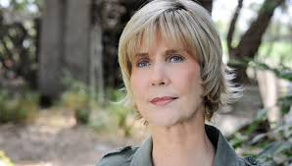
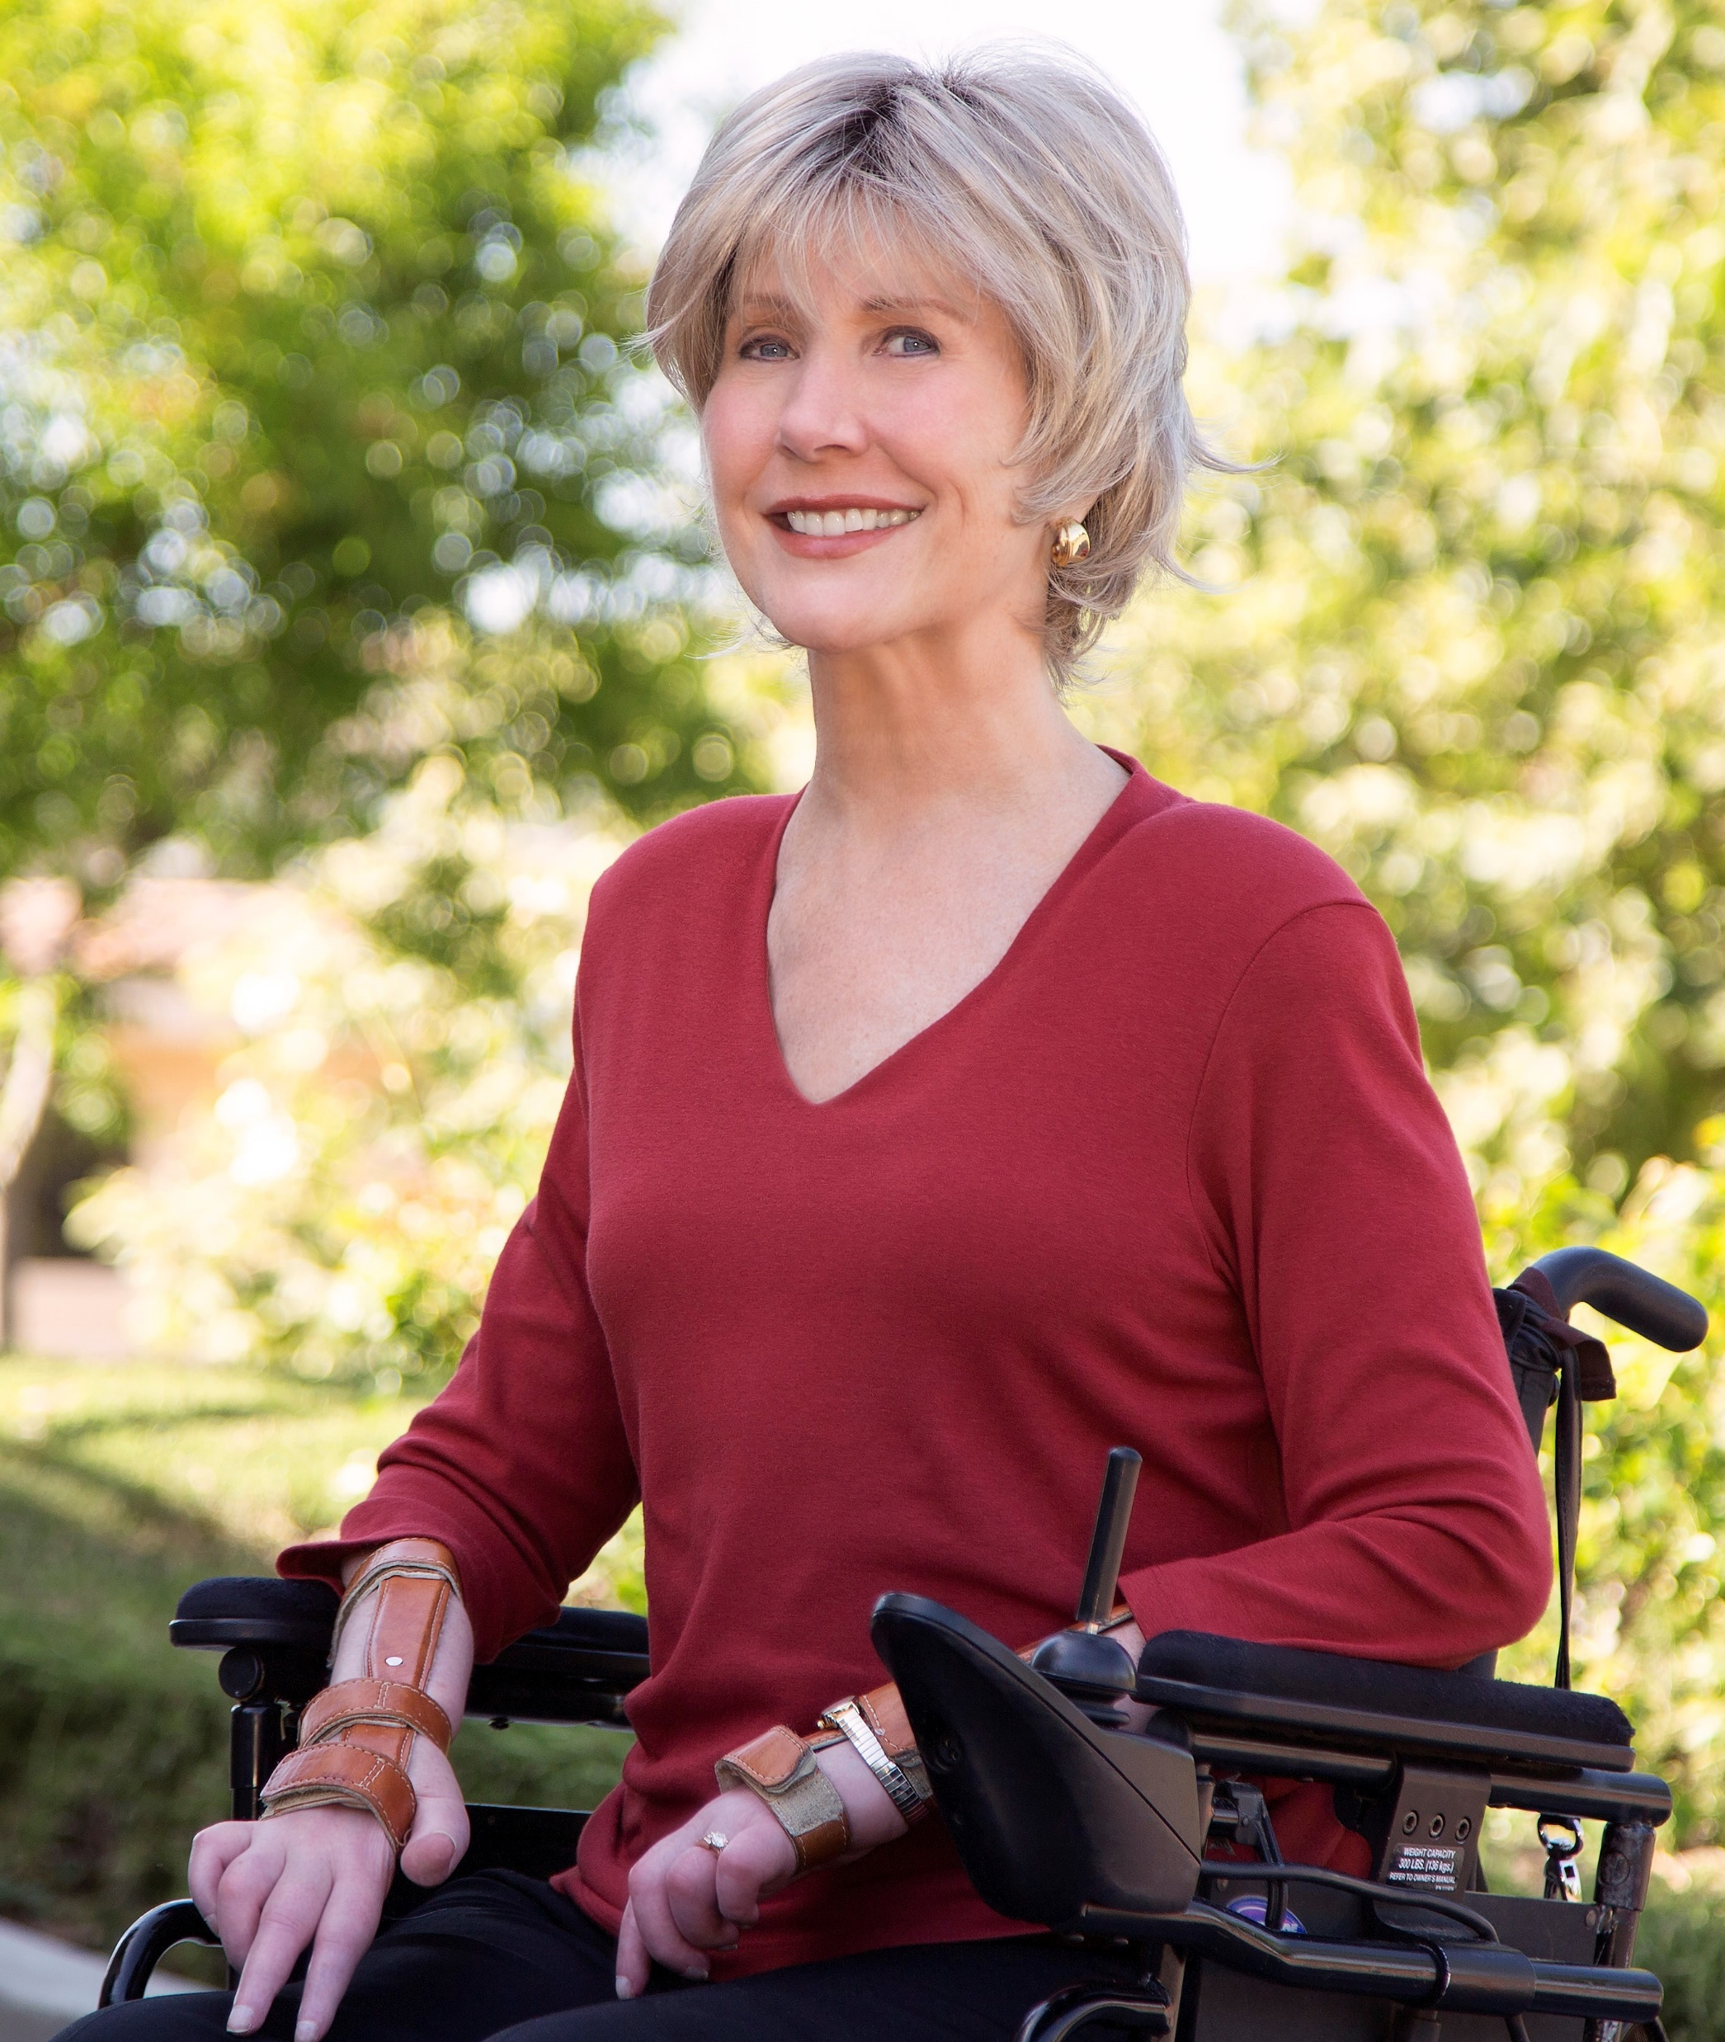
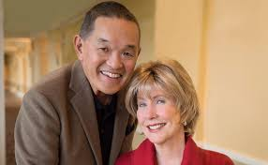
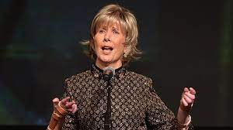
Joni Eareckson Tada

Slide 4
Jesus our Creator-God
John 1:1-18
In the beginning was the Word
The Word was with God
The Word was God
The Word was God
Jesus was the Word
Jesus is God
John 20:28-29 Thomas: My Lord and My God
Philippians 2:5-6
In the form of God
Equality with God
Hebrews 1:8
Of the Son he says
Your throne O God
Titus 2:13
Hope/appearing of God and Savior Jesus

Slide 5
Colossians 1:15-23
1:15 image of the invisible God
1:16-17 by him all things were created
1:18 head of the body, the church
1:19 the fulness of God (deity)
1:20-23 reconciled through his blood
Colossians 2:9-10 For in Him dwells all the fullness of the Godhead bodily; ¹⁰ and you are complete in Him, who is the head of all principality and power.

Slide 6
Jesus became man
Matt 1:22-23 virgin shall bring forth son, call his name Immanuel (God with us)
Jesus
(Immanuel)
God
with us
Deity
with humanity
Isaiah 7:14, 9:6-7
A child is born, a son is given
Wonderful Counselor, Mighty God, Everlasting Father, Prince of Peace
John 1:14 The Word became flesh, dwelt among us, we beheld his glory

Slide 7
Jesus our Present Helper
Colossians 1:18 he is head of the body, the church, firstborn from the dead, that in all things he might have the preeminence
Col 1:21-23 And you, who once were alienated and enemies in your mind by wicked works, yet now He has reconciled ²² in the body of His flesh through death, to present you holy, and blameless, and above reproach in His sight— ²³ if indeed you continue in the faith, grounded and steadfast, and are not moved away from the hope of the gospel
Romans 8:35-39
Nothing shall be able to separate us from the love of God in Christ Jesus our Lord
2 Timothy 1:12
I know whom I have believed He is able to keep what I have committed to Him
1 John 5:18
He who is born of God keeps himself and the wicked one does not touch him

Slide 8
Christ has power to save us and keep us saved
Ephesians 3:20-21 Now to Him who is able to do exceedingly abundantly above all that we ask or think, according to the power that works in us, ²¹ to Him be glory in the church by Christ Jesus to all generations, forever and ever. Amen.

Slide 9
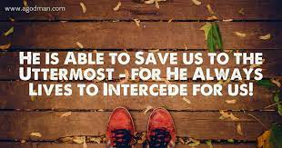

Slide 10
Jesus Divine Redeemer
Colossians 1:15-23

