Slide 1
Redemption’s Attraction
John 12:20-32

Slide 2
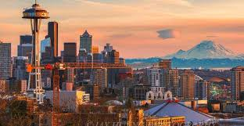
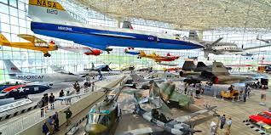
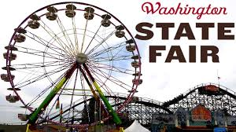
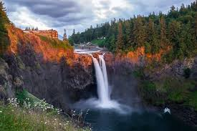
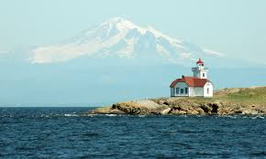
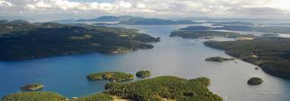
Natural attractions

Slide 3
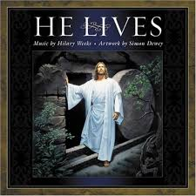
The Greatest Attraction

Slide 4
If I be lifted up..
John 12:31-32 Now is the judgment of this world; now the ruler of this world will be cast out. ³² And I, if I am lifted up from the earth, will draw all peoples to Myself.”
1 Corinthians 1:18 For the message of the cross is foolishness to those who are perishing, but to us who are being saved it is the power of God.

Slide 5
Jesus affirmed His importance
“I am the bread of life. He who comes to Me shall never hunger, and he who believes in Me shall never thirst.” John 6:35
“I am the light of the world. He who follows Me shall not walk in darkness, but have the light of life.” John 8:12
“I am the way, the truth, and the life. No one comes to the Father except through Me. John 14:6

Slide 6
Savior of the World
John 1:29 “Behold! The Lamb of God who takes away the sin of the world!”
John 3:16 For God so loved the world that He gave His only begotten Son, that whoever believes in Him should not perish but have everlasting life.
John 10:16 And other sheep I have which are not of this fold; them also I must bring, and they will hear My voice; and there will be one flock and one shepherd.

Slide 7
Attraction of Admiration
Roman centurion: “This man was the Son of God” Matthew 27:54
Thieves on cross: “Lord, remember me when You come into Your kingdom.” ⁴³ And Jesus said to him, “Assuredly, I say to you, today you will be with Me in Paradise” Luke 23:43
Prophecy: “Behold, My Servant shall be exalted and extolled and be very high.” Isaiah 52:13

Slide 9
Attraction turns to Love
When we realize His death is personal (for me)
Galatians 2:20 I have been crucified with Christ; it is no longer I who live, but Christ lives in me; and the life which I now live in the flesh I live by faith in the Son of God, who loved me and gave Himself for me.
John 6:44-45 No one can come to Me unless the Father who sent Me draws him; and I will raise him up at the last day. ⁴⁵ It is written in the prophets, ‘And they shall all be taught by God.’ Therefore everyone who ^{[a]}has heard and learned from the Father comes to Me.

Slide 10
Jesus draws us by His Love
Jeremiah 31:3 The Lord has appeared of old to me, saying: “Yes, I have loved you with an everlasting love; Therefore with lovingkindness I have drawn you.”
Hosea 11:4 I drew them with gentle cords, With bands of love, And I was to them as those who take the yoke from their neck. I stooped and fed them.
2 Corinthians 5:14 For the love of Christ compels us, because we judge thus: that if One died for all, then all died; ¹⁵ and He died for all, that those who live should live no longer for themselves, but for Him who died for them and rose again.

Slide 12
We are drawn by Gratitude
2 Corinthians 8:9 For you know the grace of our Lord Jesus Christ, that though He was rich, yet for your sakes He became poor, that you through His poverty might become rich… 9:15 Thanks be to God for His indescribable gift!
Revelation 5:9-10 And they sang a new song, saying: “You are worthy to take the scroll, And to open its seals; For You were slain, And have redeemed us to God by Your blood out of every tribe and tongue and people and nation..

Slide 13
I will draw all peoples to me
John 12:32 And I, if I am lifted up from the earth, will draw all peoples to Myself.”
John 6:44-45 No one can come to Me unless the Father who sent Me draws him; and I will raise him up at the last day. ⁴⁵ It is written in the prophets, ‘And they shall all be taught by God.’ Therefore everyone who has heard and learned from the Father comes to Me.

Slide 14
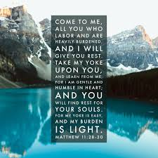
Have you been drawn by the attraction of Christ?

Slide 15
Redemption’s Attraction
John 12:20-32

