Slide 1
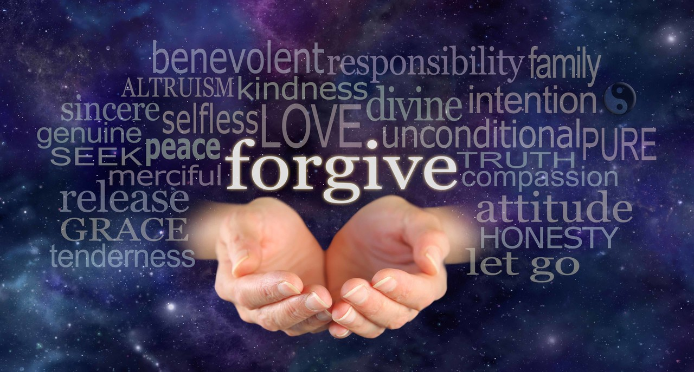
The Blessing of Forgiveness
Matthew 6:12-15

Slide 2
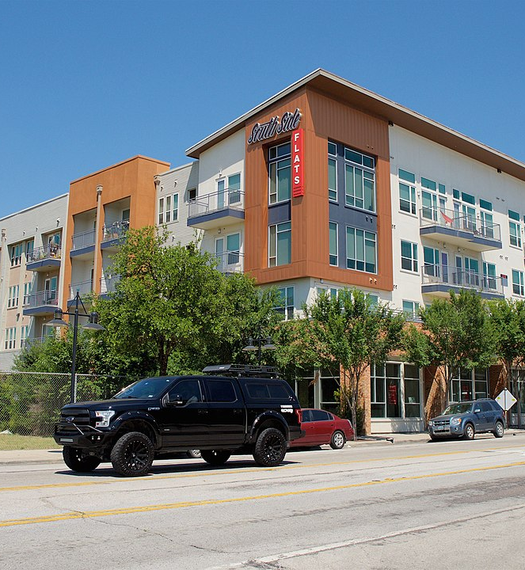
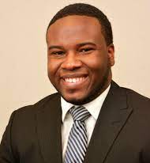

Slide 3
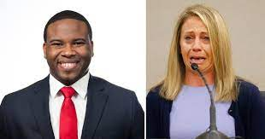

Slide 4
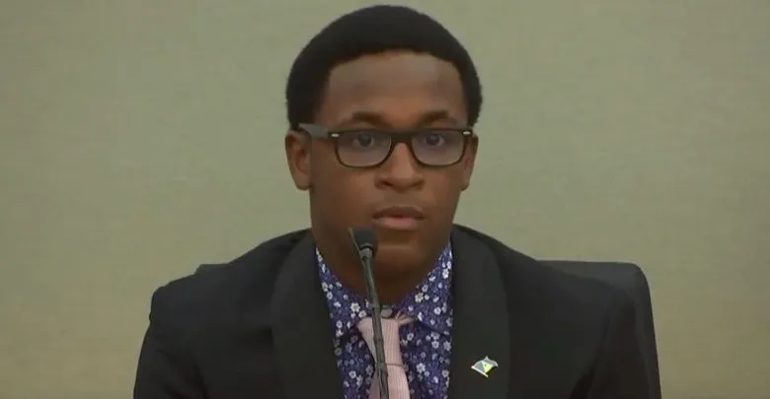

Slide 5
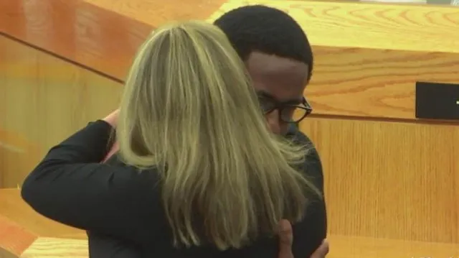

Slide 6
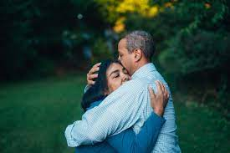
God is ready to forgive
Psalm 86:5 For You, Lord, are good, and ready to forgive, and abundant in mercy to all those who call upon You.
1 John 1:9 If we confess our sins, He is faithful and just to forgive us our sins and to cleanse us from all unrighteousness.
God is ready to forgive (when we repent)
Do I have to forgive before they ask?
Automatically or when they ask?

Slide 7
Forgiveness in our Lives
Matt 6:14-15 “For if you forgive men their trespasses, your heavenly Father will also forgive you. ¹⁵ But if you do not forgive men their trespasses, neither will your Father forgive your trespasses.
Ephesians 4:32 And be kind to one another, tenderhearted, forgiving one another, even as God in Christ forgave you.

Slide 8
What is Forgiveness
Definition – an attitude of heart which restores the offender to the former state and affections of the the offended one
Test to know if you have truly forgiven?
Do you feel as kindly toward them as before?
Is the relationship restored?

Slide 9
When God forgives..how does He treat the one forgiven?
Psalm 103:10-12 For as the heavens are high above the earth, So great is His mercy toward those who fear Him; ¹² As far as the east is from the west, So far has He removed our transgressions from us.
David’s sins were forgiven – Psalm 32, Psalm 51
1 John 1:9 If we confess our sins, He is faithful and just to forgive us our sins and to cleanse us from all unrighteousness

Slide 10
The debt is remitted, canceled
Matthew 6:12 And forgive us our debts, As we forgive our debtors.
Forgiveness says “I am going to let go of the way I feel”
But contingent on the other person repenting
Col 3:13 bearing with one another, and forgiving one another, if anyone has a complaint against another; even as Christ forgave you, so you also must do. (Eph 4:32)

Slide 11
Two kinds of forgiveness
Restore to former relationship (contingent on repentance)
I’m not going to hold this against you (not based on repentance) .. we don’t hold bitterness
Jesus on cross – “Father forgive them, for they know not what they do”
They were offered forgiveness – Acts 2:36-38 these same people had not been forgiven

Slide 12
Forgiven when we repent
Luke 17:3 Take heed to yourselves. If your brother sins against you, rebuke him; and if he repents, forgive him.
Acts 7:59-60 And they stoned Stephen as he was calling on God and saying, “Lord Jesus, receive my spirit.” ⁶⁰ Then he knelt down and cried out with a loud voice, “Lord, do not charge them with this sin.”
1 Cor 5:4-5 deliver such a one to Satan for the destruction of the flesh, that his spirit may be saved in the day of the Lord Jesus.

Slide 13
Questions..
“I’ll forgive but I’ll never forget”
Usually indicates bitterness
Matt 18:35 So My heavenly Father also will do to you if each of you, from his heart, does not forgive his brother his trespasses.”
Heb 8:12 For I will be merciful to their unrighteous-ness, and their sins and their lawless deeds I will remember no more.” (Heb 10:17)

Slide 14
Jesus’ standard
Luke 17:3-5 Take heed to yourselves. If your brother sins against you, rebuke him; and if he repents, forgive him. ⁴ And if he sins against you seven times in a day, and seven times in a day returns to you, saying, ‘I repent,’ you shall forgive him.”
Matthew 18:21-22Then Peter came to Him and said, “Lord, how often shall my brother sin against me, and I forgive him? Up to seven times?” ²² Jesus said to him, “I do not say to you, up to seven times, but up to seventy times seven.

Slide 17
The Blessing of Forgiveness
Matthew 6:12-15

