Slide 1
Our King’s Presence
Psalm 24

Slide 2
“More in ‘24”
Proverbs 20:24 A person’s steps are directed by the Lord. How then can anyone understand their own way?

Slide 3
The 24th Psalm
Psalm 22 – The Suffering Savior
Psalm 23 – The Good Shepherd
Psalm 24 – The Reigning King

Slide 4
His Power 1-2
Psalm 24:1-2 The earth is the Lord’s, and all its fullness, The world and those who dwell therein. ² For He has founded it upon the seas, And established it upon the waters.

Slide 5
His Power 1-2
Exodus 19:5 Now therefore, if you will indeed obey My voice and keep My covenant, then you shall be a special treasure to Me above all people; for all the earth is Mine.
Psalm 89:11 The heavens are Yours, the earth also is Yours; The world and all its fullness, You have founded them.

Slide 6
His Purity 3-6
Psalm 24:3-4 Who may ascend into the hill of the Lord? Or who may stand in His holy place? ⁴ He who has clean hands and a pure heart, Who has not lifted up his soul to an idol, Nor sworn deceitfully.
Clean hands (outward)
Pure heart (inward)
Not bowing to idolatry
Not false witness

Slide 7
His Purity 3-6
Psalm 24:5-6 He shall receive blessing from the Lord, And righteousness from the God of his salvation. ⁶ This is Jacob, the generation of those who seek Him, Who seek Your face. Selah

Slide 8
His Presence 7-10
Psalm 24:7 Lift up your heads, O you gates! And be lifted up, you everlasting doors! And the King of glory shall come in. ⁸ Who is this King of glory? The Lord strong and mighty, The Lord mighty in battle.

Slide 9
His Presence 7-10
Psalm 24:7 Lift up your heads, O you gates! And be lifted up, you everlasting doors! And the King of glory shall come in. ⁸ Who is this King of glory? The Lord strong and mighty, The Lord mighty in battle.

Slide 10
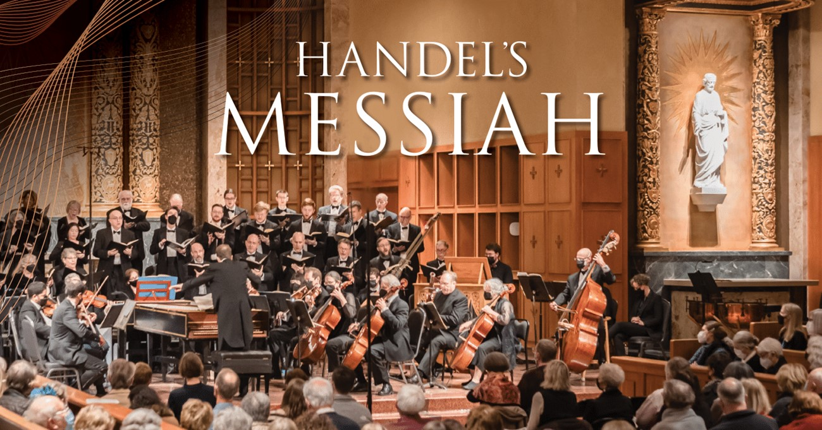
His Presence 7-10
Psalm 24:7 Lift up your heads, O you gates! And be lifted up, you everlasting doors! And the King of glory shall come in. ⁸ Who is this King of glory? The Lord strong and mighty, The Lord mighty in battle.

Slide 11
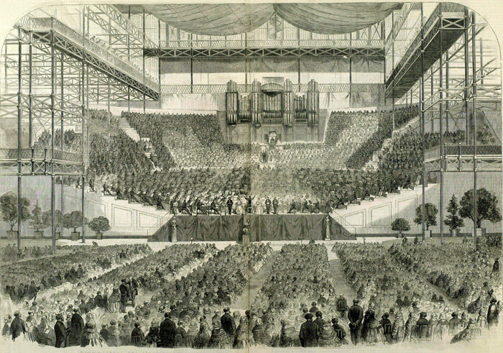
His Presence 7-10
Psalm 24:7 Lift up your heads, O you gates! And be lifted up, you everlasting doors! And the King of glory shall come in. ⁸ Who is this King of glory? The Lord strong and mighty, The Lord mighty in battle.

Slide 12
His Presence 7-10
Psalm 24:7 Lift up your heads, O you gates! And be lifted up, you everlasting doors! And the King of glory shall come in. ⁸ Who is this King of glory? The Lord strong and mighty, The Lord mighty in battle.

Slide 13
His Presence 7-10
Psalm 24:9-10 Lift up your heads, O you gates! Lift up, you everlasting doors! And the King of glory shall come in. ¹⁰ Who is this King of glory? The Lord of hosts, He is the King of glory. Selah

Slide 14
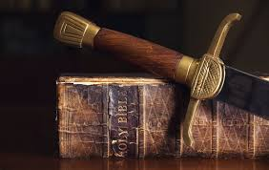
The Lord Mighty in Battle
Exodus 14:14 The Lord will fight for you!
Nehemiah 4:20 Our God will fight for us!
1 Samuel 17:47 The battle is the Lord’s!
1 Cor 15:57 thanks be to God who gives us the victory through our Lord Jesus Christ..

Slide 15
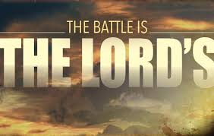

Slide 16
Our King’s Presence
Psalm 24

