Slide 1
TRUTH
Psalm 33:6-12
The Healing of America

Slide 2
America built on godly foundation
Psalm 33:12 Blessed is the nation whose God is the Lord, the people He has chosen as His own inheritance.

Slide 4
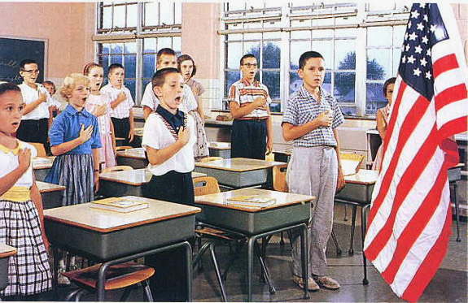

Slide 5
John 14:6 I am the way, the truth, and the life. No one comes to the Father except through me.

Slide 7
The Lies of the Deceiver
Truth is “relative”
Everyone’s “own truth”
Make your own truth
Follow your own desires

Slide 8
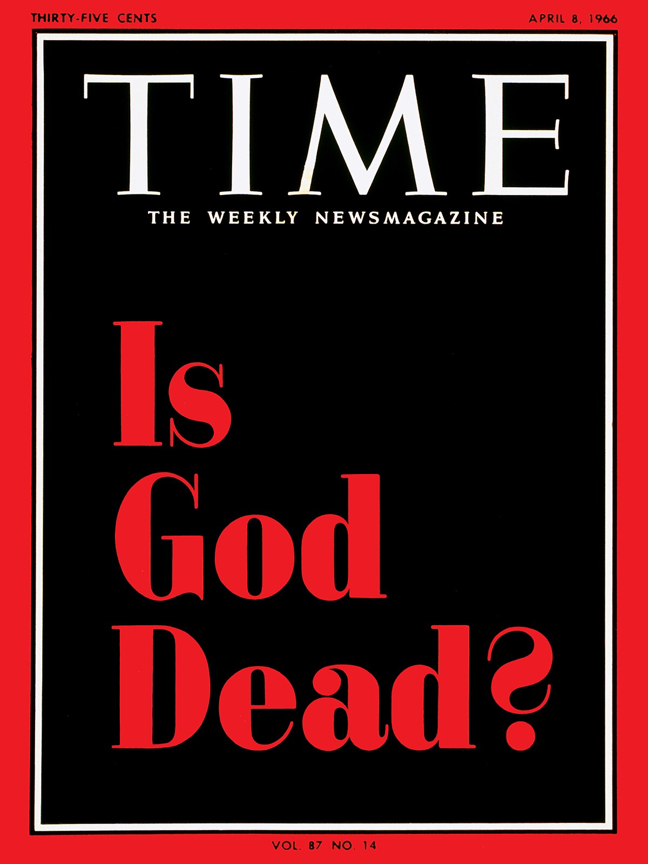
The Lord is the True God
Jeremiah 10:10 The Lord is the true God, he is the living God, the eternal king.
John 8:44 He was a murderer from the beginning, not holding to the truth, for there is no truth in him. When he lies, he speaks his native language. For he is a liar and the father of lies.

Slide 9
Questioning Truth
If God is dead what does He have to say?
If the Bible is just an ancient story, how can it apply today?
If it doesn’t apply, is there any penalty for breaking it?
If truth is relative, aren’t we free to follow our own desires?

Slide 10
All based on the lie
2 Cor 11:14 Satan transforms himself into an angel of light.
2 Thess 2:9-12 The coming of the lawless one is according to the working of Satan, with all power, signs, and lying wonders, ¹⁰ and with all unrighteous deception among those who perish, because they did not receive the love of the truth, that they might be saved. ¹¹ And for this reason God will send them strong delusion, that they should believe the lie, ¹² that they all may be condemned who did not believe the truth but had pleasure in unrighteousness.

Slide 11
The Truth sets us free
John 8:32 If you abide in my word, you are my disciples indeed. And you shall know the truth, and truth shall make you free.
We live in a dark day of no absolute truth
Sexuality ?
When life begins ?
Definition of marriage ?

Slide 12
Jesus came to show us truth
Eph 4:20-24 But you have not so learned Christ, ²¹ if indeed you have heard Him and have been taught by Him, as the truth is in Jesus: ²² that you put off, concerning your former conduct, the old man which grows corrupt according to the deceitful lusts, ²³ and be renewed in the spirit of your mind, ²⁴ and that you put on the new man which was created according to God, in true righteousness and holiness.

Slide 13
We base our lives on truth
Psalm 25:5 Lead me in Your truth and teach me, For You are the God of my salvation;
Psalm 33:4 For the word of the Lord is right, And all His work is done in truth.
Psalm119:142Your righteousness is everlast-ing, And Your law is truth.

Slide 14
TRUTH
Psalm 33:6-12
The Healing of America

