Slide 1
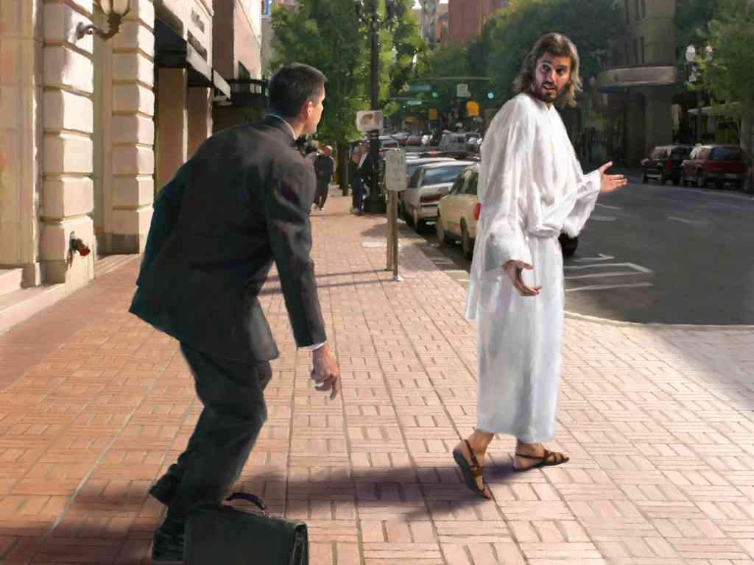
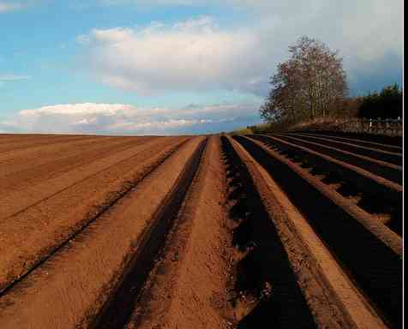
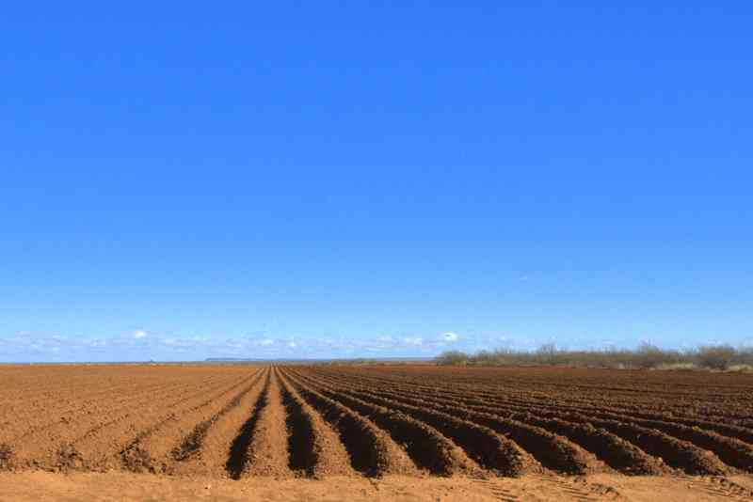
The Call to Discipleship
Luke 9:57-62

Slide 2
Who do you say I am ? ..
Luke 9:18-22 .. "Who do the crowds say that I am?" 19 So they answered and said, "John the Baptist, but some say Elijah; and others say that one of the old prophets has risen again." 20 He said to them, "But who do you say that I am?" Peter answered and said, "The Christ of God."

Slide 3
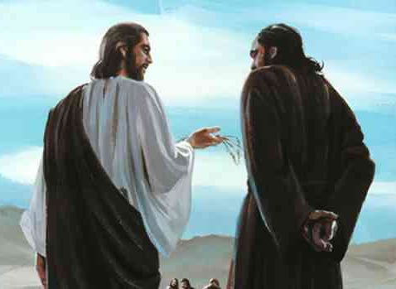
The call to discipleship: “Follow me…”

Slide 4
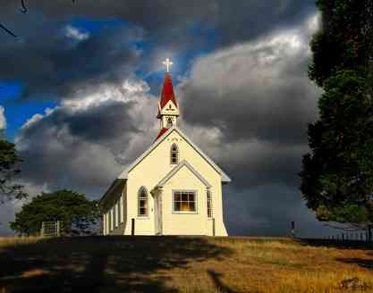
What being a disciple means..
A new priority…
A new identity…
A new mercy…

Slide 5
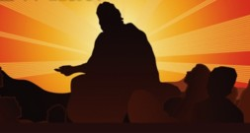
1 A New priority.. (57-62)
Are you willing to put Jesus ahead of everything else in your life?

Slide 6
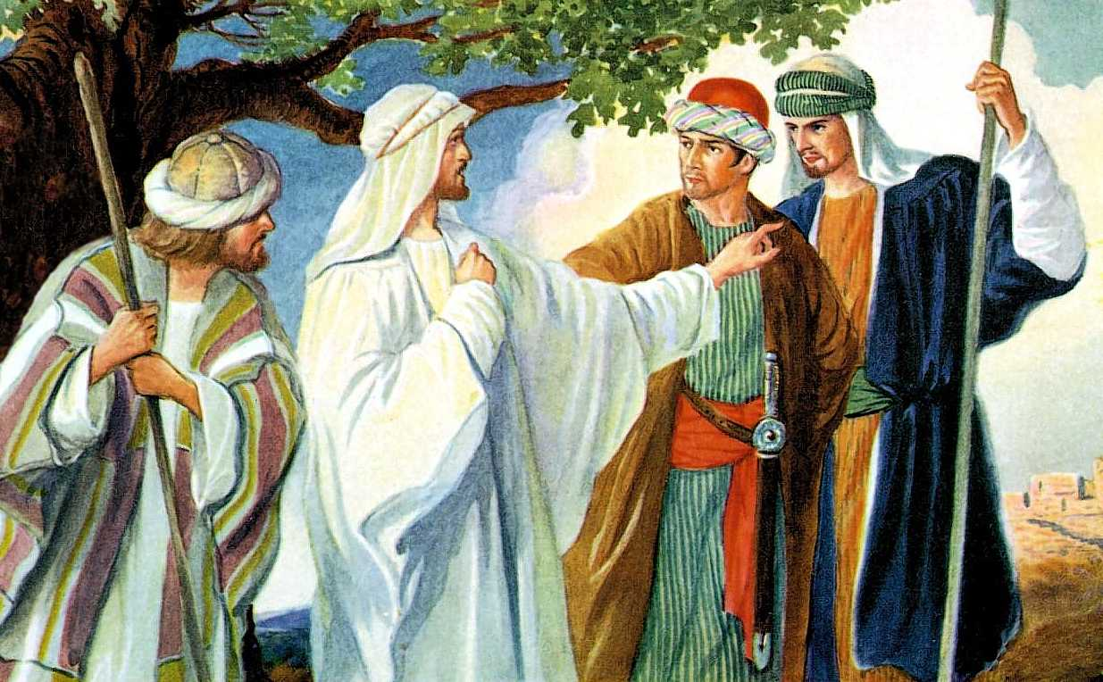
Three followers... (57-62)
Luke 9:57 Now it happened as they journeyed on the road, that someone said to Him, "Lord, I will follow You wherever You go.“

Slide 7
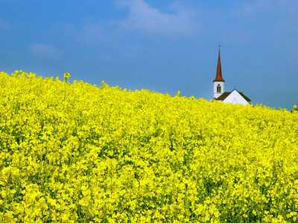
Setting a New Priority ...
58 And Jesus said to him, "Foxes have holes and birds of the air have nests, but the Son of Man has nowhere to lay His head."

Slide 8
The other two men...
59 Then He said to another, "Follow Me."But he said, "Lord, let me first go and bury my father." …
61 And another also said, "Lord, I will follow You, but let me first go and bid them farewell who are at my house."

Slide 9
We need to be completely focused..
62 But Jesus said to him, "No one, having put his hand to the plow, and looking back, is fit for the kingdom of God." (Note: “fit” means “useful”)

Slide 11
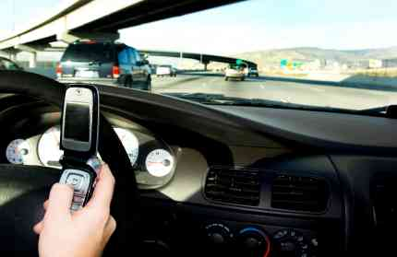
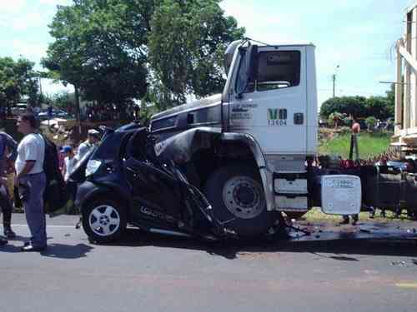

Slide 12
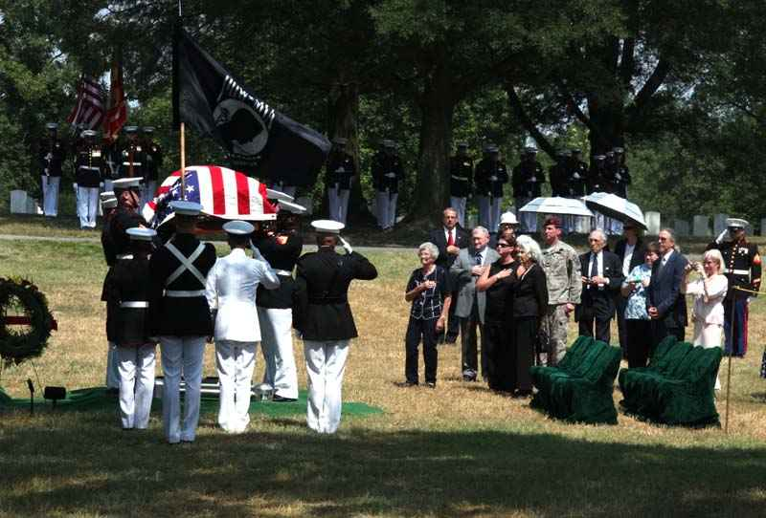
Family is important, but Jesus must come first...
60 Jesus said to him, "Let the dead bury their own dead, but you go and preach the kingdom of God."

Slide 13
I believe in You, but first..
If you are not ready to put Jesus first, then you don’t really understand… I have to be the first priority in your life!

Slide 14
Formal invite ..
Only half of you invited ..

Slide 15
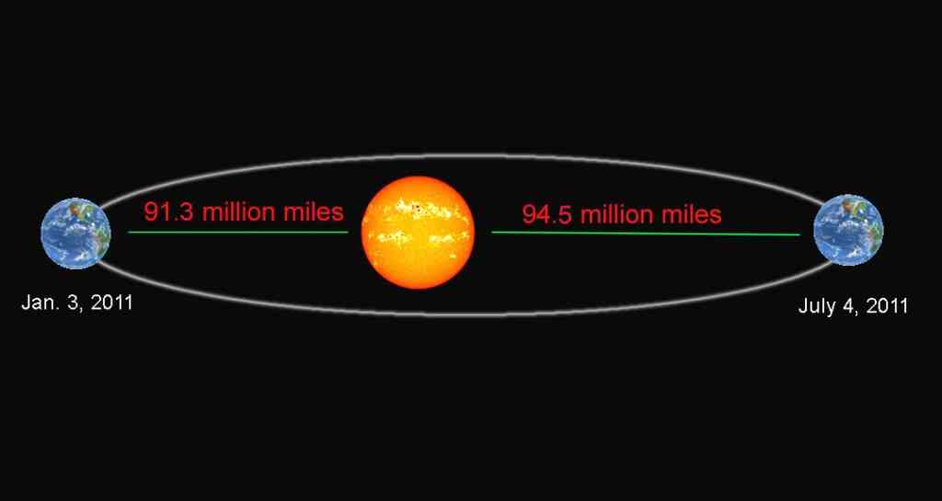
Distance of earth to sun...
If this distance was thickness of one sheet of paper …

Slide 16
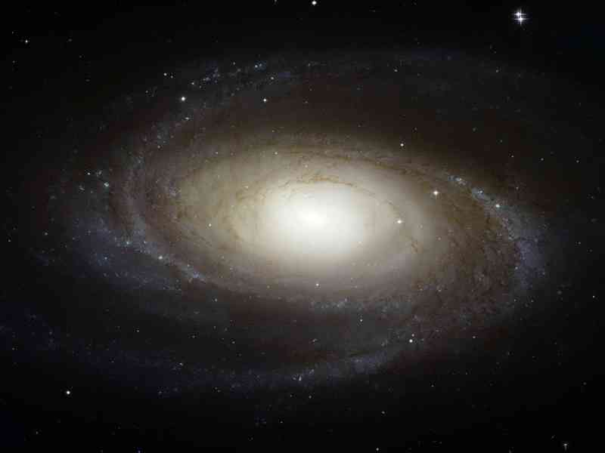
Compared to our galaxy...
Diameter of Milky Way would be a stack of paper 310 miles high..

Slide 17
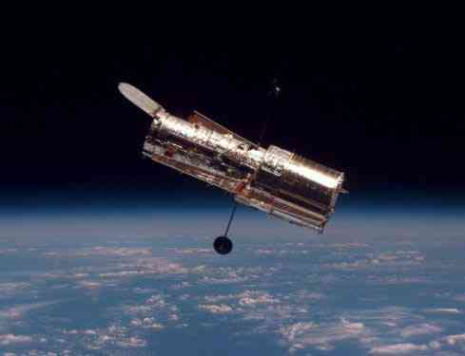
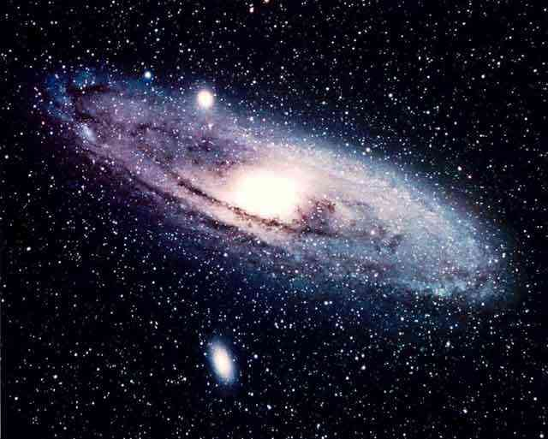
Hebrews 1:3 who upholding all things by the word of His power, when He had by Himself purged our sins, sat down at the right hand of the Majesty on high,

Slide 18
2 A New Identity ..
Luke 9:23-25 Then He said to them all, "If anyone desires to come after Me, let him deny himself, and take up his cross daily, and follow Me.
24 For whoever desires to save his life will lose it, but whoever loses his life for My sake will save it. (psyche = your old self)
25 For what profit is it to a man if he gains the whole world, and is himself destroyed or lost?

Slide 19
2 A New Identity ..

Slide 20
2 A New Identity ..
To find who you really are, you’re going to have to lose yourself in serving Me..
Not through ..
Gaining things from the world ..
A lucrative career ..
Marriage, family..

Slide 21
3 A New Mercy ..
Luke 9:51-54 Now it came to pass, when the time had come for Him to be received up, that He steadfastly set His face to go to Jerusalem, 52 and sent messengers before His face. And as they went, they entered a village of the Samaritans, to prepare for Him. 53 But they did not receive Him, because His face was set for the journey to Jerusalem. 54 And when His disciples James and John saw this, they said, "Lord, do You want us to command fire to come down from heaven and consume them, just as Elijah did?"

Slide 22
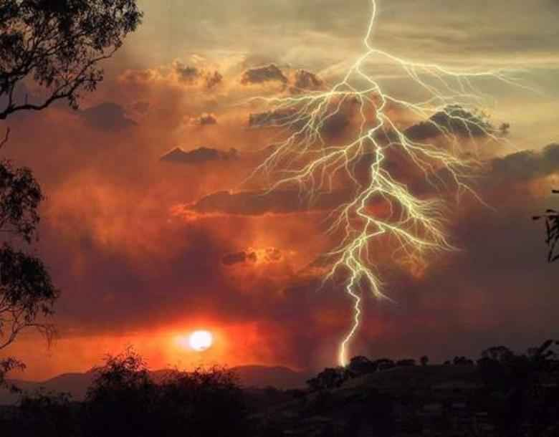
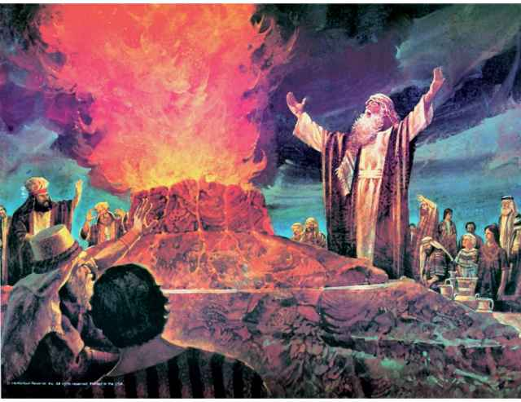
Call fire from heaven?

Slide 23
Call fire from heaven?
Luke 12:49-50 "I came to send fire on the earth, and how I wish it were already kindled! 50 But I have a baptism to be baptized with, and how distressed I am till it is accomplished!
Luke 9:22 "The Son of Man must suffer many things, and be rejected by the elders and chief priests and scribes, and be killed, and be raised the third day."

Slide 24
Heart must be changed within..

Slide 25
Being a disciple ..
Not an option ..
"If anyone desires to come after Me, let him deny himself, and take up his cross daily, and follow Me.

Slide 26
Being a disciple ..
It is a journey …
Luke 9:51 Now it came to pass, when the time had come for Him to be received up, that He steadfastly set His face to go to Jerusalem...

Slide 27
Being a disciple ..
The sign of true disciples is gentleness
Luke 9:54-56 And when His disciples James and John saw this, they said, "Lord, do You want us to command fire to come down from heaven and consume them, just as Elijah did?" 55 But He turned and rebuked them, and said, "You do not know what manner of spirit you are of. 56 For the Son of Man did not come to destroy men's lives but to save them." And they went to another village.

Slide 28
The Call to Discipleship
Luke 9:57-62

