Slide 1
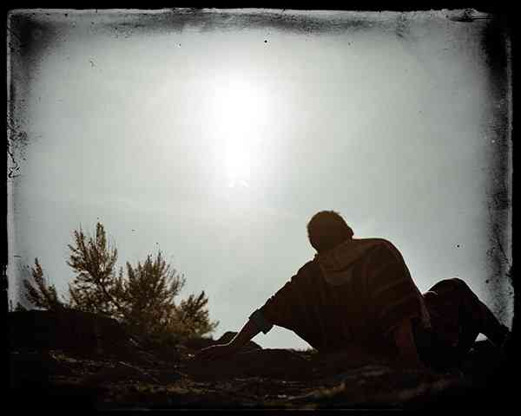
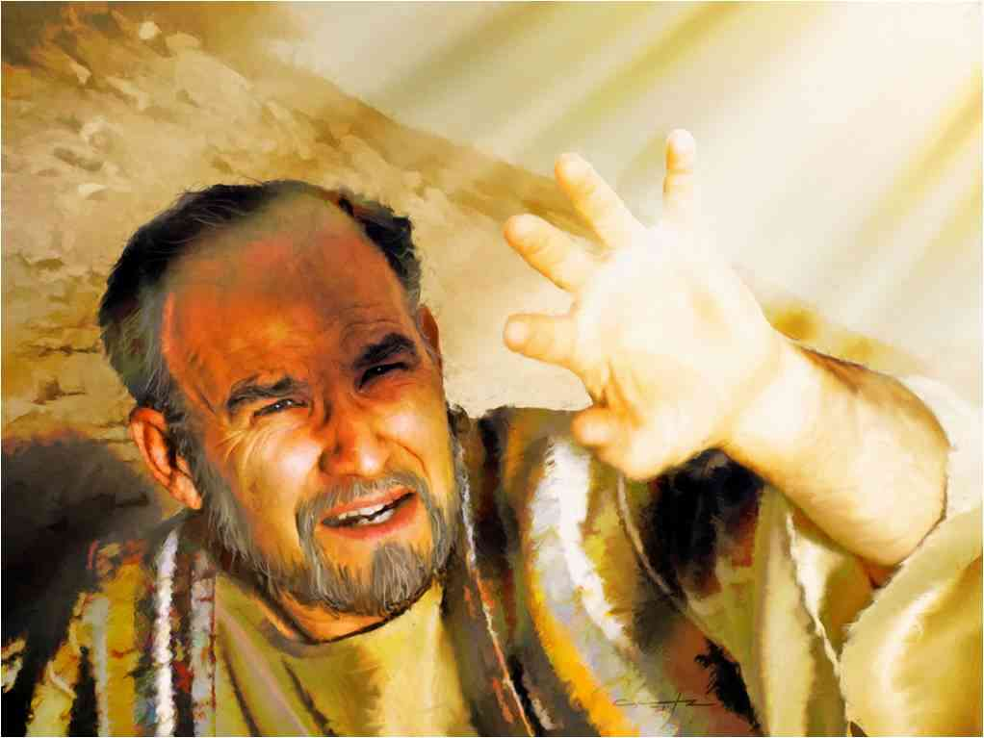
Kicking Against the Goads
Acts 9

Slide 2
Conversion of Saul..
Acts 9 Luke’s account ..
Acts 22 Paul’s defense to fellow Jews
Acts 26 Defense before Felix and Agrippa

Slide 3
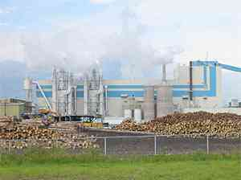
Conversion …
Process of converting one item to something completely different …
Matthew 18:3 unless you are converted and become as little children, you will by no means enter the kingdom of heaven.

Slide 4
Was Saul’s conversion typical or atypical?
Supernatural events .. blinding light and voice from heaven ..
Resurrection appearance .. 1 Cor 15:8
Other features are applicable ..
Personal encounter with Jesus
Surrender to Him in penitent obedient faith
New life of humble service

Slide 5
A Proof of Christianity..
Baron George Lyttleton’s letter to Gilbert West (1845)

Slide 6
Saul’s preconversion state..
Acts 9:1-2 Then Saul, still breathing threats and murder against the disciples of the Lord, went to the high priest 2 and asked letters from him to the synagogues of Damascus, so that if he found any who were of the Way, whether men or women, he might bring them bound to Jerusalem.

Slide 7
His state of mind…
Acts 7:58 they cast him out of the city and stoned him. And the witnesses laid down their clothes at the feet of a young man named Saul.
Acts 8:1 Now Saul was consenting to his death.
Acts 8:3 As for Saul, he made havoc of the church, entering every house, and dragging off men and women, committing them to prison.

Slide 8
Saul’s preconversion state..
Acts 9:1-2 Then Saul, still breathing threats and murder against the disciples of the Lord, went to the high priest 2 and asked letters from him to the synagogues of Damascus, so that if he found any who were of the Way, whether men or women, he might bring them bound to Jerusalem.

Slide 9
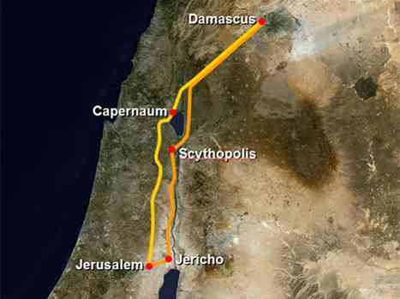

Slide 10
Followers of the Way..
John 14:6 "I am the way, the truth, and the life. No one comes to the Father except through Me.
Acts 19:9 when some were hardened and did not believe, but spoke evil of the Way before the multitude,
Acts 22:4 I persecuted this Way to the death, binding and delivering into prisons both men and women,
Acts 24:14 But this I confess to you, that according to the Way which they call a sect, so I worship the God of my fathers, believing all things which are written in the Law and in the Prophets.

Slide 11
Extent of his efforts..
Acts 26:9-11 "Indeed, I myself thought I must do many things contrary to the name of Jesus of Nazareth. 10 This I also did in Jerusalem, and many of the saints I shut up in prison, having received authority from the chief priests; and when they were put to death, I cast my vote against them. 11 And I punished them often in every synagogue and compelled them to blaspheme; and being exceedingly enraged against them, I persecuted them even to foreign cities.

Slide 12
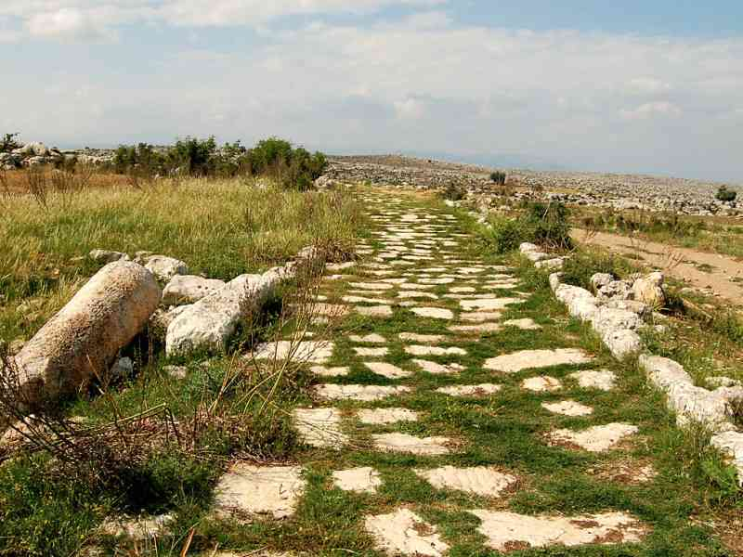
Factors in his conversion..
The power of God …
3 As he journeyed he came near Damascus, and suddenly a light shone around him from heaven. 4 Then he fell to the ground, and heard a voice saying to him, "Saul, Saul, why are you persecuting Me?"

Slide 13
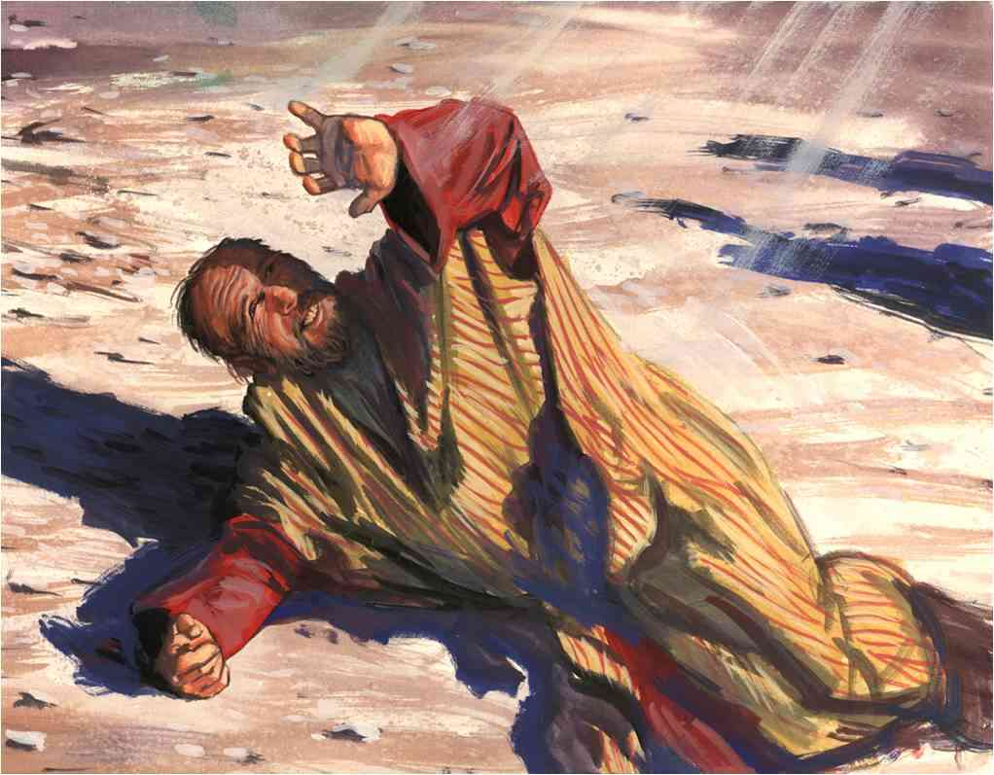
Factors in his conversion..
Confrontation with Jesus ..
5 And he said, "Who are You, Lord?" Then the Lord said, "I am Jesus, whom you are persecuting..

Slide 14
Factors in his conversion..
Struggling conscience ..
5 It is hard for you to kick against the goads." 6 So he, trembling and astonished, said, "Lord, what do You want me to do?" Then the Lord said to him, "Arise and go into the city, and you will be told what you must do."

Slide 15
Factors in his conversion..
What were these goads?
His own growing doubts concerning Jesus..
The integrity of Stephen .. Acts 7:58-60
Awareness of his own sin .. Romans 7:7-9

Slide 16
Factors in his conversion..
God’s grace and directions ..
" 6 So he, trembling and astonished, said, "Lord, what do You want me to do?" Then the Lord said to him, "Arise and go into the city, and you will be told what you must do."
7 And the men who journeyed with him stood speechless, hearing a voice but seeing no one. 8 Then Saul arose from the ground, and when his eyes were opened he saw no one. But they led him by the hand and brought him into Damascus. 9 And he was three days without sight, and neither ate nor drank.

Slide 17
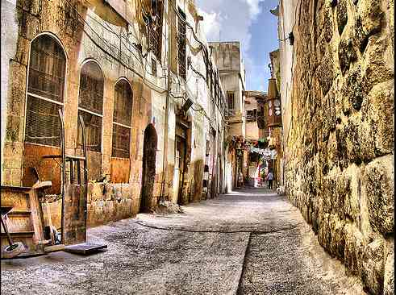
Saul in Damascus…
10 Now there was a certain disciple at Damascus named Ananias; and to him the Lord said in a vision, "Ananias." And he said, "Here I am, Lord." 11 So the Lord said to him, "Arise and go to the street called Straight, and inquire at the house of Judas for one called Saul of Tarsus, for behold, he is praying. 12 And in a vision he has seen a man named Ananias coming in and putting his hand on him, so that he might receive his sight."

Slide 18
Saul in Damascus…
13 Then Ananias answered, "Lord, I have heard from many about this man, how much harm he has done to Your saints in Jerusalem. 14 And here he has authority from the chief priests to bind all who call on Your name." 15 But the Lord said to him, "Go, for he is a chosen vessel of Mine to bear My name before Gentiles, kings, and the children of Israel. 16 For I will show him how many things he must suffer for My name's sake."

Slide 19
Saul in Damascus…
17 And Ananias went his way and entered the house; and laying his hands on him he said, "Brother Saul, the Lord Jesus, who appeared to you on the road as you came, has sent me that you may receive your sight and be filled with the Holy Spirit." 18 Immediately there fell from his eyes something like scales, and he received his sight at once; and he arose and was baptized.

Slide 20
Evidence of conversion..
New reverence for God (vs. 11 behold he is praying)
Received his eyesight, ate food ..
New relationship with the church .. (vs. 19-22)
Time alone with God in Arabia ..
Preaching the faith he once opposed …

Slide 21
His visit to Jerusalem..
20 Immediately he preached the Christ in the synagogues, that He is the Son of God. 21 Then all who heard were amazed, and said, "Is this not he who destroyed those who called on this name in Jerusalem, and has come here for that purpose, so that he might bring them bound to the chief priests?" 22 But Saul increased all the more in strength, and confounded the Jews who dwelt in Damascus, proving that this Jesus is the Christ.

Slide 22
His visit to Jerusalem..
23 Now after many days were past, the Jews plotted to kill him. 24 But their plot became known to Saul. And they watched the gates day and night, to kill him. 25 Then the disciples took him by night and let him down through the wall in a large basket.

Slide 23
His visit to Jerusalem..
26 And when Saul had come to Jerusalem, he tried to join the disciples; but they were all afraid of him, and did not believe that he was a disciple. 27 But Barnabas took him and brought him to the apostles. And he declared to them how he had seen the Lord on the road, and that He had spoken to him, and how he had preached boldly at Damascus in the name of Jesus. 28 So he was with them at Jerusalem, coming in and going out. 29 And he spoke boldly in the name of the Lord Jesus and disputed against the Hellenists, but they attempted to kill him.

Slide 24
His visit to Jerusalem..
30 When the brethren found out, they brought him down to Caesarea and sent him out to Tarsus.
31 Then the churches throughout all Judea, Galilee, and Samaria had peace and were edified. And walking in the fear of the Lord and in the comfort of the Holy Spirit, they were multiplied.

Slide 25
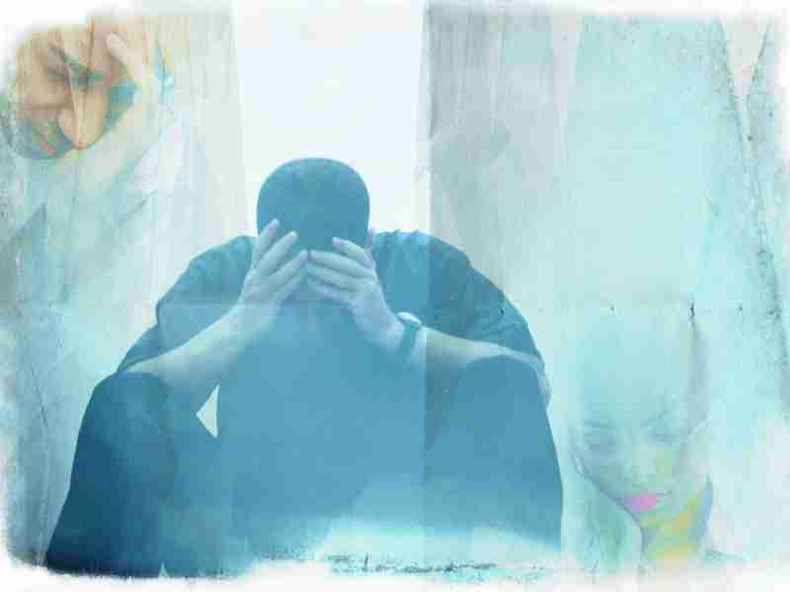
Compare your conversion?
Converted as an adult like Saul or grew up in a Christian home?
Personal genuine conviction and unswerving commitment to Jesus?
Readiness to go where he leads ..

Slide 26
Kicking Against the Goads
Acts 9

