Slide 1
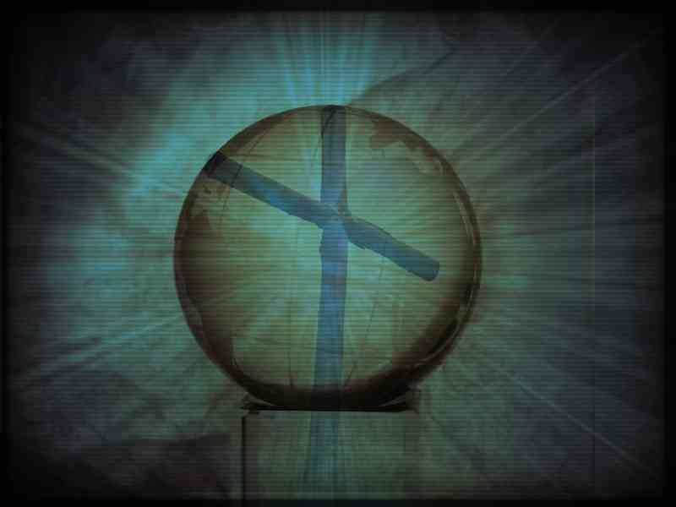
Unstoppable Devotion
Acts 2:42-47, 4:18-35

Slide 2
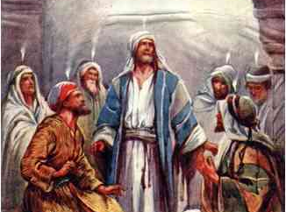
Pentecost..
Acts 2:1-4 they were all filled with the Holy Spirit and began to speak with other tongues, as the Spirit gave them utterance.

Slide 3
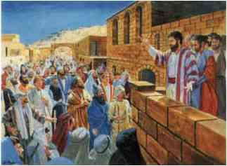
Preaching the word..
Acts 2:22-24 "Men of Israel, hear these words: Jesus of Nazareth, a Man attested by God — 23 being delivered by the determined purpose and fore-knowledge of God, you have taken by lawless hands, have crucified, and put to death; 24 whom God raised up, having loosed the pains of death, because it was not possible that He should be held by it.

Slide 4
Conversion of 3000 ..
Acts 2:37-38 Now when they heard this, they were cut to the heart, and said to Peter and the rest of the apostles, "Men and brethren, what shall we do?" 38 Then Peter said to them, "Repent, and let every one of you be baptized in the name of Jesus Christ for the remission of sins; and you shall receive the gift of the Holy Spirit.

Slide 5
The original church..
Acts 2:41-42 Then those who gladly received his word were baptized; and that day about three thousand souls were added to them. 42 And they continued steadfastly in the apostles' doctrine and fellowship, in the breaking of bread, and in prayers.

Slide 6
Terms of salvation..
First case of conversion ..
Faith, repentance, baptism
Gladly received word
2 Timothy 1:13-14 Hold fast the pattern of sound words which you have heard from me, in faith and love which are in Christ Jesus. 14 That good thing which was committed to you, keep by the Holy Spirit who dwells in us.

Slide 7
Remaining faithful…
Well balanced spiritual diet ..
Bible Study
Apostles’ doctrine
Togetherness
Fellowship
“Koinonia”
Worship
Breaking of bread
Lord’s Supper
Daily Walk
Prayer

Slide 8
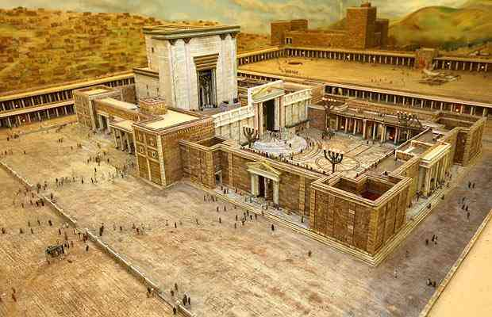
Unselfish devotion..
Acts 2:44-47 Now all who believed were together, and had all things in common, 45 and sold their possessions and goods, and divided them among all, as anyone had need. 46 So continuing daily with one accord in the temple, and breaking bread from house to house, they ate their food with gladness and simplicity of heart, 47 praising God and having favor with all the people. And the Lord added to the church daily those who were being saved.

Slide 9
Unselfish devotion..
1 Corinthians 16:1-2 On the first day of the week let each one of you lay something aside, storing up as he may prosper, that there be no collections when I come.
2 Corinthians 9:6-7 But this I say: He who sows sparingly will also reap sparingly, and he who sows bountifully will also reap bountifully. 7 So let each one give as he purposes in his heart, not grudgingly or of necessity; for God loves a cheerful giver.
1 John 3:16-17 By this we know love, because He laid down His life for us. And we also ought to lay down our lives for the brethren. 17 But whoever has this world's goods, and sees his brother in need, and shuts up his heart from him, how does the love of God abide in him?

Slide 10
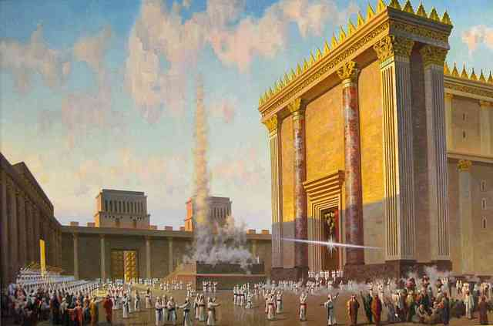
Priorities of apostles..
Time for people, time for prayer..
Acts 3:1-6 Now Peter and John went up together to the temple at the hour of prayer, the ninth hour. 2 And a certain man lame from his mother's womb was carried, whom they laid daily at the gate of the temple which is called Beautiful, to ask alms from those who entered the temple; 3 who, seeing Peter and John about to go into the temple, asked for alms. 4 And fixing his eyes on him, with John, Peter said, "Look at us." 5 So he gave them his attention, expecting to receive something from them. 6 Then Peter said, "Silver and gold I do not have, but what I do have I give you: In the name of Jesus Christ of Nazareth, rise up and walk."

Slide 11
The joy of changed lives..
Acts 3:7-11 And he took him by the right hand and lifted him up, and immediately his feet and ankle bones received strength. 8 So he, leaping up, stood and walked and entered the temple with them — walking, leaping, and praising God. 9 And all the people saw him walking and praising God. 10 Then they knew that it was he who sat begging alms at the Beautiful Gate of the temple; and they were filled with wonder and amazement at what had happened to him. 11 Now as the lame man who was healed held on to Peter and John, all the people ran together to them in the porch which is called Solomon's, greatly amazed.

Slide 12
The name of Jesus..
Acts 3:12-16 So when Peter saw it, he responded to the people: "Men of Israel, why do you marvel at this? Or why look so intently at us, as though by our own power or godliness we had made this man walk? 13 The God of Abraham, Isaac, and Jacob, the God of our fathers, glorified His Servant Jesus, whom you delivered up and denied in the presence of Pilate, when he was determined to let Him go. 14 But you denied the Holy One and the Just, and asked for a murderer to be granted to you, 15 and killed the Prince of life, whom God raised from the dead, of which we are witnesses. 16 And His name, through faith in His name, has made this man strong, whom you see and know. Yes, the faith which comes through Him has given him this perfect soundness in the presence of you all.

Slide 13
2nd Sermon Conversion..
Acts 3:17-21 "Yet now, brethren, I know that you did it in ignorance, as did also your rulers. 18 But those things which God foretold by the mouth of all His prophets, that the Christ would suffer, He has thus fulfilled. 19 Repent therefore and be converted, that your sins may be blotted out, so that times of refreshing may come from the presence of the Lord, 20 and that He may send Jesus Christ, who was preached to you before, 21 whom heaven must receive until the times of restoration of all things, which God has spoken by the mouth of all His holy prophets since the world began.

Slide 14
Courage facing opposition..
Acts 4:1-4 Now as they spoke to the people, the priests, the captain of the temple, and the Sadducees came upon them, 2 being greatly disturbed that they taught the people and preached in Jesus the resurrection from the dead. 3 And they laid hands on them, and put them in custody until the next day, for it was already evening. 4 However, many of those who heard the word believed; and the number of the men came to be about five thousand.

Slide 15
Courage facing opposition..
Acts 4:7-12 And when they had set them in the midst, they asked, "By what power or by what name have you done this?" 8 Then Peter, filled with the Holy Spirit, said to them, "Rulers of the people and elders of Israel: 9 If we this day are judged for a good deed done to a helpless man, by what means he has been made well, 10 let it be known to you all, and to all the people of Israel, that by the name of Jesus Christ of Nazareth, whom you crucified, whom God raised from the dead, by Him this man stands here before you whole. 11 This is the 'stone which was rejected by you builders, which has become the chief cornerstone.' 12 Nor is there salvation in any other, for there is no other name under heaven given among men by which we must be saved."

Slide 16
Their boldness..
Acts 4:13-16 Now when they saw the boldness of Peter and John, and perceived that they were uneducated and untrained men, they marveled. And they realized that they had been with Jesus. 14 And seeing the man who had been healed standing with them, they could say nothing against it. 15 But when they had commanded them to go aside out of the council, they conferred among themselves, 16 saying, "What shall we do to these men? For, indeed, that a notable miracle has been done through them is evident to all who dwell in Jerusalem, and we cannot deny it.

Slide 17
Their boldness..
Acts 4:18-20 So they called them and commanded them not to speak at all nor teach in the name of Jesus. 19 But Peter and John answered and said to them, "Whether it is right in the sight of God to listen to you more than to God, you judge. 20 For we cannot but speak the things which we have seen and heard."

Slide 18
Their boldness..
Acts 4:18-20 So they called them and commanded them not to speak at all nor teach in the name of Jesus. 19 But Peter and John answered and said to them, "Whether it is right in the sight of God to listen to you more than to God, you judge. 20 For we cannot but speak the things which we have seen and heard."

Slide 19
Their boldness..
Acts 4:23-31 And being let go, they went to their own companions and reported all that the chief priests and elders had said to them. 24 So when they heard that, they raised their voice to God with one accord and said: "Lord, You are God, who made heaven and earth and the sea, and all that is in them...29 Now, Lord, look on their threats, and grant to Your servants that with all boldness they may speak Your word, 30 by stretching out Your hand to heal, and that signs and wonders may be done through the name of Your holy Servant Jesus." 31 And when they had prayed, the place where they were assembled together was shaken; and they were all filled with the Holy Spirit, and they spoke the word of God with boldness.

Slide 20
Their unity..
Acts 4:32-35 Now the multitude of those who believed were of one heart and one soul; neither did anyone say that any of the things he possessed was his own, but they had all things in common. 33 And with great power the apostles gave witness to the resurrection of the Lord Jesus. And great grace was upon them all. 34 Nor was there anyone among them who lacked; for all who were possessors of lands or houses sold them, and brought the proceeds of the things that were sold, 35 and laid them at the apostles' feet; and they distributed to each as anyone had need.

Slide 22
Unstoppable Devotion The Church in Jerusalem
Acts 2:42-47, 4:18-35

