Slide 1
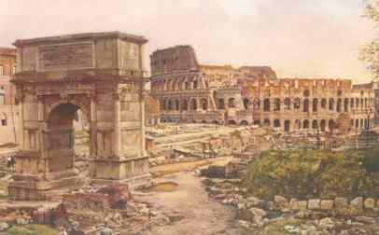
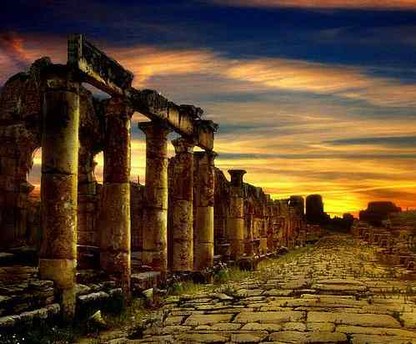
Taking Christ to Rome
Acts 21 - 28

Slide 2
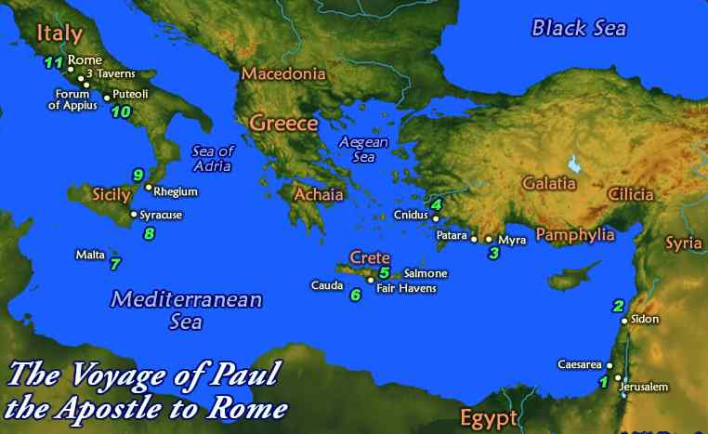
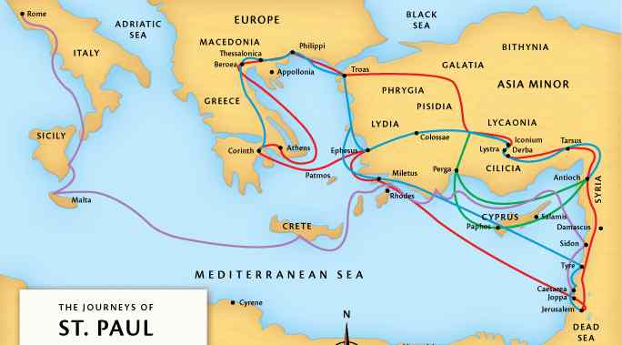
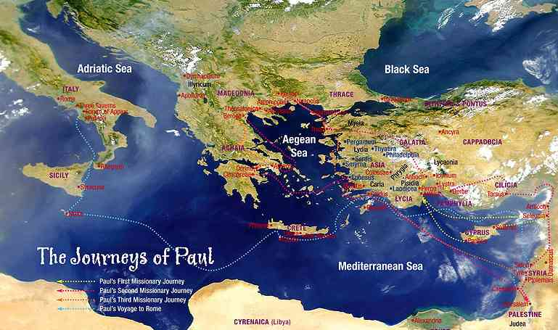
Why Rome? ..

Slide 3
Acts 20-21 ..
Paul sails from Ephesus to Jerusalem…

Slide 4
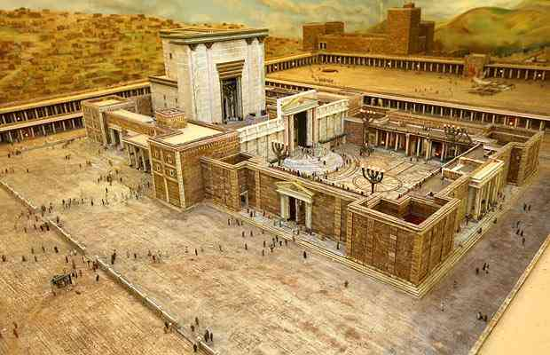
Paul arrested..
21:27-30 And all the city was disturbed; and the people ran together, seized Paul, and dragged him out of the temple..
31 as they were seeking to kill him, news came to the commander of the garrison that all Jerusalem was in an uproar.

Slide 5
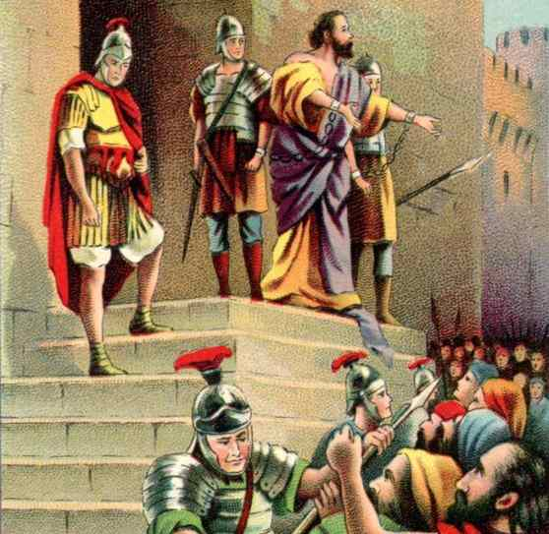
Paul’s defense..
21 Then He said to me, 'Depart, for I will send you far from here to the Gentiles.'"
22 And they listened to him until this word, and then they raised their voices and said, "Away with such a fellow from the earth, for he is not fit to live!“
Acts 22:25 And as they bound him with thongs, Paul said to the centurion who stood by, "Is it lawful for you to scourge a man who is a Roman, and uncondemned?"

Slide 6
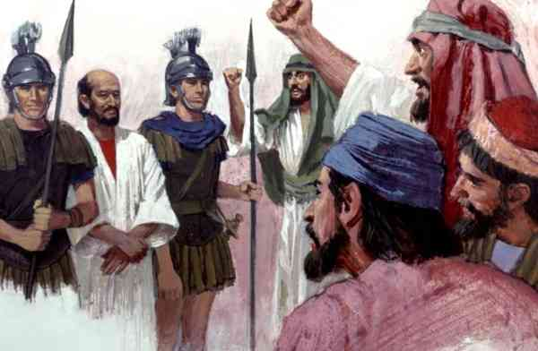
Sanhedrin..
Acts 23:9-11 when there arose a great dissension, the commander, fearing lest Paul might be pulled to pieces by them, commanded the soldiers to go down and take him by force from among them, and bring him into the barracks.
11 But the following night the Lord stood by him and said, "Be of good cheer, Paul; for as you have testified for Me in Jerusalem, so you must also bear witness at Rome."

Slide 7
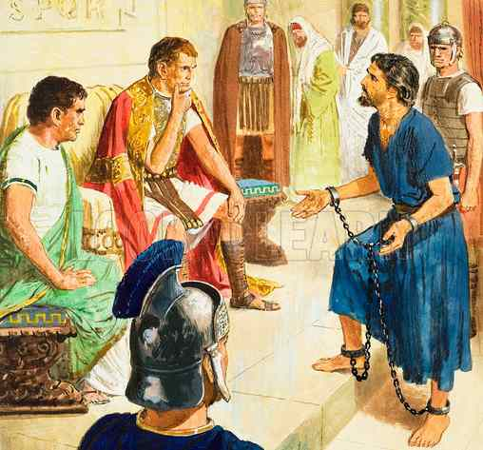
Caesarea ..
Acts 24:22 But when Felix heard these things..and said, "When Lysias the commander comes down, I will make a decision on your case."
27 But after two years Porcius Festus succeeded Felix; and Felix, wanting to do the Jews a favor, left Paul bound.

Slide 8
Caesarea ..
Acts 25:9-11 Festus said, "Are you willing to go up to Jerusalem and there be judged before me concerning these things?"
10 So Paul said, “I appeal to Caesar."
Acts 26:31-32 when they had gone aside, they talked among themselves, saying, "This man is doing nothing deserving of death or chains." 32 Then Agrippa said to Festus, "This man might have been set free if he had not appealed to Caesar."

Slide 9
Voyage and shipwreck..
Acts 27:23-24 For there stood by me this night an angel of the God to whom I belong and whom I serve, 24 saying, 'Do not be afraid, Paul; you must be brought before Caesar; and indeed God has granted you all those who sail with you.'

Slide 10
Arrival in Rome..
28:16 Now when we came to Rome, the centurion delivered the prisoners to the captain of the guard; but Paul was permitted to dwell by himself with the soldier who guarded him.
28 "Therefore let it be known to you that the salvation of God has been sent to the Gentiles, and they will hear it!" 29 And when he had said these words, the Jews departed and had a great dispute among themselves.
30 Then Paul dwelt two whole years in his own rented house, and received all who came to him, 31 preaching the kingdom of God and teaching the things which concern the Lord Jesus Christ with all confidence, no one forbidding him.

Slide 11
Why Rome?..
The center of the world .. strategic to worldwide evangelism (Acts 28:19-20)
The rejection of the gospel by the Jews helped fulfill God’s promise to Abraham (Gen. 12:3 .. all nations)

Slide 12
How does it affect you?
God made you to live for His glory and praise, love Him, live in submission..
Behooves you to see the movement of the gospel, what is going on in the world..
See how we can take advantage of living in Rome today.. opportunities God provides..

Slide 13
Why Paul?..
Acts 9:15 "he is a chosen vessel of Mine to bear My name before Gentiles, kings, and the children of Israel.
His background .. Judaism, Greek speaking, Roman citizen by birth..
His tenacious courage to keep speaking the gospel every opportunity..

Slide 14
Why Paul?..
Acts 26:27-28 King Agrippa, do you believe the prophets? I know that you do believe." 28 Then Agrippa said to Paul, "You almost persuade me to become a Christian."
29 And Paul said, "I would to God that not only you, but also all who hear me today, might become both almost and altogether such as I am, except for these chains."

Slide 15
What he gave his life for..
Acts 20:23-26 But none of these things move me; nor do I count my life dear to myself, so that I may finish my race with joy, and the ministry which I received from the Lord Jesus, to testify to the gospel of the grace of God.
What are you giving your life for?
We are not Paul but we all have responsibility
1 Pet 3:15; Matt 28:18-20; Rom 10:14-17

Slide 16
What is the Gospel?
Proclaiming Jesus the only hope.. Acts 24:24-25; 26:15-28; 28:23-24, 31
Promised Messiah 26:23
Would suffer and rise from dead 23:7-9; 25:19
Who is saved? 24:24; 26:18; 28:24
Do you believe it is the truth?

Slide 17
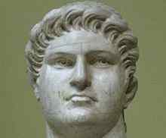
Which emperor did Paul preach to?
Nero (54-68)
Paul’s trial (64-65)
Nero took his own life 3 yrs later ..

Slide 18
Why did God want the Gospel preached in Rome?
The gospel to whole world..
Shift from Jerusalem to Rome..
A warning to earthly kings and kingdoms..

Slide 19
Taking Christ to Rome
Acts 21 - 28

