Slide 1
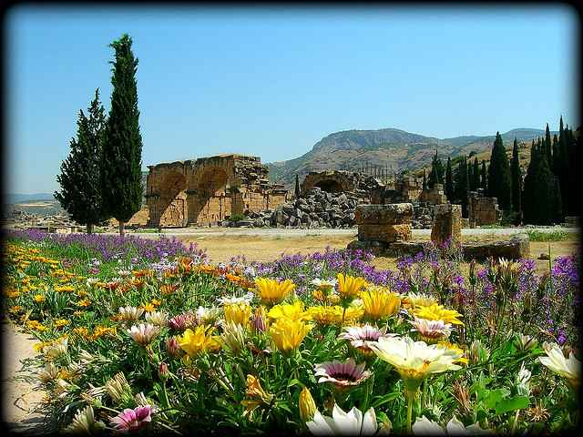
The Gospel in a Pagan World
Acts 13-15

Slide 2
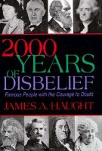
Celebrating unbelief..
Evidence unbelief growing worldwide
Western Europe, Japan … mere fringe
Sweden, Denmark .. 19%, Germans 24%, Italy 26% (America 66%)
England – only 1 million attend church
Liberalization of churches
Increase of explicit sex in films
“Death of Christianity” (?)

Slide 3
Book of Acts …
Earliest history of the church ..
Luke, a Gentile convert (2 volumes)..
Timeline …
Jesus’ death, resurrection – 30 A.D.
Day of Pentecost (Acts 2) – 30 A.D.
Conversion of Saul – 33-34 A.D.
Now about 15 years later – 47-48 A.D.

Slide 4
Early success of gospel..
Jerusalem church grew amid opposition
Death of Stephen.. Saul’s conversion
Gospel in Samaria, Judea ..
1st Gentiles (Acts 10-11) ..
How will the gospel do when it faces ..
Forceful opposition ..
False doctrine ..
Falling out among its leaders ..

Slide 5
The Gospel survives forceful opposition… 13-14
1
Acts 13:1-4 Now in the church that was at Antioch there were certain prophets and teachers: Barnabas, Simeon who was called Niger, Lucius of Cyrene, Manaen who had been brought up with Herod the tetrarch, and Saul. 2 As they ministered to the Lord and fasted, the Holy Spirit said, "Now separate to Me Barnabas and Saul for the work to which I have called them." 3 Then, having fasted and prayed, and laid hands on them, they sent them away.

Slide 6
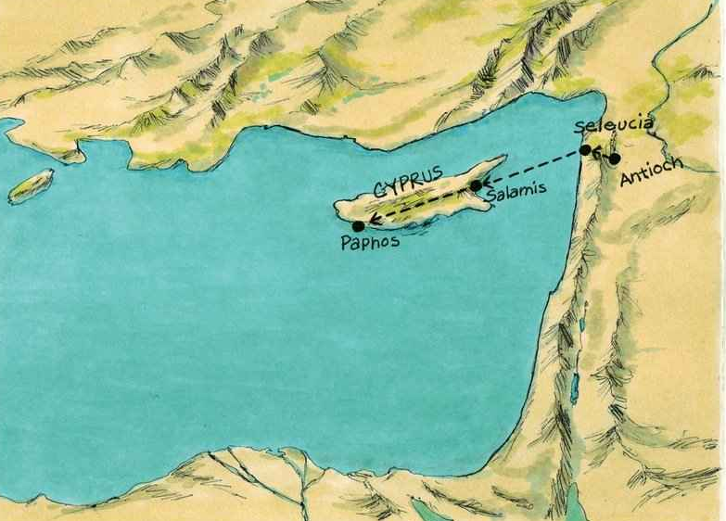
First missionary journey…

Slide 7
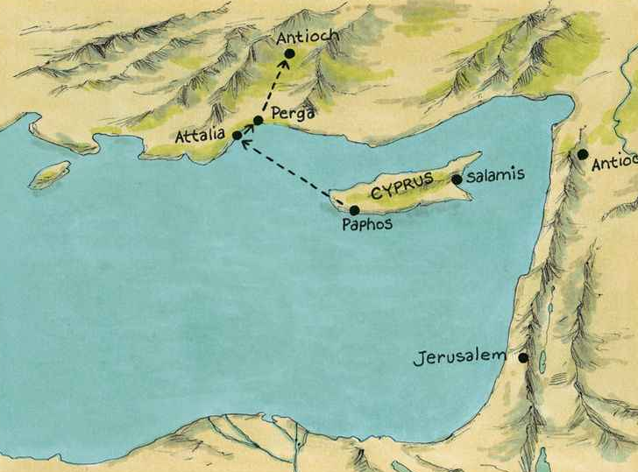

Slide 8
Paul’s first sermon…
Acts 13:26ff "Men and brethren, sons of the family of Abraham, and those among you who fear God, to you the word of this salvation has been sent. 27 For those who dwell in Jerusalem, and their rulers, because they did not know Him, nor even the voices of the Prophets which are read every Sabbath, have fulfilled them in condemning Him. 28 And though they found no cause for death in Him, they asked Pilate that He should be put to death…

Slide 9
Paul’s first sermon…
29 Now when they had fulfilled all that was written concerning Him, they took Him down from the tree and laid Him in a tomb. 30 But God raised Him from the dead. 31 He was seen for many days by those who came up with Him from Galilee to Jerusalem, who are His witnesses to the people. 32 And we declare to you glad tidings — that promise which was made to the fathers. 33 God has fulfilled this for us their children, in that He has raised up Jesus. As it is also written in the second Psalm: 'You are My Son, Today I have begotten You.'

Slide 10
Paul’s first sermon…
34 And that He raised Him from the dead, no more to return to corruption, He has spoken thus: 'I will give you the sure mercies of David.' 35 Therefore He also says in another Psalm: 'You will not allow Your Holy One to see corruption.' 36 "For David, after he had served his own generation by the will of God, fell asleep, was buried with his fathers, and saw corruption; 37 but He whom God raised up saw no corruption.

Slide 11
Promise of salvation …
Acts 13:38-41 Therefore let it be known to you, brethren, that through this Man is preached to you the forgiveness of sins; 39 and by Him everyone who believes is justified from all things from which you could not be justified by the law of Moses. 40 Beware therefore, lest what has been spoken in the prophets come upon you: 41 'Behold, you despisers, Marvel and perish! For I work a work in your days, A work which you will by no means believe, Though one were to declare it to you.'"

Slide 12
Response to the word …
42 So when the Jews went out of the synagogue, the Gentiles begged that these words might be preached to them the next Sabbath. 43 Now when the congregation had broken up, many of the Jews and devout proselytes followed Paul and Barnabas, who, speaking to them, persuaded them to continue in the grace of God.

Slide 13
Rejection …
44 On the next Sabbath almost the whole city came together to hear the word of God. 45 But when the Jews saw the multitudes, they were filled with envy; and contradicting and blaspheming, they opposed the things spoken by Paul. 46 Then Paul and Barnabas grew bold and said, "It was necessary that the word of God should be spoken to you first; but since you reject it, and judge yourselves unworthy of everlasting life, behold, we turn to the Gentiles. 47 For so the Lord has commanded us: 'I have set you as a light to the Gentiles, That you should be for salvation to the ends of the earth.'"

Slide 14
The Gospel survives …
48 Now when the Gentiles heard this, they were glad and glorified the word of the Lord. And as many as had been appointed to eternal life believed.
49 And the word of the Lord was being spread throughout all the region. 50 But the Jews stirred up the devout and prominent women and the chief men of the city, raised up persecution against Paul and Barnabas, and expelled them from their region. 51 But they shook off the dust from their feet against them, and came to Iconium. 52 And the disciples were filled with joy and with the Holy Spirit.

Slide 15
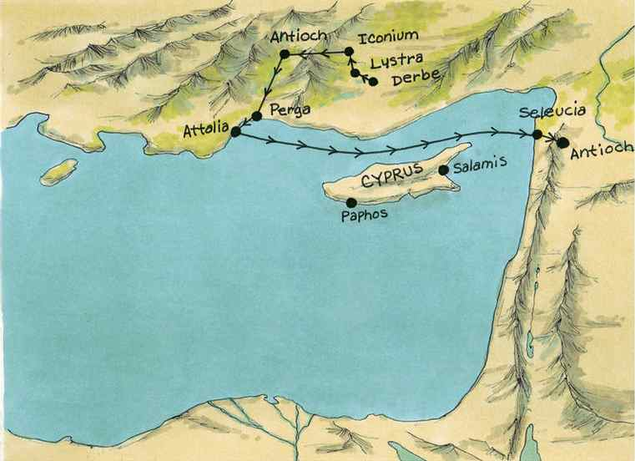
Acts 14 ..

Slide 16
Iconium, Lystra..
Acts 14:1-3 Now it happened in Iconium that they went together to the synagogue of the Jews, and so spoke that a great multitude both of the Jews and of the Greeks believed. 2 But the unbelieving Jews stirred up the Gentiles and poisoned their minds against the brethren. 3 Therefore they stayed there a long time, speaking boldly in the Lord, who was bearing witness to the word of His grace, granting signs and wonders to be done by their hands.

Slide 17
Iconium, Lystra..
8 And in Lystra a certain man without strength in his feet was sitting, a cripple from his mother's womb, who had never walked. 9 This man heard Paul speaking. Paul, observing him intently and seeing that he had faith to be healed, 10 said with a loud voice, "Stand up straight on your feet!" And he leaped and walked. 11 Now when the people saw what Paul had done, they raised their voices, saying in the Lycaonian language, "The gods have come down to us in the likeness of men!"

Slide 18
Iconium, Lystra..
And the next day he departed with Barnabas to Derbe. 21 And when they had preached the gospel to that city and made many disciples, they returned to Lystra, Iconium, and Antioch, 22 strengthening the souls of the disciples, exhorting them to continue in the faith, and saying, "We must through many tribulations enter the kingdom of God."

Slide 19
Return to Antioch..
Acts 14:24-28 And after they had passed through Pisidia, they came to Pamphylia. 25 Now when they had preached the word in Perga, they went down to Attalia. 26 From there they sailed to Antioch, where they had been commended to the grace of God for the work which they had completed.
27 Now when they had come and gathered the church together, they reported all that God had done with them, and that He had opened the door of faith to the Gentiles. 28 So they stayed there a long time with the disciples.

Slide 20
Four things of notice..
Their doctrine … authority of scripture, confidence of God in control ..
The Word of God (13:5, 15, 26, 44, 46-49)
Preach message of Christ as Savior 13:48
Their character of joy .. 13:48,52
Their organization and planning .. 14:23
Persecution is expected .. 14:22 (intensifying, but the gospel survives)

Slide 21
The Gospel survives false doctrine … Acts 15
2
Acts 15:1-2 And certain men came down from Judea and taught the brethren, "Unless you are circumcised according to the custom of Moses, you cannot be saved." 2 Therefore, when Paul and Barnabas had no small dissension and dispute with them, they determined that Paul and Barnabas and certain others of them should go up to Jerusalem, to the apostles and elders, about this question.

Slide 22
The Gospel survives false doctrine … Acts 15
2
3 So, being sent on their way by the church, they passed through Phoenicia and Samaria, describing the conversion of the Gentiles; and they caused great joy to all the brethren. 4 And when they had come to Jerusalem, they were received by the church and the apostles and the elders; and they reported all things that God had done with them. 5 But some of the sect of the Pharisees who believed rose up, saying, "It is necessary to circumcise them, and to command them to keep the law of Moses."

Slide 23
The Gospel survives false doctrine … Acts 15
2
6 Now the apostles and elders came together to consider this matter. 7 And when there had been much dispute, Peter rose up and said to them: "Men and brethren, you know that a good while ago God chose among us, that by my mouth the Gentiles should hear the word of the gospel and believe. 8 So God, who knows the heart, acknowledged them by giving them the Holy Spirit, just as He did to us, 9 and made no distinction between us and them, purifying their hearts by faith. 10 Now therefore, why do you test God by putting a yoke on the neck of the disciples which neither our fathers nor we were able to bear? 11 But we believe that through the grace of the Lord Jesus Christ we shall be saved in the same manner as they."

Slide 24
The Gospel survives false doctrine … Acts 15
2
12 Then all the multitude kept silent and listened to Barnabas and Paul declaring how many miracles and wonders God had worked through them among the Gentiles.

Slide 25
The Gospel survives false doctrine … Acts 15
2
13 And after they had become silent, James answered, saying, "Men and brethren, listen to me: 14 Simon has declared how God at the first visited the Gentiles to take out of them a people for His name. 15 And with this the words of the prophets agree, just as it is written: 16 'After! this I will return And will rebuild the tabernacle of David, which has fallen down; I will rebuild its ruins, And I will set it up; 17 So that the rest of mankind may seek the Lord, Even all the Gentiles who are called by My name, Says the Lord who does all these things.'

Slide 26
Things to avoid..
24 Since we have heard that some who went out from us have troubled you with words, unsettling your souls, saying, "You must be circumcised and keep the law" — to whom we gave no such commandment — 25 it seemed good to us, being assembled with one accord, to send chosen men to you with our beloved Barnabas and Paul, 26 men who have risked their lives for the name of our Lord Jesus Christ. 27 We have therefore sent Judas and Silas, who will also report the same things by word of mouth. 28 For it seemed good to the Holy Spirit, and to us, to lay upon you no greater burden than these necessary things: 29 that you abstain from things offered to idols, from blood, from things strangled, and from sexual immorality. If you keep yourselves from these, you will do well.

Slide 27
Things to notice here..
Good pattern for studying doctrinal issues openly (not church councils)..
The question: What is required of Gentiles? What should they do in response to the gospel?
Peter’s conclusion 15:8-11; James agrees 19-20
Vs 20ff the apostles’ decree .. not trouble them beyond four things

Slide 28
Lessons from the apostles..
Nothing beyond what the Lord commanded (vs 24)
Importance of God’s grace (15:11)
Peter was no pope here ..
Involvement of the whole church ..
They did not minimize doctrine ..

Slide 29
The Gospel survives falling out among leaders..
3
Acts 15:36-41 Then after some days Paul said to Barnabas, "Let us now go back and visit our brethren in every city where we have preached the word of the Lord, and see how they are doing." 37 Now Barnabas was determined to take with them John called Mark. 38 But Paul insisted that they should not take with them the one who had departed from them in Pamphylia, and had not gone with them to the work. 39 Then the contention (paroxysm) became so sharp that they parted from one another. And so Barnabas took Mark and sailed to Cyprus; 40 but Paul chose Silas and departed, being commended by the brethren to the grace of God. 41 And he went through Syria and Cilicia, strengthening the churches.

Slide 30
The Gospel survives and thrives..
Revelation 22:1-5 And he showed me a pure river of water of life, clear as crystal, proceeding from the throne of God and of the Lamb. 2 In the middle of its street, and on either side of the river, was the tree of life, which bore twelve fruits, each tree yielding its fruit every month. The leaves of the tree were for the healing of the nations. 3 And there shall be no more curse, but the throne of God and of the Lamb shall be in it, and His servants shall serve Him. 4 They shall see His face, and His name shall be on their foreheads. 5 There shall be no night there: They need no lamp nor light of the sun, for the Lord God gives them light. And they shall reign forever and ever.

Slide 31
The Gospel survives falling out among leaders..
3
2 Timothy 4:11 Only Luke is with me. Get Mark and bring him with you, for he is useful to me for ministry.

Slide 32
The Gospel in a Pagan World
Acts 13-15

