Slide 1
The Heart of a Leader
1 Timothy 1-4

Slide 2
What makes good leaders?..
Research by husband-wife..
Quality of “surgency”..
Contrasting types …
Sociable, assertive, leaderlike, calm self-confidence, well organized, work hard, responsible..
Quiet, reserved, withdrawn, anxiety, insecure, impulsive, irresponsible, undependable, lazy..

Slide 3
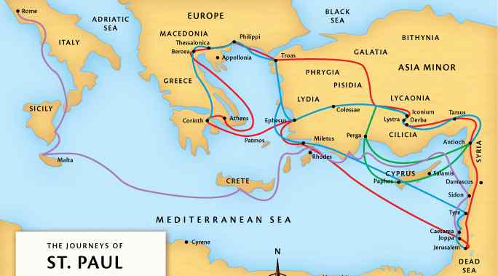
Paul’s release from first imprisonment …

Slide 4
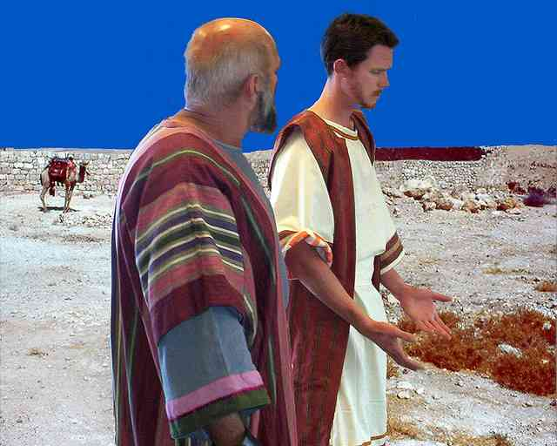
Paul and Timothy like father and son..

Slide 5
Important questions..
What should leaders be like?
What should they teach?
How should they live?
What should be at the heart of a leader in his leading?

Slide 6
What should a leader teach?
Goal… the church healthy and sound..
Paul’s warning of apostasy – Acts 20:28-32
Proper conduct in the church – 1 Tim 3:15
Charge given to Timothy - 1 Tim 1:3-10
Correct improper teaching .. 1 Tim 4:1-4
Commend teaching of Christ …1 Tim 1:13-15, 4:10,13,16

Slide 7
How should a leader live?
Desire to be a leader … 1 Tim. 3:1
Moral qualifications … 3:2-3; Tit 1:8
Social, caring, respected .. 1 Tim 3:2-4; Eph 5:22-25; 6:4
Spiritual maturity.. 1 Tim 3:6-7; Tit 1:6
Teaching ability.. 1 Tim 3:2; Tit 1:9

Slide 8
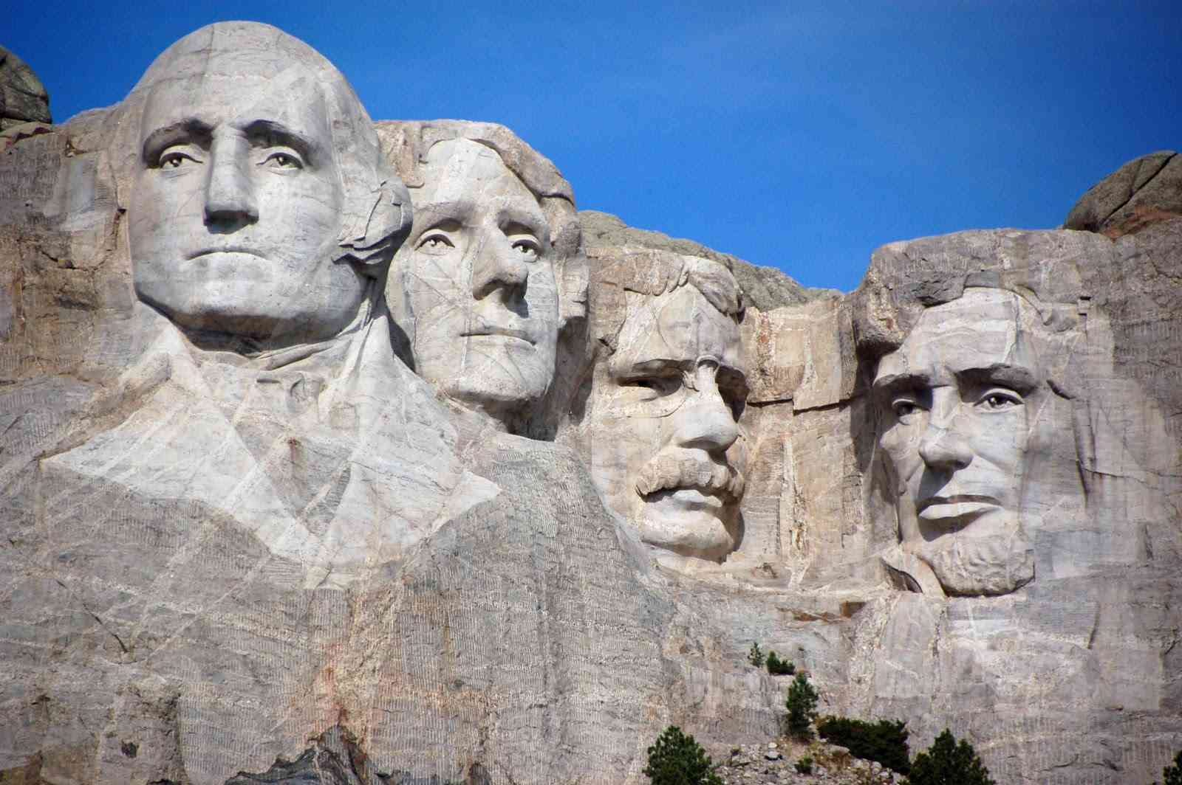
The heart of a leader..
God’s grace in your life .. 1 Tim 1:13ff
Prayer for whole world in God’s purpose to save all … 1 Tim. 2:1-7
Stay at the job … 1 Tim 1:3; 17-18; 4:16
Life and example of Jesus .. 1 Tim 3:16

Slide 9
The Heart of a Leader
1 Timothy 1-4

