Slide 1
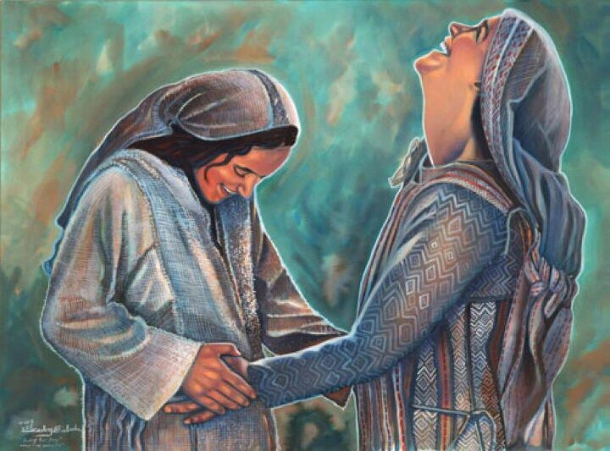
Waiting for the Lord
Luke 1

Slide 3
Psalms 37:9 “evildoers shall be cut off, but those who wait on the Lord, they shall inherit the earth.”

Slide 4
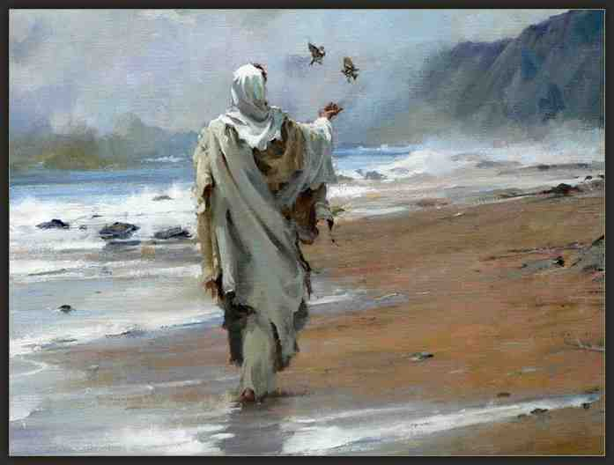
Luke’s Gospel..
Luke 1:3-4 it seemed good to me also, having had perfect understanding of all things from the very first, to write to you an orderly account, most excellent Theophilus, 4 that you may know the certainty of those things in which you were instructed.

Slide 5
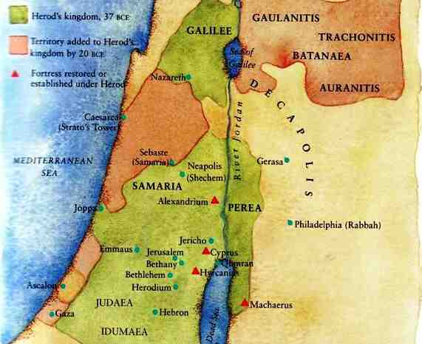
Mary
Elizabeth

Slide 6
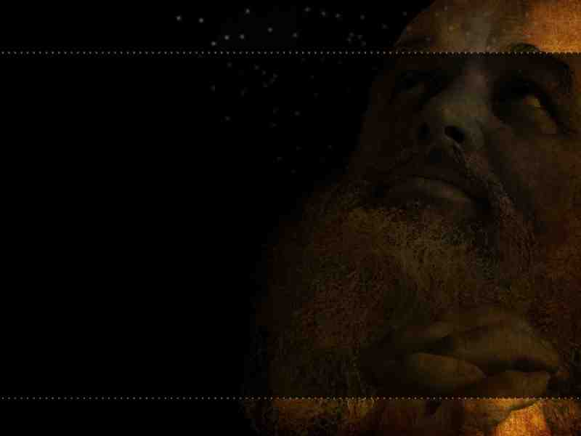
Zacharias and Elizabeth (5-25)..
Luke 1:5-7 There was in the days of Herod, the king of Judea, a certain priest named Zacharias, of the division of Abijah. His wife was of the daughters of Aaron, and her name was Elizabeth. 6 And they were both righteous before God, walking in all the commandments and ordinances of the Lord blameless. 7 But they had no child, because Elizabeth was barren, and they were both well advanced in years.

Slide 7
He continued to serve..
Luke 1:8-10 So it was, that while he was serving as priest before God in the order of his division, 9 according to the custom of the priesthood, his lot fell to burn incense when he went into the temple of the Lord. 10 And the whole multitude of the people was praying outside at the hour of incense.

Slide 8
God is preparing you..
Luke 1:8-10 So it was, that while he was serving as priest before God in the order of his division, 9 according to the custom of the priesthood, his lot fell to burn incense when he went into the temple of the Lord. 10 And the whole multitude of the people was praying outside at the hour of incense.

Slide 9
God is preparing you..
Noah worked on the ark 100 years ..
Abraham waited 25 years for a son..
Moses tended sheep for 40 years..

Slide 10
God had not forgotten..
Luke 1:11-14 Then an angel of the Lord appeared to him, standing on the right side of the altar of incense. 12 And when Zacharias saw him, he was troubled, and fear fell upon him. 13 But the angel said to him, "Do not be afraid, Zacharias, for your prayer is heard; and your wife Elizabeth will bear you a son, and you shall call his name John. 14 And you will have joy and gladness, and many will rejoice at his birth.

Slide 11
How God defines greatness..
He would live a life filled with God’s power..
15 For he will be great in the sight of the Lord, and shall drink neither wine nor strong drink. He will also be filled with the Holy Spirit, even from his mother's womb.
He would preach a life-changing message..
16 And he will turn many of the children of Israel to the Lord their God. 17 He will also go before Him in the spirit and power of Elijah, 'to turn the hearts of the fathers to the children,' and the disobedient to the wisdom of the just, to make ready a people prepared for the Lord."

Slide 12
Do you accept His will..
Luke 1:18-25 And Zacharias said to the angel, "How shall I know this? For I am an old man, and my wife is well advanced in years." 19 And the angel answered and said to him, "I am Gabriel, who stands in the presence of God, and was sent to speak to you and bring you these glad tidings. 20 But behold, you will be mute and not able to speak until the day these things take place, because you did not believe my words which will be fulfilled in their own time."

Slide 13
Learn to trust God’s timing..
21 And the people waited for Zacharias, and marveled that he lingered so long in the temple. 22 But when he came out, he could not speak to them; and they perceived that he had seen a vision in the temple, for he beckoned to them and remained speechless.
23 So it was, as soon as the days of his service were completed, that he departed to his own house. 24 Now after those days his wife Elizabeth conceived; and she hid herself five months, saying, 25 "Thus the Lord has dealt with me, in the days when He looked on me, to take away my reproach among people."

Slide 14
Announcement to Mary (26-38)..
26 Now in the sixth month the angel Gabriel was sent by God to a city of Galilee named Nazareth, 27 to a virgin betrothed to a man whose name was Joseph, of the house of David. The virgin's name was Mary. 28 And having come in, the angel said to her, "Rejoice, highly favored one, the Lord is with you; blessed are you among women!"
29 But when she saw him, she was troubled at his saying, and considered what manner of greeting this was. 30 Then the angel said to her, "Do not be afraid, Mary, for you have found favor with God. 31 And behold, you will conceive in your womb and bring forth a Son, and shall call His name Jesus. 32 He will be great, and will be called the Son of the Highest; and the Lord God will give Him the throne of His father David. 33 And He will reign over the house of Jacob forever, and of His kingdom there will be no end."

Slide 15
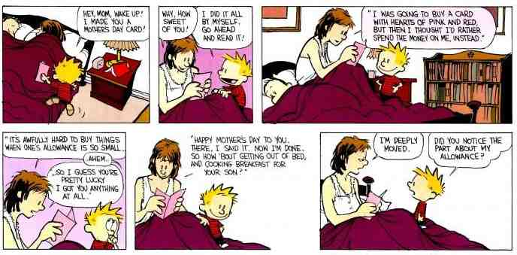
Motherhood today..

Slide 16
Difficulties she faced..
A tarnished reputation.. Matt 1:18ff
The strain of poverty.. 2 Cor 8:9
The difficult of people hating her child .. Matt 2; Psalm 127:3

Slide 17
Resources she had ..
A commitment to doing God’s will .. Luke 1:35,38
The joy of an obedient child .. Heb 4:15; Luke 2:49
A supportive husband .. Matt 1:24

Slide 18
The Joy of the two Babies..
Luke 1:39-41 Now Mary arose in those days and went into the hill country with haste, to a city of Judah, 40 and entered the house of Zacharias and greeted Elizabeth. 41 And it happened, when Elizabeth heard the greeting of Mary, that the babe leaped in her womb; and Elizabeth was filled with the Holy Spirit.

Slide 19
The Joy of the two Babies..
Luke 1:42-45 Then she spoke out with a loud voice and said, "Blessed are you among women, and blessed is the fruit of your womb! 43 But why is this granted to me, that the mother of my Lord should come to me? 44 For indeed, as soon as the voice of your greeting sounded in my ears, the babe leaped in my womb for joy. 45 Blessed is she who believed, for there will be a fulfillment of those things which were told her from the Lord."

Slide 20
Mary’s song…
Luke 1:46-49 And Mary said: "My soul magnifies the Lord, 47 And my spirit has rejoiced in God my Savior. 48 For He has regarded the lowly state of His maidservant; For behold, henceforth all generations will call me blessed. 49 For He who is mighty has done great things for me, And holy is His name. 50 And His mercy is on those who fear Him From generation to generation.

Slide 22
Waiting for the Lord
Luke 1

