Slide 1
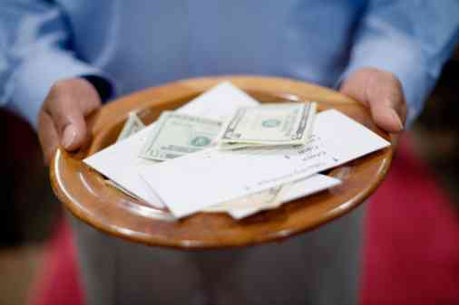
Why is Giving So Hard?
2 Corinthians 9:1-7

Slide 2
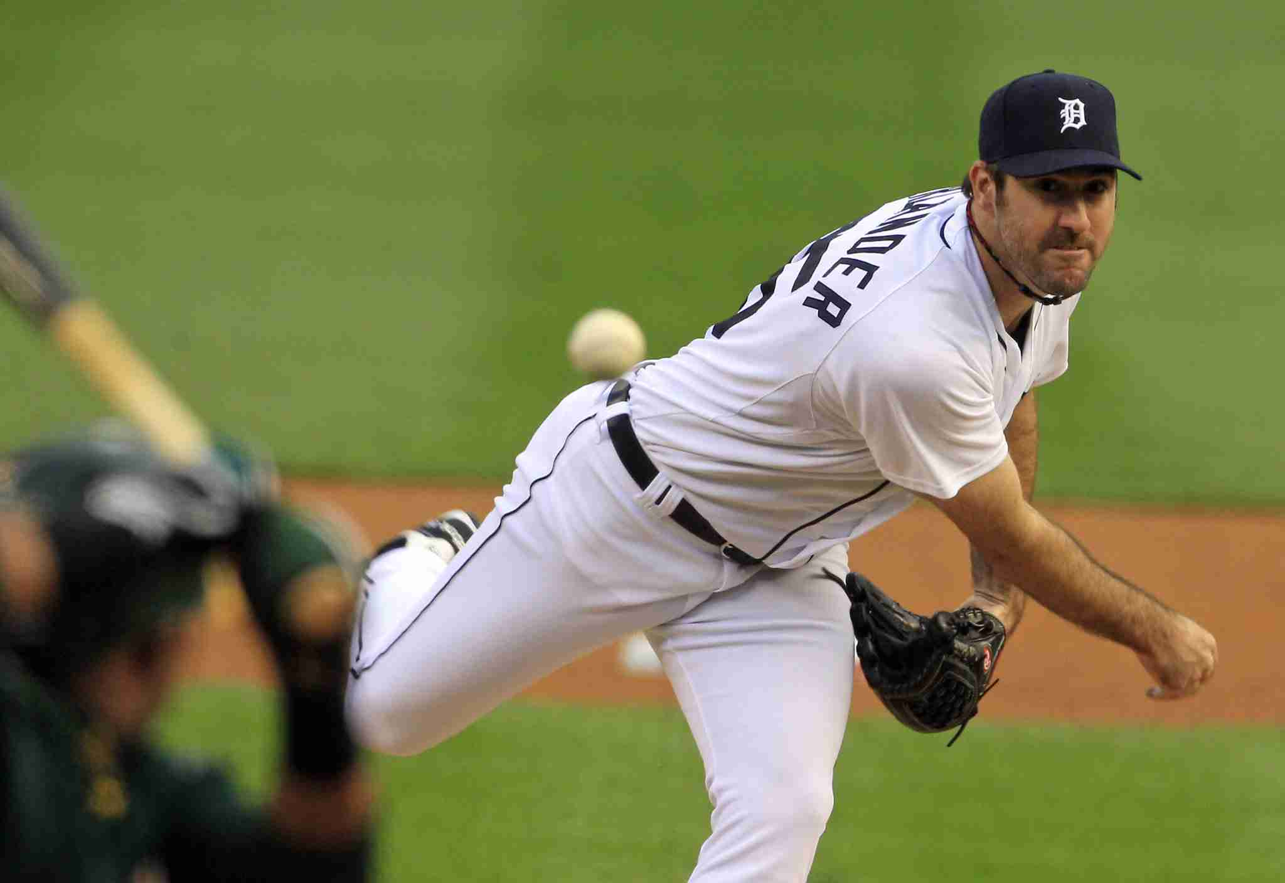
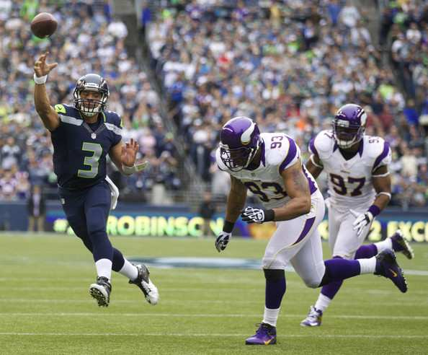
Which is harder?
Hitting a 97 mph fastball?..throwing a touchdown pass?

Slide 3
Which is harder?
Finding shoes to match purse..or purse to match shoes?

Slide 4
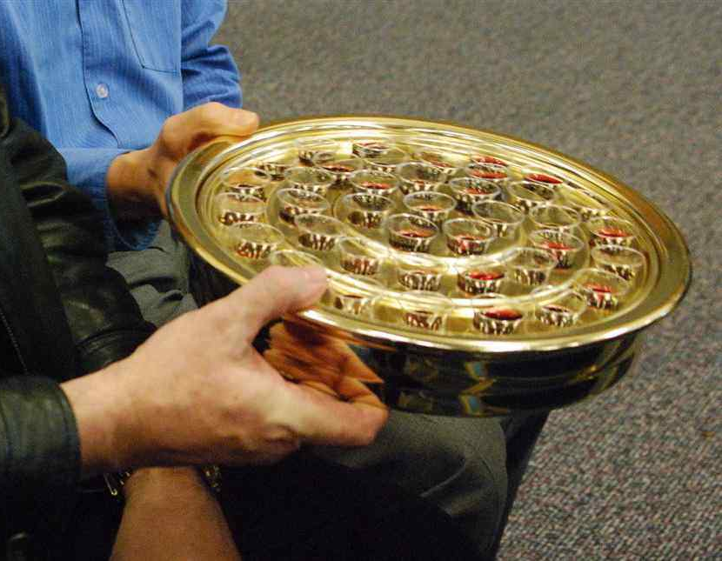
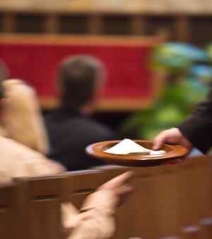
Which is harder?
Partaking of Lord’ Supper..or giving in proper manner?

Slide 5
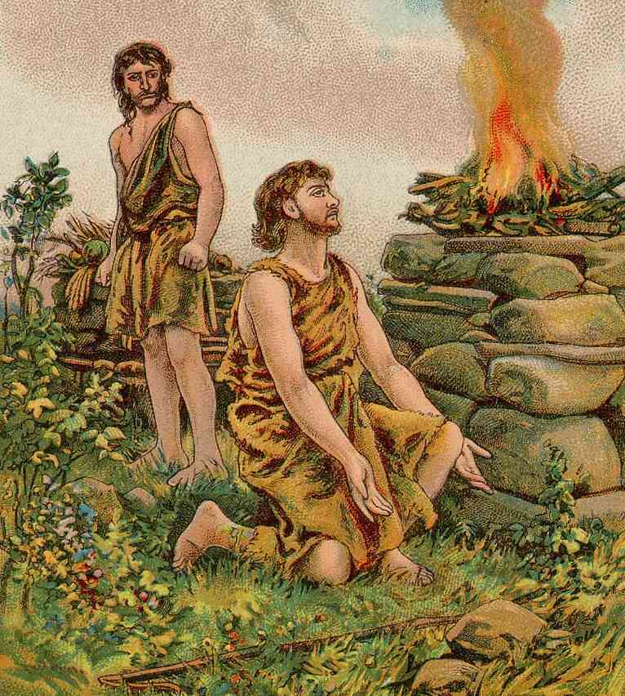
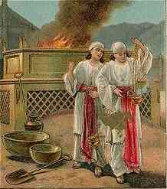
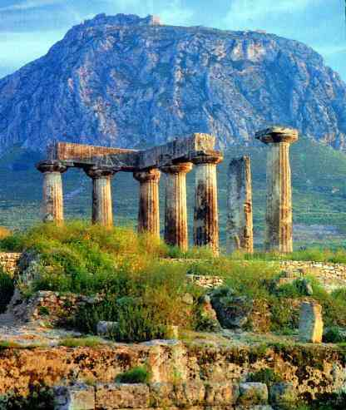
Giving through the Bible..
Cain and Abel
Nadab and Abihu
Corinthians
People had trouble in their giving…

Slide 6
Responsibility to give..
One of most difficult acts of worship..

Slide 7
1 This is our money…
We’d prefer to spend it on ourselves…
Is it really ours? .. Psa 24:1; 50:10
God says it is ours .. Acts 5:4
We choose to give ..

Slide 8
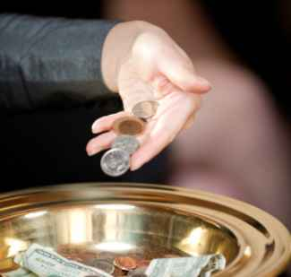
2 Lack of guidelines…
OT required 10%.. NT “as you prosper”
1 Corinthians 16:2 On the first day of the week let each one of you lay something aside, storing up as he may prosper, that there be no collections when I come.
2 Corinthians 9:6-7 But this I say: He who sows sparingly will also reap sparingly, and he who sows bountifully will also reap bountifully..So let each one give as he purposes in his heart..

Slide 9
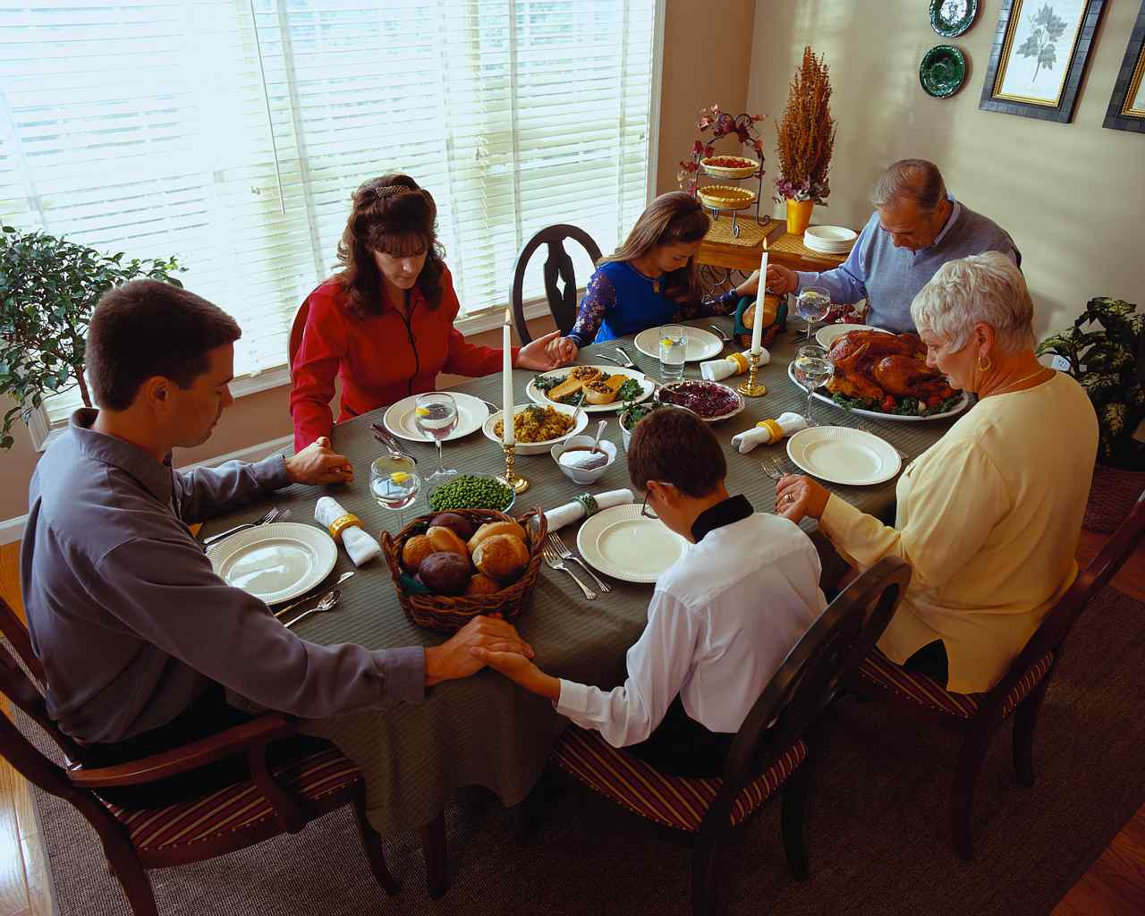
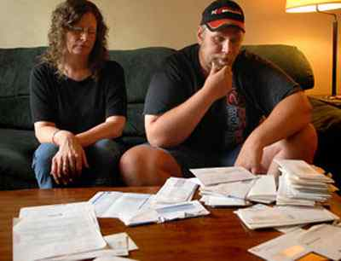
3 Our other needs…
Obligations to our family, paying bills..
1 Timothy 5:8 But if anyone does not provide for his own, and especially for those of his household, he has denied the faith and is worse than an unbeliever.
2 Corinthians 9:7 So let each one give as he purposes (decided beforehand) in his heart, not grudgingly or of necessity; for God loves a cheerful giver.

Slide 10
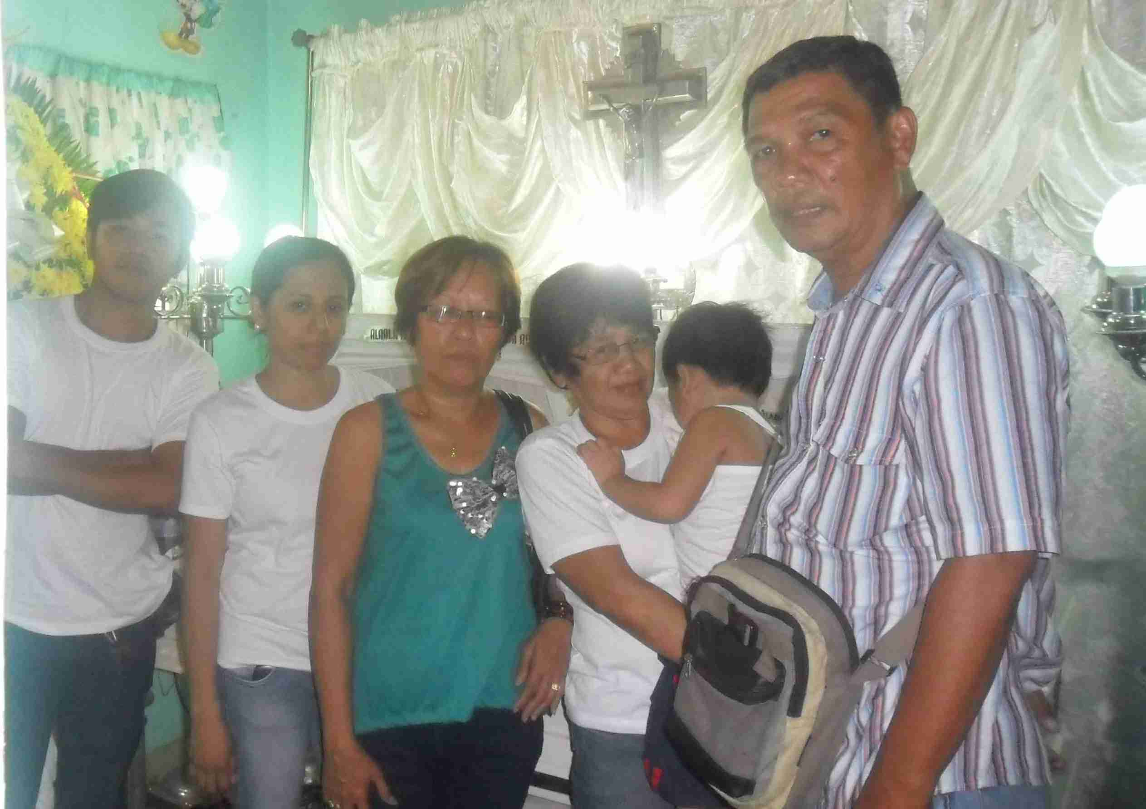
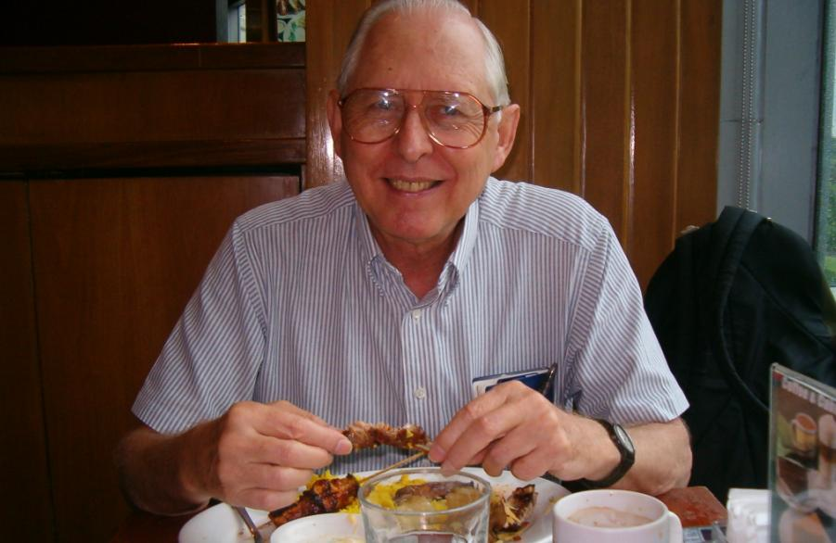
4 Where will it go…
We give to meet specific needs …
2 Corinthians 9:1-2 Now concerning the ministering to the saints, it is superfluous for me to write to you; 2 for I know your willingness, about which I boast of you to the Macedonians, that Achaia was ready a year ago; and your zeal has stirred up the majority.

Slide 11
5 Giving ourselves…
2 Corinthians 8:1-5 Moreover, brethren, we make known to you the grace of God bestowed on the churches of Macedonia: 3 For I bear witness that according to their ability, yes, and beyond their ability, they were freely willing, 4 imploring us with much urgency that we would receive the gift and the fellowship of the ministering to the saints. 5 And not only as we had hoped, but they first gave themselves to the Lord, and then to us by the will of God.

Slide 12
Which is harder?
Hitting a 97 mph fastball?..throwing a touchdown pass?

Slide 13
Which is harder?
Finding shoes to match purse..or purse to match shoes?

Slide 14
Which is harder?
Partaking of Lord’ Supper..or giving in proper manner?

Slide 15
Why is Giving So Hard?
2 Corinthians 9:1-7

