Slide 1
Comfortable without God
2 Timothy 3: 1-5

Slide 2
Perilous times…
Lovers of themselves, money, pleasure..
Self centered..breakdown of family
Out of control..
Shallow religiosity..

Slide 3
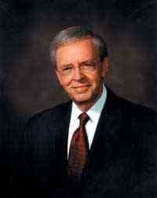
Warning signs..
Charles Stanley: "We know the truth, we know the principles of God. In spite of all that, we find ourselves as a nation violating the laws of God, heading in a direction that is going to be disastrous for us, for our children and the generations that are to come unless there is a change.“

Slide 4
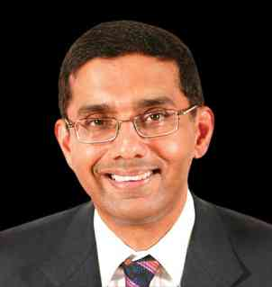
Warning signs..
Dinesh D’Souza: "No longer does Christianity form the moral basis of society. Many of us now reside in secular communities, where arguments drawn from the Bible carry no weight…

Slide 5
Warning signs..
It is a temptation even for believers. We want to be saved as long as we are not saved from our sins. We are quite willing to be saved from a whole host of social evils, from poverty to disease to war. We need spiritual healing, but we do not want it.

Slide 6
Why you need to be a Christian ..

Slide 7
1 Sinners are not ready to meet God..
Sin is against God .. Ezek 18:20
All have sinned .. Rom 3:10-12, 23
We can do something.. Acts 17:30-31
Judgment is unavoidable.. Jude 14-15
A Christian is forgiven.. Acts 11:26

Slide 8
2 Because God loved you and gave His Son..
We were lost .. but God .. Eph 2:1-4
God provided a way for us .. Rom 6:4-5
Only possible by His love .. 1 John 4:8-10
How can we reject such love .. John 1:17

Slide 9
3 You have no promise of another day..
We must number our days.. Psalm 90:7-12
Don’t plan without God … James 4:13-17
Judgment is on its way.. Matt 24:42-44
Now is the time to respond .. 2 Cor 6:1-2

Slide 10
Don’t put it off..

Slide 11
4 Jesus died for you..
He came to save, but He will come again in judgment .. 2 Thess 1:7-9
Rejecting Him determines your eternity .. Rom 14:10-12
Time is passing .. 1 Sam 20:3
Life is short, don’t waste it .. 1 Pet 1:24-25

Slide 12
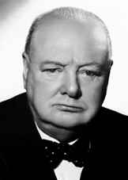
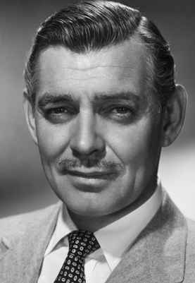
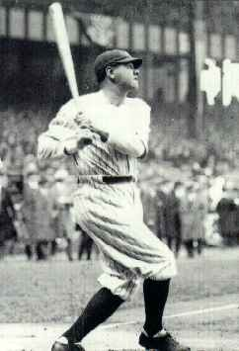
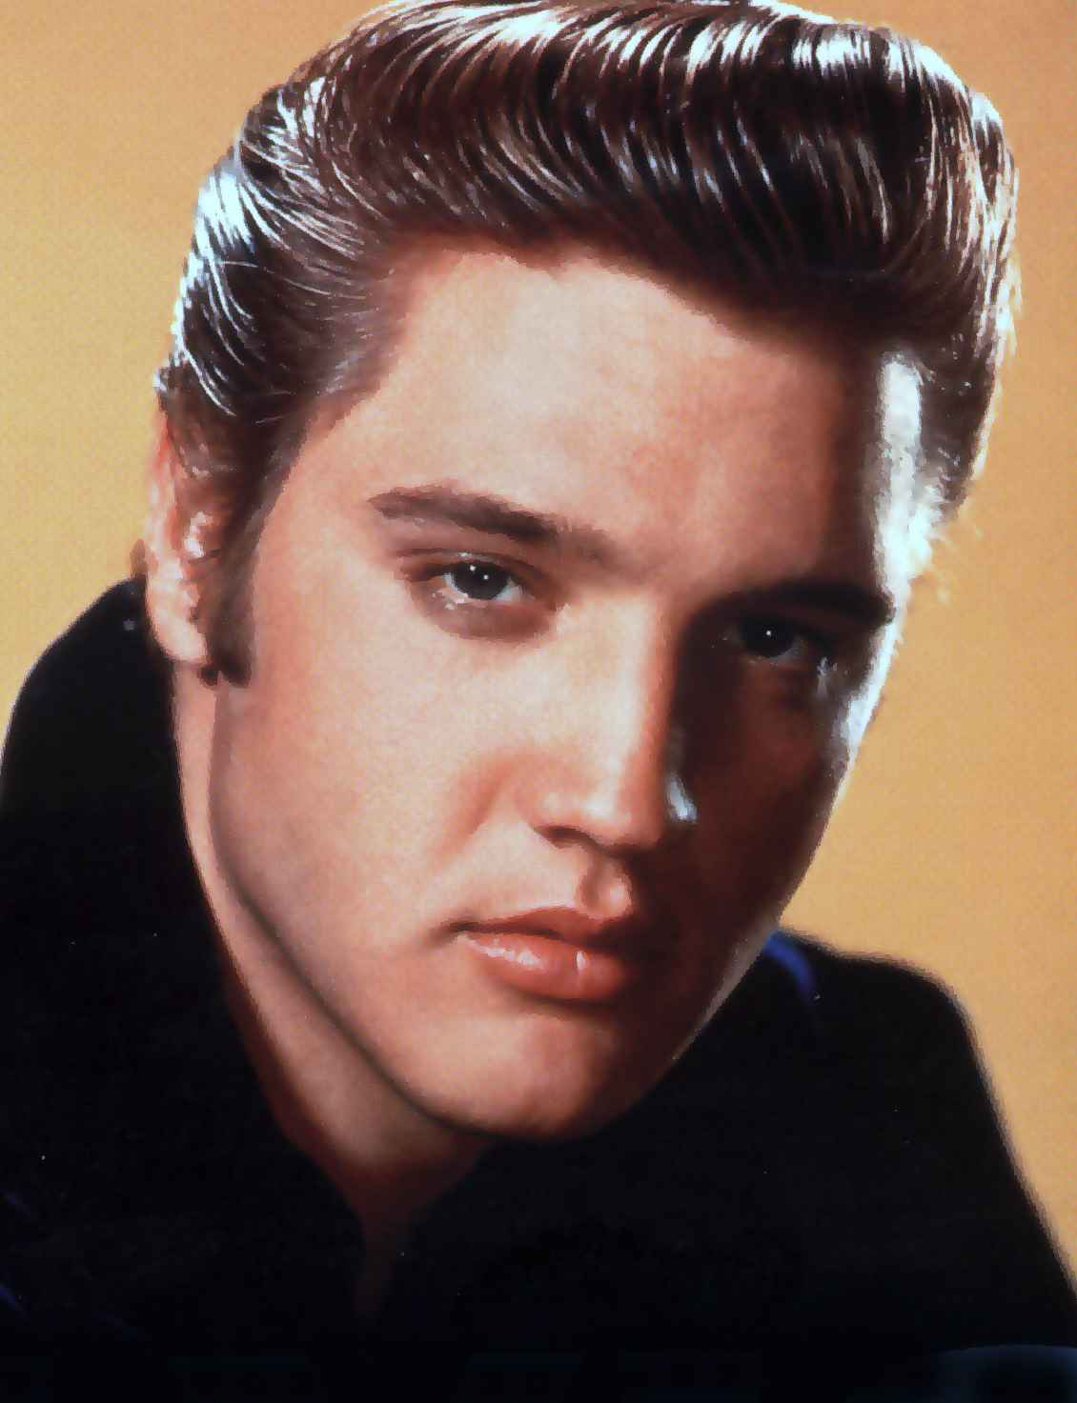
Where are they now?
Matthew 28:19-20 Go therefore and make disciples of all the nations, baptizing them in the name of the Father and of the Son and of the Holy Spirit, 20 teaching them to observe all things that I have commanded you; and lo, I am with you always, even to the end of the age."

Slide 13
Comfortable without God
2 Timothy 3: 1-5

