Slide 1
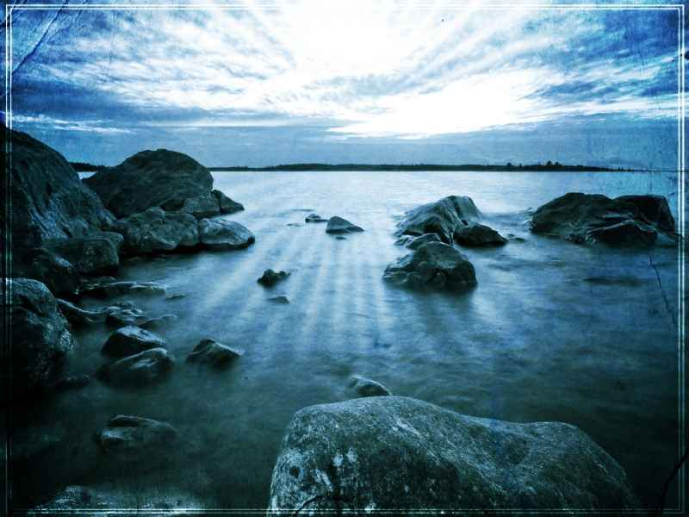
God our Father
1 John 3:1-2

Slide 2
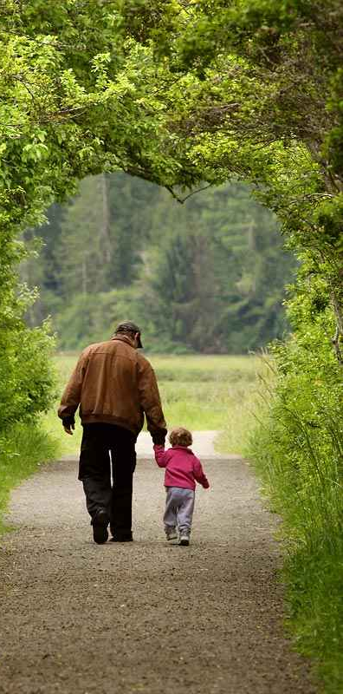
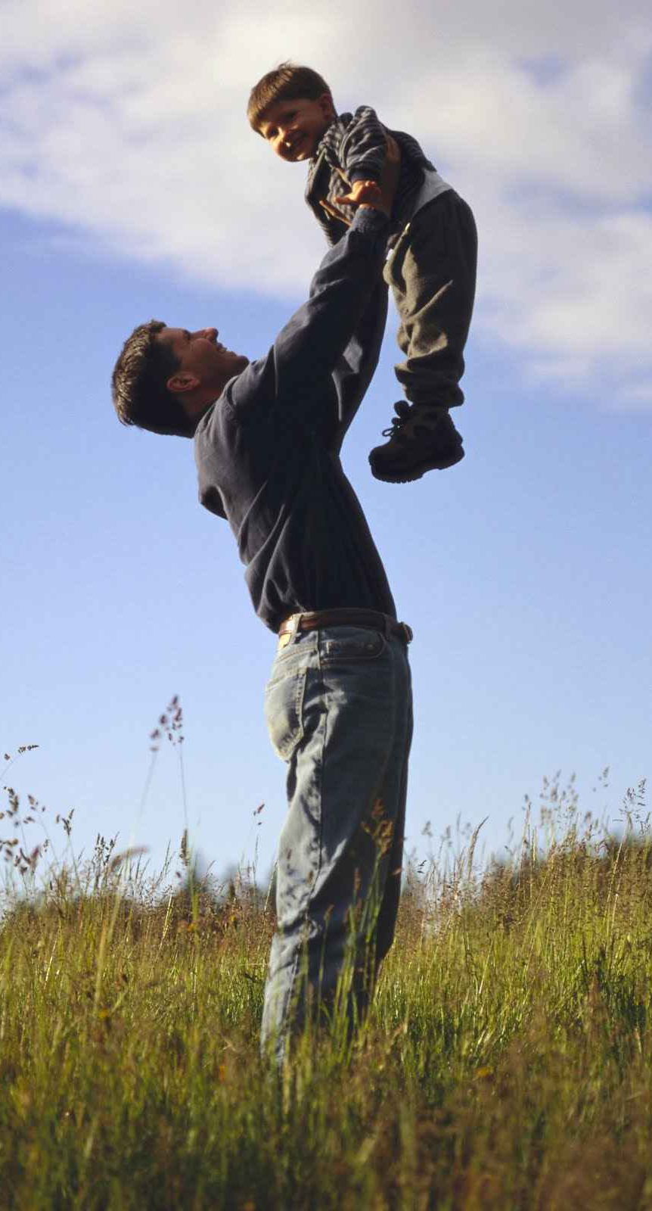
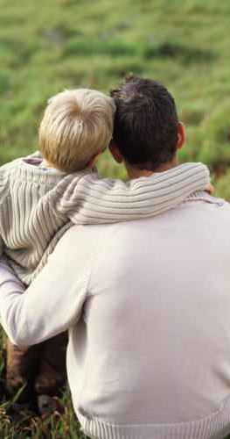
Our fathers..

Slide 3
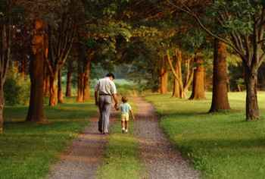
Great love..
1 John 3:1-2 Behold what manner of love the Father has bestowed on us, that we should be called children of God! Therefore the world does not know us, because it did not know Him. 2 Beloved, now we are children of God; and it has not yet been revealed what we shall be, but we know that when He is revealed, we shall be like Him, for we shall see Him as He is.

Slide 4
Special blessings …
With responsibilities …

Slide 5
A spiritual relationship..
Galatians 3:27-28 For as many of you as were baptized into Christ have put on Christ. 28 There is neither Jew nor Greek, there is neither slave nor free, there is neither male nor female; for you are all one in Christ Jesus.

Slide 6
Submission to His will..
Romans 8:14-16 For as many as are led by the Spirit of God, these are sons of God. 15 For you did not receive the spirit of bondage again to fear, but you received the Spirit of adoption by whom we cry out, "Abba, Father." 16 The Spirit Himself bears witness with our spirit that we are children of God..

Slide 7
Two witnesses..
The Spirit of God…
Our own spirit …

Slide 8
The Spirit’s testimony..
What constitutes a child of God..
As many as are led by the Spirit … His word a lamp to my feet (Psa 119:105)
By faith baptized into Jesus Christ (Gal 3:26-27)
Repented from godly sorrow (2 Cor 7:10-11)
Confess my faith in Jesus as Lord (Rom 10:9-10)
My spirit testifies I have complied..

Slide 9
God’s promise and will..
I will be your Father.. so long as you subject your will to My will as your Father..”
A good father does not allow his children to live with no restrictions..

Slide 10
Specific responsibilities..
2 Corinthians 6:14-17 Do not be unequally yoked together with unbelievers. For what fellowship has righteousness with lawlessness? And what communion has light with darkness? 15 And what accord has Christ with Belial? Or what part has a believer with an unbeliever? 16 And what agreement has the temple of God with idols?

Slide 11
Specific responsibilities..
2 Corinthians 6:14-17 For you are the temple of the living God. As God has said: "I will dwell in them and walk among them. I will be their God, and they shall be My people." 17 Therefore "Come out from among them and be separate, says the Lord. Do not touch what is unclean, and I will receive you."

Slide 12
Specific responsibilities..
2 Corinthians 7:1 Therefore, having these promises, beloved, let us cleanse ourselves from all filthiness of the flesh and spirit, perfecting holiness in the fear of God.

Slide 13
Made free from sin..
Romans 6:17-18 But God be thanked that though you were slaves of sin, yet you obeyed from the heart that form of doctrine to which you were delivered. 18 And having been set free from sin, you became slaves of righteousness.

Slide 14
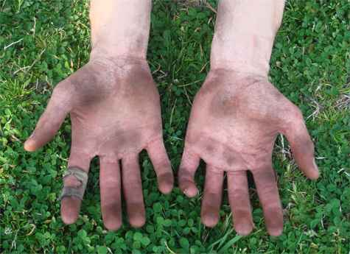
Cleanse ourselves..
2 Corinthians 7:1 Therefore, having these promises, beloved, let us cleanse ourselves from all filthiness of the flesh and spirit, perfecting holiness in the fear of God.

Slide 15
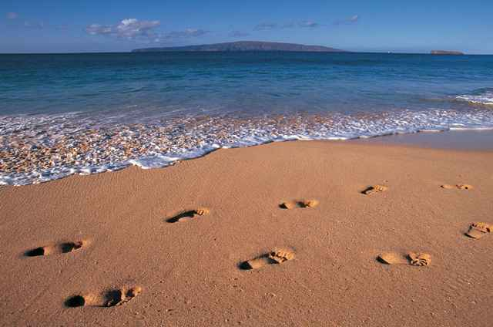
Renew your mind ..
Philippians 4:8 Finally, brethren, whatever things are true, whatever things are noble, whatever things are just, whatever things are pure, whatever things are lovely, whatever things are of good report, if there is any virtue and if there is anything praiseworthy — meditate on these things.

Slide 16
Purify your life..
Ephesians 5:1-6 Therefore be imitators of God as dear children. 2 And walk in love, as Christ also has loved us and given Himself for us, an offering and a sacrifice to God for a sweet-smelling aroma.
3 But fornication and all uncleanness or covetousness, let it not even be named among you, as is fitting for saints; 4 neither filthiness, nor foolish talking, nor coarse jesting, which are not fitting, but rather giving of thanks. 5 For this you know, that no fornicator, unclean person, nor covetous man, who is an idolater, has any inheritance in the kingdom of Christ and God. 6 Let no one deceive you with empty words, for because of these things the wrath of God comes upon the sons of disobedience.

Slide 17
Unique blessings..
Tender relationship with the Father…
Galatians 4:4-7 But when the fullness of the time had come, God sent forth His Son, born of a woman, born under the law, 5 to redeem those who were under the law, that we might receive the adoption as sons. 6 And because you are sons, God has sent forth the Spirit of His Son into your hearts, crying out, "Abba, Father!" 7 Therefore you are no longer a slave but a son, and if a son, then an heir of God through Christ.

Slide 18
Absence of worry..
Philippians 4:6-7 Be anxious for nothing, but in everything by prayer and supplication, with thanksgiving, let your requests be made known to God; 7 and the peace of God, which surpasses all understanding, will guard your hearts and minds through Christ Jesus.

Slide 19
The Father’s discipline..
Hebrews 12:5-8 And you have forgotten the exhortation which speaks to you as to sons: "My son, do not despise the chastening of the Lord, Nor be discouraged when you are rebuked by Him; 6 For whom the Lord loves He chastens, And scourges every son whom He receives." 7 If you endure chastening, God deals with you as with sons; for what son is there whom a father does not chasten? 8 But if you are without chastening, of which all have become partakers, then you are illegitimate and not sons.

Slide 20
The Father’s discipline..
Hebrews 12:9-12 Furthermore, we have had human fathers who corrected us, and we paid them respect. Shall we not much more readily be in subjection to the Father of spirits and live? 10 For they indeed for a few days chastened us as seemed best to them, but He for our profit, that we may be partakers of His holiness. 11 Now no chastening seems to be joyful for the present, but painful; nevertheless, afterward it yields the peaceable fruit of righteousness to those who have been trained by it. 12 Therefore strengthen the hands which hang down, and the feeble knees 13 and make straight paths for your feet, so that what is lame may not be dislocated, but rather be healed.

Slide 21
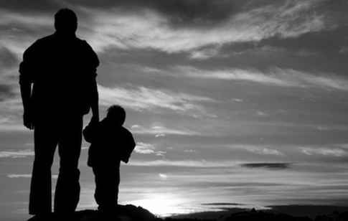
Our choice..
Be in subjection to the Father of Spirits … and live
Not be in subjection to His will .. die

Slide 22
God our Father
1 John 3:1-2

