Slide 1
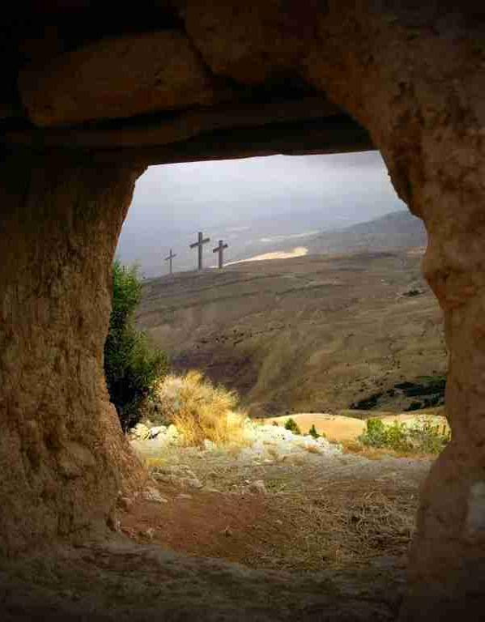
If Jesus is not Risen
1 Corinthians 15

Slide 2
If Jesus is not Risen
1 Corinthians 15:16-17 For if the dead do not rise, then Christ is not risen. 17 And if Christ is not risen, your faith is futile; you are still in your sins!
1 Corinthians 15

Slide 3
Have you examined the evidence ..
Some believers have never taken time ..
Some have considered the evidence but have rejected the resurrection ..

Slide 4
Some doubt the resurrection..
Thomas.."Unless I see in His hands the print of the nails, and put my finger into the print of the nails, and put my hand into His side, I will not believe." John 20:25
8 days later.. "Reach your finger here, and look at My hands; and reach your hand here, and put it into My side. Do not be unbelieving, but believing." 28 And Thomas answered.. "My Lord and my God!" 29 Jesus said.. "Thomas, because you have seen Me, you have believed. Blessed are those who have not seen and yet have believed."

Slide 5
Was Jesus raised?
A question of fact .. either fact or fiction
Not a question of science or philosophy..
Not knowable as the original disciples..
A matter of faith.. from written testimony

Slide 6
The Bible gives the evidence..
Not blind faith .. on written evidence
John 20:30-31 And truly Jesus did many other signs in the presence of His disciples, which are not written in this book; 31 but these are written that you may believe that Jesus is the Christ, the Son of God, and that believing you may have life in His name.
Romans 10:17 So then faith comes by hearing, and hearing by the word of God.

Slide 7
Truth of the events..
The events of Jesus’ death..
Eyewitness testimony..
Effect upon the apostles ..
Previous testimony of Jesus ..

Slide 8
Proof that Jesus died
Matthew 27:50-55 And Jesus cried out again with a loud voice, and yielded up His spirit. 51 Then, behold, the veil of the temple was torn in two from top to bottom; and the earth quaked, and the rocks were split, 52 and the graves were opened; and many bodies of the saints who had fallen asleep were raised..appeared to many. 54 So when the centurion and those with him, who were guarding Jesus, saw the earthquake and the things that had happened, they feared greatly, saying, "Truly this was the Son of God!"

Slide 9
Proof that Jesus died
Matthew 27:55-61 And many women who followed Jesus from Galilee, were there looking on .. among whom were Mary Magdalene, Mary the mother of James and Joses, and the mother of Zebedee's sons. 57 Now when evening had come, there came a rich man from Arimathea, named Joseph, who himself had also become a disciple of Jesus. 58 This man went to Pilate and asked for the body of Jesus. Then Pilate commanded the body to be given to him. 59 When Joseph had taken the body, he wrapped it in a clean linen cloth, 60 and laid it in his new tomb which he had hewn out of the rock; and he rolled a large stone against the door of the tomb, and departed. 61 And Mary Magdalene was there, and the other Mary, sitting opposite the tomb.

Slide 10
Proof that Jesus died
Matthew 27:63-66 "Sir, we remember, while He was still alive, how that deceiver said, 'After three days I will rise.' 64 Therefore command that the tomb be made secure until the third day, lest His disciples come by night and steal Him away, and say to the people, 'He has risen from the dead.' So the last deception will be worse than the first." 65 Pilate said to them, "You have a guard; go your way, make it as secure as you know how." 66 So they went and made the tomb secure, sealing the stone and setting the guard.

Slide 11
Eyewitnesses..
Mary Magdalene..
Mark 16:3-7 4 But when they looked up, they saw that the stone had been rolled away — for it was very large. 5 And entering the tomb, they saw a young man clothed in a long white robe sitting on the right side; and they were alarmed. 6 But he said to them, "Do not be alarmed. You seek Jesus of Nazareth, who was crucified. He is risen! He is not here. See the place where they laid Him. 7 But go, tell His disciples — and Peter — that He is going before you into Galilee; there you will see Him, as He said to you."

Slide 12
Eyewitnesses..
Mary Magdalene..
Mark 16:9-11 Now when He rose early on the first day of the week, He appeared first to Mary Magdalene, out of whom He had cast seven demons. 10 She went and told those who had been with Him, as they mourned and wept. 11 And when they heard that He was alive and had been seen by her, they did not believe.

Slide 13
Eyewitnesses..
Two more witnesses ..
Mark 16:12-13 After that, He appeared in another form to two of them as they walked and went into the country. 13 And they went and told it to the rest, but they did not believe them either.

Slide 14
Eyewitnesses..
Resurrection appearances ..
1 Corinthians 15:5-8 and that He was seen by Cephas, then by the twelve. 6 After that He was seen by over five hundred brethren at once, of whom the greater part remain to the present, but some have fallen asleep. 7 After that He was seen by James, then by all the apostles. 8 Then last of all He was seen by me also, as by one born out of due time.

Slide 15
Effect upon the apostles
Before Pentecost ..
Matthew 16:22 Then Peter took Him aside and began to rebuke Him, saying, "Far be it from You, Lord; this shall not happen to You!"
Uncertain and fearful.. Peter denied Jesus three times .. Matt 26:69-74

Slide 16
Effect upon the apostles
On Pentecost and after ..
Acts 2:22-24 "Men of Israel, hear these words: Jesus of Nazareth, a Man attested by God to you by miracles, wonders, and signs which God did through Him in your midst, as you yourselves also know — 23 Him, being delivered by the determined purpose and foreknowledge of God, you have taken by lawless hands, have crucified, and put to death; 24 whom God raised up, having loosed the pains of death, because it was not possible that He should be held by it.

Slide 17
Effect upon the apostles
On Pentecost and after ..
Acts 2:29-32 "Men and brethren, let me speak freely to you of the patriarch David, that he is both dead and buried, and his tomb is with us to this day. 30 Therefore, being a prophet, and knowing that God had sworn with an oath to him that of the fruit of his body, according to the flesh, He would raise up the Christ to sit on his throne, 31 he, foreseeing this, spoke concerning the resurrection of the Christ, that His soul was not left in Hades, nor did His flesh see corruption. 32 This Jesus God has raised up, of which we are all witnesses.

Slide 18
Testimony of Jesus
Jesus knew He was going to die ..
Matthew 20:17-19 Now Jesus, going up to Jerusalem, took the twelve disciples aside on the road and said to them, 18 "Behold, we are going up to Jerusalem, and the Son of Man will be betrayed to the chief priests and to the scribes; and they will condemn Him to death, 19 and deliver Him to the Gentiles to mock and to scourge and to crucify. And the third day He will rise again."

Slide 19
Effect in your life..
Do you believe? John 20:29; John 1:12
Worship and Joy Matt 28:8
Obedience
Repent Luke 13:3
Confess Matt 10:32-33
Baptized Acts 2:38; Gal 3:26-27
Change is possible in you because He rose ..

Slide 20
If Jesus is not Risen
1 Corinthians 15

