Slide 1
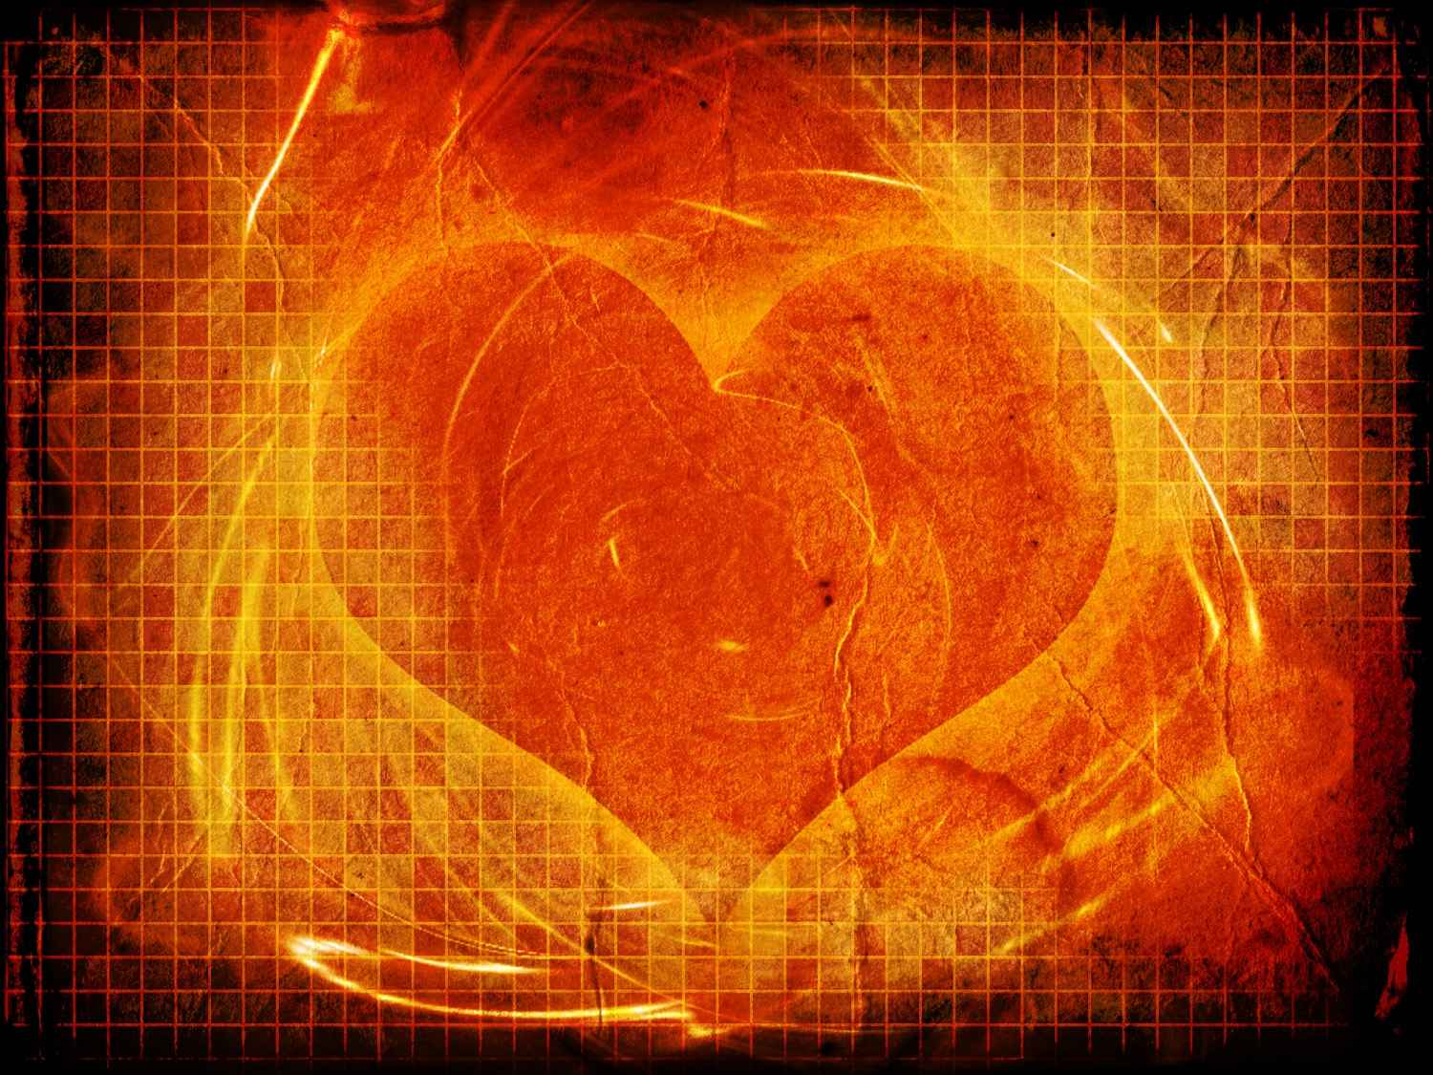
Pure in Heart
Matthew 5:8

Slide 2
Defining Pure..
Pure (katharos) clean, cleansed, free from any impurities..
Keep yourself pure.. 1 Tim 5:22
Pure conscience .. 2 Tim 1:3
Purified souls, pure heart .. 1 Pet 1:22

Slide 3
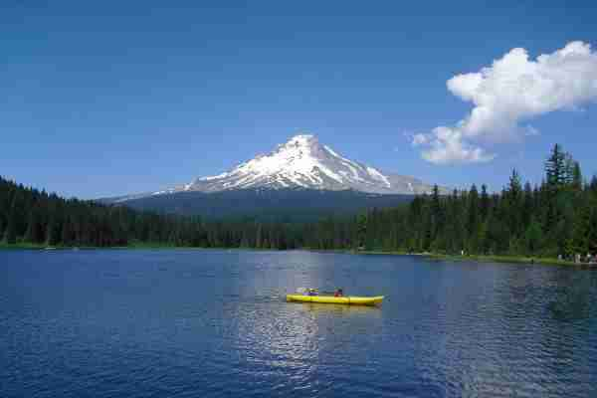
Pure air…

Slide 4
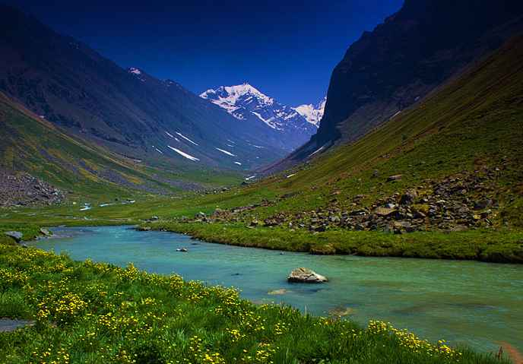
Pure stream..

Slide 5
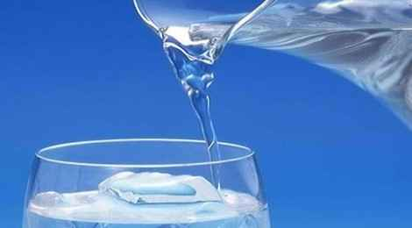
Pure water..

Slide 6
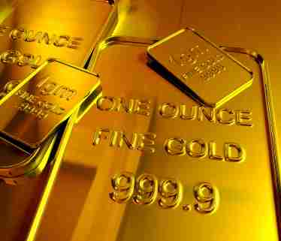
Pure gold..

Slide 7
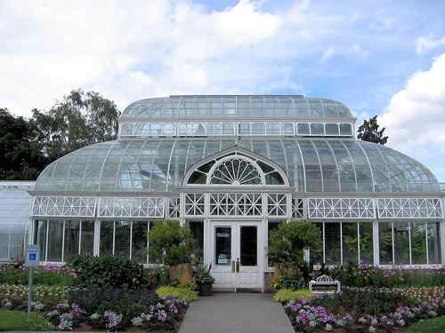

Slide 9
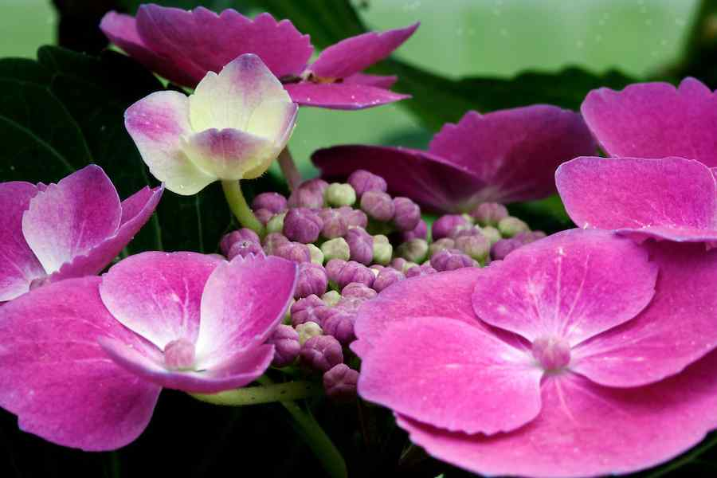

Slide 10
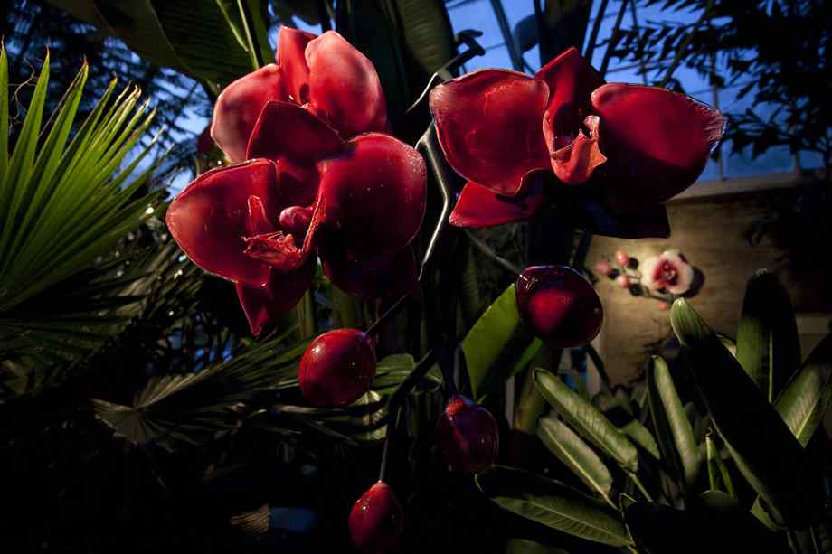

Slide 12
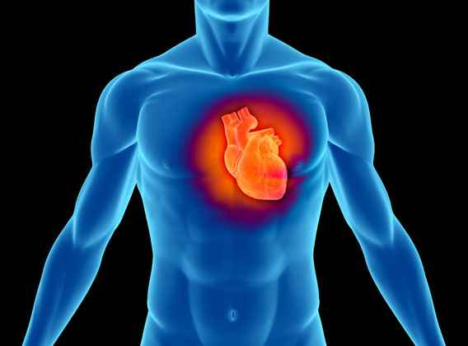
Defining the heart..
Physical heart ..
100,000 times / day
1800 gallons blood / day
Life center of body

Slide 13
Defining the heart..
The inner self …
Intellect, emotional, moral qualities ..Prov 4:23
Thoughts, attitudes, will.. Matt 9:4
The true inner person… Prov 23:7; Deut 6:4; Psalm 51:6; 73:1

Slide 14
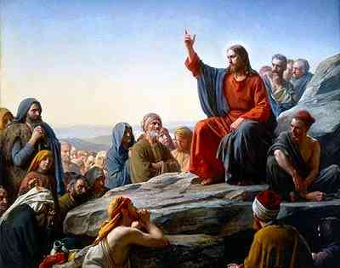
God’s concern with the inner person..
Need for God..
Submission to Him..
Hunger for righteousness..
Merciful, pure heart..
Opposite of outward religion..Matt 5:20-48

Slide 15
What is a pure heart?
Lives to do what is right…
2 Tim 2:22 Flee youthful lusts, but pursue righteousness, faith, love peace with those who call on the Lord out of a pure heart..
Determined by God.. Acts 10:15 “clean/unclean”..
Defined by His law .. Psa 119 ..
Physical laws vs moral law..

Slide 16
What is a pure heart?
Lives for purpose of pleasing God..
Not selfish motives .. James 3:14-16
Not for material gain.. 2 Pet 2:3; 1 Thess 2:4-5
Santify God in our heart.. 1 Pet 3:15-16
Loves God, brothers, sisters, neighbor ..

Slide 17
How acquired…
Comes only from God…
We cannot know own heart .. Jer 17:9
Qualities God seeks .. Psa 24:3-5
Promised by God.. Jer 31:34; Ezek 36:25-26
Cleansed by blood of Christ .. Heb 9:113-15, 1 Pet 1:22; 3:21

Slide 18
Pure in Heart
Matthew 5:8

