Slide 1
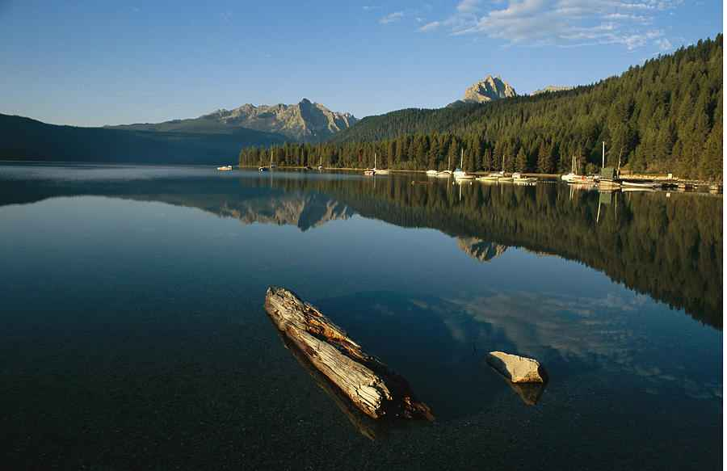
Staying Calm in Troubled Times
John 14:1-6

Slide 2
John 14:1-6
"Let not your heart be troubled; you believe in God, believe also in Me…

Slide 3
Calmness in scripture
Psalm 107:24 He calms storm, waves are still.
Luke 8:24 Jesus rebukes the wind and waves
Psalm131 I have calmed and quieted my soul
Prov 17:27 person of understanding has calm spirit
Isaiah 7:4 Be careful, keep calm, don't be afraid...

Slide 4
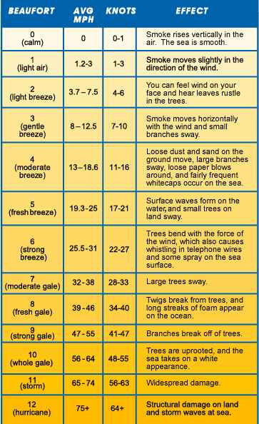
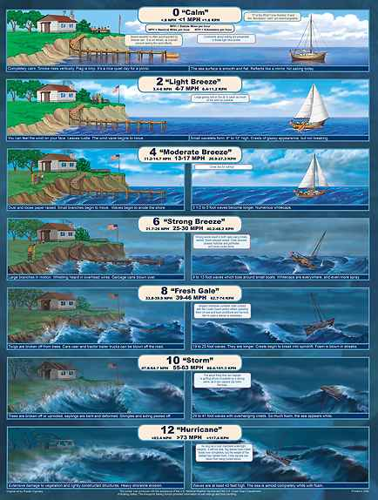

Slide 5
John 14:1-3
"Let not your heart be troubled; you believe in God, believe also in Me. 2 In My Father's house are many mansions; if it were not so, I would have told you. I go to prepare a place for you. 3 And if I go and prepare a place for you, I will come again and receive you to Myself; that where I am, there you may be also.

Slide 6
A Stress-free life?
John 16:33 These things I have spoken to you, that in Me you may have peace. In the world you will have tribulation; but be of good cheer, I have overcome the world."

Slide 7
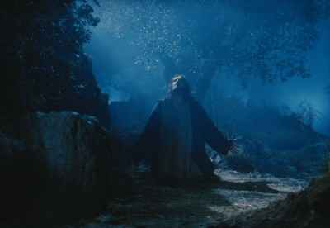
Jesus felt pressure..
John 11:33 He groaned in the spirit and was troubled.
John 12:27 "Now My soul is troubled, and what shall I say? 'Father, save Me from this hour'?
John 13:21 When Jesus had said these things, He was troubled in spirit..
Hebrews 4:15 we do not have a High Priest who cannot sympathize with our weaknesses, but was in all points tempted as we are, yet without sin.

Slide 8
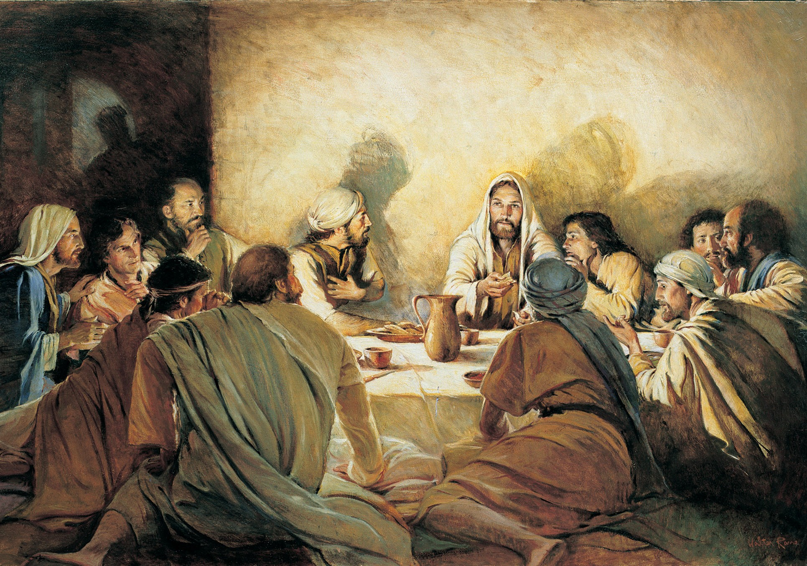
Jesus comforted his disciples…
John 13:33-36 Little children, I shall be with you a little while longer. You will seek Me; and as I said to the Jews, 'Where I am going, you cannot come,' so now I say to you.
36 Simon Peter said to Him, "Lord, where are You going?" Jesus answered him, "Where I am going you cannot follow Me now, but you shall follow Me afterward."

Slide 9
1 Believe in a person…
John 14:1 "Let not your heart be troubled; you believe in God, believe also in Me.

Slide 10
1 Believe in a person…
Deut 6:4-5 "Hear, O Israel: The Lord our God, the Lord is one! 5 You shall love the Lord your God with all your heart, with all your soul, and with all your strength.
John 1:1 In the beginning was the Word, and the Word was with God, and the Word was God. NKJV
John 10:30 I and My Father are one."

Slide 11
2 Believe in a place…
John 14:2 In My Father's house are many mansions; if it were not so, I would have told you. I go to prepare a place for you.

Slide 12
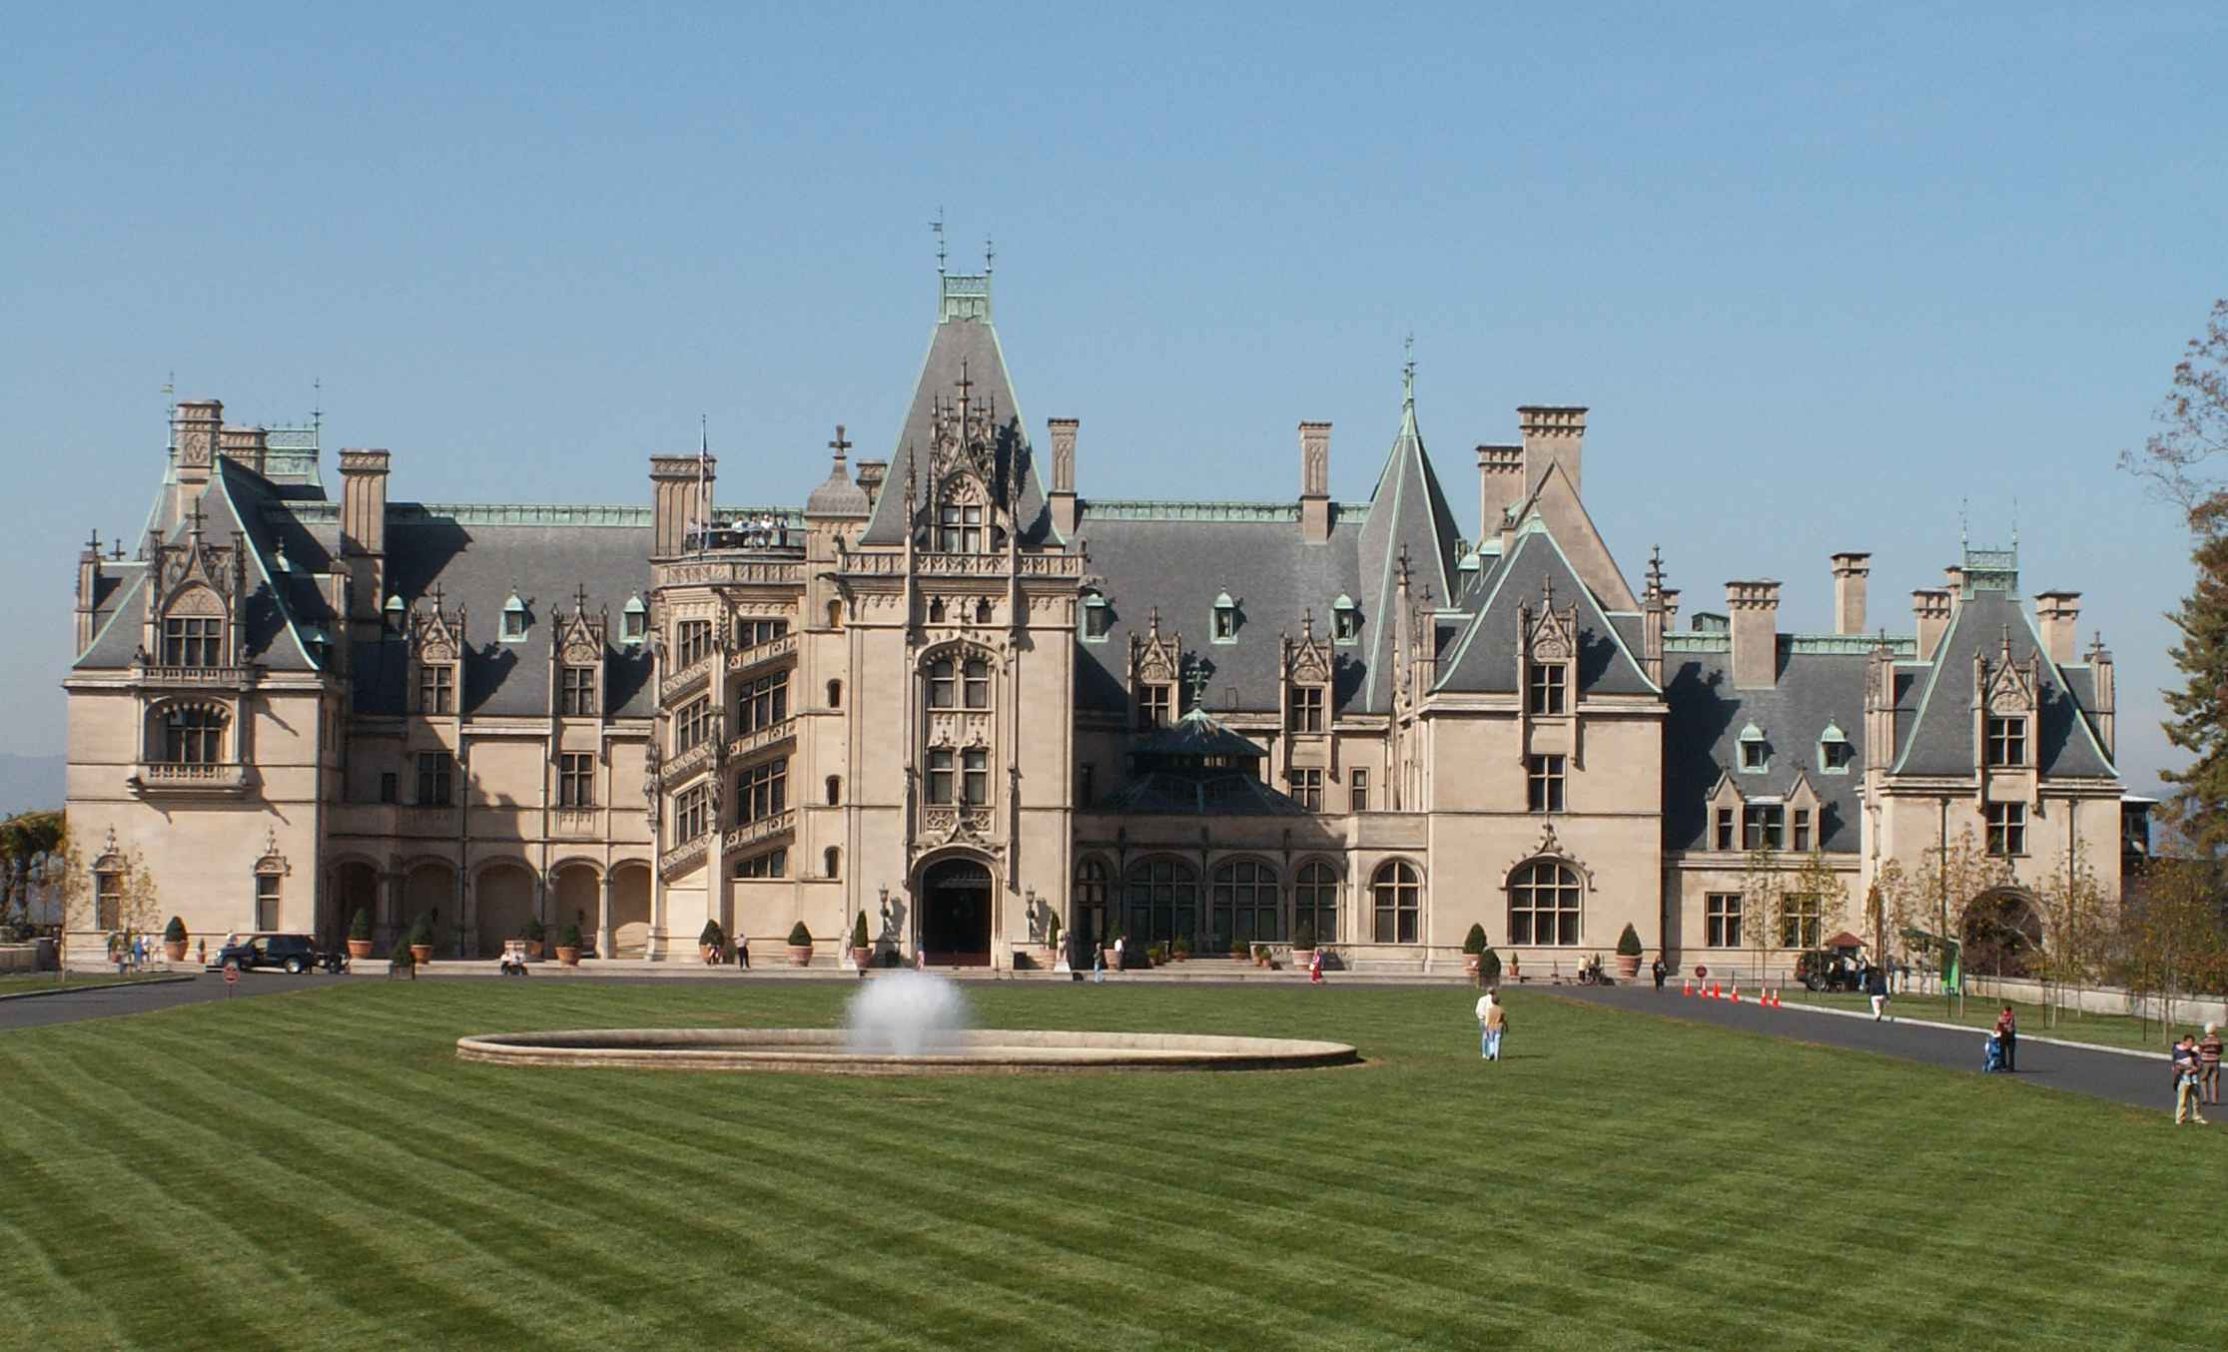
Biltmore Estate

Slide 13
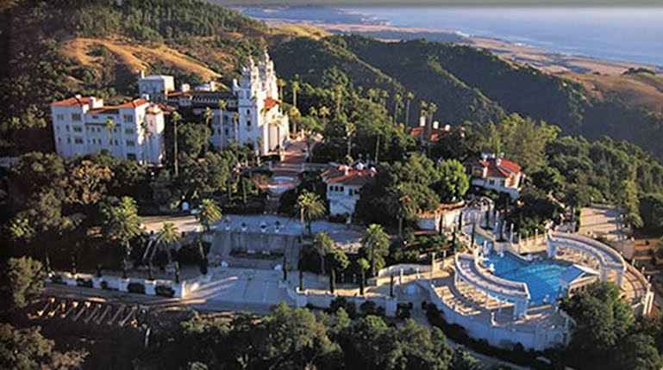
Hearst Castle

Slide 14
Jesus had no home
Matthew 8:20 And Jesus said to him, "Foxes have holes and birds of the air have nests, but the Son of Man has nowhere to lay His head."

Slide 15
3 Believe in a promise..
John 14:3 And if I go and prepare a place for you, I will come again and receive you to Myself; that where I am, there you may be also.

Slide 16
3 Believe in a promise..
Luke 16:22 So it was that the beggar died, and was carried by the angels to Abraham's bosom..
John 17:24 "Father, I desire that they also whom You gave Me may be with Me where I am, that they may behold My glory which You have given Me; for You loved Me before the foundation of the world.

Slide 17
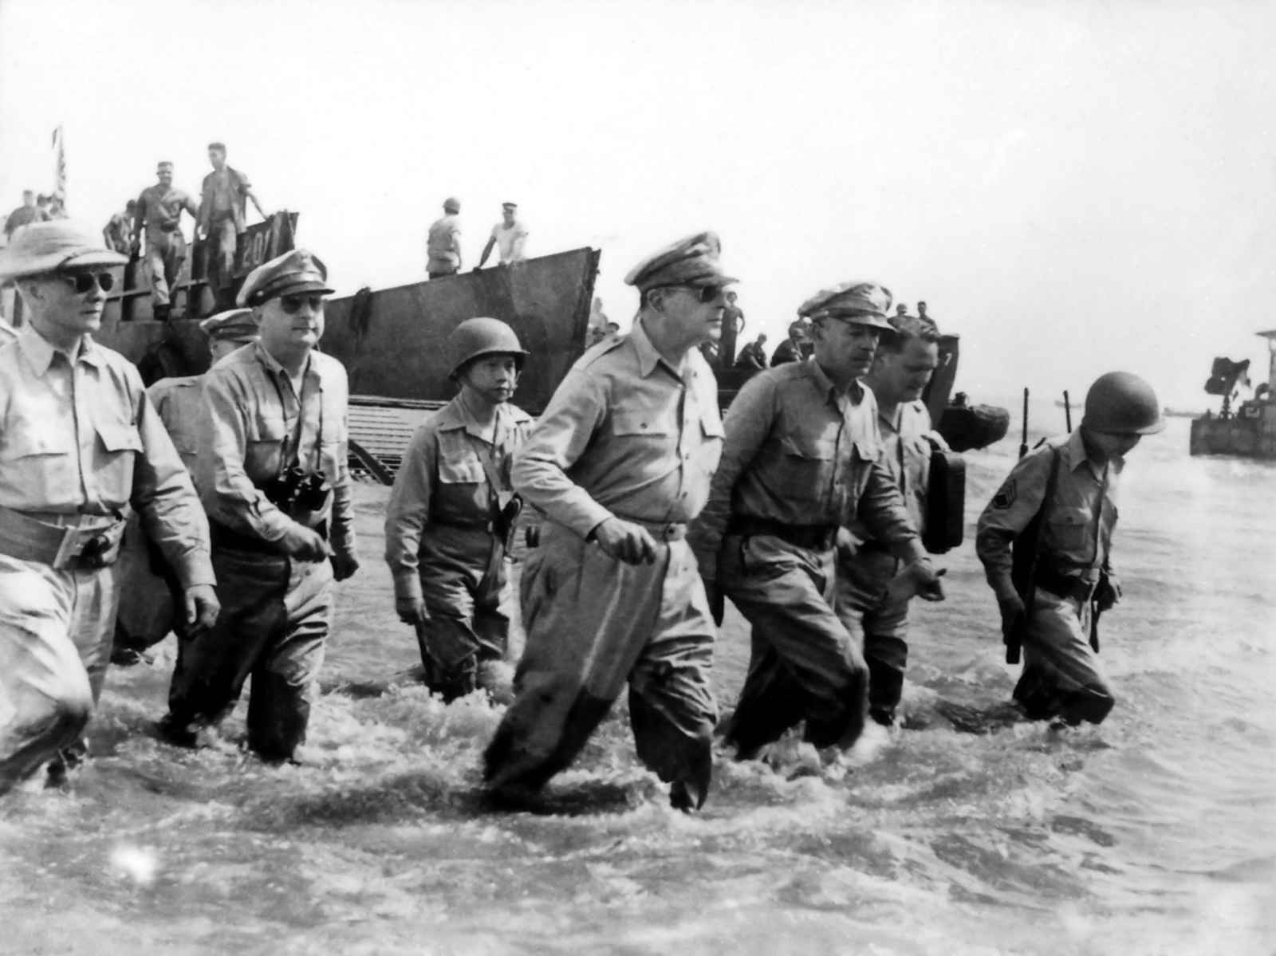
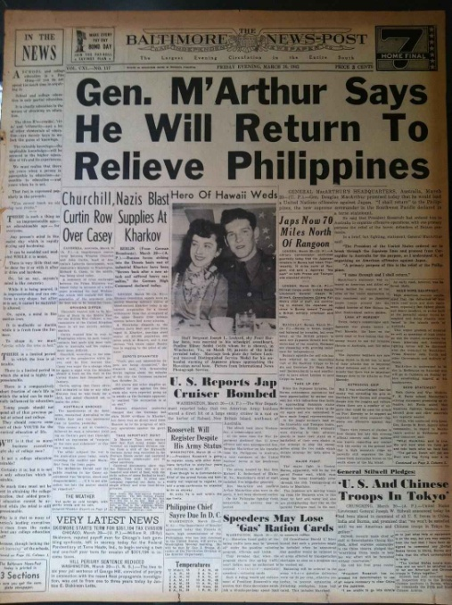
“I shall return”

Slide 18
4 Believe in a plan..
John 14:4-6 And where I go you know, and the way you know." 5 Thomas said to Him, "Lord, we do not know where You are going, and how can we know the way?"
6 Jesus said to him, "I am the way, the truth, and the life. No one comes to the Father except through Me.

Slide 19
4 Believe in a plan..
Matthew 7:13 "Enter by the narrow gate; for wide is the gate and broad is the way that leads to destruction, and there are many who go in by it.
John 8:24 if you do not believe that I am He, you will die in your sins."
Acts 4:12 Nor is there salvation in any other, for there is no other name under heaven given among men by which we must be saved."
1 Timothy 2:5 For there is one God and one Mediator between God and men, the Man Christ Jesus..

Slide 20
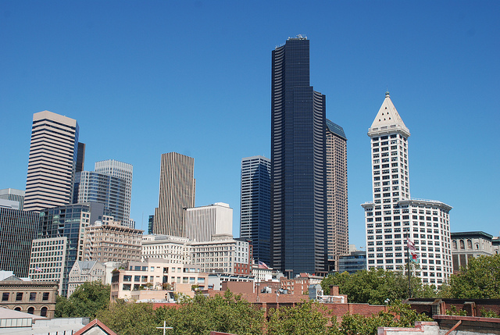

Slide 21
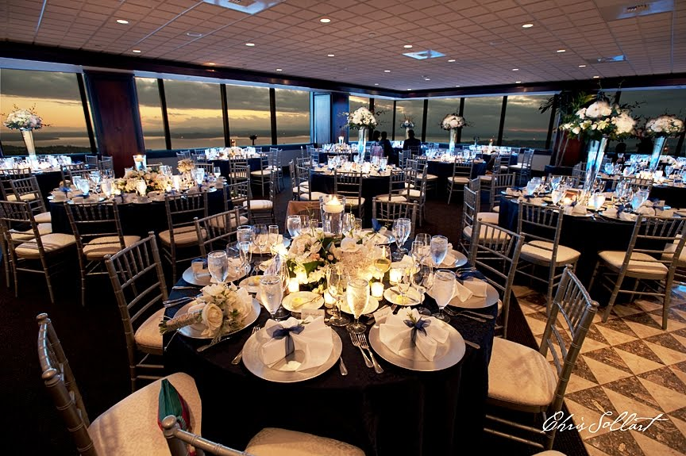

Slide 22
Staying Calm in Troubled Times
John 14:1-6

