Slide 1
Staying Constructive in a Skeptical World
John 21:15-24

Slide 2
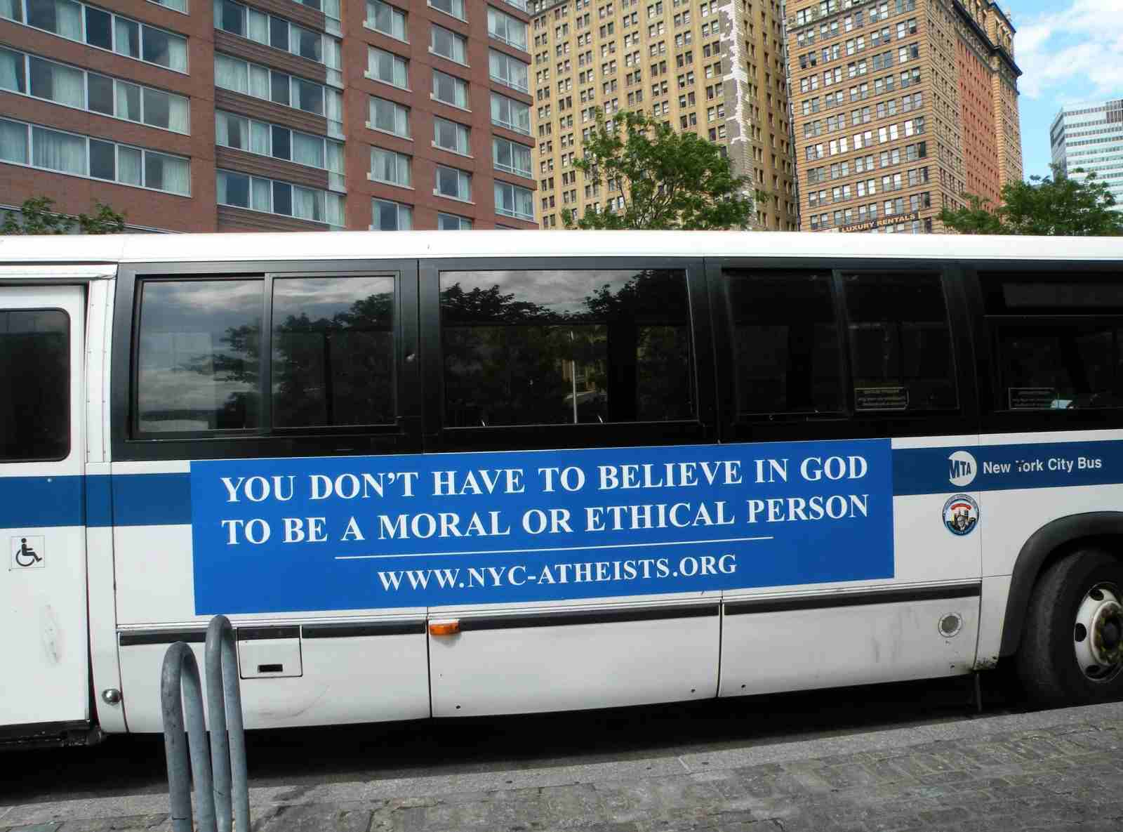
Advertising atheism..

Slide 3
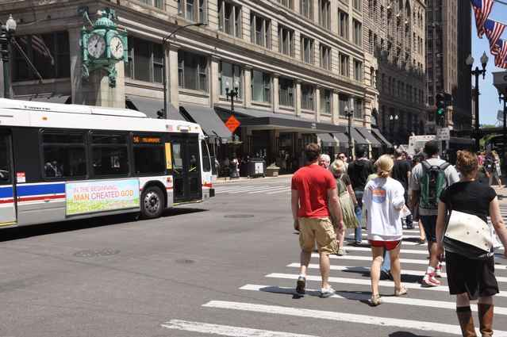

Slide 7
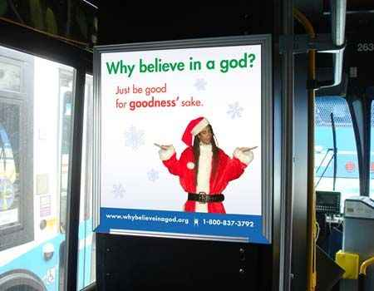

Slide 9
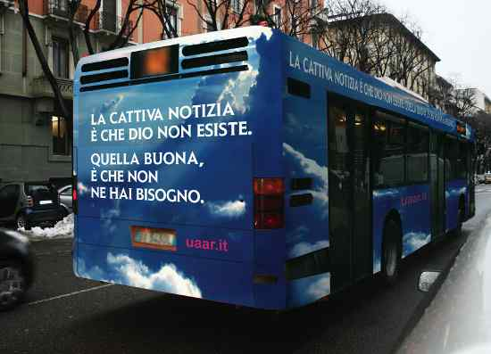

Slide 10
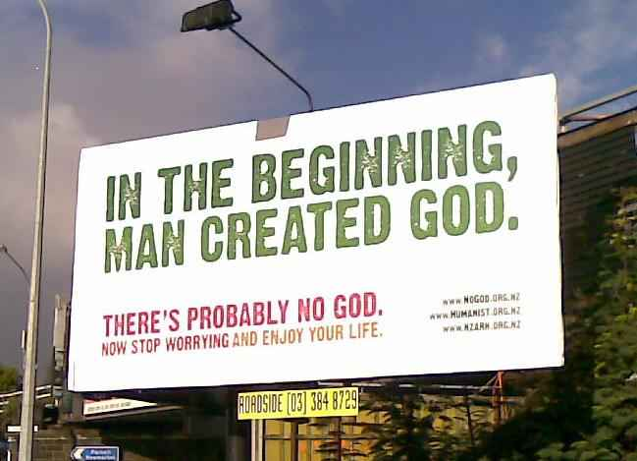

Slide 11
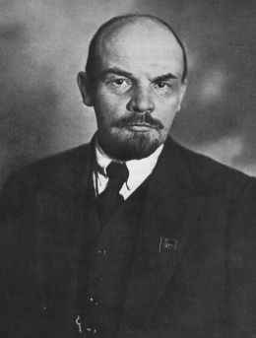
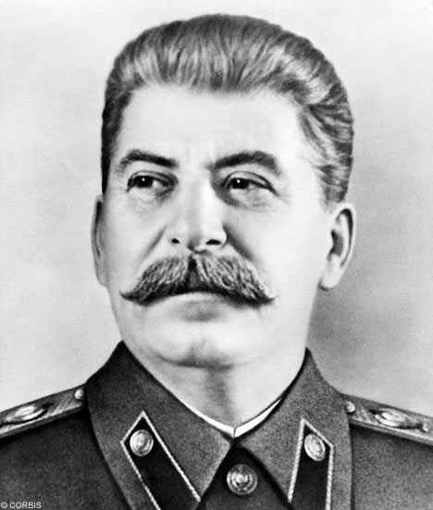
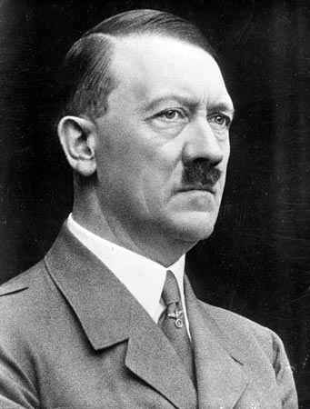
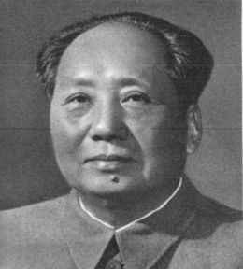
Atheists of 20th century..
Atheism and secularism are inherently anti-Christian and can only tear down..

Slide 12
Christ is in the business of building up..
Eccl 3:3 “There is a time to tear down, and a time to build up..”

Slide 13
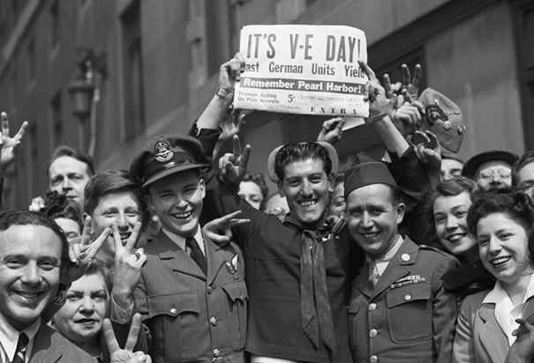
A time to build up..

Slide 14
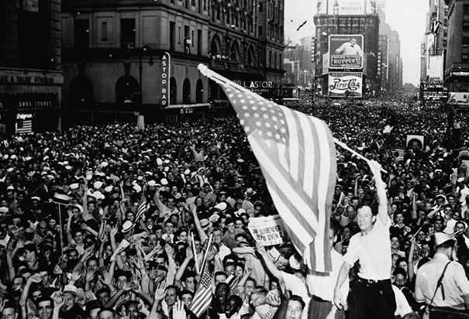

Slide 15
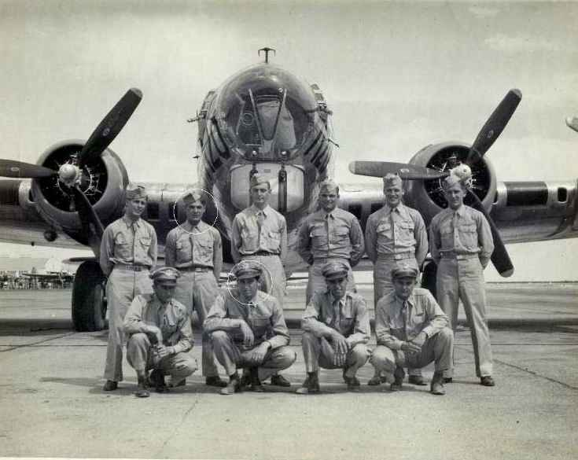
The Greatest Generation..
Built interstate highway system..
Developed corporations..
Advances in medicine, science, and technology..

Slide 16
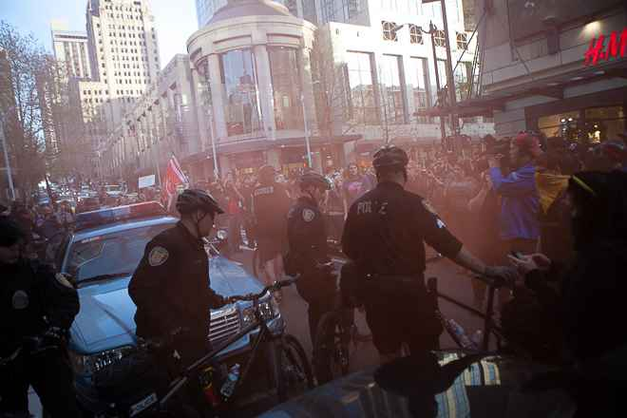
A time to tear down..
We’ve torn down integrity, purity, honesty, respect, national pride, ideals, dreams …

Slide 17
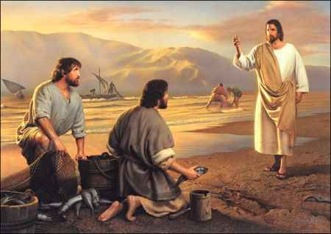
Jesus dealing with Peter…
“Follow me… I will make you fishers of men..”

Slide 18
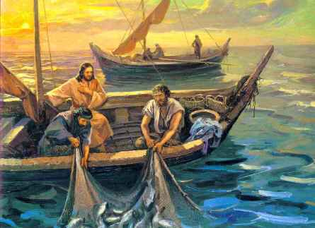

Slide 19
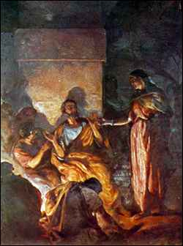
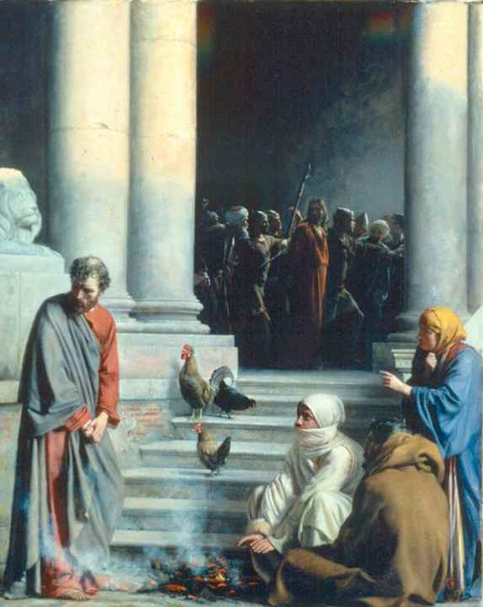
Peter’s time of tearing down…
“You will deny me three times .. afterwards strengthen your brethren..

Slide 20
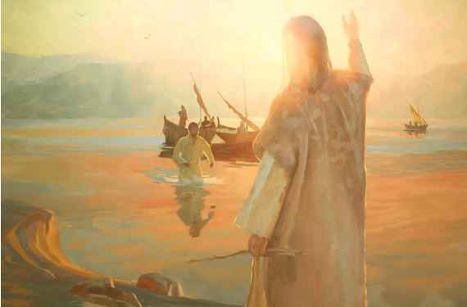
Peter’s time of building up..
John 21:1-6 But when the morning had now come, Jesus stood on the shore; yet the disciples did not know that it was Jesus. 5 Then Jesus said to them, "Children, have you any food?“ They answered Him, "No."
6 And He said to them, "Cast the net on the right side of the boat, and you will find some." So they cast, and now they were not able to draw it in because of the multitude of fish.

Slide 21
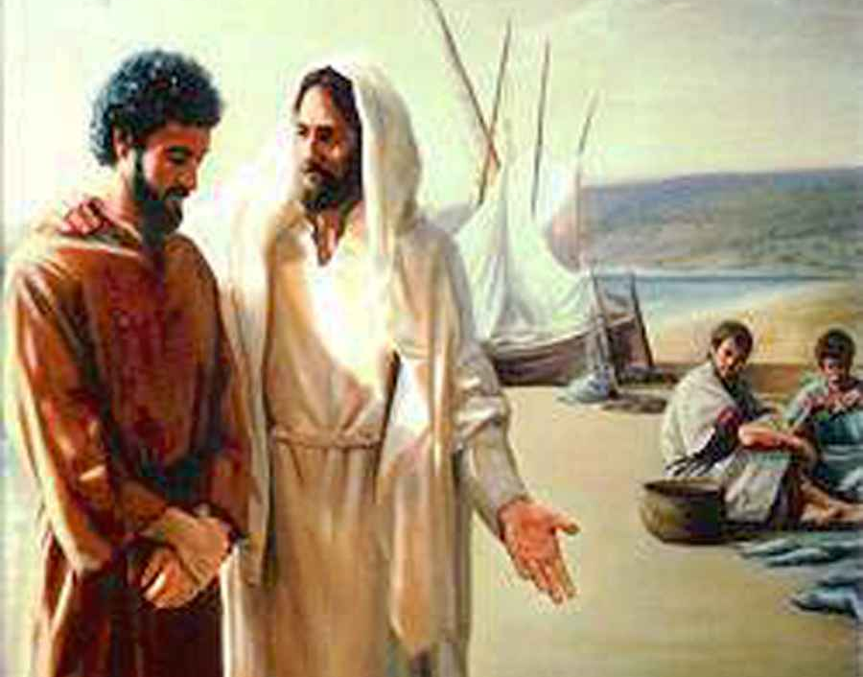
Building Peter back up..
John 21:15 So when they had eaten breakfast, Jesus said to Simon Peter, "Simon, son of Jonah, do you love Me more than these?" He said to Him, "Yes, Lord; You know that I love You”…17 He said to him the third time, "Simon, son of Jonah, do you love Me?" Peter was grieved because He said to him the third time, "Do you love Me?" And he said to Him, "Lord, You know all things; You know that I love You." Jesus said to him, "Feed My sheep.

Slide 22
Building Peter back up..
18 Most assuredly, I say to you, when you were younger, you girded yourself and walked where you wished; but when you are old, you will stretch out your hands, and another will gird you and carry you where you do not wish." 19 This He spoke, signifying by what death he would glorify God. And when He had spoken this, He said to him, "Follow Me."

Slide 23
Building Peter back up..
20 Then Peter, turning around, saw the disciple whom Jesus loved following, who also had leaned on His breast at the supper, and said, "Lord, who is the one who betrays You?" 21 Peter, seeing him, said to Jesus, "But Lord, what about this man?"
22 Jesus said to him, "If I will that he remain till I come, what is that to you? You follow Me."

Slide 24
Jesus taught Peter to build up…
Peter lived this out by faithfully devoting his life to building up others..

Slide 25
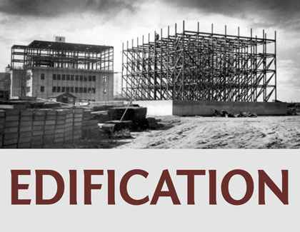
Edification..
Oikodomeo .. Oikos (house) domeo (to build)..

Slide 26
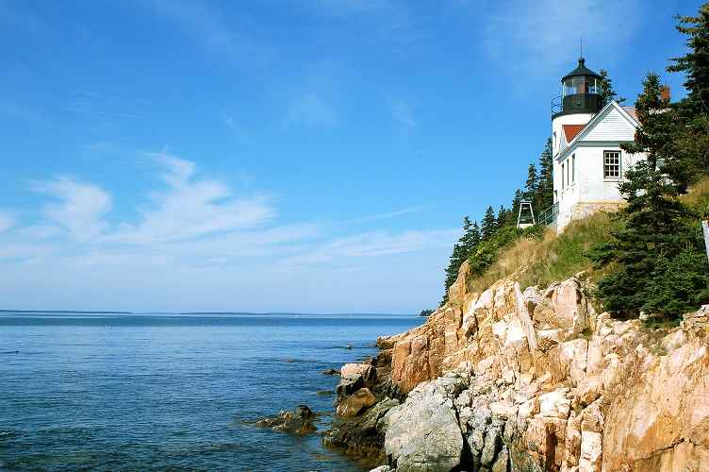
Building literal sense…
Matthew 7:24 "Therefore whoever hears these sayings of Mine, and does them, I will liken him to a wise man who built his house on the rock..

Slide 27
Jesus the builder..
Colossians 1:16-17 For by Him all things were created that are in heaven and that are on earth, visible and invisible, whether thrones or dominions or principalities or powers. All things were created through Him and for Him. 17 And He is before all things, and in Him all things consist.

Slide 28
Edification.. “Building people”..
1 Pet 2:5 – as living stones built up a spiritual house.. dwelling of God
1 Cor 3:16 – you are temple of God
Matt 16:18 – build My church..

Slide 29
Edifying others, not self..
1 Cor 10:23-24 All things are lawful for me, but not all things are helpful; all things are lawful for me, but not all things edify. 24 Let no one seek his own, but each one the other's well-being.
1 Corinthians 14:4 He who speaks in a tongue edifies himself, but he who prophesies edifies the church.

Slide 30
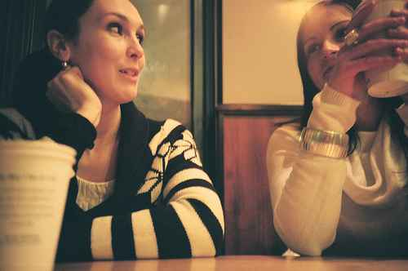
Edifying others, not self..
1 Thessalonians 5:11 Therefore comfort each other and edify one another, just as you also are doing.
Ephesians 4:29 Let no corrupt word proceed out of your mouth, but what is good for necessary edification, that it may impart grace to the hearers.

Slide 31
Pursue edification
Romans 14:19 Therefore let us pursue the things which make for peace and the things by which one may edify another.
1 Timothy 1:4 nor give heed to fables and endless genealogies, which cause disputes rather than godly edification which is in faith.

Slide 32
Not just knowledge..
1 Corinthians 8:1 Now concerning things offered to idols: We know that we all have knowledge. Knowledge puffs up, but love edifies.

Slide 33
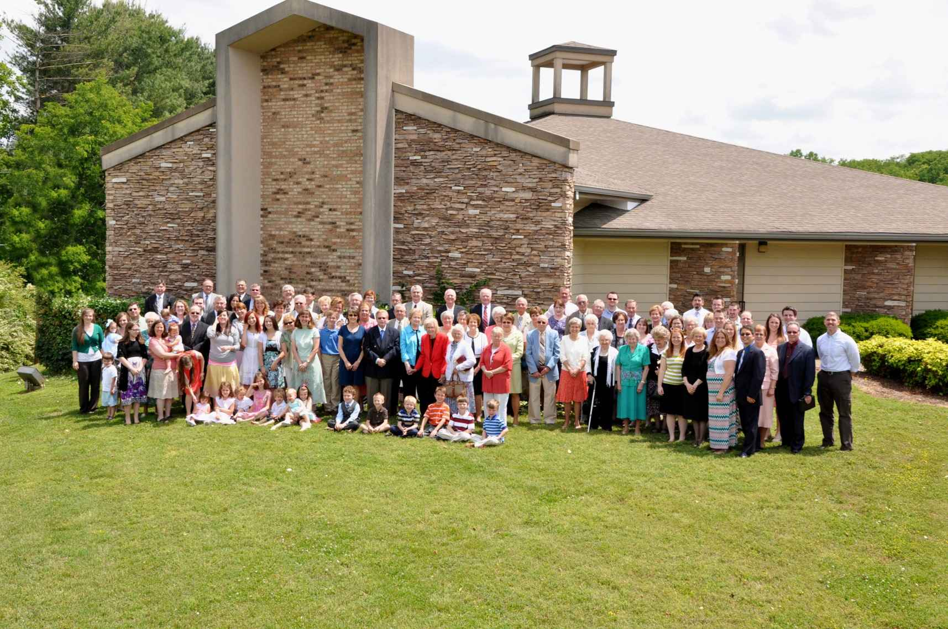
Use of spiritual gifts
1 Cor 14:12 Seek to excel for the edification of the church
1 Cor 14:26 let all be done for edification

Slide 34
Rely on God’s Word..
Acts 20:32 "So now, brethren, I commend you to God and to the word of His grace, which is able to build you up and give you an inheritance among all those who are sanctified.

Slide 35
Rely on God’s Word..
Jude 20-21 But you, beloved, building yourselves up on your most holy faith, praying in the Holy Spirit, 21 keep yourselves in the love of God, looking for the mercy of our Lord Jesus Christ unto eternal life.

Slide 36
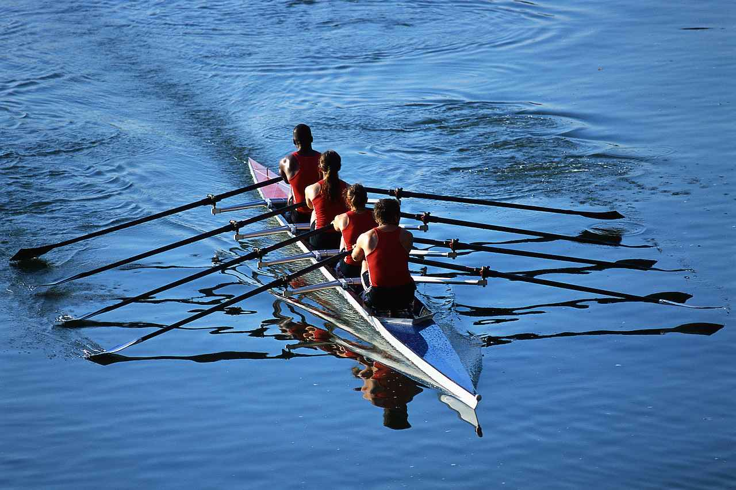

Slide 38
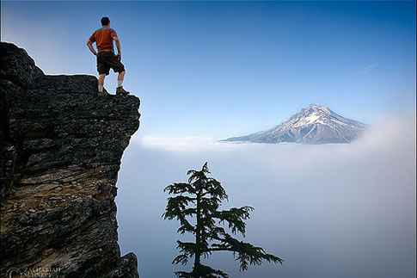
Staying constructive
There is a God…
Christ is returning..
The best is yet to come…

Slide 39
Let all be done for edification..
1 Corinthians 14:26 How is it then, brethren? Whenever you come together, each of you has a psalm, has a teaching, has a tongue, has a revelation, has an interpretation. Let all things be done for edification.

Slide 40
Staying Constructive in a Skeptical World
John 21:15-24

