Slide 1
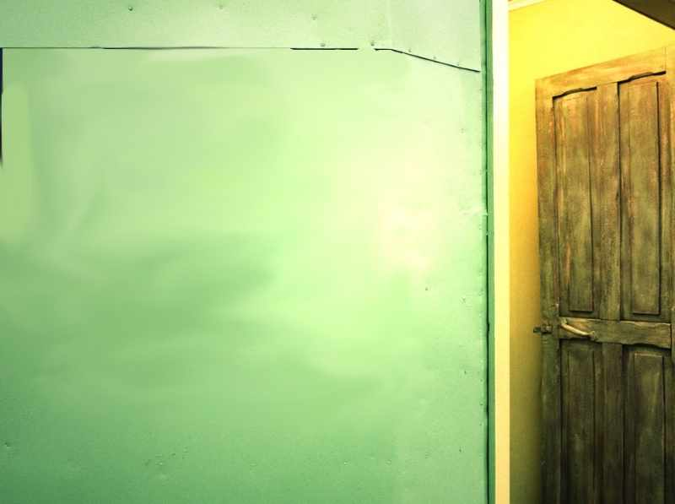
The Secret Place
Matthew 6: 5-8

Slide 2
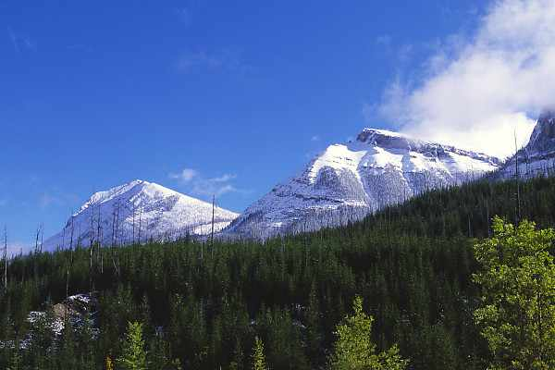
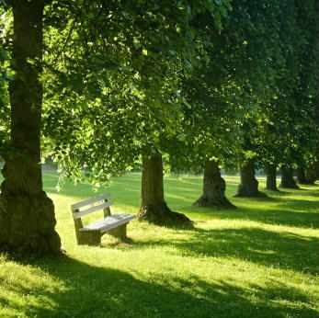
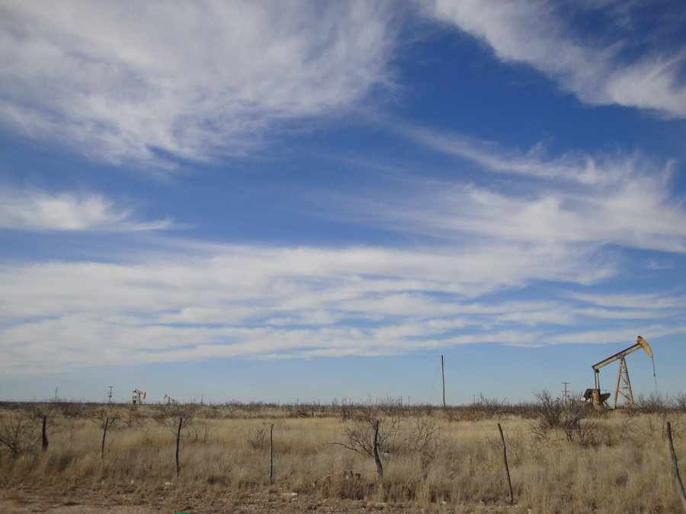
A place to be alone..

Slide 3
Time alone with God..
Matthew 6:5-6 "And when you pray, you shall not be like the hypocrites.. 6 But you, when you pray, go into your room, and when you have shut your door, pray to your Father who is in the secret place; and your Father who sees in secret will reward you openly.

Slide 4
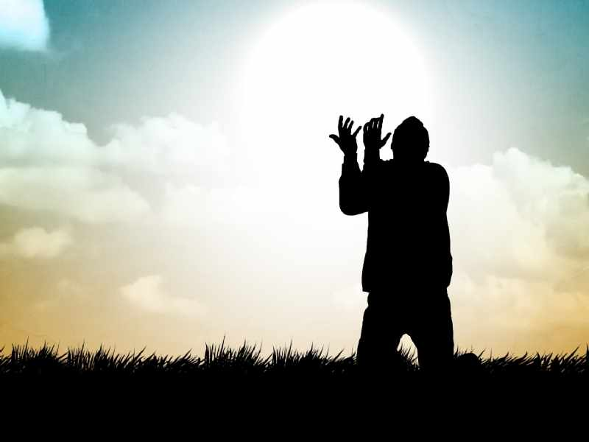
Our best praying..

Slide 5
1 Regular prayer time..
“But you, when you pray, go into your room, and when you have shut your door, pray to your Father who is in the secret place..”

Slide 6
When you pray..
Philippians 4:6-7 in everything by prayer and supplication, with thanksgiving, let your requests be made known to God..
Psalms 55:16-17 Evening and morning and at noon I will pray, and cry aloud, And He shall hear my voice.
Daniel 6:10 with his windows open toward Jerusalem, he knelt down on his knees three times that day, and prayed and gave thanks before his God, as was his custom ...

Slide 7
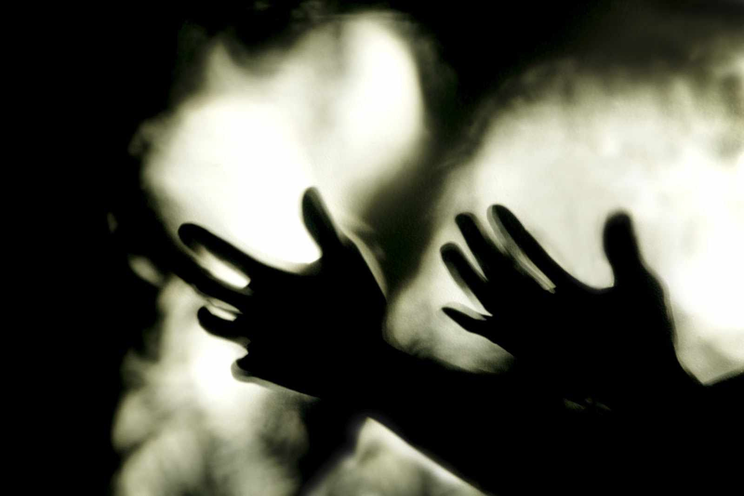
Pour out your heart..
Psalms 6:2-4 Have mercy on me, O Lord, for I am weak; O Lord, heal me, for my bones are troubled. 3 My soul also is greatly troubled; But You, O Lord — how long? 4 Return, O Lord, deliver me! Oh, save me for Your mercies' sake!
Psalms 55:4-5 My heart is severely pained within me, And the terrors of death have fallen upon me. 5 Fearfulness and trembling have come upon me, And horror has overwhelmed me.
1 Peter 5:6-7 casting all your care upon Him, for He cares for you.

Slide 8
2 Your private time ..
Matthew 6:5-6 "And when you pray, you shall not be like the hypocrites. For they love to pray standing in the synagogues and on the corners of the streets, that they may be seen by men. Assuredly, I say to you, they have their reward. 6 But you, when you pray, go into your room, and when you have shut your door, pray to your Father who is in the secret place; and your Father who sees in secret will reward you openly.

Slide 9
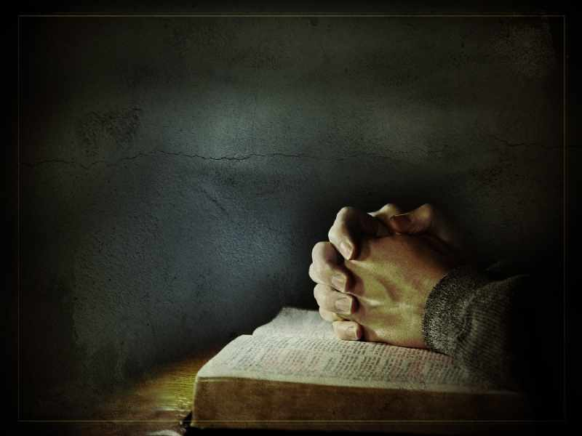
Quiet alone with God..
1 Thessalonians 5:17 pray without ceasing..
Mark 1:35 Now in the morning, having risen a long while before daylight, He went out and departed to a solitary place; and there He prayed.
Matthew 14:23 And when He had sent the multitudes away, He went up on the mountain by Himself to pray. Now when evening came, He was alone there.

Slide 10
3 Your personal relationship..
Matthew 6:4-6 when you pray, go into your room, and when you have shut your door, pray to your Father who is in the secret place; and your Father who sees in secret will reward you openly.

Slide 11
Your personal relationship..
Ephesians 1:4-5 just as He chose us in Him before the foundation of the world, that we should be holy and without blame before Him in love, 5 having predestined us to adoption as sons by Jesus Christ to Himself, according to the good pleasure of His will,
1 John 3:1 Behold what manner of love the Father has bestowed on us, that we should be called children of God!
John 1:11-12 He came to His own, and His own did not receive Him. 12 But as many as received Him, to them He gave the right to become children of God, to those who believe in His name..

Slide 12
Father and son/daughter..
Mark 14:36 And He said, "Abba, Father, all things are possible for You. Take this cup away from Me; nevertheless, not what I will, but what You will."
Galatians 4:6-7 And because you are sons, God has sent forth the Spirit of His Son into your hearts, crying out, "Abba, Father!" 7 Therefore you are no longer a slave but a son, and if a son, then an heir of God through Christ.

Slide 13
4 Your promised reward..
Matthew 6:4-6 when you pray, go into your room, and when you have shut your door, pray to your Father who is in the secret place; and your Father who sees in secret will reward you openly.

Slide 14
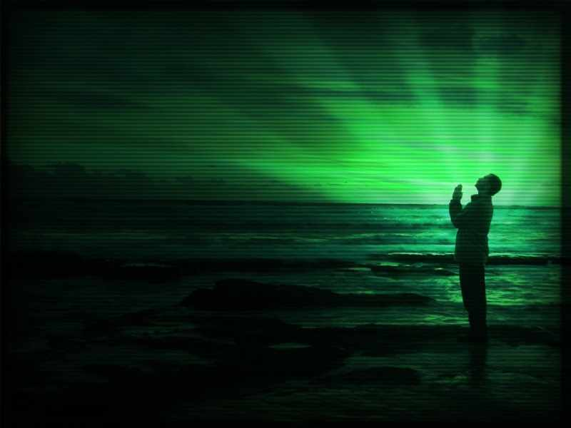
Seeking God…
Hebrews 11:6 But without faith it is impossible to please Him, for he who comes to God must believe that He is, and that He is a rewarder of those who diligently seek Him.

Slide 15
Our greatest reward..
Finding Him … knowing Him..
We begin to resemble Him..
Influence others by releasing the essence and fragrance of heaven..

Slide 16
The Secret Place
Matthew 6: 5-8

