Slide 1
What Do You Need to Go to Heaven?
1 Corinthians 1:1-2

Slide 2
Paul writes a local church..
1 Corinthians 1:1-2 Paul, called to be an apostle of Jesus Christ through the will of God, and Sosthenes our brother, to the church of God which is at Corinth, to those who are sanctified in Christ Jesus, called to be saints, with all who in every place call on the name of Jesus Christ our Lord, both theirs and ours..

Slide 3
What need to go to heaven?
To get started, baptism ... Acts 2:38
Start reading your Bible … Psa 119:105
Learning to pray … Matt 6:5-8
Your love for the Lord … Matt 22:35-38
Be part of a local church .. 1 Cor 1:1-2

Slide 4
Why people don’t want to join a church?
Too much commitment .. Gal 6:1-2
Too many negatives .. 1 Pet 2:9-10
Don’t want accountability.. Heb 3:13

Slide 5
Why you need the local church..
Identified a genuine believer.. Acts 9:26
Move out of isolation.. “one another”
Rom 12:10 be affectionate, preference to one another..
Rom 15:14 able admonish (instruct) one another..
2 Cor 13:11-12 of one mind, greet one another..
Ephesians 4:32 be kind to one another, forgiving ..
1 Thess 5:11 comfort each other,edify one another..

Slide 6
Why you need the local church..
Identified a genuine believer.. Acts 9:26
Move out of isolation.. “one another”
Opportunities to grow in serving.. Eph 4:16
Help you avoid falling away … Heb 3:13
Protect from sin, error.. Heb 13:17, Acts 20:29

Slide 7
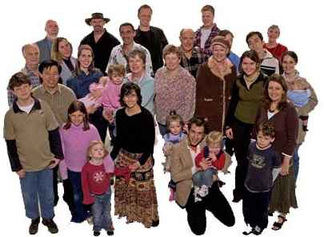
What Do You Need to Go to Heaven?
1 Corinthians 1:1-2

