Slide 1
Commit these to
2 Timothy 2:1-2

Slide 2
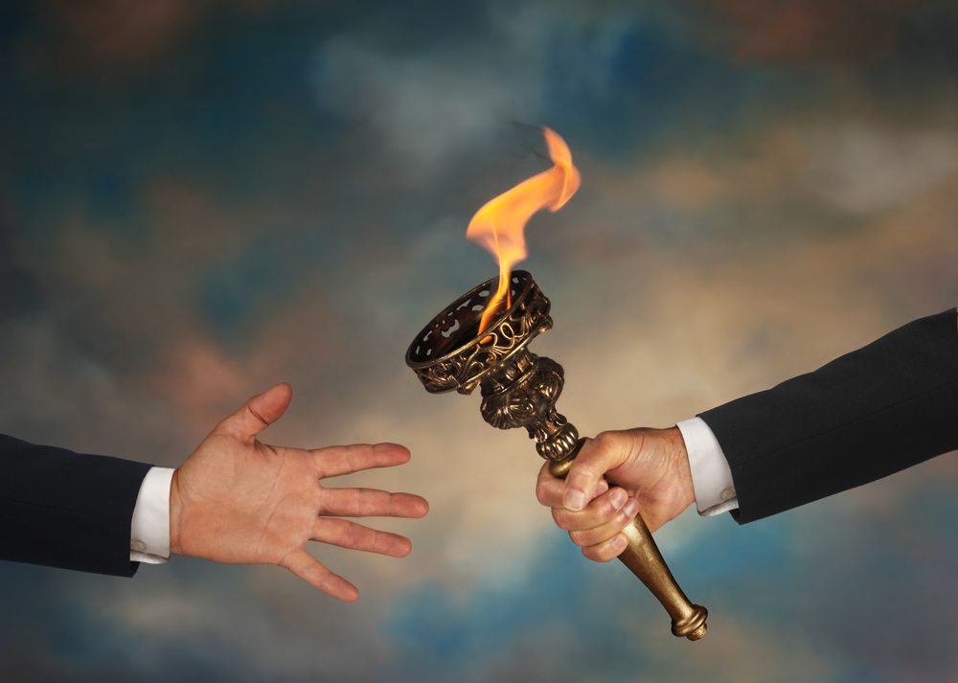
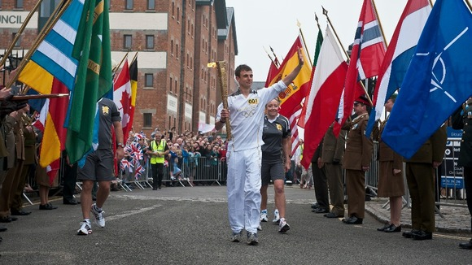
Passing the torch..

Slide 3
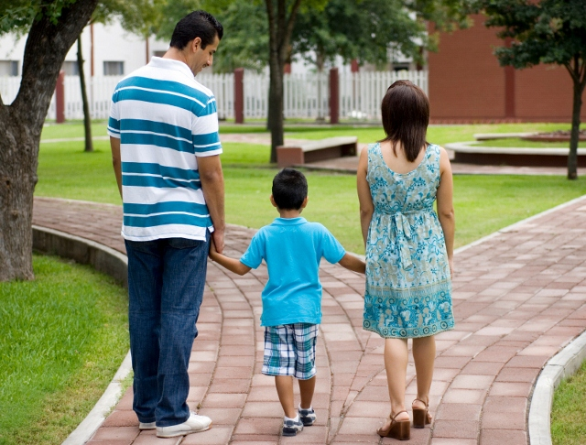

Slide 4
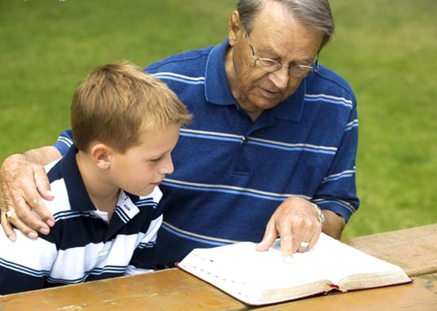

Slide 5
COMMIT THESE TO FAITHFUL MEN..
1. Able to teach others also..
- Matt 9:37-38..
2. Faithful men ..
- 2 Tim 4:7..
3. Faithful teachers ..
-2 Tim 2:15..
4. Commit these ..
- 2 Tim 1:13..
2 Tim 2:24..
Eph 4:12..
Judg 2:10..
Heb 10:23..
Eph 4:13-14..
2 Tim 2:24..
James 3:1..
Titus 2:1..
1 Cor 9:16-17..
2 Tim 4:2-4..

Slide 7
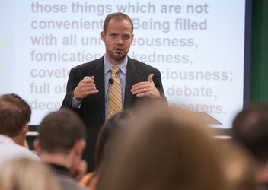

Slide 8
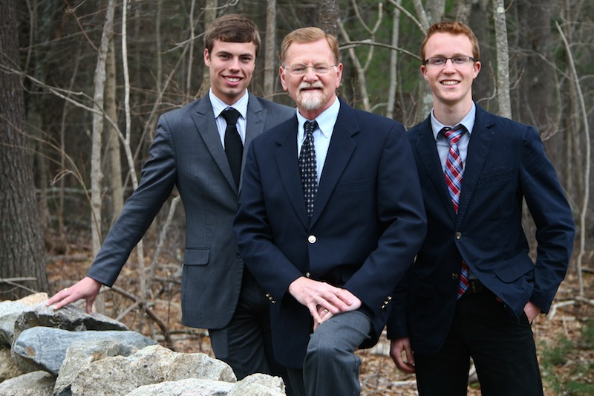

Slide 9
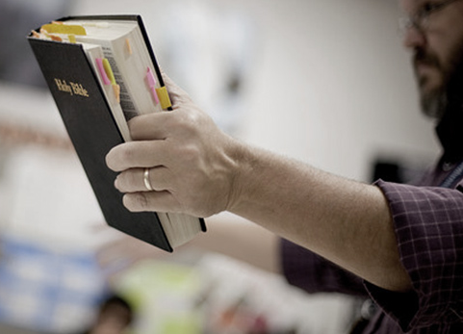

Slide 10
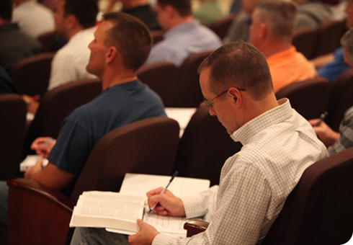

Slide 11
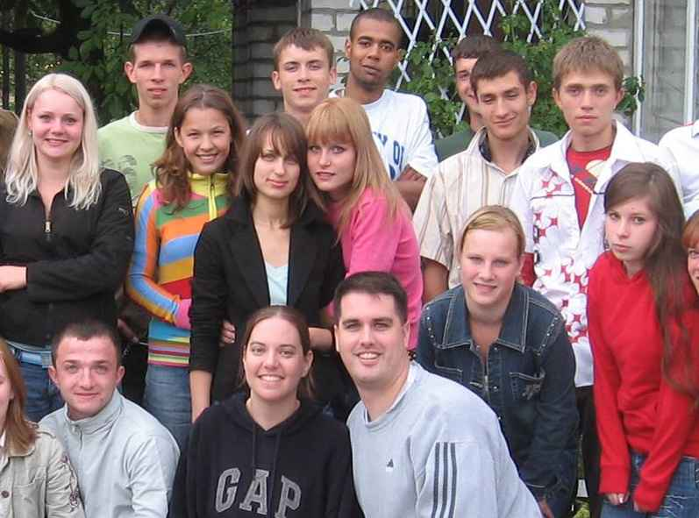

Slide 12
COMMIT THESE TO FAITHFUL
MEN
2 Timothy 2:1-2

