Slide 1
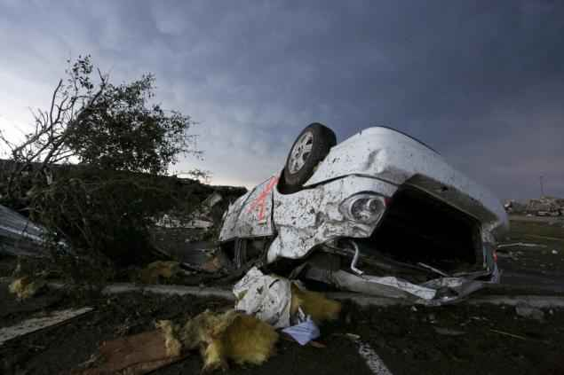
Sometimes Life isn’t Fair
Psalm 73:1-8, 21-28

Slide 2
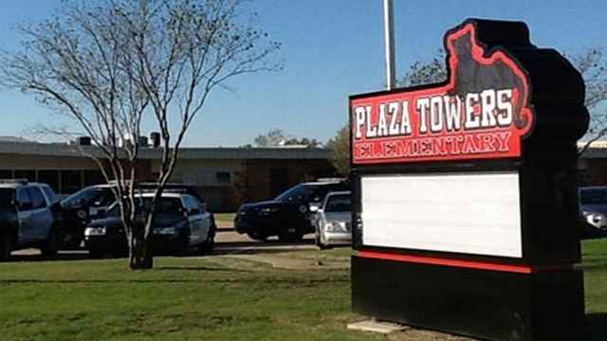
Moore, Oklahoma..

Slide 3
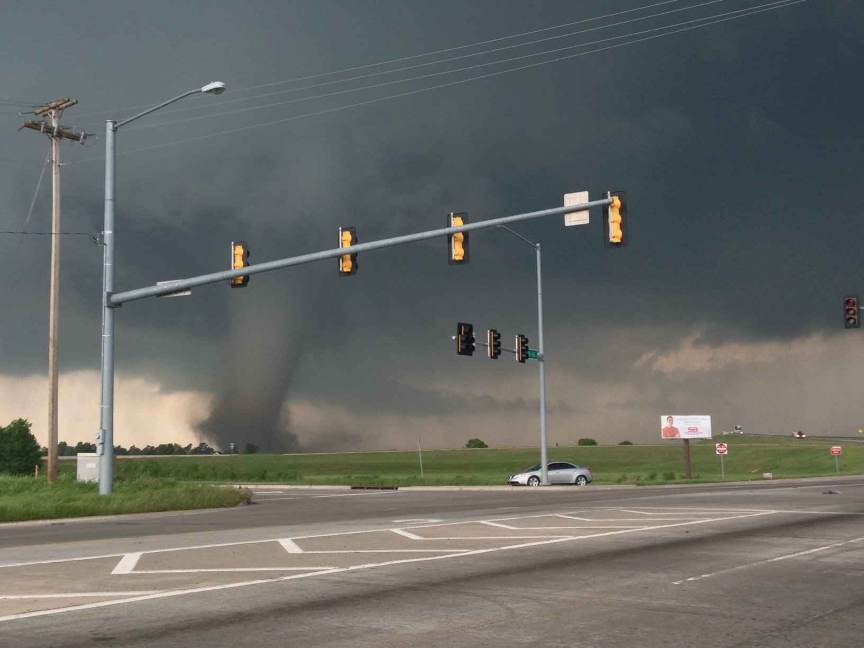

Slide 4
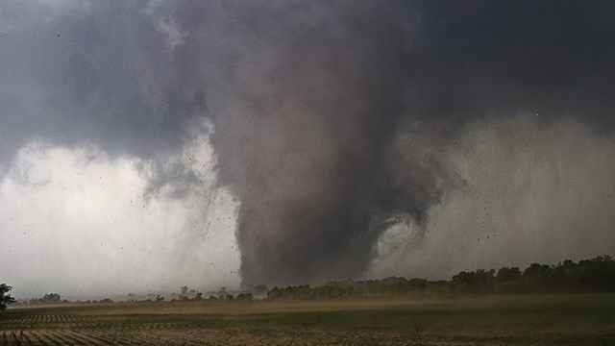

Slide 5
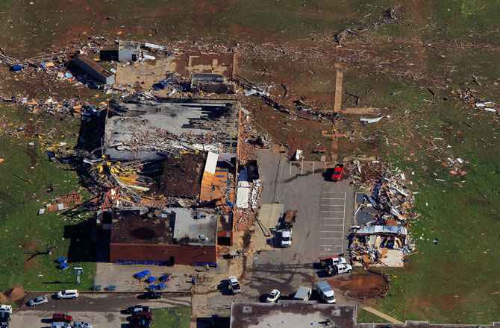

Slide 6
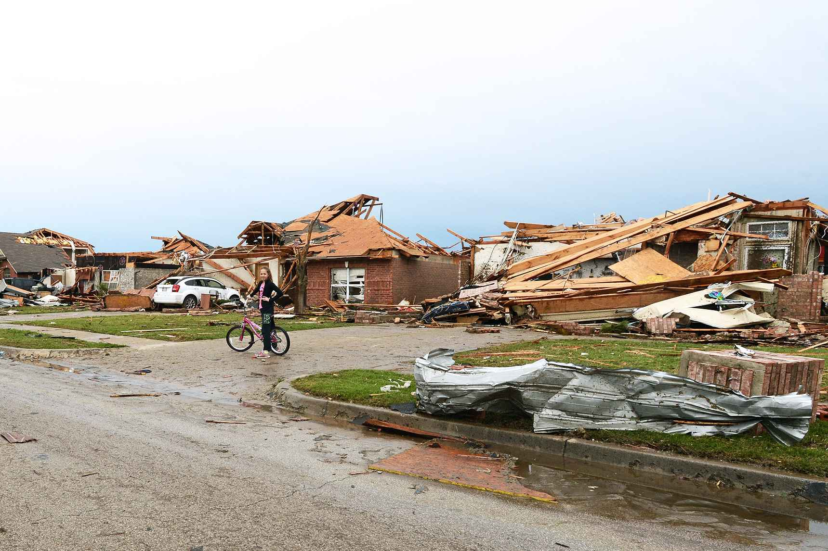

Slide 7
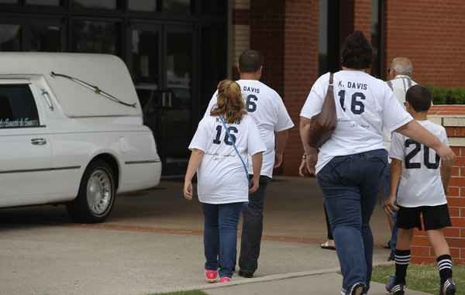

Slide 8
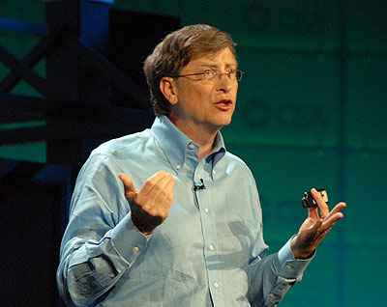
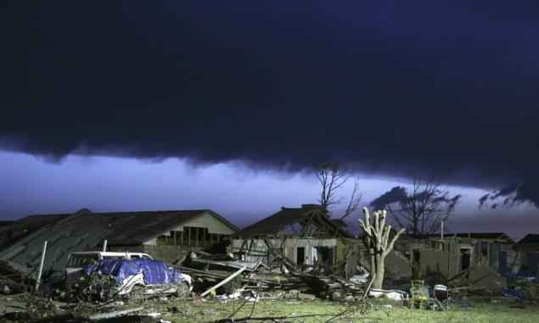
Bill Gates 10 rules for life..
“Life isn’t fair .. Get used to it..”

Slide 9
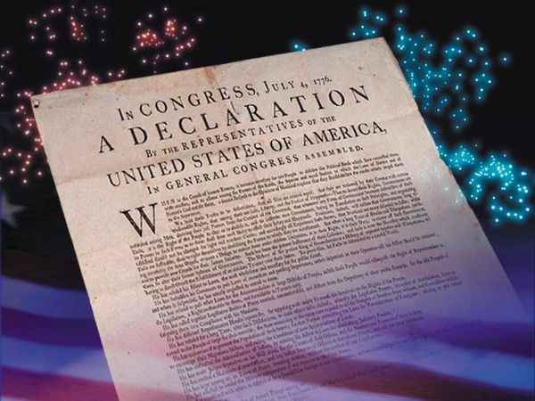

Slide 10
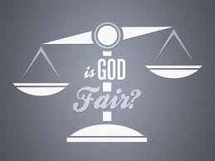

Slide 11
Blaming God..
Genesis 3:11-23 "Have you eaten from the tree of which I commanded you that you should not eat?" 12 Then the man said, "The woman whom You gave to be with me, she gave me of the tree, and I ate."

Slide 12
Suffering of Job..
Job 1:8 Then the Lord said to Satan, "Have you considered my servant Job? There is no one on earth like him; he is blameless and upright, a man who fears God and shuns evil."
9 So Satan answered the Lord and said, "Does Job fear God for nothing? 10 Have You not made a hedge around him, around his household, and around all that he has on every side? You have blessed the work of his hands, and his possessions have increased in the land. 11 But now, stretch out Your hand and touch all that he has, and he will surely curse You to Your face!"

Slide 13
1 God is not the Author of Evil…
Gen 3:17-19 Then to Adam He said, "Because you have heeded the voice of your wife, and have eaten from the tree of which I commanded you, saying, 'You shall not eat of it': "Cursed is the ground for your sake; In toil you shall eat of it All the days of your life. 18 Both thorns and thistles it shall bring forth for you..

Slide 14
1 God is not the Author of Evil…
Luke 13:1-5 There were present at that season some who told Him about the Galileans whose blood Pilate had mingled with their sacrifices. 2 And Jesus answered and said to them, "Do you suppose that these Galileans were worse sinners than all other Galileans, because they suffered such things? 3 I tell you, no; but unless you repent you will all likewise perish. 4 Or those eighteen on whom the tower in Siloam fell and killed them, do you think that they were worse sinners than all other men who dwelt in Jerusalem? 5 I tell you, no; but unless you repent you will all likewise perish."

Slide 15
1 God is not the Author of Evil…
God allowed the risk of free moral agency… Gen 2:16-18
God loved us when we were yet sinners .. Rom 5:6-8
God is still in control.. James 1:17

Slide 16
2 God can take evil and use it for good …
Romans 8:28 all things work together for good…
Pharoah and Egypt… God turned it for good..
Eph 5:25-27 .. Christ takes the church and presents it glorious…

Slide 17
3 Salvation is not fair…
If God gave us what was just, we would all be lost … Rom 3:23
Jonah preaching to Nineveh..Jonah 4
Prodigal’s older brother .. “it’s not fair”

Slide 18
Conclusions..
There’s no easy answer for tragedies that seem so unfair..
God will bring justice when Jesus comes .. 2 Thess 1:7-8
God is always faithful… we must trust Him.. Job 38-42

Slide 19
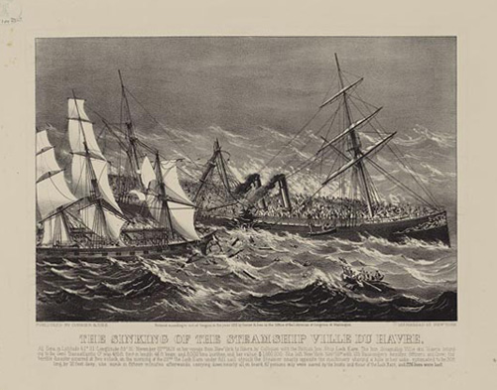
It is Well with My Soul..

Slide 20
Sometimes Life isn’t Fair
Psalm 73:1-8, 21-28

