Slide 1
Why Did Jesus Come
Into The World?
The Big Question
Why was Jesus born?
For what reason?
For what purpose?

Slide 2
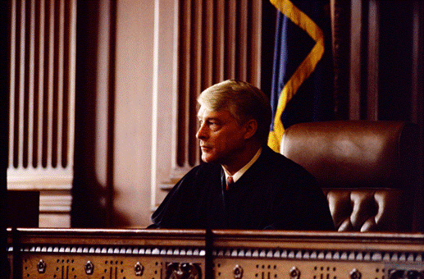
“I was born for this, and I have come into the world for this: to
testify to the truth.”
John 18:33-38
To state to be true, especially when open to question
Jesus testified to the truth claims of God.

Slide 3
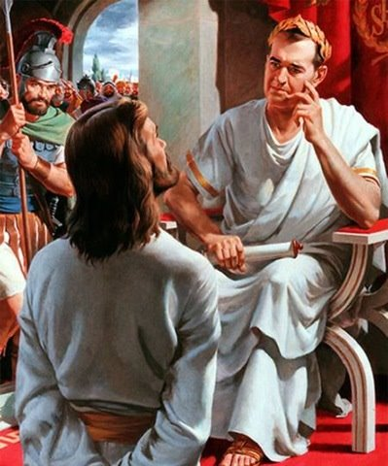
What is truth?
John 18:33-38
Jesus’
discourse
with Pilot

Slide 4
What IS Truth?
Not only was Jesus on trial, the truth claims of God were on trial.

Slide 5
1 Timothy 6:13
“I charge you in the presence of God, who gives life to all things, and of Christ Jesus, who testified the good confession before Pontius Pilate,”
What is truth?

Slide 6
Jesus on the Witness Stand
Matt 5:18 “For truly I say to you, until heaven and earth pass away…
Matt 10:15 “Truly I say to you, it will be more tolerable for the land of Sodom…
Matt 13:17 “For truly I say to you that many prophets …desired to see..
Matt 16:28 “Truly I say to you, there are some of those who are standing here…
Matt 17:20 “…for truly I say to you, if you have faith the size of a mustard seed,
Matt 18:3 “Truly I say to you, unless you are converted…
Matt 18:18 “Truly I say to you, whatever you bind on earth..
Matt 19:23 “Truly I say to you, it is hard for a rich man…
Matt 21:21 “Truly I say to you, if you have faith and do not doubt,…
Matt 23:36 “Truly I say to you, all these things will come upon this generation.
Matt 24:2 Truly I say to you, not one stone here will be left upon another…
Matt 25:40 ‘Truly I say to you, to the extent that you did it to one…
Matt 26:21 “Truly I say to you that one of you will betray Me.”
Matt 26:34 “Truly I say to you that this very night, before a rooster crows,

Slide 7
Jesus on the Witness Stand
John 3:3 “Truly, truly, I say to you, unless one is born again
John 3:5 “Truly, truly, I say to you, unless one is born of water
John 3:11 “Truly, truly, I say to you, we speak…and testify
John 5:19 “Truly, truly, I say to you, the Son can do nothing of Himself
John 5:24 “Truly, truly, I say to you, he who hears My word,
John 5:25 “Truly, truly, I say to you, an hour is coming
John 6:26 “Truly, truly, I say to you, you seek
John 6:32 “Truly, truly, I say to you, it is not Moses
John 6:47 “Truly, truly, I say to you, he who believes has eternal life.
John 6:53 “Truly, truly, I say to you, unless you eat the flesh
John 8:34 “Truly, truly, I say to you, everyone who commits sin
John 8:51 “Truly, truly, I say to you, if anyone keeps My word
John 8:58 “Truly, truly, I say to you, before Abraham was born, I am.”

Slide 8
Truth is on Trial.
Jesus’ Truth Claims are on Trial.

Slide 9
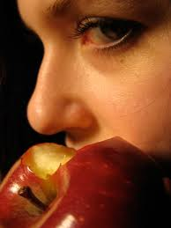
God’s
Truth Claim
“You will die.” Gen 2:17
Satan's
Truth Claim
“You will not die.” Gen 3:4

Slide 10
The Eternal Battle
God’s
Truth Claim
Satan's
Truth Claim
VS

Slide 11
The Bible’s Truth Claims
John 8:32
“and you will know the truth, and the truth will make you free.”

Slide 12
The Bible’s Truth Claims
For the Law was given through Moses; grace and truth were realized through Jesus Christ. John 1:17
Jesus said to him, “I am the way, and the truth, and the life; no one comes to the Father but through Me. John 14:6
“Sanctify them in the truth; Your word is truth. John 17:17
“God is spirit, and those who worship Him must worship in spirit and truth.” John 4:24

Slide 13
The Bible’s Truth Claims
John 14:16–17
“I will ask the Father, and He will give you another Helper, that He may be with you forever; that is the Spirit of truth, whom the world cannot receive, because it does not see Him or know Him, but you know Him because He abides with you and will be in you.”

Slide 14
The Bible’s Truth Claims
John 16:13
“But when He, the Spirit of truth, comes, He will guide you into all the truth; for He will not speak on His own initiative, but whatever He hears, He will speak; and He will disclose to you what is to come.”

Slide 15
The Bible’s Truth Claims
1 Timothy 2:3–4
“This is good and acceptable in the sight of God our Savior, who desires all men to be saved and to come to the knowledge of the truth.”

Slide 16
The Bible’s Truth Claims
Ephesians 6:14
“Stand firm therefore, having girded your loins with truth, and having put on the breastplate of righteousness,”

Slide 17
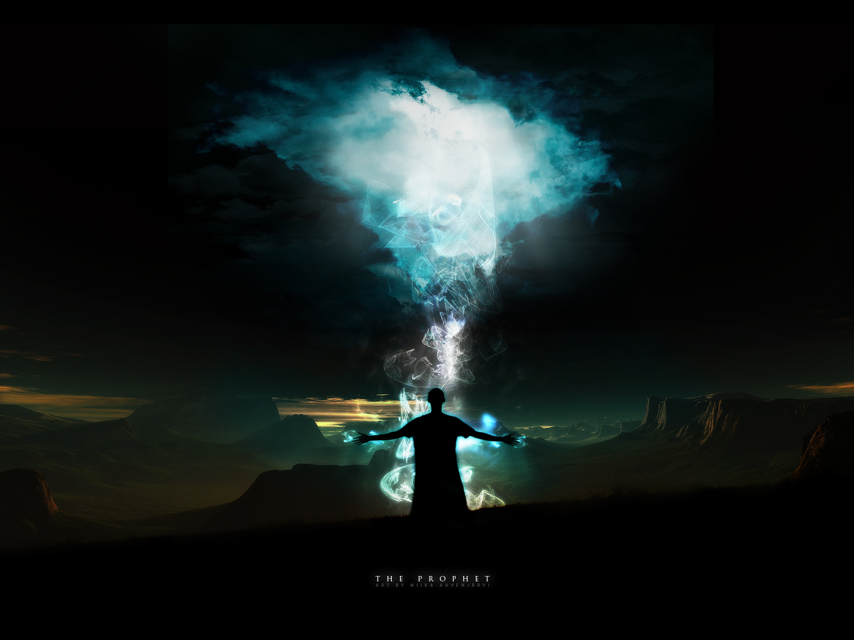
Jeremiah 7:28
“You shall say to them, ‘This is the nation that did not obey the voice of the Lord their God or accept correction; truth has perished and has been cut off from their mouth.”
Isaiah 59:14
“Justice is turned back, And righteousness stands far away; For truth has stumbled in the street, And uprightness cannot enter.”
The Prophets Lament

Slide 18
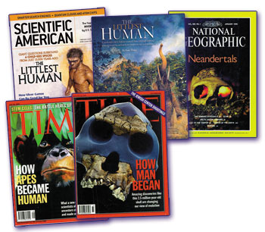
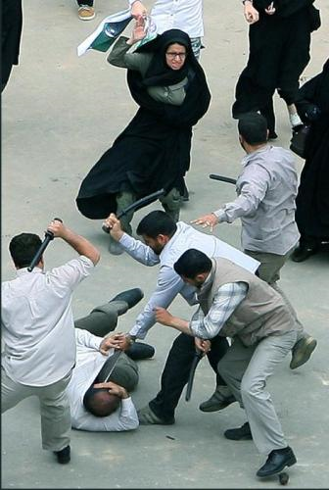
How does the world react to Truth?

Slide 19
How the world reacts to Truth?
1 Timothy 4:3-4
“For the time is coming when people will not endure sound teaching, but having itching ears they will accumulate for themselves teachers to suit their own passions, and will turn away from listening to the truth and wander off into myths.”

Slide 20
How the world reacts to Truth?
Romans 1:18
“For the wrath of God is revealed from heaven against all ungodliness and unrighteousness of men, who by their unrighteousness suppress the truth.”
Acts 20:30
“Even from among your own group men will arise, teaching perversions of the truth to draw the disciples away after them.” The NET Bible

Slide 21
How the world reacts to Truth?
Romans 2:8
“but for those who are self-seeking and do not obey the truth, but obey unrighteousness, there will be wrath and fury.”
Romans 1:25
“because they exchanged the truth about God for a lie and worshiped and served the creature rather than the Creator, who is blessed forever! Amen.”

Slide 22
The Real Trial.
Truth
VS
Lies

Slide 23
Everyone on the side
of truth listens to Jesus
John 18:37
Spirit of Truth
Spirit of Lies
(falsehood)
1 John 4:6
“We belong to God. And those who know God listen to us. But those who don’t belong to God don’t listen to us. That’s how we can tell the difference between the Spirit of truth and the spirit of lies.”

Slide 24
2 Thessalonians 2:9–13
“…that is, the one whose coming is in accord with the activity of Satan, with all power and signs and false (counterfeit) wonders, and with all the deception of wickedness for those who perish, because they did not receive the love of the truth so as to be saved.”

Slide 25
2 Thessalonians 2:9–13
“For this reason God will send upon them a deluding influence so that they will believe what is false, in order that they all may be judged who did not believe the truth, but took pleasure in wickedness. But we should always give thanks to God for you, brethren beloved by the Lord, because God has chosen you from the beginning for salvation through sanctification by the Spirit and faith in the truth.”

Slide 26
What men do to truth.
“For the time is coming when people will not endure sound teaching, but having itching ears they will accumulate for themselves teachers to suit their own passions, and will turn away from listening to the truth and wander off into myths.”
1 Timothy 4:3-4
“For the wrath of God is revealed from heaven against all ungodliness and unrighteousness of men, who by their unrighteousness suppress the truth.” Romans 1:18
“Even from among your own group men will arise, teaching perversions of the truth to draw the disciples away after them.”
Acts 20:30

Slide 27
What men do to truth.
“but for those who are self-seeking and do not obey the truth, but obey unrighteousness, there will be wrath and fury.”
Romans 2:8
“because they exchanged the truth about God for a lie and worshiped and served the creature rather than the Creator, who is blessed forever! Amen.”
Romans 1:25

Slide 28
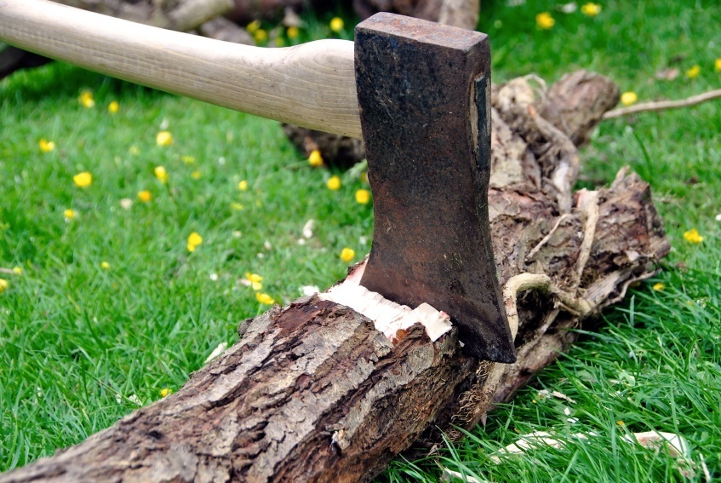
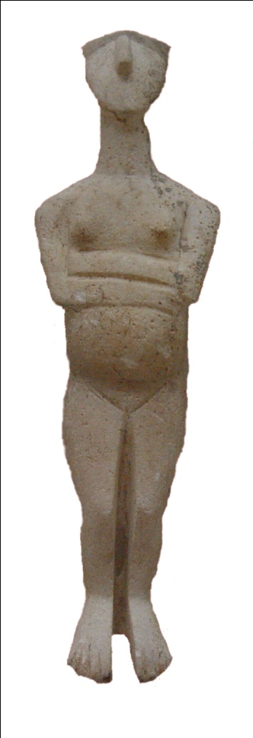
from this to a god

Slide 29
Isaiah 44:14 -15
“He cuts down cedars, or he chooses a cypress tree or an oak and lets it grow strong among the trees of the forest. He plants a cedar and the rain nourishes it. Then it becomes fuel for a man. He takes a part of it and warms himself; he kindles a fire and bakes bread. Also he makes a god and worships it; he makes it an idol and falls down before it.”

Slide 30
Isaiah 44:16-18
“Half of it he burns in the fire. Over the half he eats meat; he roasts it and is satisfied. Also he warms himself and says, “Aha, I am warm, I have seen the fire!” And the rest of it he makes into a god, his idol, and falls down to it and worships it. He prays to it and says, “Deliver me, for you are my god!” They know not, nor do they discern, for he has shut their eyes, so that they cannot see, and their hearts, so that they cannot understand.”

Slide 31
Isaiah 44:19-20
“No one considers, nor is there knowledge or discernment to say, “Half of it I burned in the fire; I also baked bread on its coals; I roasted meat and have eaten. And shall I make the rest of it an abomination? Shall I fall down before a block of wood?”
He feeds on ashes; a deluded heart has led him astray, and he cannot deliver himself or say, Is there not a lie in my right hand?”

Slide 32
Wisdom So-called
Colossians 2:2–4
“…Christ Himself, in whom are hidden all the treasures of wisdom and knowledge. I say this in order that no one may delude you with persuasive argument.”

