Slide 1
Forgiveness in the Old Testament
Psalm 103:8-12

Slide 2
God’s lovingkindness..
Psalms 103:8-14 The Lord is merciful and gracious, Slow to anger, and abounding in mercy…10 He has not dealt with us according to our sins, Nor punished us according to our iniquities. 11 For as the heavens are high above the earth, So great is His mercy toward those who fear Him; 12 As far as the east is from the west, So far has He removed our transgressions from us.

Slide 3
Seeming difficulty..
How could there be forgiveness before Jesus died?
Does the Old Testament say that sins were being forgiven?
Doesn’t the N.T. say that animal sacrifices could not take away sin?

Slide 4
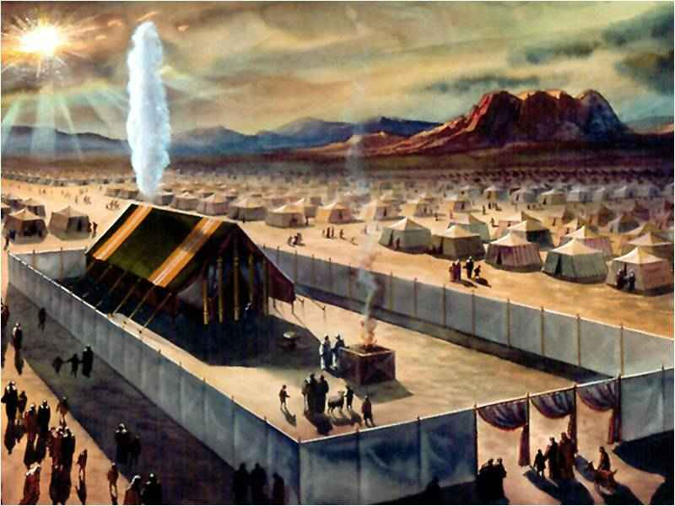
Sacrifices under the law…
Leviticus 4:20 And he shall do with the bull as he did with the bull as a sin offering; thus he shall do with it. So the priest shall make atonement for them, and it shall be forgiven them.
Leviticus 4:26 he shall burn all its fat on the altar, like the fat of the sacrifice of the peace offering. So the priest shall make atonement for him concerning his sin, and it shall be forgiven him.

Slide 5
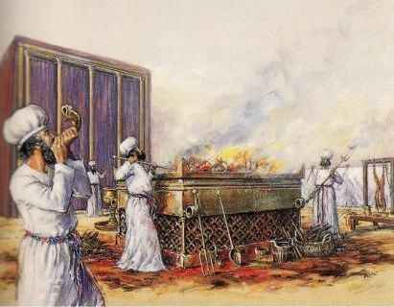
Leviticus 4:31 the priest shall burn it on the altar for a sweet aroma to the Lord. So the priest shall make atonement for him, and it shall be forgiven him. (4:35; 5:10,13,16,18; 6:7; 19:22)

Slide 6
God is merciful..
Exodus 34:6-7 "The Lord, the Lord God, merciful and gracious, longsuffering, and abounding in goodness and truth, 7 keeping mercy for thousands, forgiving iniquity and transgression and sin, by no means clearing the guilty, visiting the iniquity of the fathers upon the children and the children's children to the third and the fourth generation."

Slide 7
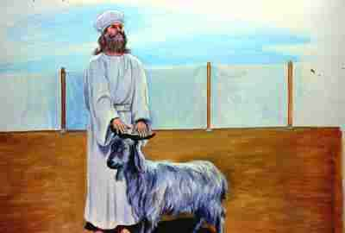
Day of Atonement..
Leviticus 16:30 For on that day the priest shall make atonement for you, to cleanse you, that you may be clean from all your sins before the Lord.

Slide 8
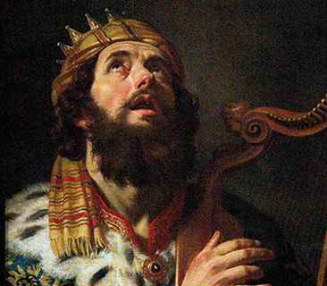
Sins of David..
2 Samuel 11-12 Adultery, attempting to cover up his sin, murder of Uriah..

Slide 9
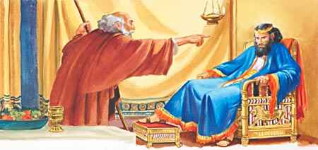
God sends Nathan..
2 Samuel 12:13 So David said to Nathan, "I have sinned against the Lord." And Nathan said to David, "The Lord also has put away your sin; you shall not die.
Psalms 32:1-2 Blessed is he whose transgression is forgiven, Whose sin is covered. 2 Blessed is the man to whom the Lord does not impute iniquity, And in whose spirit there is no deceit.

Slide 10
Ministry of John and Jesus..
Mark 1:4 John came baptizing in the wilderness and preaching a baptism of repentance for the remission of sins.
Mark 2:5-11 When Jesus saw their faith, He said to the paralytic, "Son, your sins are forgiven you." 10 But that you may know that the Son of Man has power on earth to forgive sins" — He said to the paralytic, 11 "I say to you, arise, take up your bed, and go to your house."

Slide 11
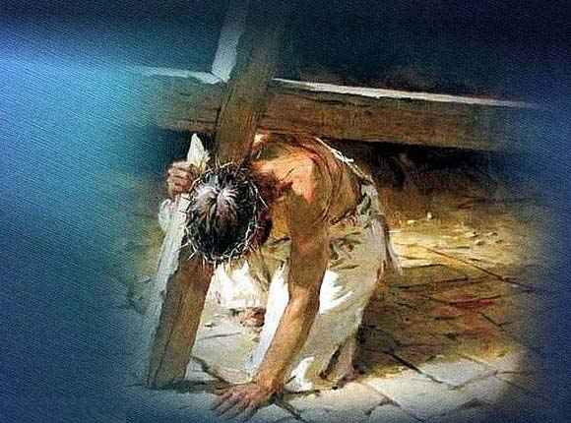
NT vantage point..
John 1:29 "Behold! The Lamb of God who takes away the sin of the world!
Galatians 2:21 I do not set aside the grace of God; for if righteousness comes through the law, then Christ died in vain."

Slide 12
New Covenant..
Hebrews 9:15 And for this reason He is the Mediator of the new covenant, by means of death, for the redemption of the transgressions under the first covenant, that those who are called may receive the promise of the eternal inheritance.

Slide 13
New Covenant..
Hebrews 9:24-28 For Christ has not entered the holy places made with hands, which are copies of the true, but into heaven itself, now to appear in the presence of God for us; 25 not that He should offer Himself often, as the high priest enters the Most Holy Place every year with blood of another — 26 He then would have had to suffer often since the foundation of the world; but now, once at the end of the ages, He has appeared to put away sin by the sacrifice of Himself. 27 And as it is appointed for men to die once, but after this the judgment, 28 so Christ was offered once to bear the sins of many. To those who eagerly wait for Him He will appear a second time, apart from sin, for salvation.

Slide 14
New Covenant..
Hebrews 10:3-4 But in those sacrifices there is a reminder of sins every year. 4 For it is not possible that the blood of bulls and goats could take away sins.
Hebrews 10:11-14 And every priest stands ministering daily and offering repeatedly the same sacrifices, which can never take away sins. 12 But this Man, after He had offered one sacrifice for sins forever, sat down at the right hand of God, 13 from that time waiting till His enemies are made His footstool. 14 For by one offering He has perfected forever those who are being sanctified.

Slide 15
Did God not truly forgive their sins?
To deny the promises of forgiveness under the law questions the OT..
How can we see that both OT and NT are correct?

Slide 16
Book of Romans..
Romans 3:23-26 for all have sinned and fall short of the glory of God, 24 being justified freely by His grace through the redemption that is in Christ Jesus, 25 whom God set forth as a propitiation by His blood, through faith, to demonstrate His righteousness, because in His forbearance God had passed over the sins that were previously committed, 26 to demonstrate at the present time His righteousness, that He might be just and the justifier of the one who has faith in Jesus.

Slide 17
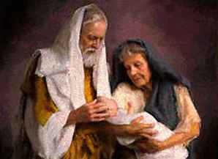
Book of Romans..
Romans 4:15-17 Therefore it is of faith that it might be according to grace, so that the promise might be sure to all the seed, not only to those who are of the law, but also to those who are of the faith of Abraham, who is the father of us all 17 (as it is written, "I have made you a father of many nations") in the presence of Him whom he believed — God, who gives life to the dead and calls those things which do not exist as though they did...

Slide 18
God dwells outside time…
God saw what was to come as an accomplished cetainty …

Slide 19
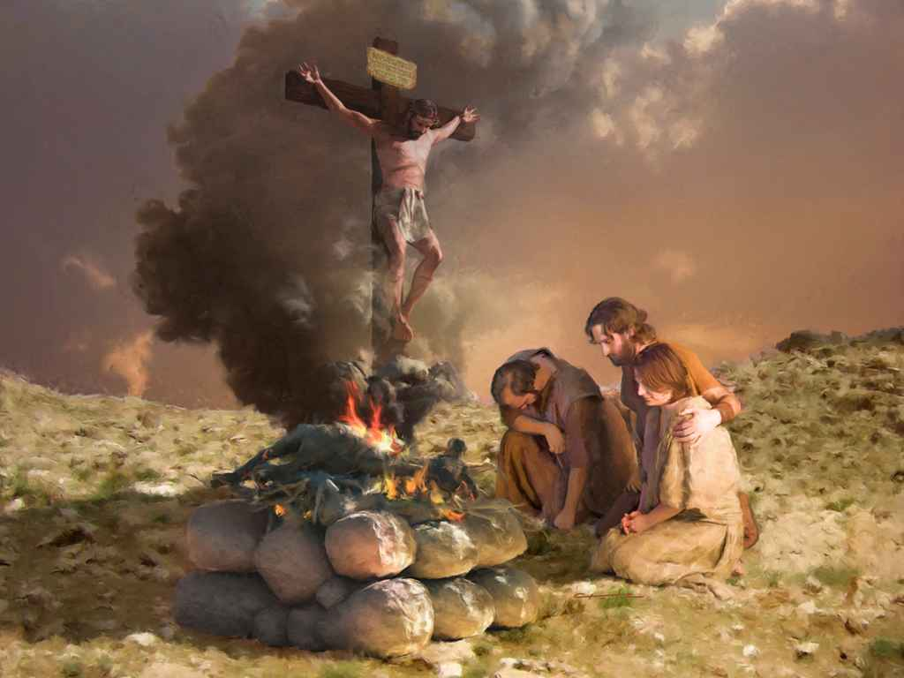
The sacrifices under the OT were types and shadows of things to come…

Slide 20
God calls things that do not exist as though they are..
Romans 4:18-22 who, contrary to hope, in hope believed, so that he became the father of many nations, according to what was spoken, "So shall your descendants be." 19 And not being weak in faith, he did not consider his own body, already dead (since he was about a hundred years old), and the deadness of Sarah's womb. 20 He did not waver at the promise of God through unbelief, but was strengthened in faith, giving glory to God, 21 and being fully convinced that what He had promised He was also able to perform. 22 And therefore "it was accounted to him for righteousness."

Slide 21
Forgiveness in the Old Testament
Psalm 103:8-12

