Slide 1
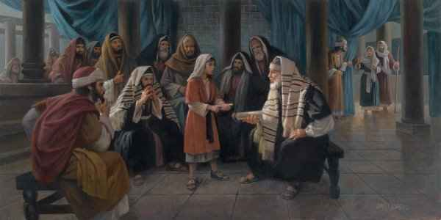
In My Father’s Business
Learning from Jesus

Slide 2
Jesus’ childhood..
From infancy to adult .. 30 years ..
Luke chose this one event in His life..
We see Jesus growing and seeing His purpose in life …

Slide 3
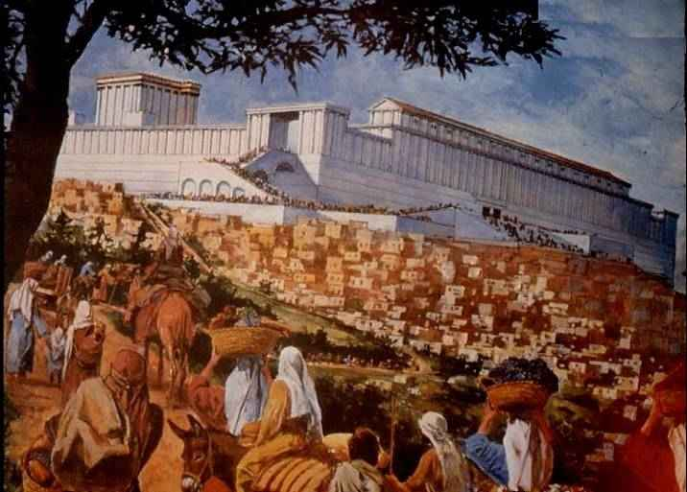
His parents’ spiritual dedication and emphasis..
Luke 2:22 according to the law of Moses.., they brought Him to Jerusalem to present Him to the Lord .. 23 as it is written in the law of the Lord..
2:27 to do for Him according to the custom of the law..
2:39-40 So when they had performed all things according to the law of the Lord, they returned to Galilee, to their own city, Nazareth. 40 And the Child grew and became strong in spirit, filled with wisdom; and the grace of God was upon Him.

Slide 4
His parents’ spiritual dedication and emphasis..
Luke 2:41 His parents went to Jerusalem every year at the Feast of the Passover.
Jewish males over 21 yrs required to attend feasts (Exod 23:14-17; 34:23; Deut 16:16)
From Nazareth – 65 to 80 miles..
Luke 2:42 And when He was twelve years old, they went up to Jerusalem according to the custom of the feast.

Slide 5
His parents’ spiritual dedication and emphasis..
Luke 4:16 So He came to Nazareth, where He had been brought up. And as His custom was, He went into the synagogue on the Sabbath day, and stood up to read.
Joseph and Mary took their role seriously as parents to do what was best for their family spiritually..

Slide 6
Jesus takes responsibility for his own spiritual growth..
Phase 1 (age 5) .. school to learn to read and memorize Law of Moses..
Phase 2 (age 10)..study the Talmud
Age 12-13 … becoming a man
Phase 3 for gifted.. young men allowed to discuss, ask questions..

Slide 7
Jesus takes responsibility for his own spiritual growth..
Luke 2:43-44 When they had finished the days, as they returned, the Boy Jesus lingered behind in Jerusalem. And Joseph and His mother did not know it; 44 but supposing Him to have been in the company, they went a day's journey, and sought Him among their relatives and acquaintances.

Slide 8
Jesus takes responsibility for his own spiritual growth..
Luke 2:45-46 So when they did not find Him, they returned to Jerusalem, seeking Him. 46 Now so it was that after three days they found Him in the temple, sitting in the midst of the teachers, both listening to them and asking them questions.

Slide 9
Jesus takes responsibility for his own spiritual growth..
Luke 2:47-48 And all who heard Him were astonished at His understanding and answers. 48 So when they saw Him, they were amazed; and His mother said to Him, "Son, why have You done this to us? Look, Your father and I have sought You anxiously."

Slide 10
Jesus takes responsibility for his own spiritual growth..
Luke 2:49 And He said to them, "Why did you seek Me? Did you not know that I must be about My Father's business?"

Slide 11
Jesus accepted being subject to His parents..
Luke 2:50-52 But they did not understand the statement which He spoke to them. 51 Then He went down with them and came to Nazareth, and was (continued in) subject to them, but His mother kept all these things in her heart.

Slide 12
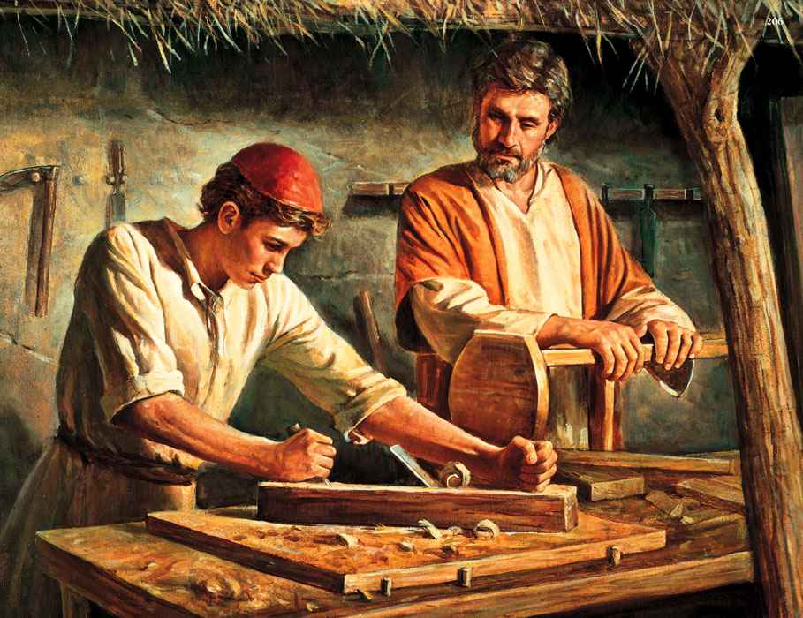
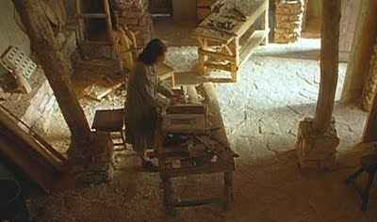
Jesus accepted being subject to His parents..
“He who does not teach his son a trade teaches him to steal”
Mark 6:3 Is this not the carpenter, the Son of Mary, and brother of James, Joses, Judas, and Simon? And are not His sisters here with us?" So they were offended at Him.
He grew as a young man learning skills, being human (Phil 2:5-8; Heb 5:8-9)

Slide 13
He continued to grow in every area..
Luke 2:52 And Jesus increased in wisdom and stature, and in favor with God and men.
Luke 2:40 And the Child grew and became strong in spirit, filled with wisdom; and the grace of God was upon Him.

Slide 14
Lessons we can learn..
Jesus was unique as both human and divine Son of God.. Sense of identity
We can have strong sense of identity that we are human sons of God..
God has a plan for our lives .. We must be about the Father’s business

Slide 15
Lessons we can learn..
We must prepare ourselves to be about the Father’s business.
Those involved will face scorn and suffering… (1 Pet 2:21ff; 2 Tim 3:12)
Jesus will strengthen us to do His will (Eph 3:16-20; Col. 1:11; Jas 1:2-4)

Slide 16
Lessons we can learn..
The Father’s business is people .. Matt 5:44-45; John 3:16
My Father’s business is serving people .. Phil 2:5-9; Luke 10:29-37
My Father’s business is saving people .. 2 Pet 3:9; Mark 16:15-16; Gal 6:1-2

Slide 17
In My Father’s Business
Learning from Jesus

