Slide 1
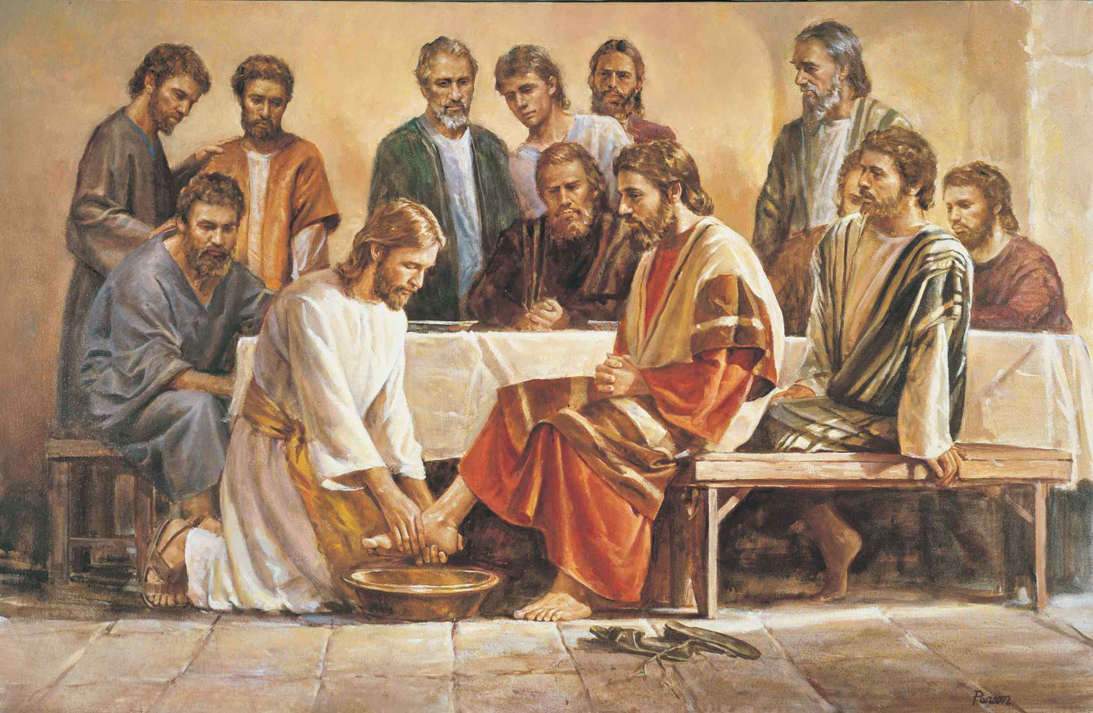
Jesus’ Model for Ministry
John 13:1-17

Slide 2
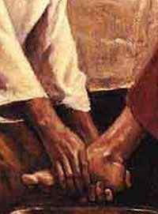
What was Jesus thinking?
John 13:1-3 Now before the Feast of the Passover, when Jesus knew that His hour had come that He should depart from this world to the Father, having loved His own who were in the world, He loved them to the end. 2 And supper being ended, the devil having already put it into the heart of Judas Iscariot, Simon's son, to betray Him, 3 Jesus, knowing that the Father had given all things into His hands, and that He had come from God and was going to God,

Slide 3
What were the disciples thinking?
Luke 22:22-26 Now there was also a dispute among them, as to which of them should be considered the greatest. 25 And He said to them, "The kings of the Gentiles exercise lordship over them, and those who exercise authority over them are called 'benefactors.' 26 But not so among you; on the contrary, he who is greatest among you, let him be as the younger, and he who governs as he who serves.

Slide 4
How did Jesus react?
John 13:3-5 Jesus, knowing that the Father had given all things into His hands, and that He had come from God and was going to God, 4 rose from supper and laid aside His garments, took a towel and girded Himself. 5 After that, He poured water into a basin and began to wash the disciples' feet, and to wipe them with the towel with which He was girded.

Slide 5
What does this teach us?
We learn to lead by serving…
The road to greatness is through service…
Humility is a Godlike virtue..

Slide 6
Attitudes we must develop..
Alert to opportunities to serve.. Mark 13:37
Learn to be obedient.. John 6:38; Phil 2:5-8
Learn to take initiative.. take the first step

Slide 7
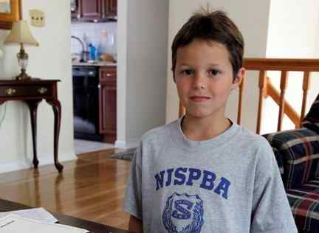
Reese Ronceray, 9, saved a 5-year-old neighbor from drowning. He is being given a $10,000 scholarship from Centenary College, where he learned to swim.

Slide 8
Attitudes we must develop..
Be industrious .. not too good to do hard work.. John 9:4
Be shrewd and wise .. Luke 16:1-13
Be willing to serve beyond duty.. Luke 19:10; Luke 17:10; Matt 5:40-42 go extra mile
John 13:17 If you know these things, blessed are you if you do them.

Slide 9
Application
Look for ways to serve in your church family..
Look for ways to serve in your earthly family.. Gal 6:10

Slide 10
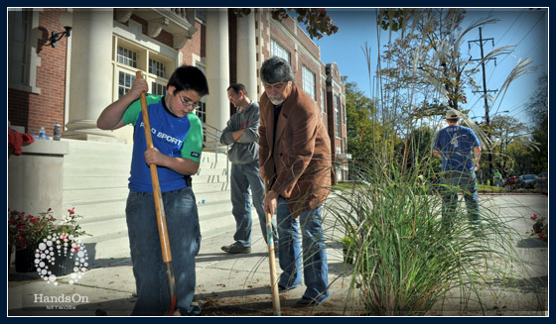
Make a difference day

Slide 11
Jesus’ Model for Ministry
John 13:1-17

