Slide 1
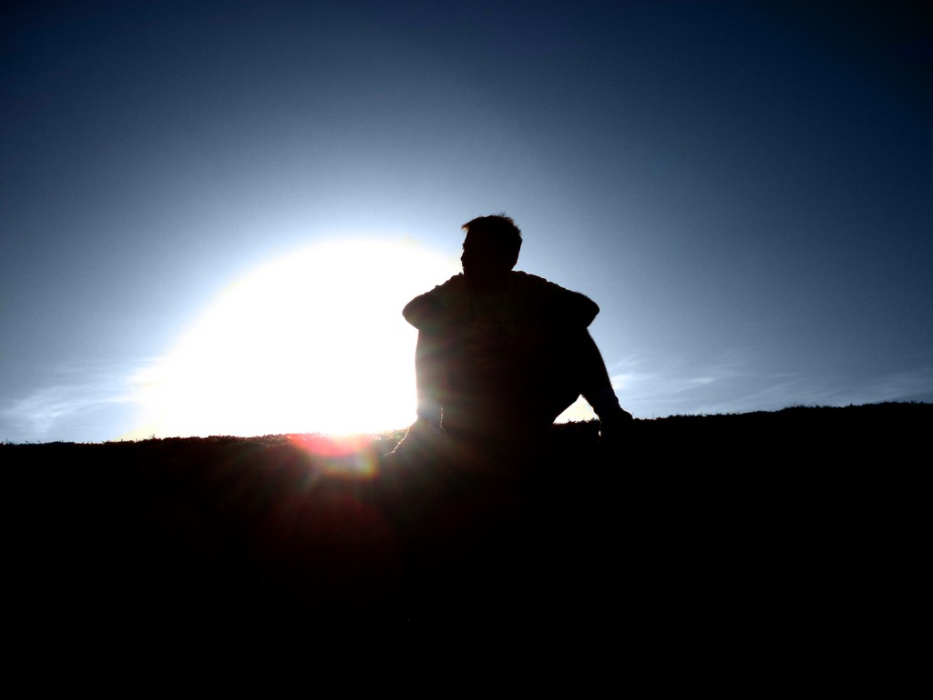
Everyone Wants Better
Matthew 19:16-22

Slide 2
Everyone wants better..
But nobody wants change.

Slide 3
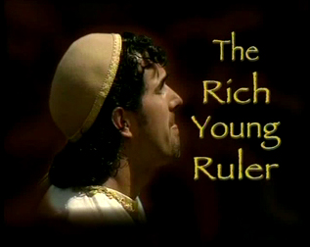
Matthew 19:16-22
"Good Teacher, what good thing shall I do that I may have eternal life?“
But if you want to enter into life, keep the commandments
"If you want to be perfect, go, sell what you have and give to the poor, and you will have treasure in heaven; and come, follow Me." 22 But when the young man heard that saying, he went away sorrowful, for he had great possessions.

Slide 4
Willing to change?
Friends who are not good for you?
Possessions hindering you?

Slide 5
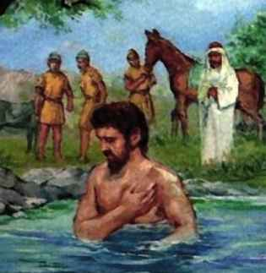
Naaman the leper .. 2 Kings 5
9 Then Naaman went with his horses and chariot, and he stood at the door of Elisha's house. 10 And Elisha sent a messenger to him, saying, "Go and wash in the Jordan seven times, and your flesh shall be restored to you, and you shall be clean." 11 But Naaman became furious, and went away and said, "Indeed, I said to myself, 'He will surely come out to me, and stand and call on the name of the Lord his God, and wave his hand over the place, and heal the leprosy.' 12 Are not the Abanah and the Pharpar, the rivers of Damascus, better than all the waters of Israel? Could I not wash in them and be clean?" So he turned and went away in a rage.

Slide 6
Are we humble enough to be healed?
Romans 6:12-13 Therefore do not let sin reign in your mortal body, that you should obey it in its lusts. 13 And do not present your members as instruments of unrighteousness to sin, but present yourselves to God as being alive from the dead, and your members as instruments of righteousness to God.

Slide 7
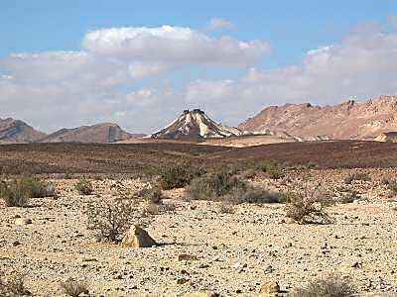
Israel in the wilderness..
10 Moreover, brethren, I do not want you to be unaware that all our fathers were under the cloud, all passed through the sea, 2 all were baptized into Moses in the cloud and in the sea, 3 all ate the same spiritual food, 4 and all drank the same spiritual drink. For they drank of that spiritual Rock that followed them, and that Rock was Christ. 5 But with most of them God was not well pleased, for their bodies were scattered in the wilderness.

Slide 8
We want to go home..
Colossians 3:1-4 If then you were raised with Christ, seek those things which are above, where Christ is, sitting at the right hand of God. 2 Set your mind on things above, not on things on the earth. 3 For you died, and your life is hidden with Christ in God. 4 When Christ who is our life appears, then you also will appear with Him in glory.

Slide 9
Some positive examples..
Abraham promised a better land…
Hebrews 11:8-10 By faith Abraham obeyed when he was called to go out to the place which he would receive as an inheritance. And he went out, not knowing where he was going. 9 By faith he dwelt in the land of promise as in a foreign country, dwelling in tents with Isaac and Jacob, the heirs with him of the same promise; 10 for he waited for the city which has foundations, whose builder and maker is God.

Slide 10
Some positive examples..
Saul of Tarsus recognized he was lost..
Acts 22:10-16 So I said, 'What shall I do, Lord?' And the Lord said to me, 'Arise and go into Damascus, and there you will be told all things which are appointed for you to do.' 11 And since I could not see for the glory of that light, being led by the hand of those who were with me, I came into Damascus.
16 And now why are you waiting? Arise and be baptized, and wash away your sins, calling on the name of the Lord.'

Slide 11
Some positive examples..
Early church in Jerusalem …
Acts 2:43-45 Now all who believed were together, and had all things in common, 45 and sold their possessions and goods, and divided them among all, as anyone had need.
Acts 4:32-35 Now the multitude of those who believed were of one heart and one soul; neither did anyone say that any of the things he possessed was his own, but they had all things in common. 34 Nor was there anyone among them who lacked; for all who were possessors of lands or houses sold them, and brought the proceeds of the things that were sold, 35 and laid them at the apostles' feet; and they distributed to each as anyone had need.

Slide 15
Everyone Wants Better
Matthew 19:16-26

