Slide 1
God Uses the Ordinary
1 Corinthians 12:12-27

Slide 2
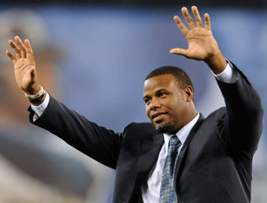
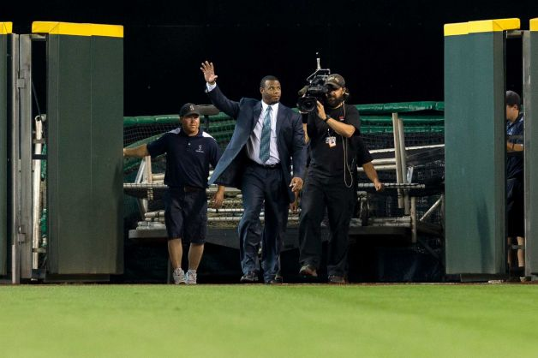
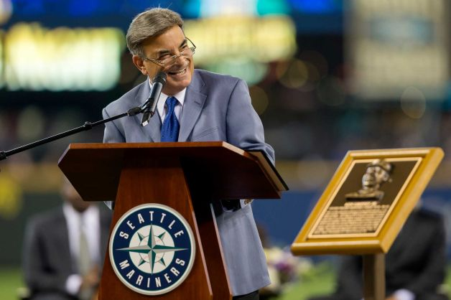
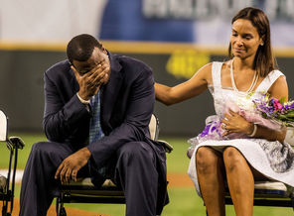

Slide 3
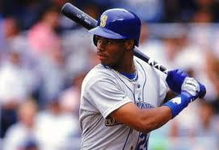
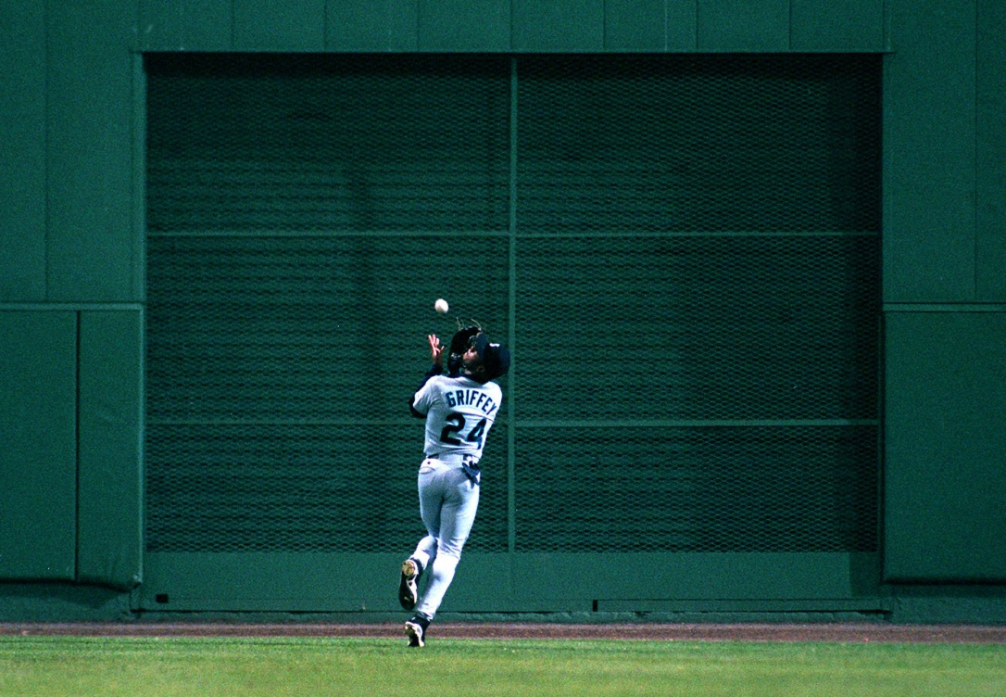
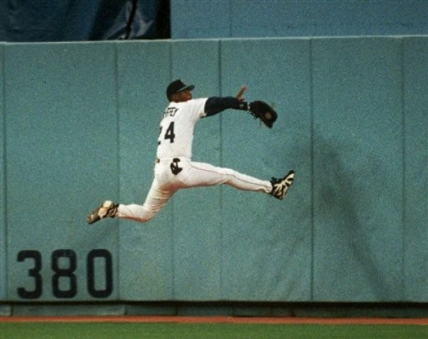
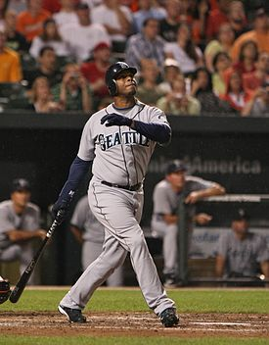
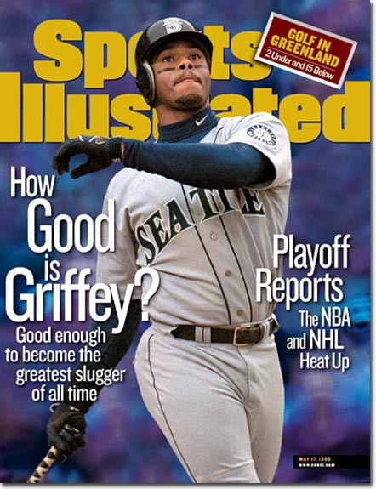

Slide 4
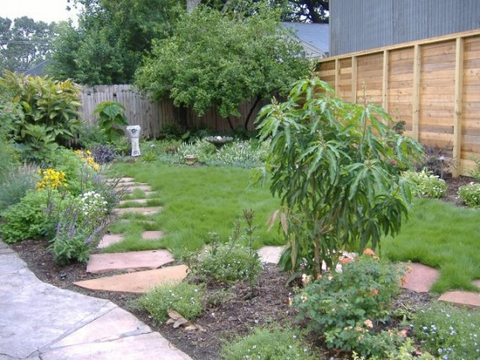
God uses the ordinary..

Slide 5
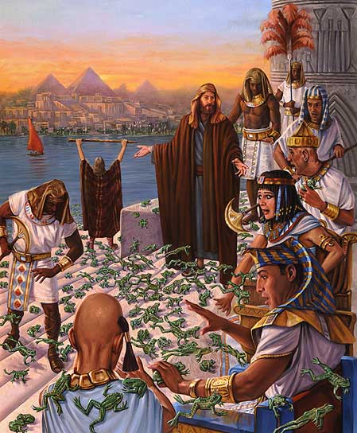
Frogs, flies..

Slide 6
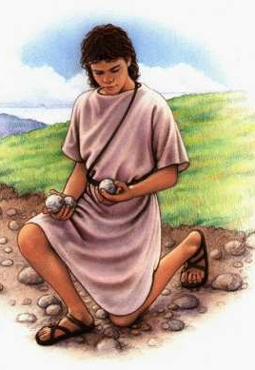
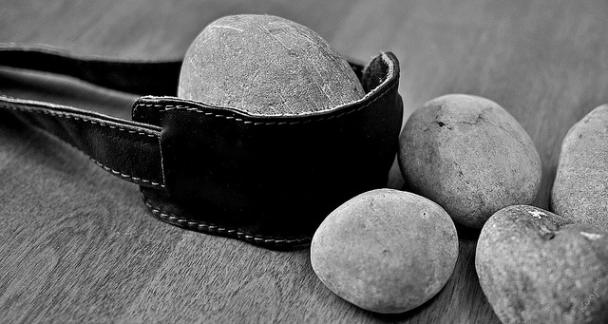
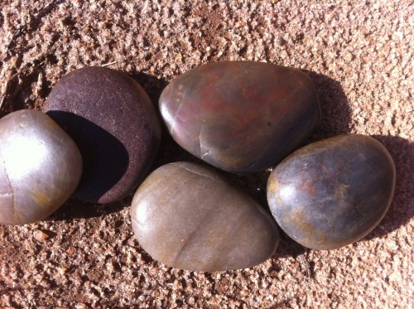
Five stones ..

Slide 7
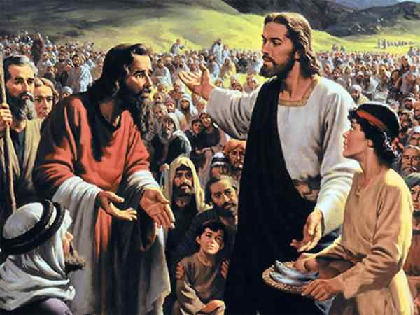
Five loaves, two fish ..

Slide 8
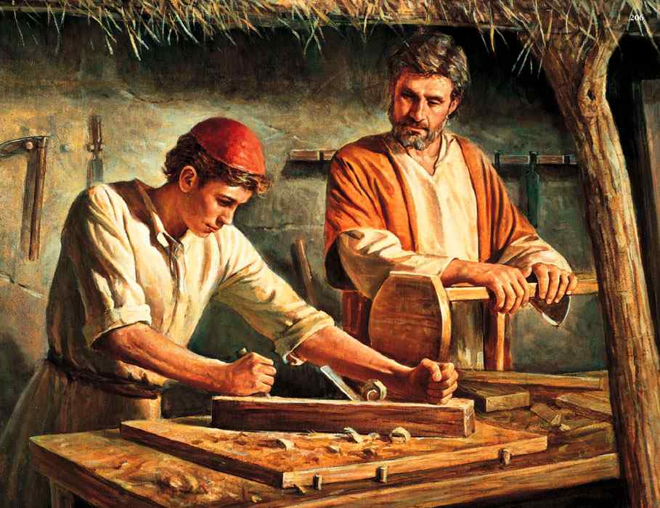
Jesus carpenter’s son..

Slide 9
God uses each of us..
Colossians 3:17 And whatever you do in word or deed, do all in the name of the Lord Jesus, giving thanks to God the Father through Him.
Colossians 3:23 And whatever you do, do it heartily, as to the Lord and not to men 24 knowing that from the Lord you will receive the reward of the inheritance; for you serve the Lord Christ.

Slide 10
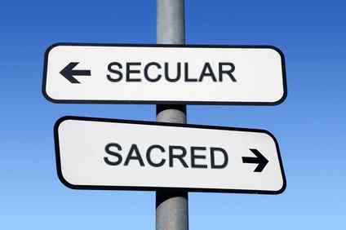
Definitions ..
Sacred: Relating to religion; relating to holiness or spirituality - that which is not common
Secular: Pertaining to things of the world; not spiritual or sacred; relating to or connected to worldly things

Slide 11
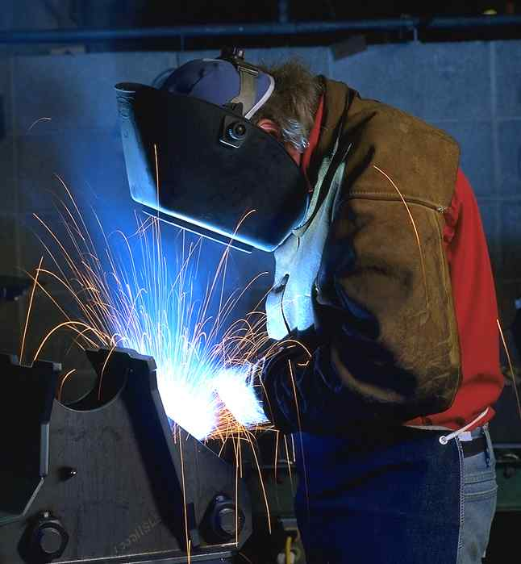
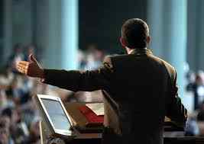
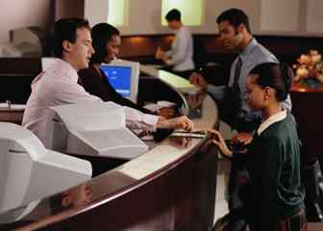
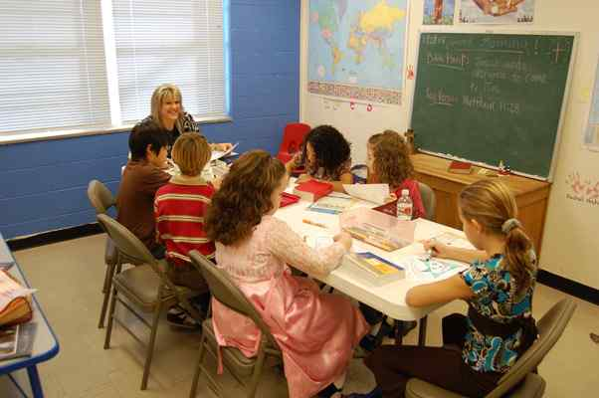
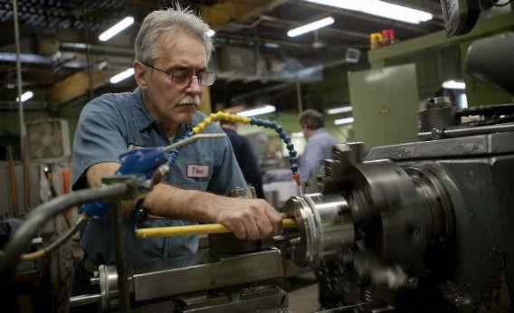
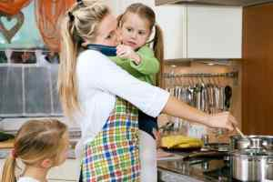
Secular or Sacred?
Welder
Preacher
Bank clerk
Bible class teacher
Waiter or waittress
Machinist
Stay at home mom

Slide 12
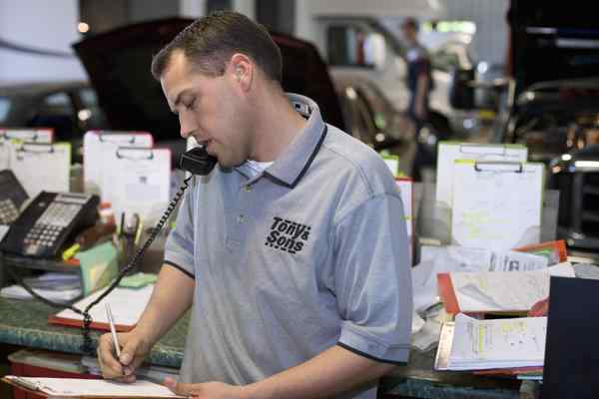
Importance of Work..
Ephesians 4:28 Let him who stole steal no longer, but rather let him labor, working with his hands what is good, that he may have something to give him who has need.
Colossians 3:23 And whatever you do, do it heartily, as to the Lord and not to men 24 knowing that from the Lord you will receive the reward of the inheritance; for you serve the Lord Christ.

Slide 13
Motive and attitude matters…
2 Corinthians 2:17 For we are not, as so many, peddling the word of God; but as of sincerity, but as from God, we speak in the sight of God in Christ.
Acts 20:34-35 Yes, you yourselves know that these hands have provided for my necessities, and for those who were with me. 35 I have shown you in every way, by laboring like this, that you must support the weak. And remember the words of the Lord Jesus, that He said, 'It is more blessed to give than to receive.'"

Slide 14
Each given spiritual gifts ..
Ephesians 4:11-12 And He Himself gave some to be apostles, some prophets, some evangelists, and some pastors and teachers, 12 for the equipping of the saints for the work of ministry, for the edifying of the body of Christ,
Romans 12:6-8 Having then gifts differing according to the grace that is given to us, let us use them: if prophecy, let us prophesy in proportion to our faith; 7 or ministry, let us use it in our ministering; he who teaches, in teaching; 8 he who exhorts, in exhortation; he who gives, with liberality; he who leads, with diligence; he who shows mercy, with cheerfulness.

Slide 15
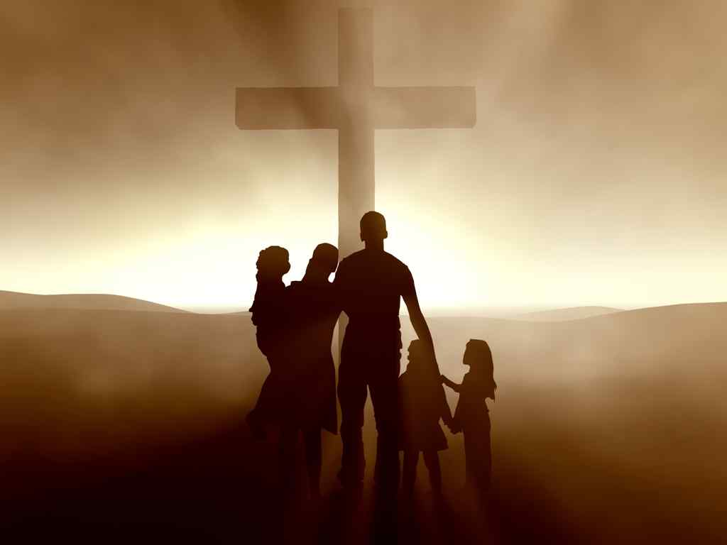
We are all priests..
1 Peter 2:4-5 Coming to Him as to a living stone, rejected indeed by men, but chosen by God and precious, 5 you also, as living stones, are being built up a spiritual house, a holy priesthood, to offer up spiritual sacrifices acceptable to God through Jesus Christ.

Slide 16
God Uses the Ordinary
1 Corinthians 12:12-27

