Slide 1
The Issues of Life
Proverbs 4:23

Slide 2
Guard your heart…
Keep your heart with all diligence, for out of it spring the issues of life.
(chayiym ‎‎towtsaa owt)

Slide 3
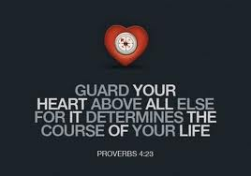

Slide 4
Life is filled with issues..
There’s always somebody that has it worse off in life..

Slide 5
Issues with circumstances..

Slide 6
Issues with circumstances.. health
Job 2:7-10 So Satan went out from the presence of the Lord, and struck Job with painful boils from the sole of his foot to the crown of his head. 8 And he took for himself a potsherd with which to scrape himself while he sat in the midst of the ashes. 9 Then his wife said to him, "Do you still hold fast to your integrity? Curse God and die!" 10 But he said to her, "You speak as one of the foolish women speaks. Shall we indeed accept good from God, and shall we not accept adversity?" In all this Job did not sin with his lips.

Slide 7
Issues with circumstances.. our jobs
Colossians 3:23-24 And whatever you do, do it heartily, as to the Lord and not to men, 24 knowing that from the Lord you will receive the reward of the inheritance; for you serve the Lord Christ.
Philippians 2:14 Do all things without complaining and disputing …

Slide 8
Issues with circumstances.. finances
1 Timothy 6:6-10 Now godliness with contentment is great gain. 7 For we brought nothing into this world, and it is certain we can carry nothing out. 8 And having food and clothing, with these we shall be content. 9 But those who desire to be rich fall into temptation and a snare, and into many foolish and harmful lusts which drown men in destruction and perdition.
Philippians 4:11-13 Not that I speak in regard to need, for I have learned in whatever state I am, to be content: 12 I know how to be abased, and I know how to abound. Everywhere and in all things I have learned both to be full and to be hungry, both to abound and to suffer need. 13 I can do all things through Christ who strengthens me.

Slide 9
These are all heart issues..

Slide 10
Issues with faith..
Matthew 6:30 “oh you of little faith”..
Matt 8:26; 14:31; 16:8
John 11:20-27 Martha said to Jesus, "Lord, if You had been here, my brother would not have died. 22 But even now I know that whatever You ask of God, God will give You.“ …. 25 Jesus said to her, "I am the resurrection and the life. He who believes in Me, though he may die, he shall live. 26 And whoever lives and believes in Me shall never die. Do you believe this?"

Slide 11
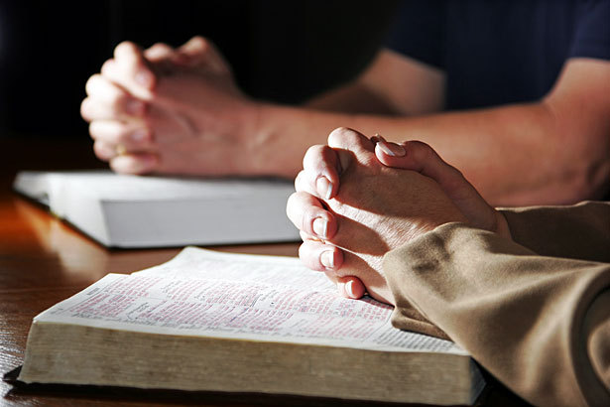
Issues with faith..
Hebrews 11:1-6 Now faith is the substance of things hoped for, the evidence of things not seen. 2 For by it the elders obtained a good testimony. … 6 But without faith it is impossible to please Him, for he who comes to God must believe that He is, and that He is a rewarder of those who diligently seek Him.
Hebrews 3:12-13 Beware, brethren, lest there be in any of you an evil heart of unbelief in departing from the living God; 13 but exhort one another daily, while it is called "Today," lest any of you be hardened through the deceitfulness of sin.

Slide 12
Issues with people…
Proverbs 14:12 There is a way that seems right to a man ...

Slide 13
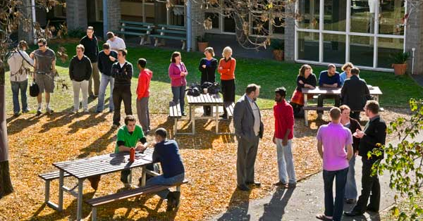
Issues with people…
People in the community…
Matthew 5:16 Let your light so shine before men, that they may see your good works and glorify your Father in heaven.
Matthew 7:12 Therefore, whatever you want men to do to you, do also to them, for this is the Law and the Prophets.

Slide 14
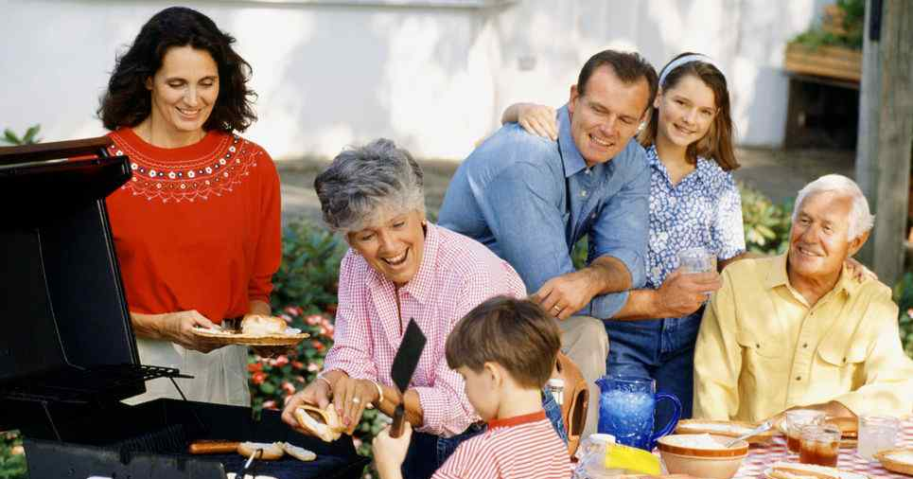
Issues with people…
Family members…
Ephesians 5:22-33 Wives, submit to your own husbands, as to the Lord. 25 Husbands, love your wives, just as Christ also loved the church and gave Himself for her .. 32 This is a great mystery, but I speak concerning Christ and the church. 33 Nevertheless let each one of you in particular so love his own wife as himself, and let the wife see that she respects her husband.
Ephesians 6:1-4 Children, obey your parents in the Lord, for this is right. 2 "Honor your father and mother," which is the first commandment with promise: 3 "that it may be well with you and you may live long on the earth." 4 And you, fathers, do not provoke your children to wrath, but bring them up in the training and admonition of the Lord.

Slide 15
Issues with brethren…
Romans 12:9-10 Let love be without hypocrisy. Abhor what is evil. Cling to what is good. 10 Be kindly affectionate to one another with brotherly love, in honor giving preference to one another ...
Galatians 6:9-10 And let us not grow weary while doing good, for in due season we shall reap if we do not lose heart. 10 Therefore, as we have opportunity, let us do good to all, especially to those who are of the household of faith.

Slide 16
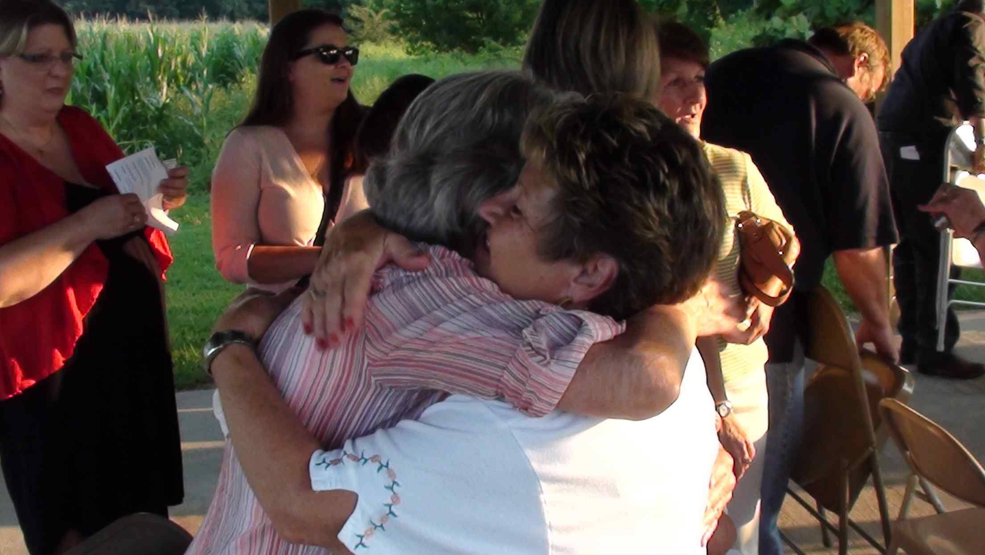
Issues with brethren…
Relational issues can weigh heavily on the heart…

Slide 17
Issues with sin…
Romans 3:23 for all have sinned and fall short of the glory of God..
Romans 6:23 For the wages of sin is death, but the gift of God is eternal life in Christ Jesus our Lord.

Slide 18
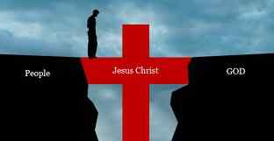
Issues with sin…
John 3:16 For God so loved the world that He gave His only begotten Son, that whoever believes in Him should not perish but have everlasting life.
Luke 19:10 the Son of Man has come to seek and to save that which was lost.

Slide 19
Issues with sin…
Luke 8:15 But the ones that fell on the good ground are those who, having heard the word with a noble and good heart, keep it and bear fruit with patience.
A good and honest heart is receptive to God’s plan…

Slide 20
We’ve all got issues..
Keep your heart with all diligence, for out of it spring the issues of life.

Slide 21
Guard your heart…
Keep your heart with all diligence, for out of it spring the issues of life.
(chayiym ‎‎towtsaa owt)

Slide 22
The Issues of Life
Proverbs 4:23

