Slide 1
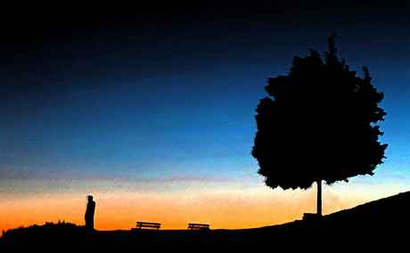
Faith that will Stand
1 Peter 1:5-9

Slide 2
Faith is Indispensable..
Hebrews 11:6 But without faith it is impossible to please God…
John 3:16 For God so loved the world that He gave His only begotten Son, that whoever believes in Him should not perish but have everlasting life.

Slide 3
Spiritual freedom..
John 8:32 And you shall know the truth, and the truth shall make you free."
Romans 6:3-7 we were buried with Him through baptism into death, that just as Christ was raised from the dead by the glory of the Father, even so we also should walk in newness of life… 18 And having been set free from sin, you became slaves of righteousness.

Slide 4
Faith the foundation of a solid Christian life..
Hebrews 11:1 faith is the confidence of things hoped for, the conviction of things not seen.

Slide 5
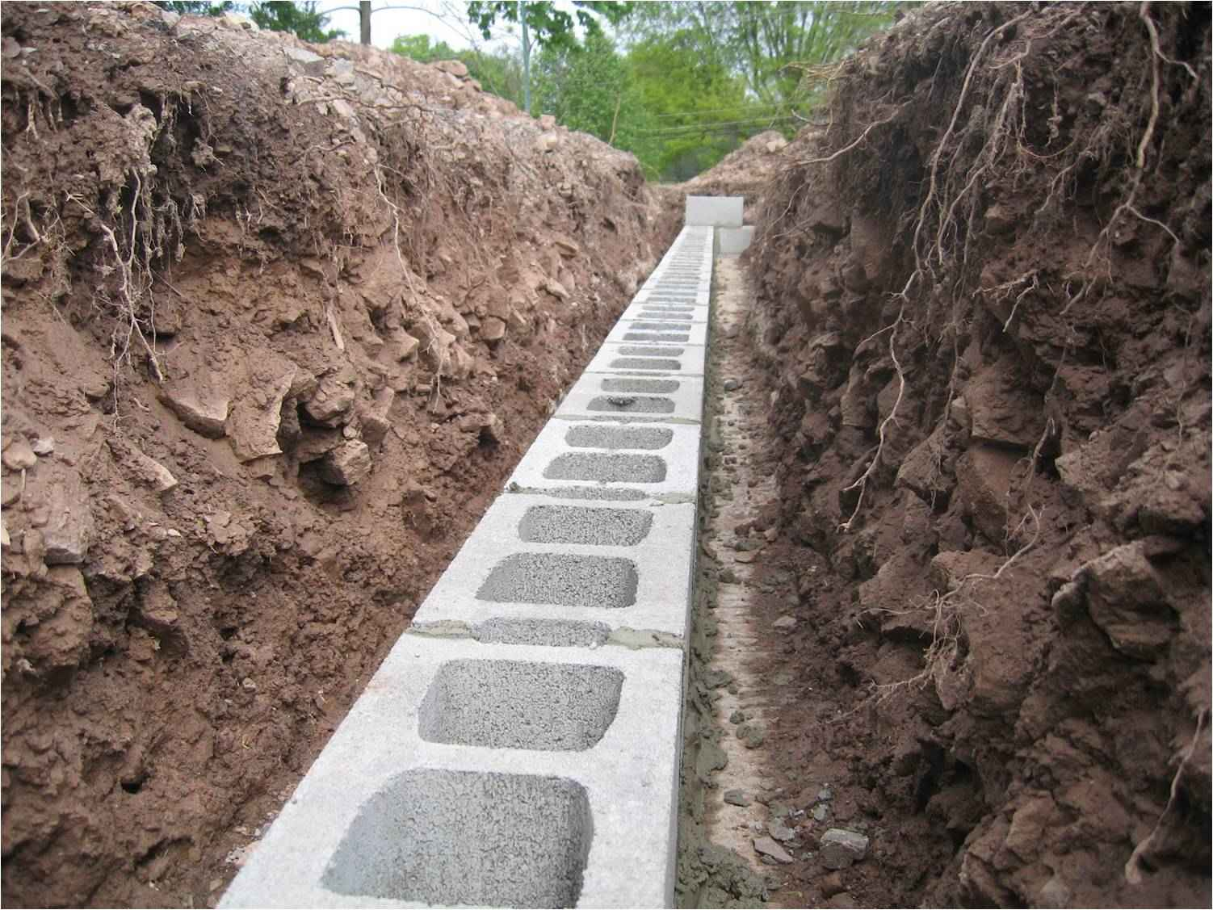
Solid faith…
Absolute conviction God exists..
The Bible is God’s inspired word..
Knowing God’s nature, character, and promises…

Slide 6
Faith is tested by fire..
1 Peter 1:6-8 that the genuineness of your faith, being much more precious than gold that perishes, though it is tested by fire, may be found to praise, honor, and glory at the revelation of Jesus Christ..
Hebrews 3:12 Beware, brethren, lest there be in any of you an evil heart of unbelief in departing from the living God..
Why did God let this happen?
I am mad at God ..
I don’t believe in God any more

Slide 7
Burdens test our strength..
Galatians 6:2 Bear one another's burdens, and so fulfill the law of Christ.
Galatians 6:5 For each one shall bear his own load.

Slide 8
Standing the test..
1 Peter 1:7-9 that the genuineness of your faith, being much more precious than gold that perishes, though it is tested by fire, may be found to praise, honor, and glory at the revelation of Jesus Christ, 8 whom having not seen you love. Though now you do not see Him, yet believing, you rejoice with joy inexpressible and full of glory, 9 receiving the end of your faith — the salvation of your souls.

Slide 9
Crying out to God..
Psalms 102 - a prayer of the afflicted, when he is overwhelmed and pours out his complaint before the Lord.
1-2 Hear my prayer, O Lord, And let my cry come to You. 2 Do not hide Your face from me in the day of my trouble; Incline Your ear to me; In the day that I call, answer me speedily.

Slide 10
Crying out to God..
Psalms 102 - a prayer of the afflicted, when he is overwhelmed and pours out his complaint before the Lord.
3-11 overwhelmed mentally, physically, socially, spiritually

Slide 11
Crying out to God..
Psalms 102 - a prayer of the afflicted, when he is overwhelmed and pours out his complaint before the Lord.
12-28 He found hope in God …
12-13 Eternal God who never changes..
14-20 God of mercy who is trustworthy..
21-24 He is faithful to His promises
25-28 He who laid the foundation of the earth is able to help His children..

Slide 12
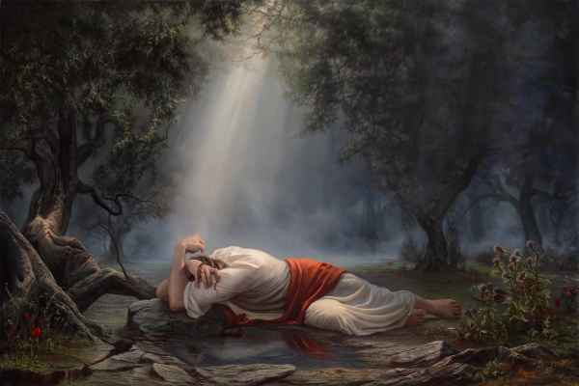
Jesus cried out in Gethsamane..
Luke 22:40-42 And He was withdrawn from them about a stone's throw, and He knelt down and prayed, 42 saying, "Father, if it is Your will, take this cup away from Me; nevertheless not My will, but Yours, be done."

Slide 13
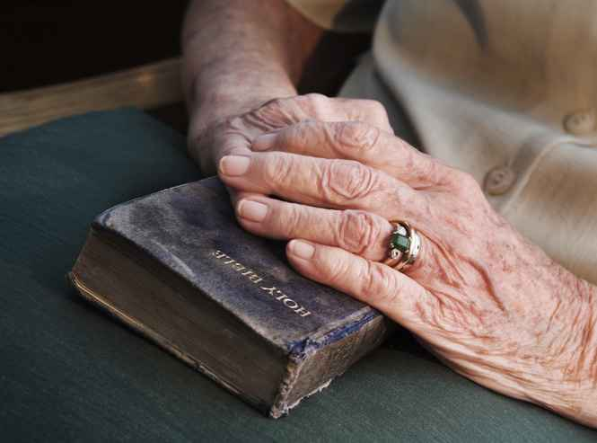
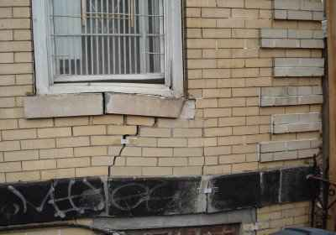
Will your foundation stand?

Slide 14
Faith that will Stand
1 Peter 1:5-9

