Slide 1
Finding Our Strength
Psalm 46:1-3, 7-10

Slide 2
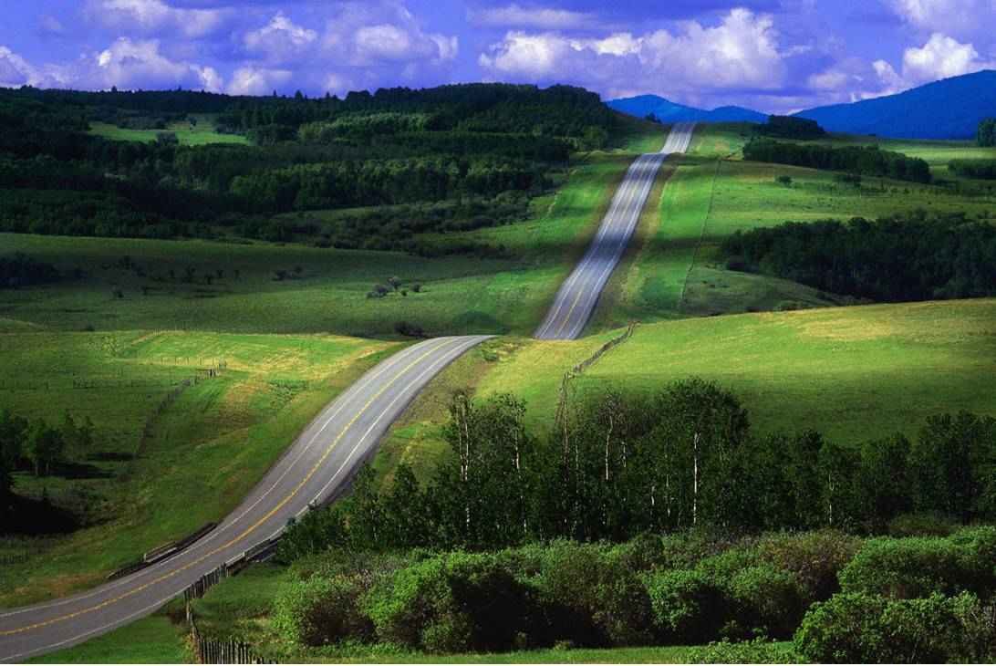
The road of life..
Joy and happiness..
1 Pet 3:10 “love life and see good days”..
Challenges, discouragement

Slide 3
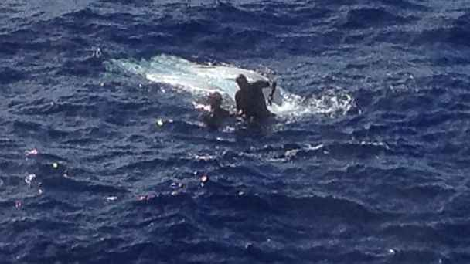
Feeling helpless..
Psalms 130:1 Out of the depths I have cried to You, O Lord ..

Slide 4
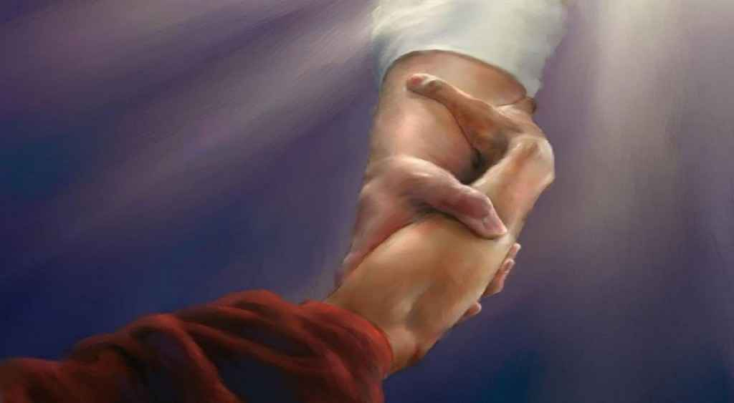
Bearing burdens..
Galatians 6:2 Bear one another's burdens, and so fulfill the law of Christ.

Slide 5
Bearing burdens..
Ephesians 4:14-16 that we should no longer be children, tossed to and fro and carried about with every wind of doctrine… 15 but, speaking the truth in love, may grow up in all things into Him who is the head — Christ — 16 from whom the whole body, joined and knit together by what every joint supplies, according to the effective working by which every part does its share, causes growth of the body for the edifying of itself in love.

Slide 6
Hopeless moments..
Lost .. dead in sin (Eph 2:1-2)
Heavy laden, distressed (Matt 11:28-30)
Burdened (by sin, sorrow) (Gal 6:2)
Spiritually empty, thirsty (Rev 22:17)
Wandering, distant from God (Luke 15)

Slide 7
Heaven’s invitation..
“Come unto me, all who labor..”
“Raised to newness of life” (Rom 6:3-4)
“If God is for us….” (Rom 8:31-39)
“Come to the waters” (Isa 55:1-3)
“Come take waters of life” (Rev 22:17)

Slide 8
Without God (no hope) …
Materialism “rich fool” (Luke 12:16-21)
Destructive relationships (John 4:13-18)
Vain pursuits (Ecclesiastes 2:1ff, 12:13)

Slide 9
Help is near… Psalm 46
Psalms 46:1-3 God is our refuge and strength, A very present help in trouble. 2 Therefore we will not fear, Even though the earth be removed, And though the mountains be carried into the midst of the sea; 3 Though its waters roar and be troubled, Though the mountains shake with its swelling...

Slide 10
Help is near… Psalm 46
Psalms 46:4-7 There is a river whose streams shall make glad the city of God, The holy place of the tabernacle of the Most High. 5 God is in the midst of her, she shall not be moved; God shall help her, just at the break of dawn. 6 The nations raged, the kingdoms were moved; He uttered His voice, the earth melted. 7 The Lord of hosts is with us; The God of Jacob is our refuge.

Slide 11
Help is near… Psalm 46
Psalms 46:8-11 Come, behold the works of the Lord, Who has made desolations in the earth. 9 He makes wars cease to the end of the earth; He breaks the bow and cuts the spear in two; He burns the chariot in the fire. 10 Be still, and know that I am God; I will be exalted among the nations, I will be exalted in the earth! 11 The Lord of hosts is with us; The God of Jacob is our refuge.

Slide 12
Help is near… Psalm 46
Confidence.. God is our refuge and strength
Surrounding.. The earth may fall apart..
Consideration.. God controls the nations
Call .. Behold God’s works…be still and know that He is God
(Heb “raphah” weak, slack, hands drop)
Relax, trust in Him, to do what we cannot

Slide 13
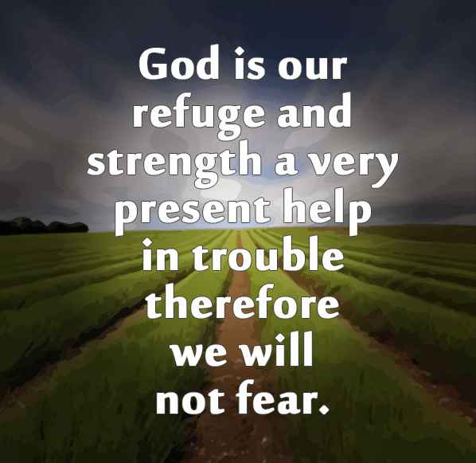

Slide 14
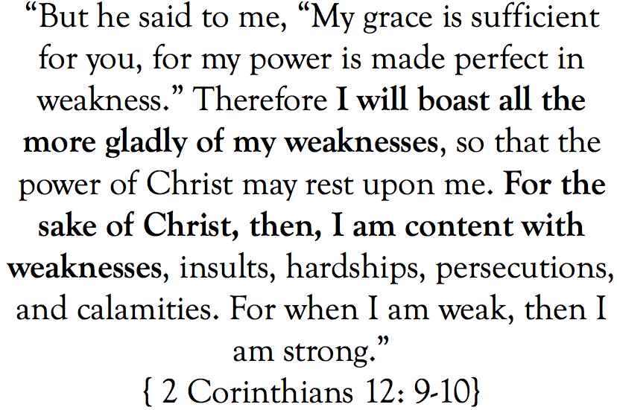

Slide 15
Finding Our Strength
Psalm 46:1-3, 7-10

