Slide 1
Hebrews 9:11-15

Slide 2
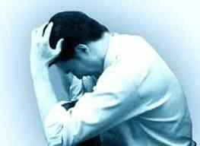
What is guilt?..
Objective
Subjective
A Verdict in Court
A Feeling of Shame

Slide 3
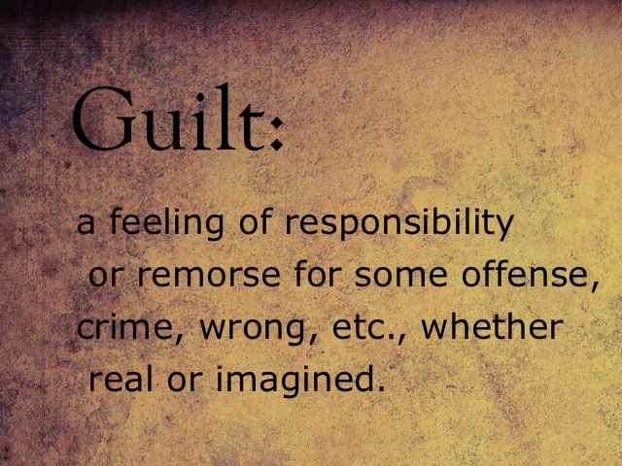

Slide 4
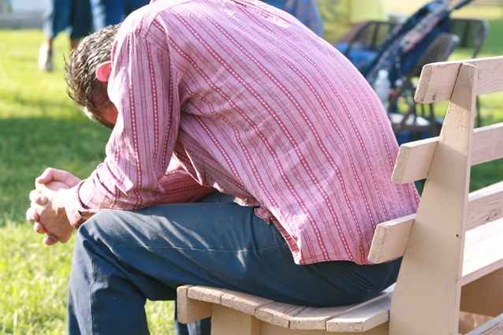
A spiritual state we are in …
Innocence
Guilt before God

Slide 5
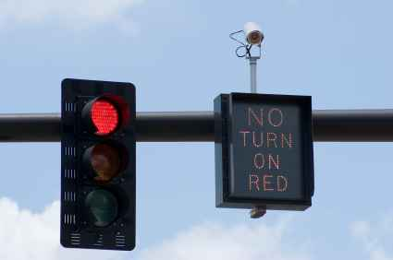
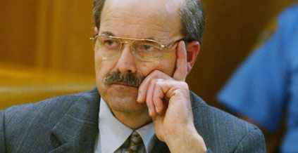
Objective Guilt..
An objective standard (law) is broken..
Legal guilt clearly proven..
May or may not feel guilty..
Regardless, if they broke law… guilty!

Slide 6
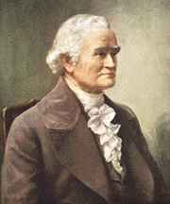
Absolute moral standard..
“Our citizens should early understand that the genuine source of correct republican principles is the Bible, particularly the New Testament or the Christian religion.. The religion which has introduced civil liberty is the religion of Christ and His apostles, which enjoins humility, piety, and benevolence; which acknowledges every person a brother, or a sister, and a citizen with equal rights. This is genuine Christianity..

Slide 7
Absolute moral standard..
"The moral principles and precepts contained in the scriptures ought to form the basis of all civil constitution and laws. All the miseries and evils which men suffer from vice, crime, ambition, injustice, oppression, slavery, and war, proceed from their despising or neglecting the precepts contained in the Bible."

Slide 8
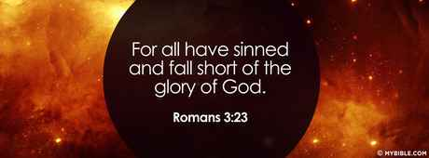
All are guilty of sin..
1 John 3:4 whoever sins transgresses the law, for sin is the transgression of the law.

Slide 9
Subjective guilt…
How a person feels in his conscience..
Conscience may be past feeling ..
Ephesians 4:19 who, being past feeling…
Overly sensitive conscience ..

Slide 10
Four ways we can feel about guilt…
Guilty and feel guilty..
Guilty but feel no guilt ..
Disturbed individuals
Ignorant of their condition
Not guilty but feel guilty
Acts 3:19; Rom 7:14; 1 John 4:17-19
Not guilty and feel no guilt
1 John 1:7, 2:1-2; Heb 7:25

Slide 11
Freedom in Christ…
Any person can be forgiven if they repent and obey the Lord…
John 3:16; Mark 16:15-16; Heb 5:9; 1 John 1:7-9
Every saved person can stay saved if they pursue the Christian life ..
Romans 7:14-25; 8:1-2
Can fall away if choose a life of sin .. Heb 3:12; 10:26-27
God loves us and wants to bring us home.
Romans 5:1-11; Rom 8:31-39; 1 John 3:19-24

Slide 12
God’s forgiveness..
Casts them into the sea (Micah 7:19)
Removes far as east to west (Ps 103:12)
Forgets, remembers no more (Heb 8:12)
Forgives, remission (Acts 2:38)
Lays iniquity on Christ (Isa 53:6-8)
Christ became righteousness (2 Cor 5:20)

Slide 13
Hebrews 9:11-15

