Slide 1
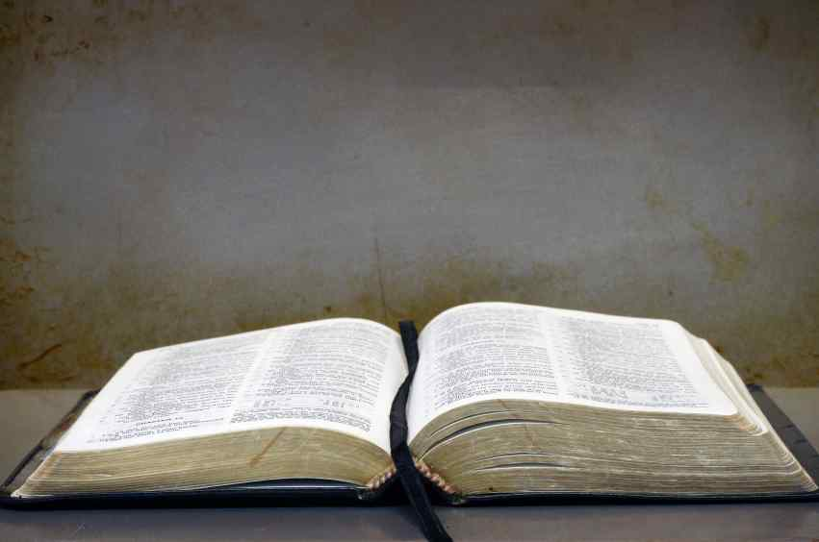
Open to Truth
Acts 17:1-11

Slide 2
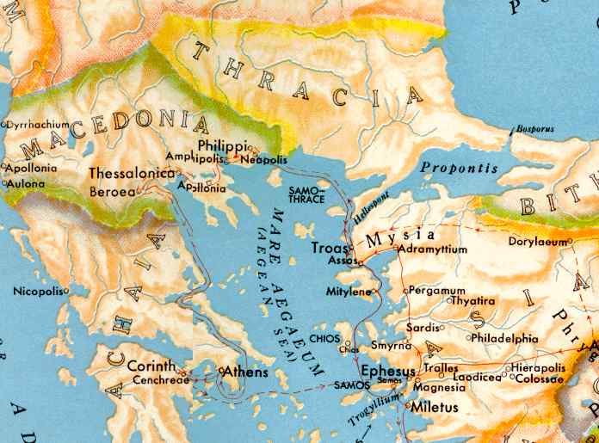
Acts 17:1-4 they came to Thessalonica, where there was a synagogue of the Jews. 2 Then Paul, as his custom was, went in to them, and for three Sabbaths reasoned with them from the Scriptures, 3 explaining and demonstrating that the Christ had to suffer and rise again from the dead, and saying, "This Jesus whom I preach to you is the Christ." 4 And some of them were persuaded; and a great multitude of the devout Greeks, and not a few of the leading women, joined Paul and Silas.

Slide 3
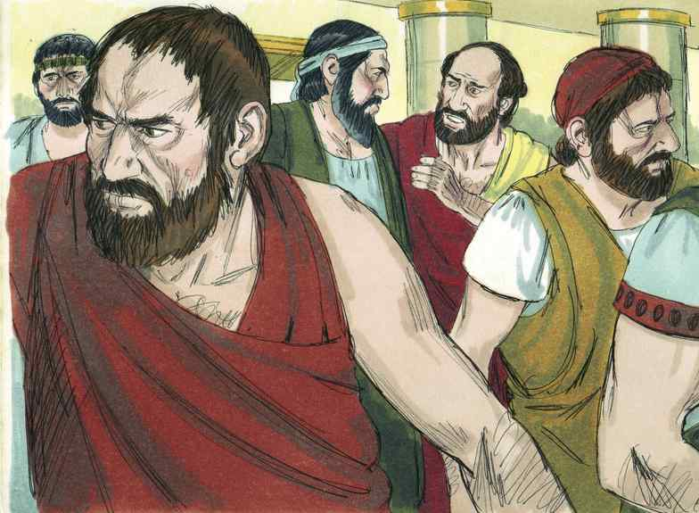
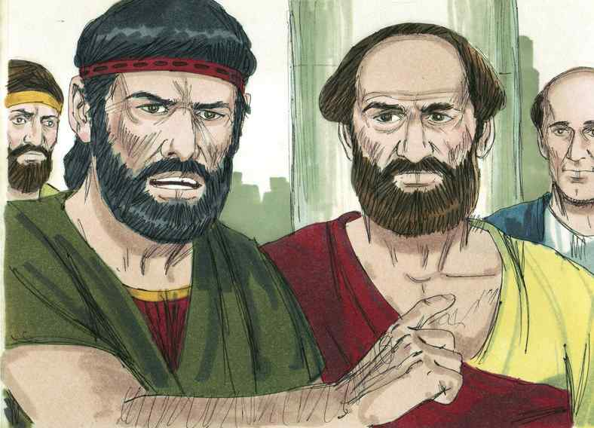
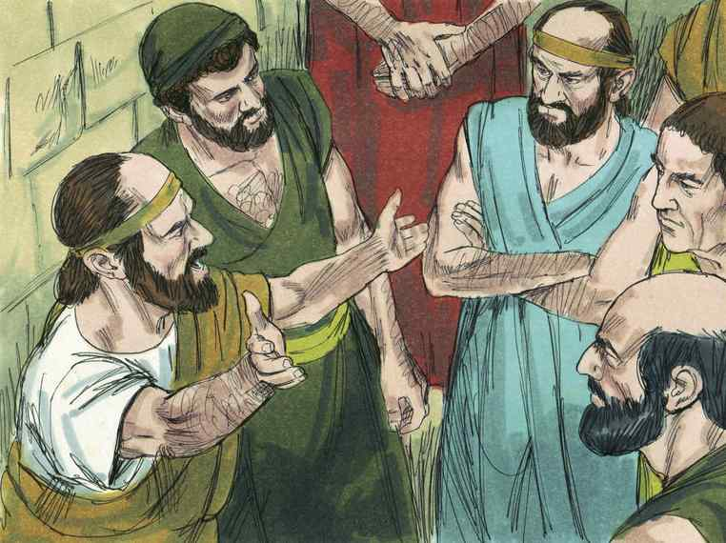
The Bereans..
Acts 17:11 These were more fair-minded than those in Thessalonica, in that they received the word with all readiness, and searched the Scriptures daily to find out whether these things were so.

Slide 4
We must do what the Bereans did..
We too must be open to truth …
Are you truly open to truth ?

Slide 5
1st Opening our minds..
“they received the word ...”
“with all readiness …”

Slide 6
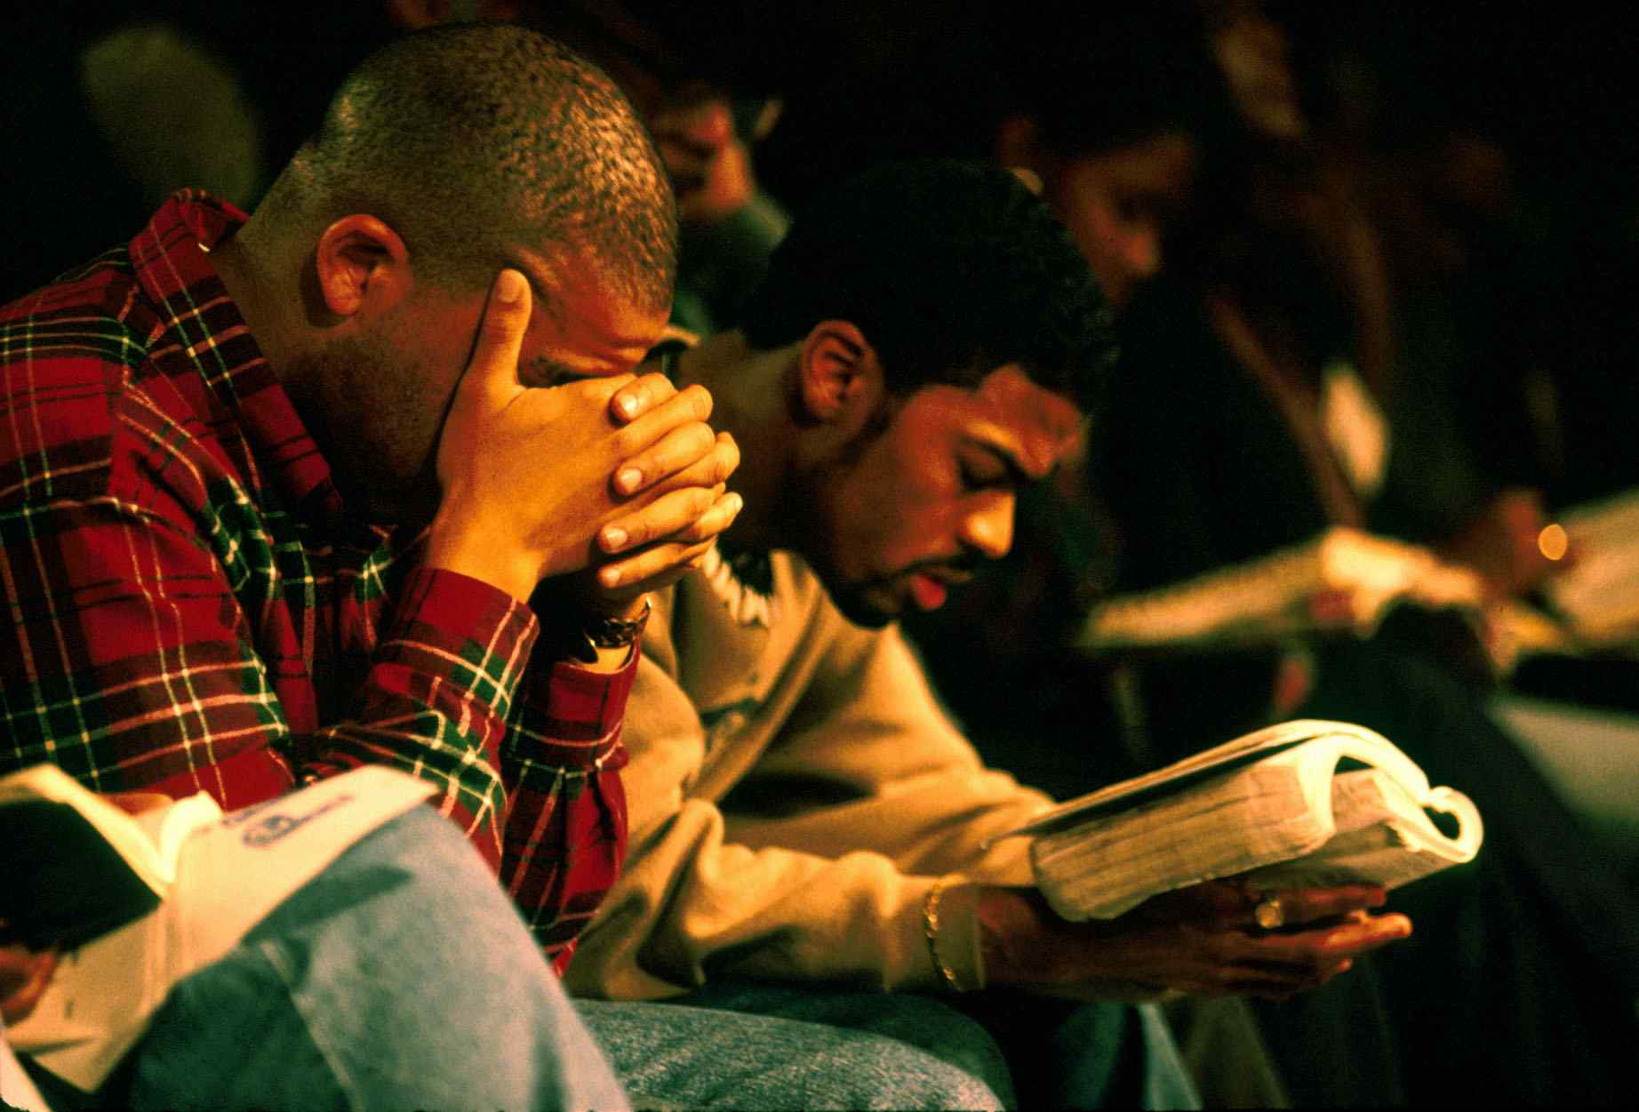
Coming to the truth..
John 6:45 It is written in the prophets, 'And they shall all be taught by God.' Therefore everyone who has heard and learned from the Father comes to Me.

Slide 7
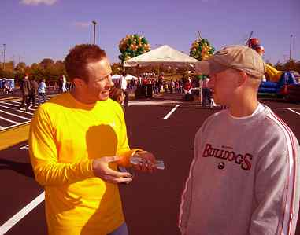
Good listeners have open minds..
James 1:19-21 So then, my beloved brethren, let every man be swift to hear, slow to speak, slow to wrath; 20 for the wrath of man does not produce the righteousness of God. 21 Therefore lay aside all filthiness and overflow of wickedness, and receive with meekness the implanted word, which is able to save your souls.

Slide 8
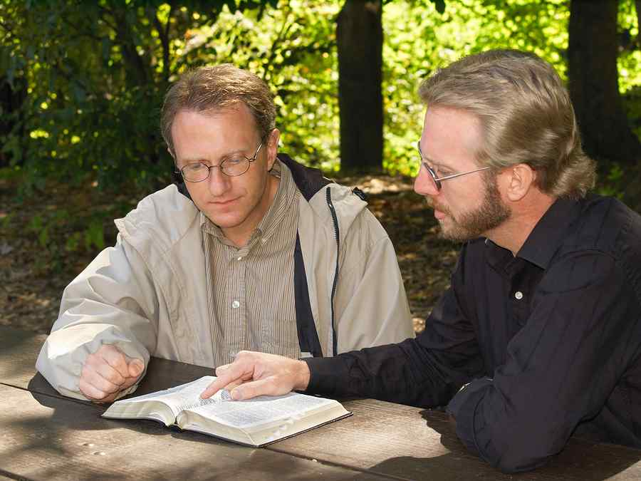
Readiness of mind..
Luke 8:15 But the ones that fell on the good ground are those who, having heard the word with a noble and good heart, keep it and bear fruit with patience.

Slide 9
Readiness of mind..
John 7:17 If anyone wills to do His will, he shall know concerning the doctrine, whether it is from God or whether I speak on My own authority.

Slide 10
2nd Opening our Bibles..
“they searched the scriptures” …
“to find out whether these things were so”

Slide 11
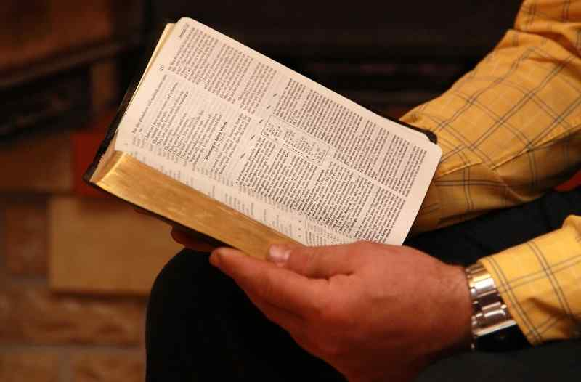
Regarding scripture as authoritative..
2 Timothy 3:15-17 and that from childhood you have known the Holy Scriptures, which are able to make you wise for salvation through faith which is in Christ Jesus. 16 All Scripture is given by inspiration of God, and is profitable for doctrine, for reproof, for correction, for instruction in righteousness, 17 that the man of God may be complete, thoroughly equipped for every good work.

Slide 12
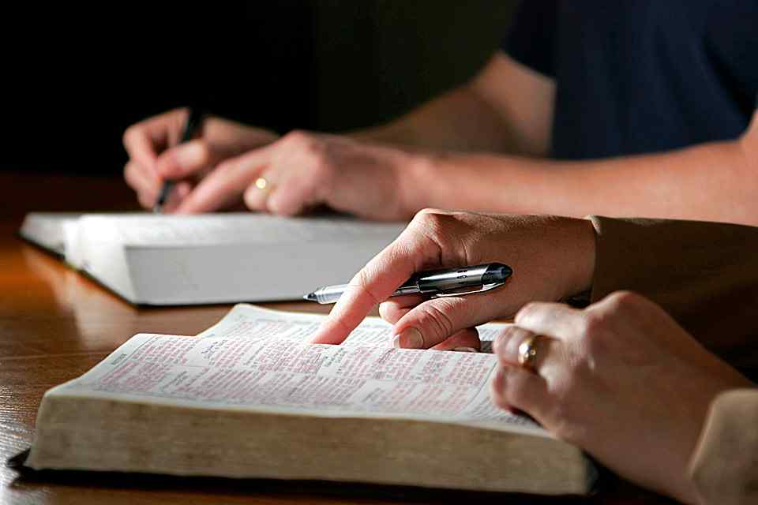
Proving all things..
1 Thessalonians 5:21 Test all things; hold fast what is good.
1 Peter 4:11 If anyone speaks, let him speak as the oracles of God... that in all things God may be glorified ..
2 Timothy 2:15 Be diligent to present yourself approved to God, a worker who does not need to be ashamed, rightly dividing the word of truth.

Slide 13
3rd Opening our schedules..
“they examined the scriptures daily..”

Slide 14
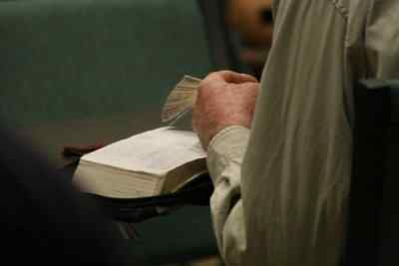
See value of daily exhortation..
Hebrews 3:13 but exhort one another daily, while it is called "Today," lest any of you be hardened through the deceitfulness of sin.

Slide 15
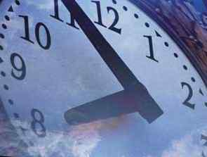
Redeeming the time..
Ephesians 5:15-16 See then that you walk circumspectly, not as fools but as wise, 16 redeeming the time, because the days are evil.

Slide 16
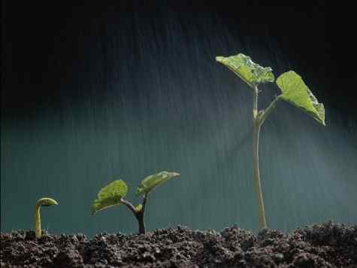
Growth from daily involvement..
1 Peter 2:1-3 Therefore, laying aside all malice, all deceit, hypocrisy, envy, and all evil speaking, 2 as newborn babes, desire the pure milk of the word, that you may grow thereby, 3 if indeed you have tasted that the Lord is gracious.

Slide 17
Open to Truth
Acts 17:1-11

Slide 18
Open to Truth…

