Slide 1
What Will You Do With Jesus?
Matthew 27:22

Slide 2
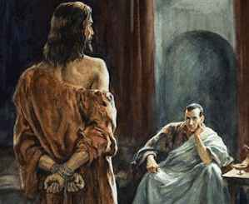
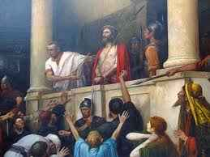
Pontius Pilate ..
The Jewish authorities brought Jesus to Pilate to approve the execution..

Slide 3
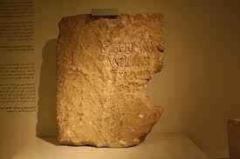
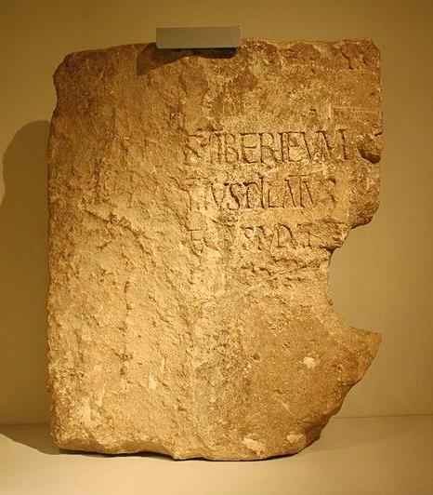
Pilate Stone discovered at Caesarea 1961
Served as governor of Judea 10 years..
Overshadowed by one interview..

Slide 4
Pilate’s question..
Matthew 27:22 "What then shall I do with Jesus who is called Christ?"

Slide 5
We each have a choice..
Deut 30:19 I have set before you life and death, blessing and cursing; therefore choose life, that both you and your descendants may live..
Joshua 24:15 choose for yourselves this day whom you will serve... But as for me and my house, we will serve the Lord."
1 Kings 18:21 "How long will you falter between two opinions? If the Lord is God, follow Him; but if Baal, follow him." But the people answered him not a word.

Slide 6
Even Pilate had the power of choice…
“What shall you do with Jesus?”…

Slide 7
You must examine Him for yourself…
Pilate wanted to talk with the prisoner..
What did he find out?
Vs 18 “for envy they handed him over”..
John 18:38; 19:4,6 “I find no fault in him”..
Matt 27:23 “what evil has he done?”

Slide 8
It’s not wrong to investigate..
Thomas in John 20:25 .. I want to see the imprint of the nails …
John 20:27 Reach your finger here, and look at My hands; and reach your hand here, and put it into My side. Do not be unbelieving, but believing."
1 John 1:1-3 That which was from the beginning, which we have heard, which we have seen with our eyes, which we have looked upon, and our hands have handled, concerning the Word of life — 2 the life was manifested, and we have seen, and bear witness,

Slide 9
You can’t remain neutral..
Pilate attempted to put it off..
Luke 22:6-7 He’s from Galilee .. sent him to Herod .. (Herod sent Him back)
Matt 27:15 I will release any one prisoner .. Jesus or Barabbas? (20-21 they chose Barabbas)
Matt 27:24 tried to wash his hands

Slide 11
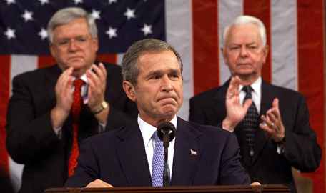
President’s speech 9/11
“If you are not with us, you are with the enemy…” (Matt 12:30)

Slide 13
Do the right thing..
James 4:17 to him that knows to do right and does not do it, to him it is sin
Pilate knew what was right .. but he was persuaded by outside sources (vs 24)
“What is right” overshadowed by “What is right for me?”
The right thing is not always easy..

Slide 14
What Will You Do With Jesus?
Matthew 27:22

