Slide 1
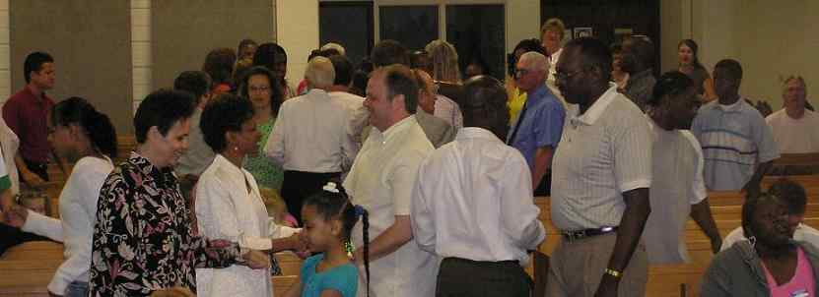
Stay Connected
Hebrews 10:22-25

Slide 2
Seeking connections..
World of cyber communication..
People want to stay connected with one another, someone who cares…

Slide 3
God’s Design..
Made for relationships ..
Genesis 1:26-27 Let Us make man in Our image, according to Our likeness…
Genesis 2:18 God said, "It is not good that man should be alone”..

Slide 4
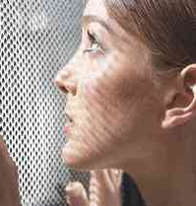
Salvation relationship…
Relationship with Christ ..
John 1:12-13 But as many as received Him, to them He gave the right to become children of God, to those who believe in His name..
Romans 6:3-5 do you not know that as many of us as were baptized into Christ Jesus were baptized into His death? 4 Therefore we were buried with Him through baptism into death..

Slide 5
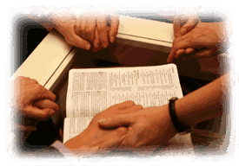
Christian growth..
With fellow Christians ..
John 3:16 gave His only begotten Son, that whoever believes in Him should not perish but have everlasting life.
1 John 3:16 By this we know love, because He laid down His life for us. And we also ought to lay down our lives for the brethren.
Colossians 3:16 Let the word of Christ dwell in you richly in all wisdom, teaching and admonishing one another in psalms and hymns and spiritual songs, singing with grace in your hearts to the Lord.

Slide 6
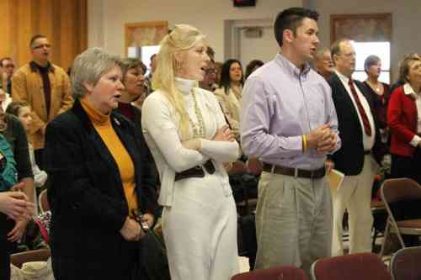
Gathering together..
Christ’s presence…
Matthew 18:20 For where two or three are gathered together in My name, I am there in the midst of them."

Slide 7
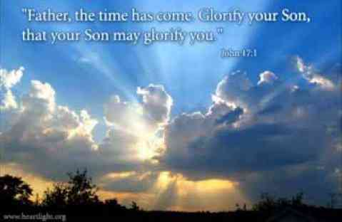
Father, Son, Spirit..
Seek to glorify each other..
John 14:13 whatever you ask in My name, that I will do, that the Father may be glorified in the Son.
John 17:1 "Father, the hour has come. Glorify Your Son, that Your Son also may glorify You..

Slide 8
Church and the power of positive relationships..
Loving one another helps us grow..
Love one another, encourage one another, bear with one another..
We reflect the nature of God, become the body of Christ, fellowship of the Spirit..

Slide 9
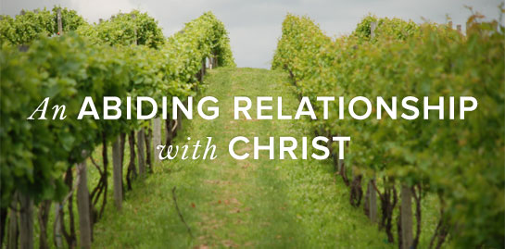
Church and the power of positive relationships..
Connection to Christ and each other..
John 15:5-8 "I am the vine, you are the branches. He who abides in Me, and I in him, bears much fruit; for without Me you can do nothing.7 If you abide in Me, and My words abide in you, you will ask what you desire, and it shall be done for you. 8 By this My Father is glorified, that you bear much fruit; so you will be My disciples.
Hebrews 10:24-25 And let us consider one another in order to stir up love and good works, 25 not forsaking the assembling of ourselves together, as is the manner of some, but exhorting one another, and so much the more as you see the Day approaching.

Slide 10
Three imperatives..
Hebrews 10:22-25..
22 Let us draw near with a true heart and full assurance of faith (responbility to God)
23 Let us hold fast the confession of our hope (responsibility to ourselves)
24 Let us consider one another to stir up love and good works (responsibility to one another)

Slide 11
Early Christians..
Gathered both publicly and privately..
Acts 2:46 So continuing daily with one accord in the temple, and breaking bread from house to house, they ate their food with gladness and simplicity of heart..
Hebrews 10:25 not forsaking the assembling of ourselves together, as is the manner of some, but exhorting one another, and so much the more as you see the Day approaching.
2 Thessalonians 2:1 Now, brethren, concerning the coming of our Lord Jesus Christ and our gathering together to Him, we ask you..

Slide 12
Early Christians..
Gathered both publicly and privately..
Acts 2:46 So continuing daily with one accord in the temple, and breaking bread from house to house, they ate their food with gladness and simplicity of heart..
Acts 20:20 how I kept back nothing that was helpful, but proclaimed it to you, and taught you publicly and from house to house..

Slide 13
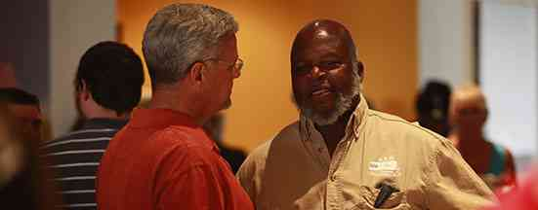
Good things happen..
Priceless privilege (freedom of worship)..
We promote love (vs 24)
We provoke good works (vs 24)
We provide encouragement (vs 25)

Slide 14
Stay Connected
Hebrews 10:22-25

