Slide 1
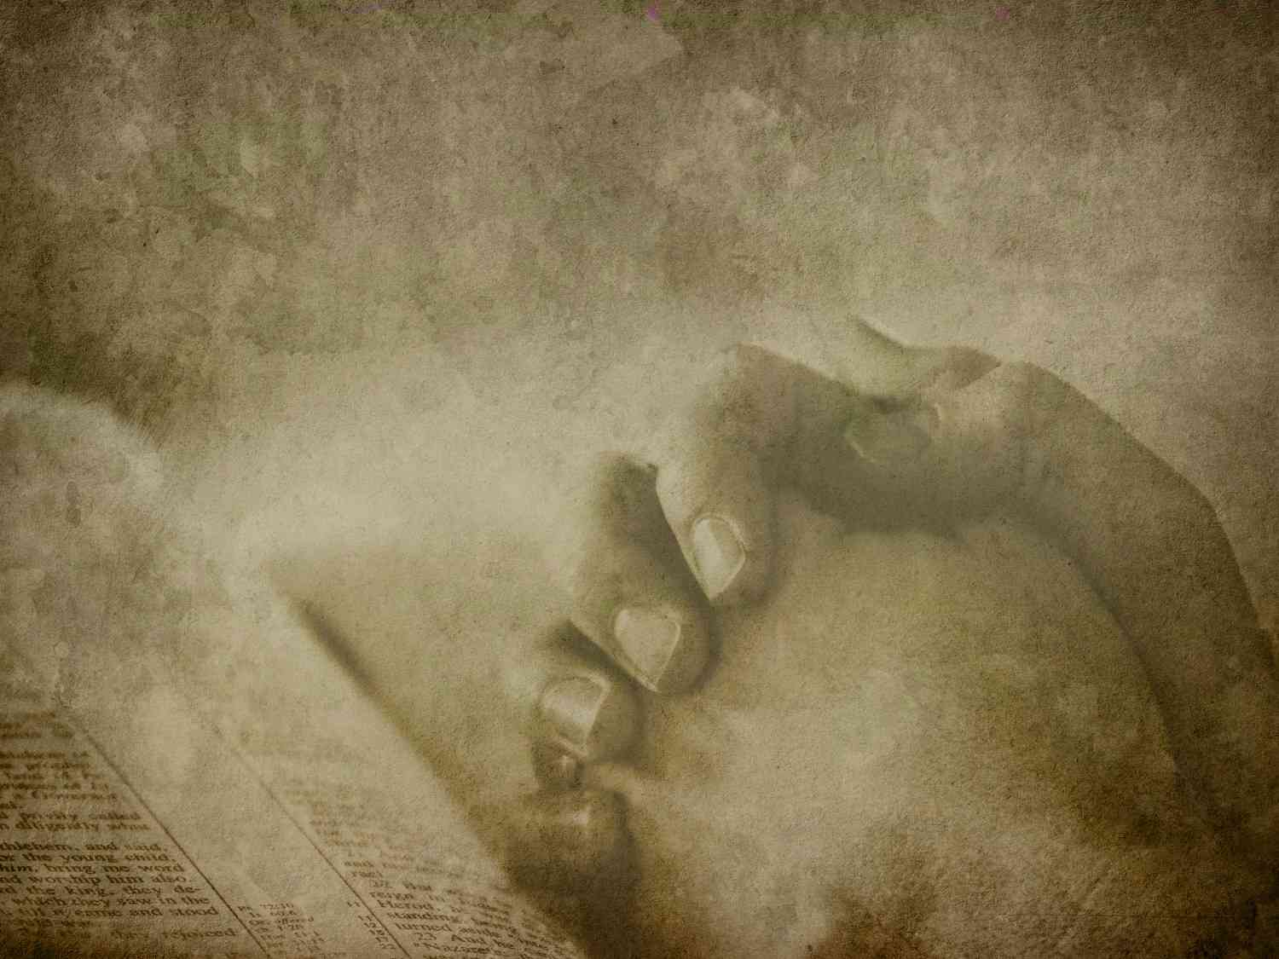
The Importance of Worship
John 4:20-24

Slide 2
Our desire to worship..
“Teach us to pray”… Luke 11:1-4
Early church devoted .. Acts 2:42
Angels worship .. Heb 1:6
All will worship at judgment .. Phil 2:10
Worship in heaven .. Rev 14:1-3

Slide 3
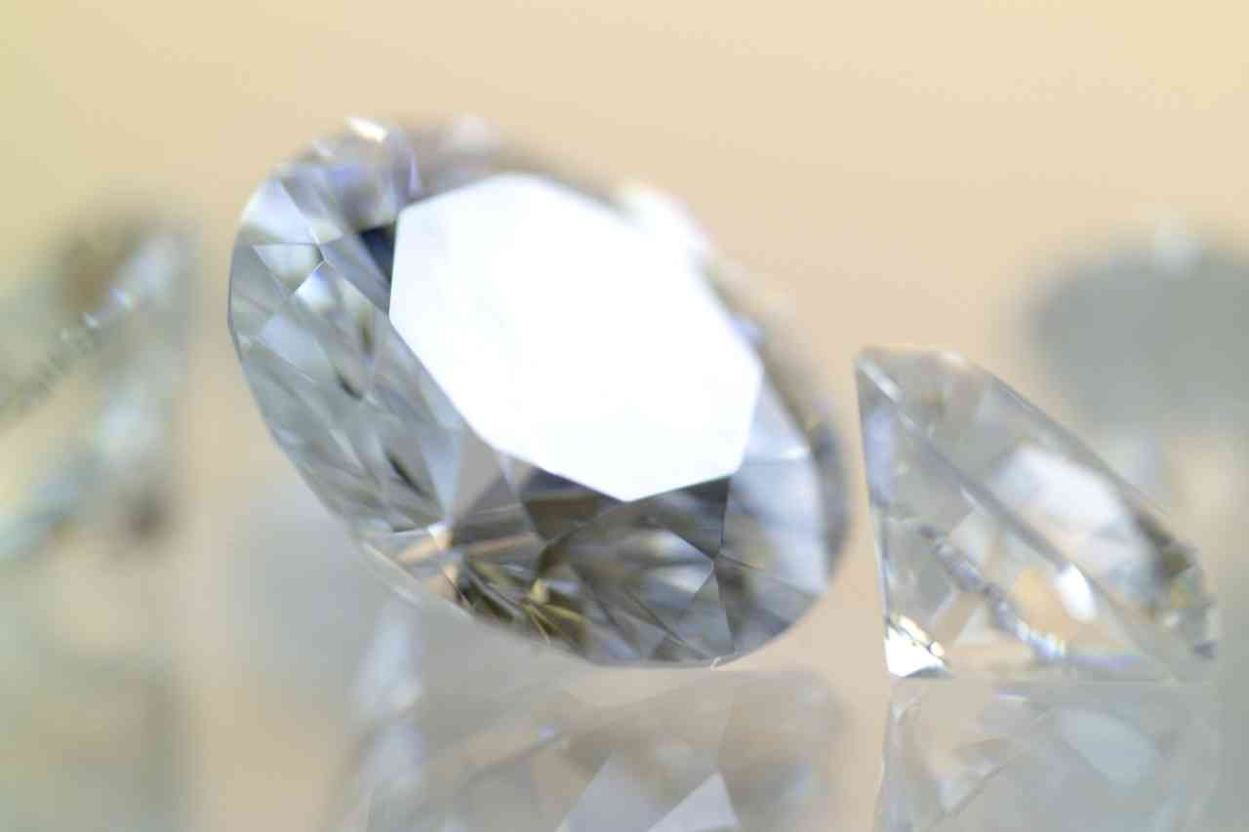
Worship.. the ultimate priority
The missing jewel…

Slide 4
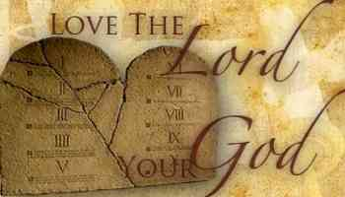
1 Priority commandment..
Exodus 20:1-2 I am the Lord.. You shall have no other gods before Me..
Matt 22:35-40 the greatest command

Slide 5
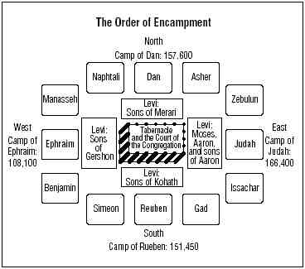
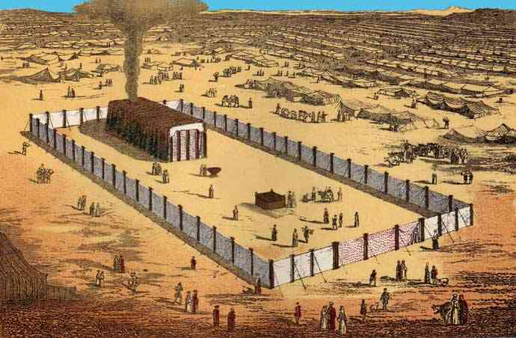
2 Pattern of OT..
God’s instructions .. Leviticus 7 chapters
Tabernacle placed in center of Israel

Slide 6
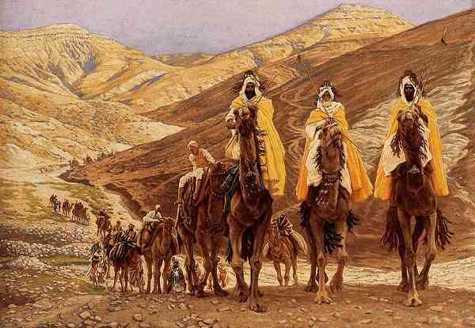
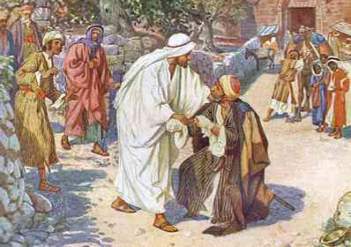
3 Practice of those who recognized Jesus…
Matt 2:11 wise men worshipped Him
Matt 8:2 leper worshipped Him
Matt 9:18 ruler worshipped Him
Matt 14:33 disciples… 15:25 Canaanite woman … 28:17 disciples on mountain

Slide 7
4 Our primary responsibility..
Psalms 27:4 One thing I have desired of the Lord, That will I seek: That I may dwell in the house of the Lord All the days of my life, To behold the beauty of the Lord, And to inquire in His temple.
Philippians 3:10 10 that I may know Him and the power of His resurrection, and the fellowship of His sufferings, being conformed to His death

Slide 8
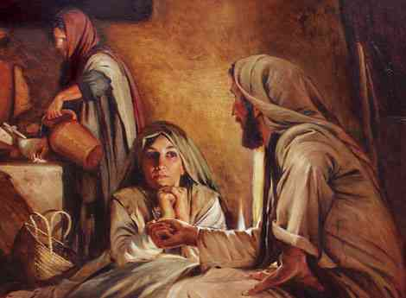
4 Our primary responsibility..
Luke 10:38-42 Now it happened as they went that He entered a certain village; and a certain woman named Martha welcomed Him into her house. 39 And she had a sister called Mary, who also sat at Jesus' feet and heard His word. 40 But Martha was distracted with much serving, and she approached Him and said, "Lord, do You not care that my sister has left me to serve alone? Therefore tell her to help me."
41 And Jesus answered and said to her, "Martha, Martha, you are worried and troubled about many things. 42 But one thing is needed, and Mary has chosen that good part, which will not be taken away from her."

Slide 9
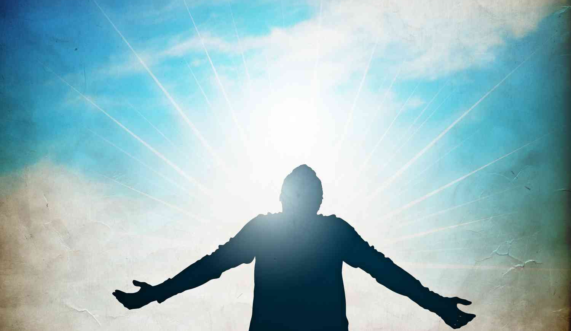
5 The place where God is at home ..
Psalms 22:1-3 O My God, I cry in the daytime, but You do not hear; And in the night season, and am not silent. 3 But You are holy, Enthroned in the praises of Israel.

Slide 10
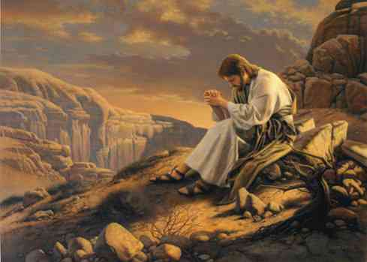
6 Prerequisite for service..
Matthew 4:8-10 Again, the devil took Him up on an exceedingly high mountain, and showed Him all the kingdoms of the world and their glory. 9 And he said to Him, "All these things I will give You if You will fall down and worship me."
10 Then Jesus said to him, "Away with you, Satan! For it is written, 'You shall worship the Lord your God, and Him only you shall serve.'"

Slide 11
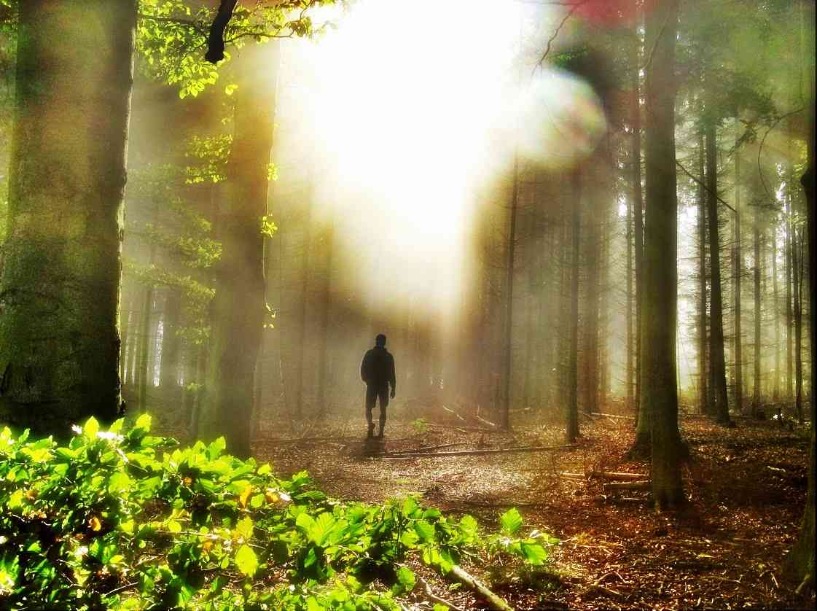
7 Cure for discouragement..
Isaiah 61:1-4 "The Spirit of the Lord God is upon Me, Because the Lord has anointed Me To preach good tidings to the poor; He has sent Me to heal the brokenhearted, To proclaim liberty to the captives … 3 To console those who mourn in Zion, To give them beauty for ashes, The oil of joy for mourning, The garment of praise for the spirit of heaviness;

Slide 12
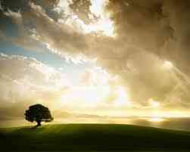
8 The passion of God ..
John 4:20-24 Our fathers worshiped on this mountain, and you Jews say that in Jerusalem is the place where one ought to worship."
21 Jesus said to her, "Woman, believe Me, the hour is coming when you will neither on this mountain, nor in Jerusalem, worship the Father. 22 You worship what you do not know; we know what we worship, for salvation is of the Jews. 23 But the hour is coming, and now is, when the true worshipers will worship the Father in spirit and truth; for the Father is seeking such to worship Him. 24 God is Spirit, and those who worship Him must worship in spirit and truth."

Slide 13
The Importance of Worship
John 4:20-24

