Slide 1
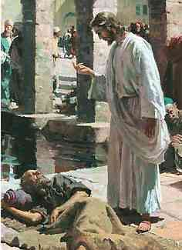
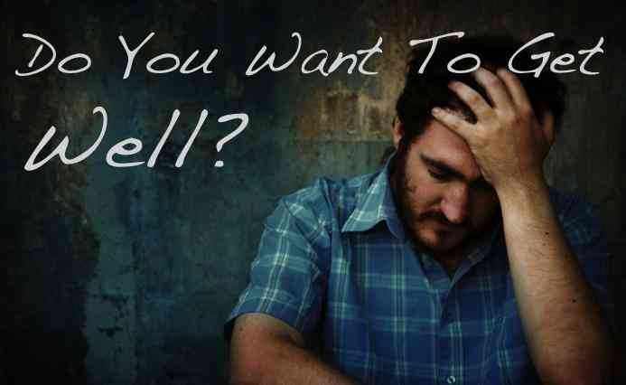
Do You Want to be Made Well?
John 5:1-14

Slide 2
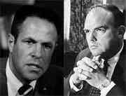
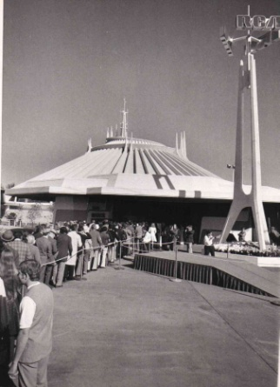
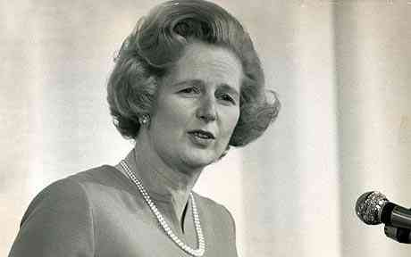
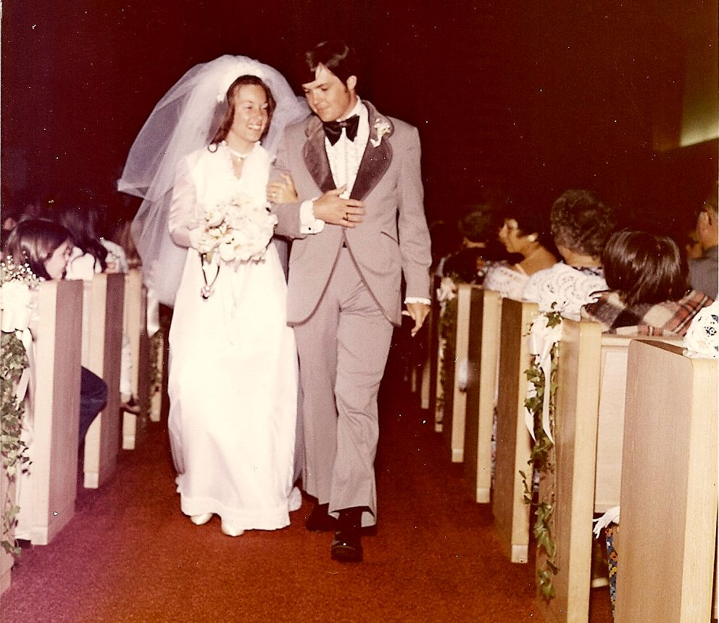
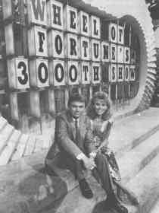
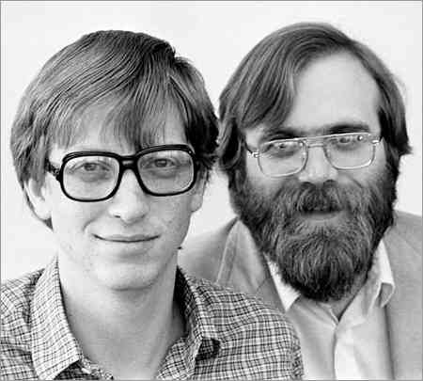
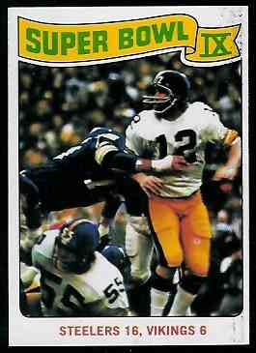
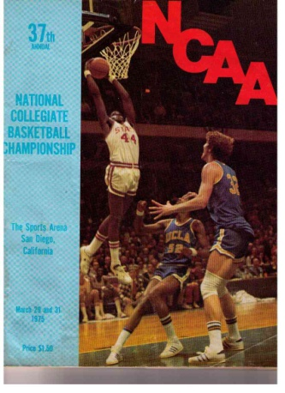
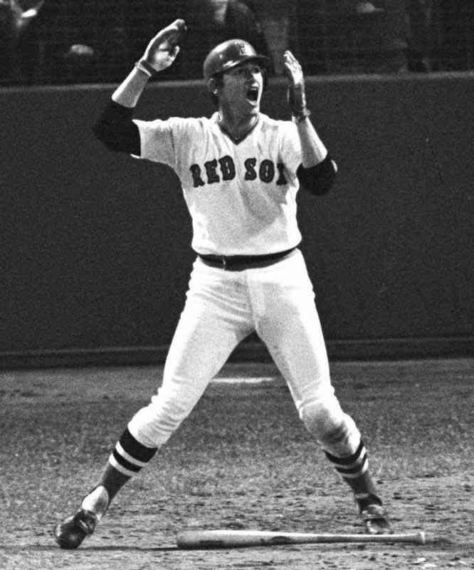
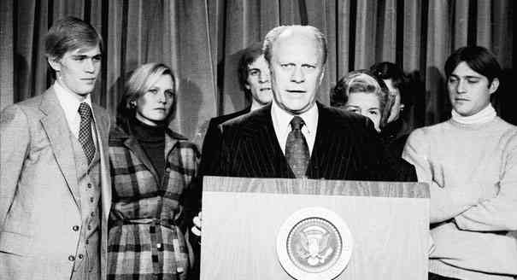
38 years ago… 1975
Watergate verdict ..
Wheel of Fortune ..
Superbowl IX ..
Space Mountain ..
Jeffersons ..
UCLA champions ..
Margaret Thatcher ..
Microsoft founded ..
Carlton Fisk HR ..
Gerald Ford 38th President..

Slide 3
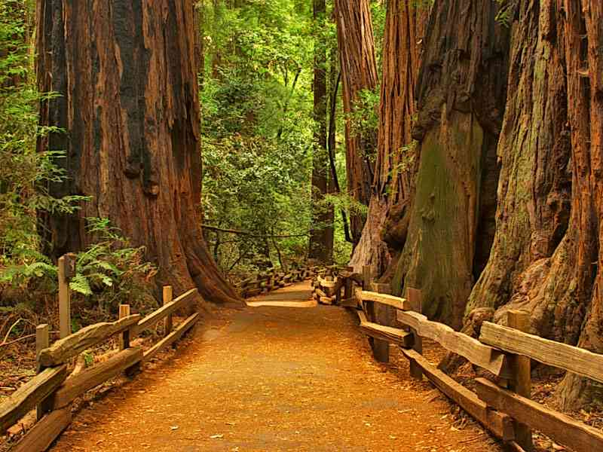
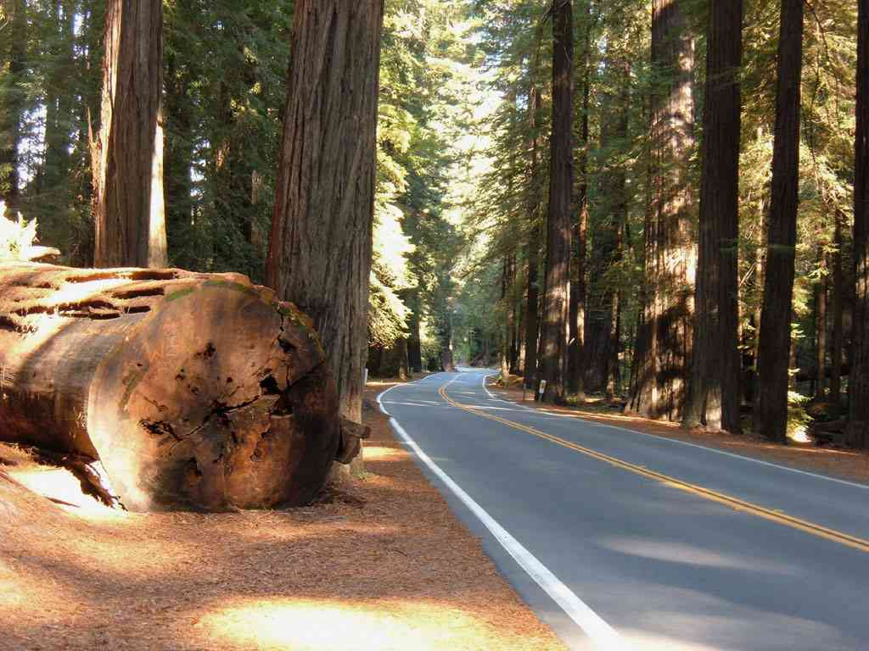
Giant redwoods…

Slide 4
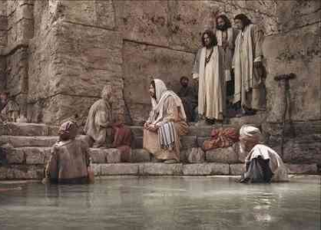
Lame man at pool..
John 5:1-4 After this there was a feast of the Jews, and Jesus went up to Jerusalem. 2 Now there is in Jerusalem by the Sheep Gate a pool, which is called in Hebrew, Bethesda, having five porches. 3 In these lay a great multitude of sick people, blind, lame, paralyzed, waiting for the moving of the water. 4 For an angel went down at a certain time into the pool and stirred up the water; then whoever stepped in first, after the stirring of the water, was made well of whatever disease he had.

Slide 5
A crazy question ..
5 Now a certain man was there who had an infirmity thirty-eight years. 6 When Jesus saw him lying there, and knew that he already had been in that condition a long time, He said to him, "Do you want to be made well?“

Slide 6
A lame excuse..
7 The sick man answered Him, "Sir, I have no man to put me into the pool when the water is stirred up; but while I am coming, another steps down before me."

Slide 7
An impossible instruction..
8 Jesus said to him, "Rise, take up your bed and walk." 9 And immediately the man was made well, took up his bed, and walked.

Slide 8
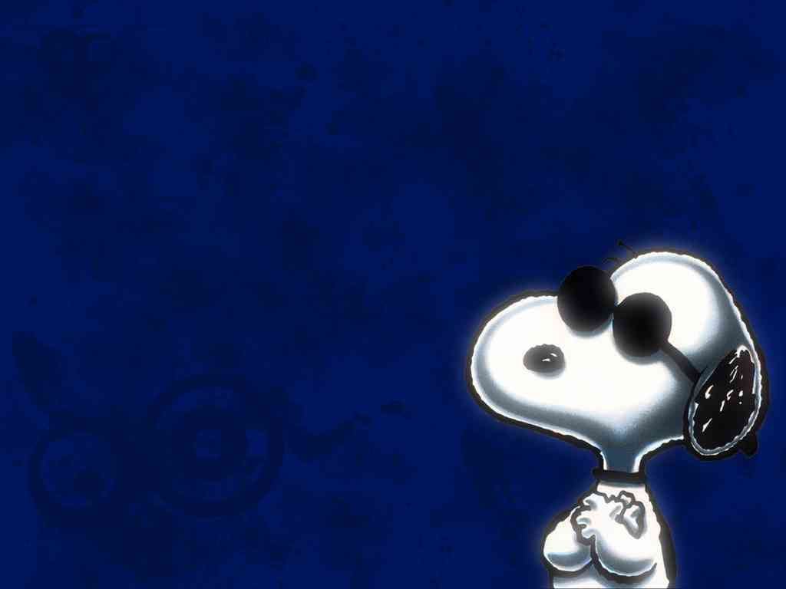
Snoopy…
"Yesterday I was a dog. Today I’m a dog. Tomorrow I’ll probably still be a dog. There’s so little hope for advancement.”

Slide 9
Robert Reed.. Abilene Christian University ..

Slide 10
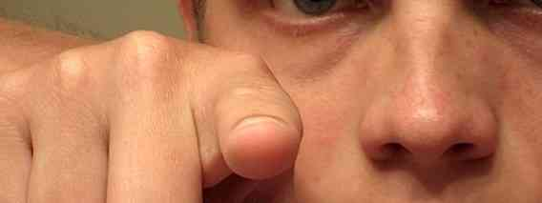
Do Want to be Made Well?
In Jesus we have some someone who can help make us well…
We must decide if we want to be changed.. (vs 6)

Slide 11
Do Want to be Made Well?
We must decide not to keep making excuses (vs 7)..
We must decide if we are ready to act.. (vs 8-9)

Slide 12
Are you a perpetual victim?
Victims repeat how they have been mistreated..
Victims live by the notion that life should be fair…
Victims find it difficult to forgive others..
Victims have difficulty maintaining close relationships because they have difficulty trusting other people…

Slide 13
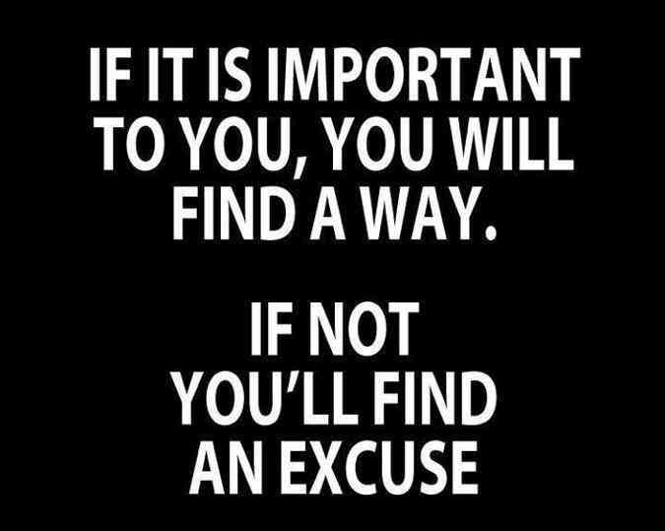

Slide 14
A life saving challenge..
14 Afterward Jesus found him in the temple, and said to him, "See, you have been made well. Sin no more, lest a worse thing come upon you."

Slide 15
Do You Want to be Made Well?
John 5:1-14

