Slide 1
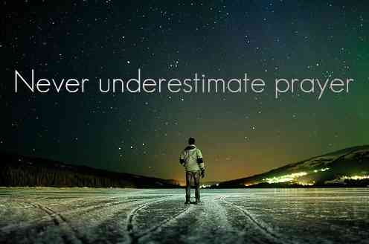
Jesus Challenges Growing Faith
John 4:46-54

Slide 2
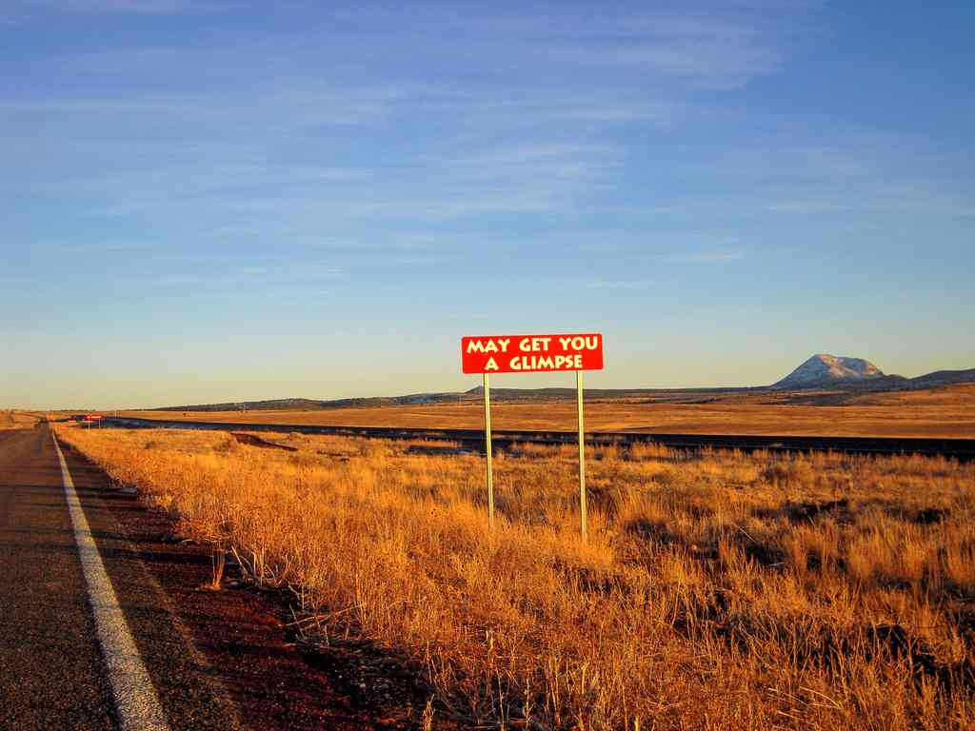

Slide 3
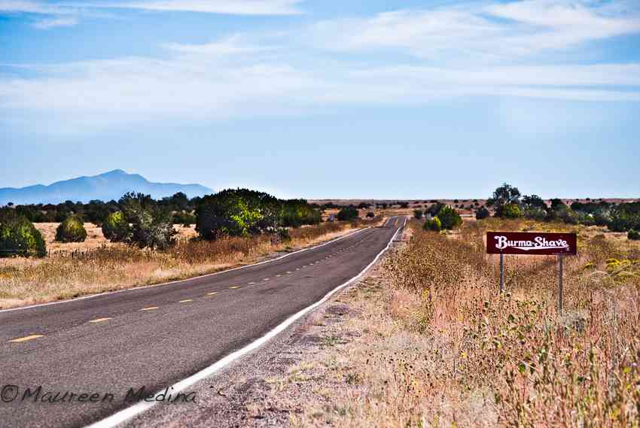

Slide 4
John’s theme..
John 20:30-31 Jesus did many other signs in the presence of His disciples, which are not written in this book; 31 but these are written that you may believe that Jesus is the Christ, the Son of God, and that believing you may have life in His name.

Slide 5
We all wish we had stronger faith…
Matthew 9:29 "According to your faith let it be to you.”
“If I could only see a miracle, then my faith would be strong..”
Galatians 3:11 The just shall live by faith ..

Slide 6
“If I could only see a miracle, then my faith would be strong..”

Slide 7
Jesus’ miracles not only show His power, but also that He is God’s answer to the things we struggle with in our lives ..

Slide 8
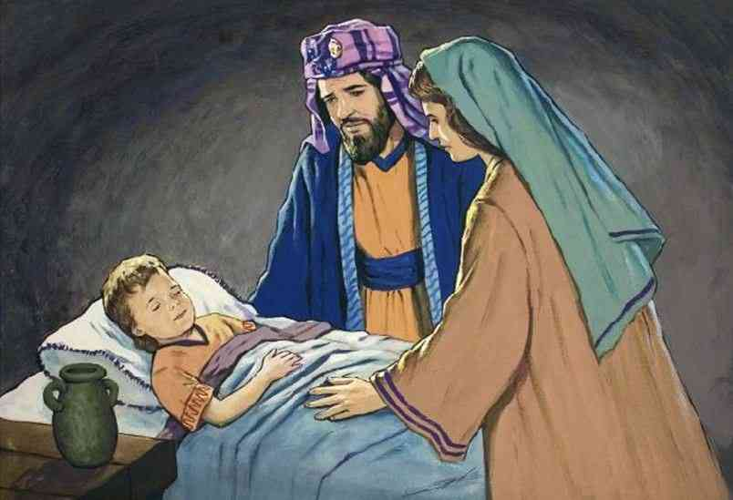
The nobleman’s son.. John 4:46-54
John 4:46-47 So Jesus came again to Cana of Galilee where He had made the water wine. And there was a certain nobleman whose son was sick at Capernaum. 47 When he heard that Jesus had come out of Judea into Galilee, he went to Him and implored Him to come down and heal his son, for he was at the point of death.

Slide 9
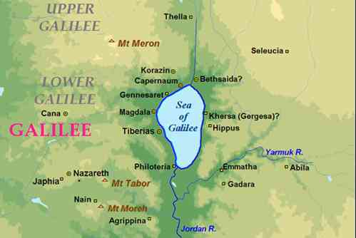

Slide 10
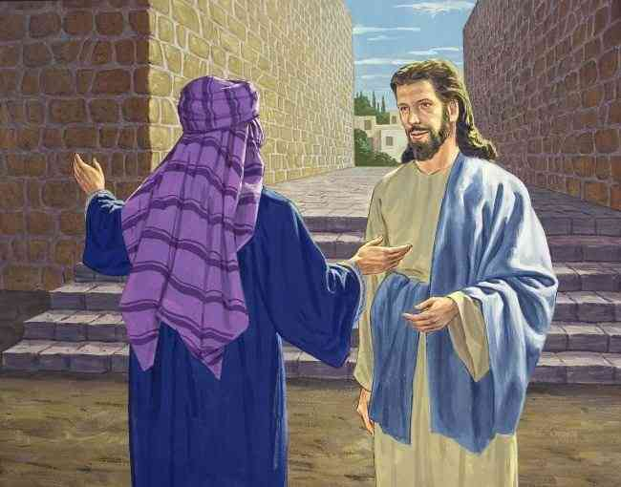
Obstacles to strong faith..
His faith was second hand ..
He had heard about Jesus’ miracles..
If Jesus could change water to wine, maybe he could heal my son …
John 4:48-49 Jesus said to him, "Unless you people see signs and wonders, you will by no means believe." 49 The nobleman said to Him, "Sir, come down before my child dies!"
John 4:50 Jesus said to him, "Go your way; your son lives

Slide 11
Obstacles to strong faith..
Sign-demanding faith …
vs 48 .. "unless you people see signs and wonders, you will by no means believe"...
Matthew 12:39 "An evil and adulterous genera- tion seeks after a sign, and no sign will be given to it except the sign of the prophet Jonah.
Matt 27:42"Let him now come down from the cross, and we will believe him ..”

Slide 12
Is seeing believing?
John 2:23-25 Now when He was in Jerusalem at the Passover, during the feast, many believed in His name when they saw the signs which He did. 24 But Jesus did not commit Himself to them, because He knew all men, 25 and had no need that anyone should testify of man, for He knew what was in man.
John 6 – Jesus fed 5000, but the people only wanted more food.. when Jesus began talking of eternal truths they began to leave Him..

Slide 13
Obstacles to strong faith..
Self-centered faith ..
Vs. 49 “Sir, come down before my child dies!”
Not wrong to plead for his child, but this was all he was concerned with ..
Strong-willed faith ..
Vs. 49 “Sir, come down before my child dies!”
Vs 50 “Go your way, your son lives”..

Slide 14
The operation of strong faith..
Hearing the word ..
Jesus said “Go your way, your son lives”
Romans 10:14 How then shall they call on Him in whom they have not believed? And how shall they believe in Him of whom they have not heard? And how shall they hear without a preacher?
Romans 10:17 So then faith comes by hearing, and hearing by the word of God.

Slide 15
The operation of strong faith..
Believing the word ..
John 4:50 Jesus said to him, "Go your way; your son lives." So the man believed the word that Jesus spoke to him.
Hebrews 3:12 Beware, brethren, lest there be in any of you an evil heart of unbelief in departing from the living God..

Slide 16
The operation of strong faith..
Obeying the word ..
John 4:50 So the man believed the word that Jesus spoke to him and he went his way..
Romans 16:26 now made manifest, and by the prophetic Scriptures made known to all nations, according to the commandment of the everlasting God, for obedience to the faith —
James 2:26 For as the body without the spirit is dead, so faith without works is dead also.
Galatians 3:26-27 For you are all sons of God through faith in Christ Jesus. 27 For as many of you as were baptized into Christ have put on Christ. There's no substitute for obedience

Slide 17
The operation of strong faith..
Resting in the word ..
John 4:51-53 And as he was now going down, his servants met him and told him, saying, "Your son lives!" 52 Then he inquired of them the hour when he got better. And they said to him, "Yesterday at the seventh hour the fever left him." 53 So the father knew that it was at the same hour in which Jesus said to him, "Your son lives." And he himself believed, and his whole household.
Psalms 37:5-7 Commit your way to the Lord, Trust also in Him, And He shall bring it to pass. 6 He shall bring forth your righteousness as the light, And your justice as the noonday. 7 Rest in the Lord, and wait patiently for Him...

Slide 18
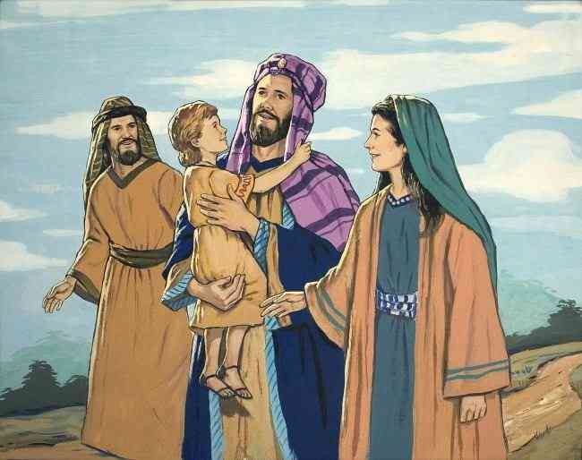
He believed and his household..
John 4:53-54 So the father knew that it was at the same hour in which Jesus said to him, "Your son lives." And he himself believed, and his whole household. 54 This again is the second sign Jesus did when He had come out of Judea into Galilee.

Slide 19
Jesus Challenges Growing Faith
John 4:46-54

