Slide 1
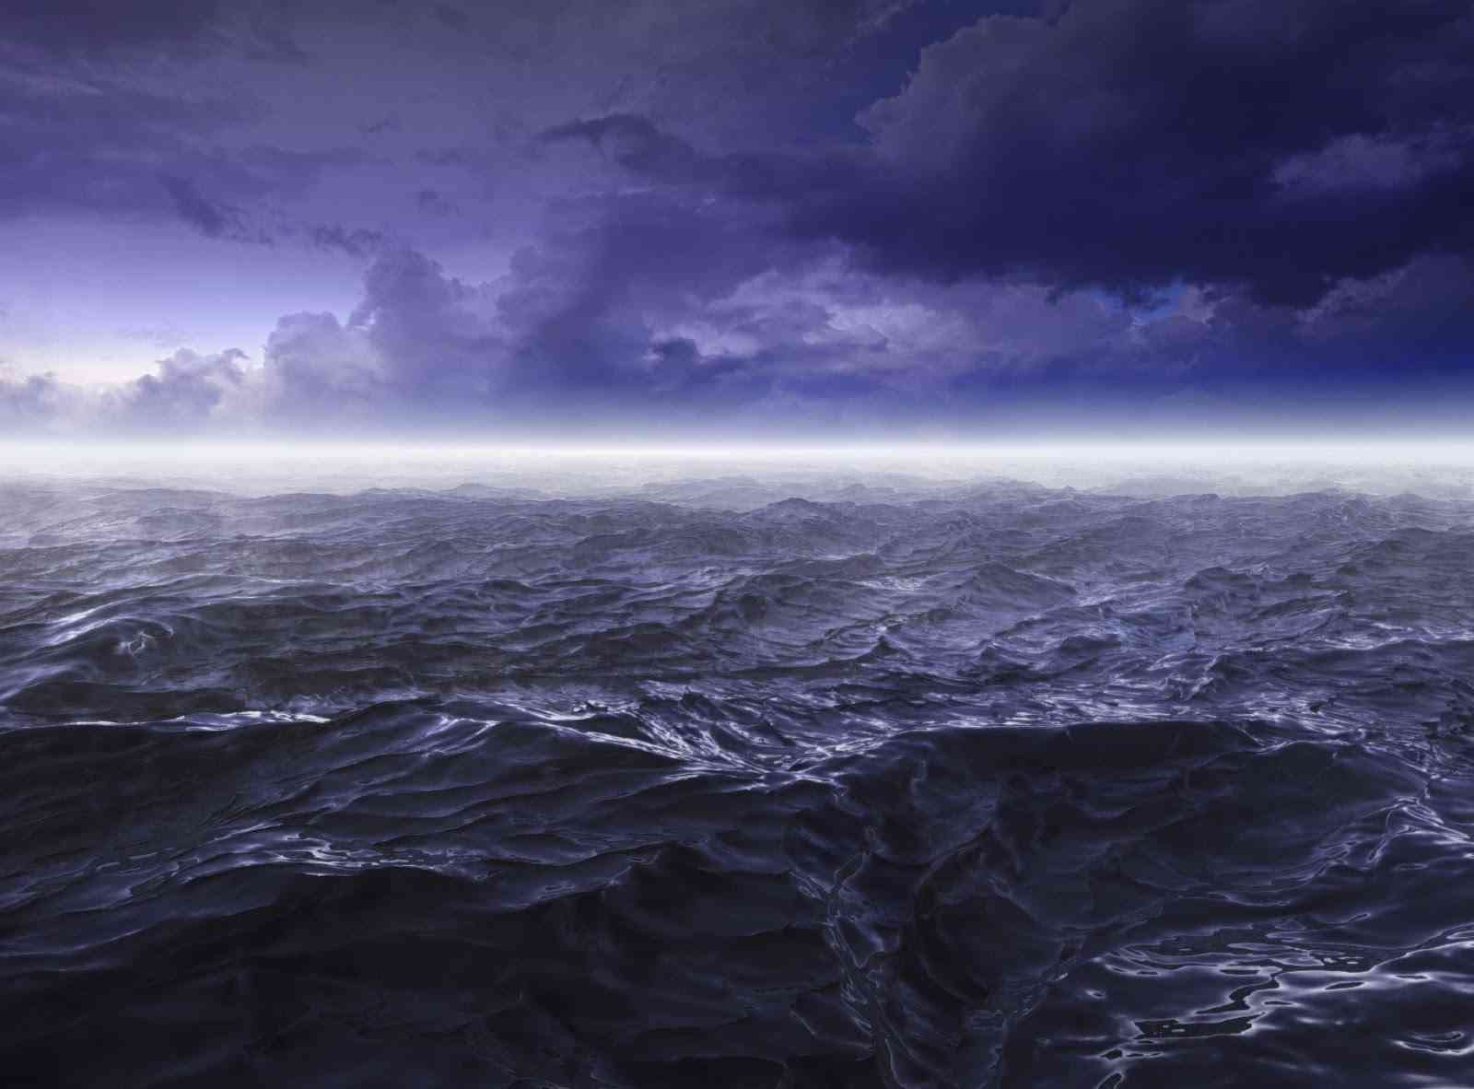
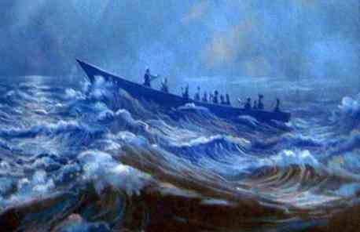
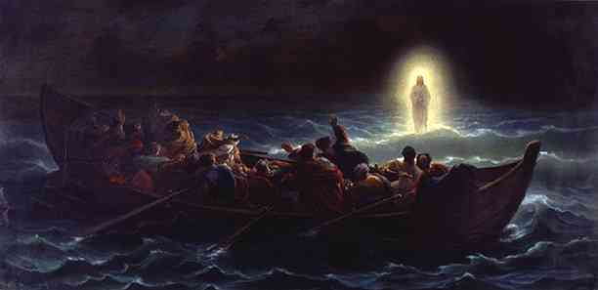
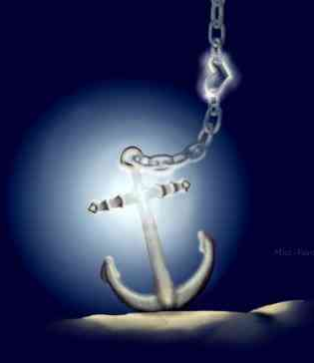
Anchors in the Storm
John 6:15-21

Slide 2
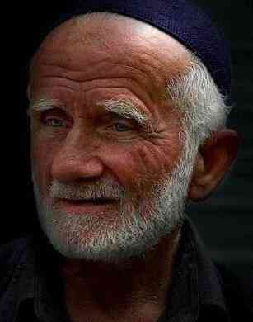
An old friend ..
What is a friend? ..
Someone who makes you a better person …

Slide 3
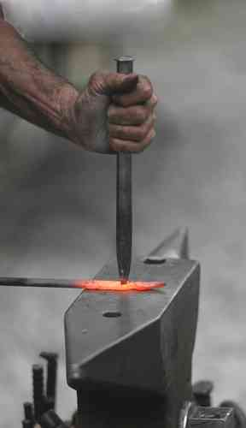

Slide 4
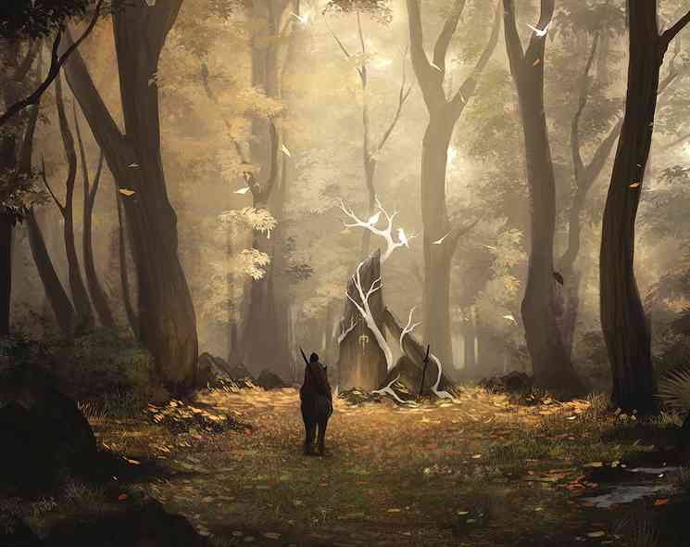
A friend who would ..
Help you live a clean life …
Draw closer to God ..
More spiritual strength ..
More mature believer…

Slide 5
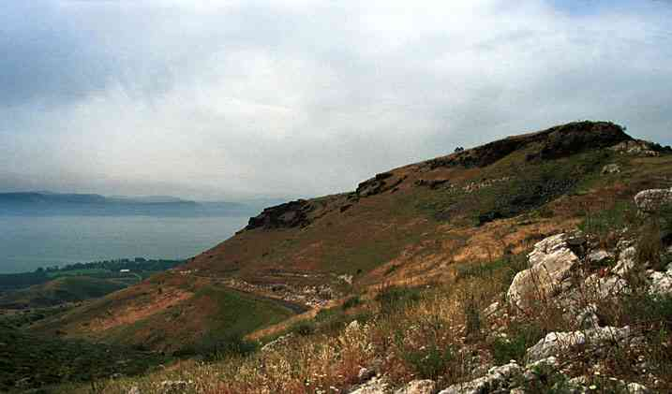
John 6…
The disciples in trouble ..
Jesus’ miracle and message…

Slide 6
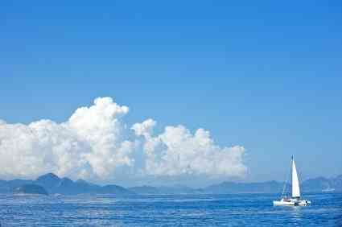
Life sailing smoothly..

Slide 7
When storms come…
You can go to Jesus ..

Slide 8
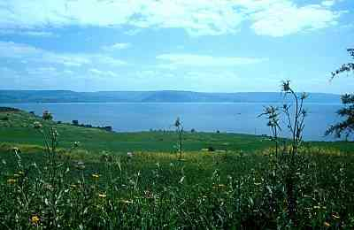
John 6 context..
1-14 Feeding the 5000 ..
15-21 From hillside by Sea of Galilee into middle of the sea ..

Slide 9
1st Anchor..
When in a storm you are in God’s providence ..

Slide 10
John 6:15-18..
John 6:15-18 Therefore when Jesus perceived that they were about to come and take Him by force to make Him king, He departed again to the mountain by Himself alone. 16 Now when evening came, His disciples went down to the sea, 17 got into the boat, and went over the sea toward Capernaum. And it was already dark, and Jesus had not come to them. 18 Then the sea arose because a great wind was blowing.

Slide 11
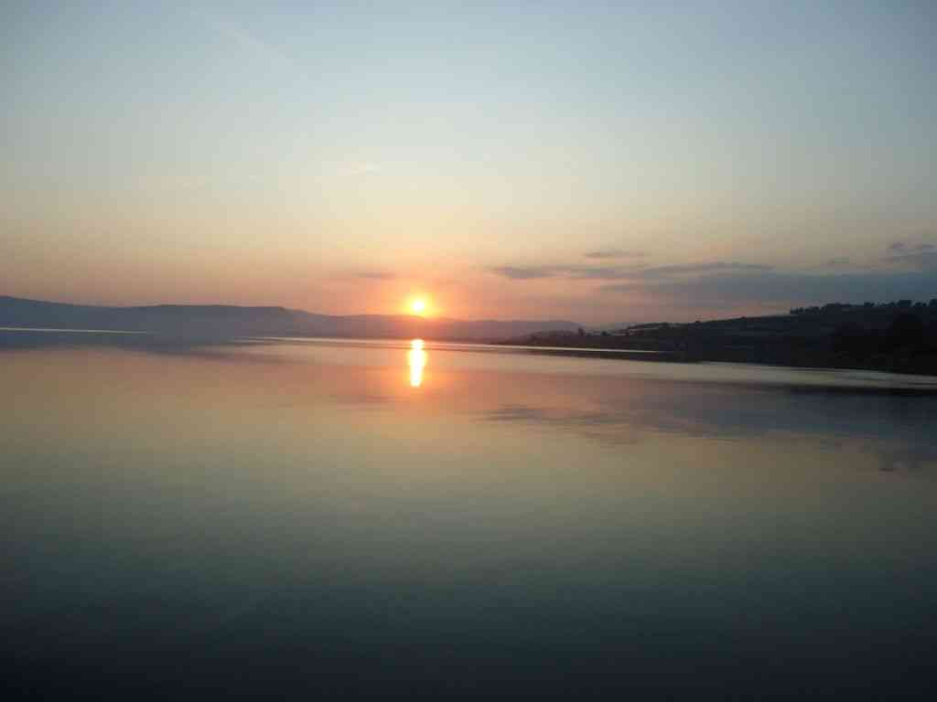
Sea of Galilee ..
Matthew 14:22 Immediately Jesus made His disciples get into the boat ("constrained them") and go before Him to the other side, while He sent the multitudes away...

Slide 12
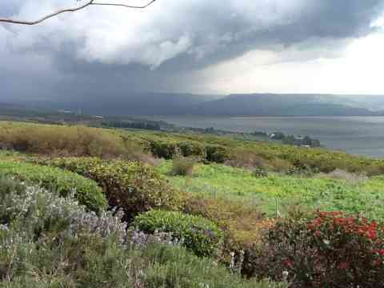
Storms can come suddenly …

Slide 13
Darkest part of night..
Matthew 14:24-25 the boat was now in the middle of the sea, tossed by the waves, for the wind was contrary. 25 Now in the fourth watch of the night Jesus went to them..

Slide 14
1st Anchor..
When in a storm you are in God’s providence ..
Their plight fully known to Jesus..
He was watching and was in control..

Slide 15
2nd Anchor..
When the storm is worst you grow stronger in your faith in Him..
Jesus allowed this storm for the benefit of His disciples ..

Slide 16
Benefit of trials…
James 1:2-4 My brethren, count it all joy when you fall into various trials, 3 knowing that the testing of your faith produces patience. 4 But let patience have its perfect work, that you may be perfect and complete, lacking nothing.

Slide 17
3rd Anchor..
When you are in the storm you are being blessed by His prayers..

Slide 18
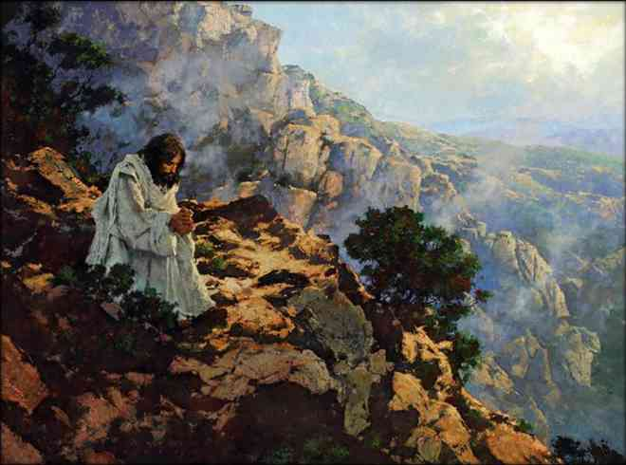
Jesus was alone..
John 6:15 Therefore when Jesus perceived that they were about to come and take Him by force to make Him king, He departed again to the mountain by Himself alone.
Matthew 14:23 And when He had sent the multitudes away, He went up on the mountain by Himself to pray. Now when evening came, He was alone there.

Slide 19
He now prays for us..
Hebrews 7:25 Therefore He is also able to save to the uttermost those who come to God through Him, since He always lives to make intercession for them.

Slide 20
4th Anchor..
In the darkest hour Jesus will come to you..

Slide 21
John 6:19-20..
John 6:19-20 So when they had rowed about three or four miles, they saw Jesus walking on the sea and drawing near the boat; and they were afraid. 20 But He said to them, "It is I; do not be afraid."

Slide 22
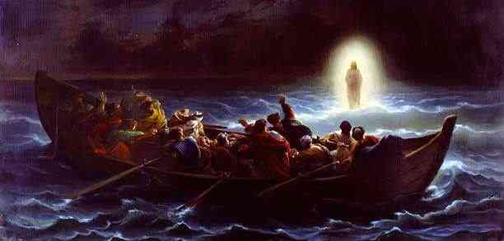
Why didn’t He come sooner?..
Mark 6:51-52 Then He went up into the boat to them, and the wind ceased. And they were greatly amazed in themselves beyond measure, and marveled. 52 For they had not understood about the loaves, because their heart was hardened.

Slide 23
5th Anchor..
During the storm Jesus is guarding you with His power..
John 6:20 But He said to them, "It is I; do not be afraid."

Slide 24
Jesus calms our fears..
Matthew 14:26-27 And when the disciples saw Him walking on the sea, they were troubled, saying, "It is a ghost!" And they cried out for fear. 27 But immediately Jesus spoke to them, saying, "Be of good cheer! It is I; do not be afraid."
John 16:33 These things I have spoken to you, that in Me you may have peace. In the world you will have tribulation; but be of good cheer, I have overcome the world."

Slide 25
6th Anchor..
God hasn’t promised smooth sailing, but He has promised a safe landing..
John 6:21 Then they willingly received Him into the boat, and immediately the boat was at the land where they were going.

Slide 26
6th Anchor..
God hasn’t promised smooth sailing, but He has promised a safe landing..
Hebrews 13:5 Let your conduct be without covetousness; be content with such things as you have. For He Himself has said, "I will never leave you nor forsake you."
Philippians 1:6 being confident of this very thing, that He who has begun a good work in you will complete it until the day of Jesus Christ..

Slide 27
Anchors in the Storm
John 6:15-21

