Slide 1
Fulfilling Our Joy
Philippians 2:1-4

Slide 2
Philippians 2:1-4
Therefore if there is any consolation in Christ, if any comfort of love, if any fellowship of the Spirit, if any affection and mercy, 2 fulfill my joy by being like-minded, having the same love, being of one accord, of one mind. 3 Let nothing be done through selfish ambition or conceit, but in lowliness of mind let each esteem others better than himself. 4 Let each of you look out not only for his own interests, but also for the interests of others.

Slide 3
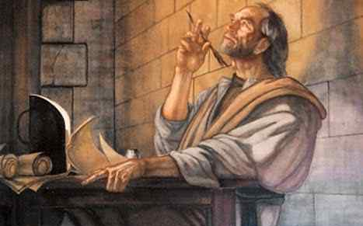
Paul’s joy in Christ...
Joy in their fellowship – 1: 3-5
Joy in progress of gospel – 1: 12-18
Joy in life or death – 1: 20-24
Complete my joy .. 2: 1-4
( their unity)

Slide 4
Disunity in the world..
International Strife
Political Turmoil
Broken homes
The Divided Church

Slide 5
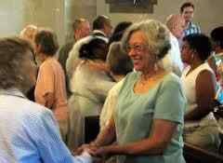
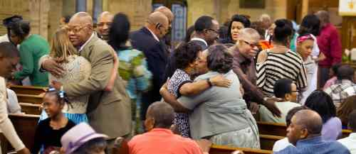
Four keys to the goal of unity in Christ..
See what Christ has done in us (1)
Be of the same mind in the Lord (2)
Don’t allow selfish rivalry a place (3)
Look for the significance of others (4)

Slide 6
1st What Christ has done..
1 Therefore if there is any consolation in Christ, if any comfort of love, if any fellowship of the Spirit, if any affection and mercy…
- The consolation of being in Christ ..
- The comfort of God’s redeeming love..
- Fellowship created by the Spirit..
- Tender affection and kindness..

Slide 7
Show this inner beauty by living in harmony..

Slide 8
2nd Be of the same mind in the Lord…
2 fulfill my joy by being like-minded, having the same love, being of one accord, of one mind.
Be of the same mind..
Maintain the same love..
Unite in one spirit..
Be intent on one purpose..

Slide 9
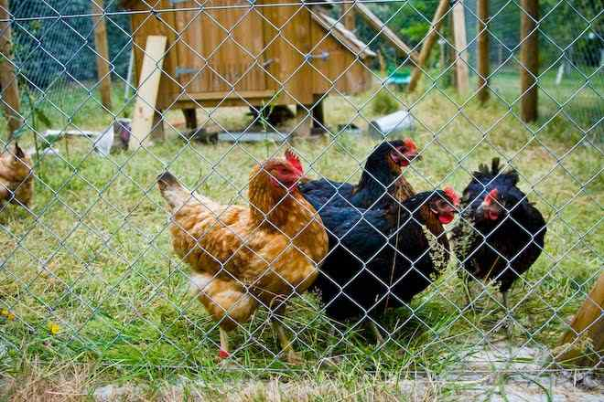
3rd Don’t allow selfish rivalry or conceit..
3 Let nothing be done through selfish ambition or conceit..

Slide 10
4th Look to the significance of others..
.. but in lowliness of mind let each esteem others better than himself. 4 Let each of you look out not only for his own interests, but also for the interests of others.

Slide 11
Fulfilling Our Joy
Philippians 2:1-4

